Slide 1
Software Plan
Friday, September 21st 2012

Slide 2
Welcome
Our Client:
Dr. Darren Lim
Professor of Computer Science
Siena College

Slide 3
Agenda

Slide 4
Introduction
Christopher Small
Team Leader
Alyssa Nghiem
Web Master
Eduardo Pinto Barbosa
Document Analyst
Tyler Vorpahl
Lead Graphic Designer
Ryan Kennedy
Lead Developer

Slide 5
Agenda

Slide 6
Problem Definition
Consortium for Computing Sciences in Colleges
North East (CCSCNE) Conference
Integrated System that handles…
Attendee Registration
Scholarly Works Submission
Scholarly Works Review
Information Access

Slide 7
Agenda

Slide 8
System Justification
An easy to use registration system
The ability to manage submissions
A system to assign reviewers for submissions
Simplification of the duties of organizers
Our system will provide:

Slide 9
Agenda

Slide 10
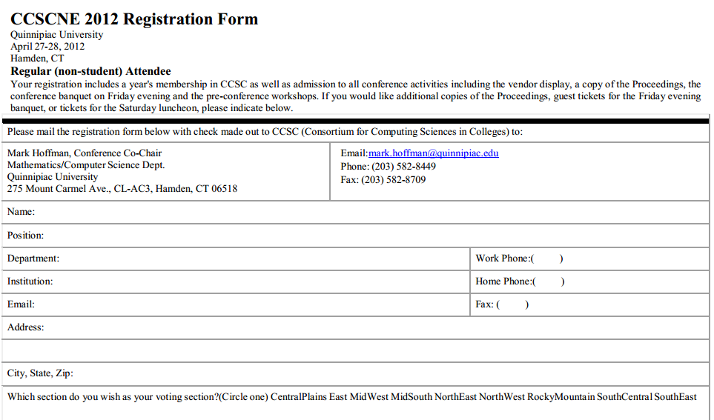
Current Solution

Slide 11
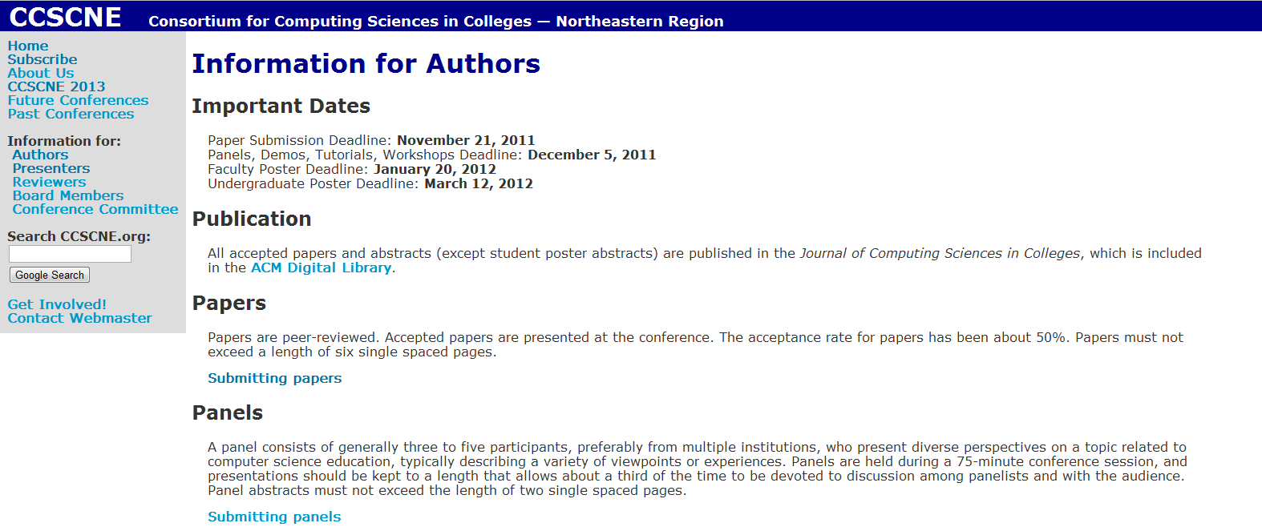
Current Solution (cont.)

Slide 12
Agenda

Slide 13
System Goals
Our goal is to develop…
A web based software system
A clean and simple registration process
A simple submission system
An organizational tool for event organizers

Slide 14
Agenda

Slide 15
System Constraints
Ensure compatibility with all major browsers
Store all user information securely
Handle validation and anonimity of reviewers and ensure that they may not review works from their school

Slide 16
Agenda

Slide 17
Resources
Languages:
HTML, PHP, CSS, SQL, Java
Hardware:
Software Engineering Lab (Macs and PCs)
Oraserve
Software:
Firefox, Chrome, IE, Safari, Apache Web Server, Eclipse, Oracle SQL Server
Personnel:
Dr. Darren Lim, Dr. Tim Lederman, Team Members

Slide 18
Agenda

Slide 19
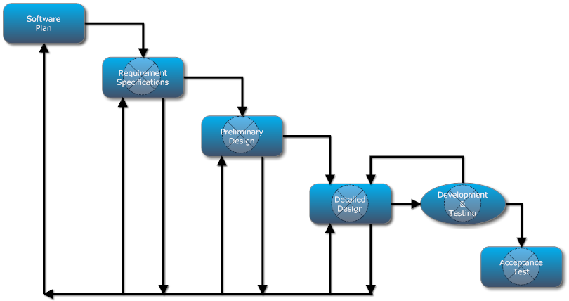
Development Model

Slide 20
Agenda

Slide 21
Timeline

Slide 22
Timeline (cont.)
Software Plan – September 21, 2012
Requirement Specifications – October 29, 2012
Preliminary Design – December 10, 2012

Slide 23
Questions?

