Slide 1
Grassroot Givers
SMARK Solutions

Slide 2
Agenda
Company and Client Introduction
Problem and Constraints
Solution and Goals
Project Timeline

Slide 3
SMARK Solutions Be intuitive. Be efficient. Be SMARK.
Salvatore Baisley - Database Manager
Mary Ritchie - Webmaster
Anna Grant - Team Lead
Ryan Martin - Chief QA/Testing
Kathryn Egan - Lead Programmer
“Providing technologies to make what matters most to you possible, that’s SMARK.”

Slide 4
Client Introduction
Ms. Mary Partidge-Brown
Ms. Roberta Sandler
Co-Directors of the Grassroot Givers’
Community Store

Slide 5
Agenda
Company and Client Introduction
Problem and Constraints
Solution and Goals
Project Timeline

Slide 6
Problem
Ability to track history of customers and donors, in particular “hot” items.
Simple profiles and an organized database for accessible records.
Supplement the everyday functions of the store.

Slide 7
Constraints
Simple software, requiring little maintenance.
Need to complete software before end of course.
Web-based storage to prevent loss of data.

Slide 8
Agenda
Company and Client Introduction
Problem and Constraints
Solution and Goals
Project Timeline

Slide 9
Solution
Customer and donor profiles.
Popular item inventory.
Documented store interactions.

Slide 10
Goals
Simple, straight forward forms for data entry.
Accommodate users of varying technology levels.

Slide 11
Resources
Clients:
Ms. Mary Partidge-Brown
Ms. Roberta Sandler
Professors:
Dr. Breimer
Dr. Fryling
Dr. Lim
Dr. Vandenburg
Operating Systems:
Windows 7 Enterprise
OS X Lion 10.7.5
Languages:
CSS, HTML, Javascript, PHP, and SQL

Slide 12
Agenda
Company and Client Introduction
Problem and Constraints
Solution and Goals
Project Timeline

Slide 13
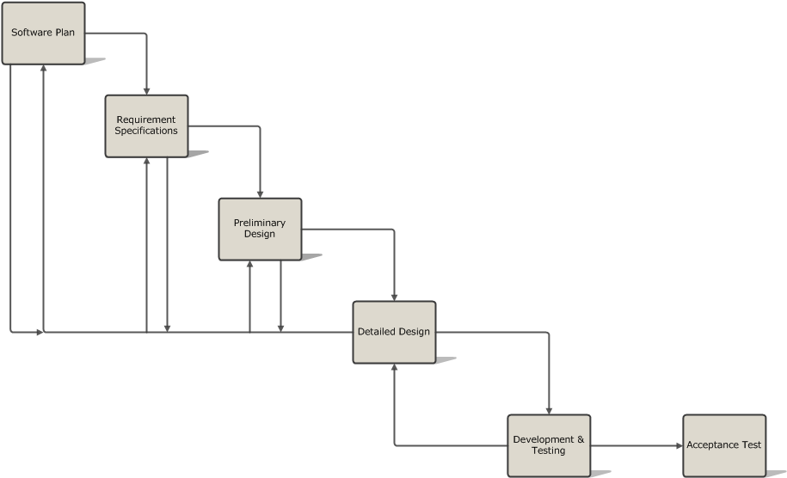
Development Model

Slide 14
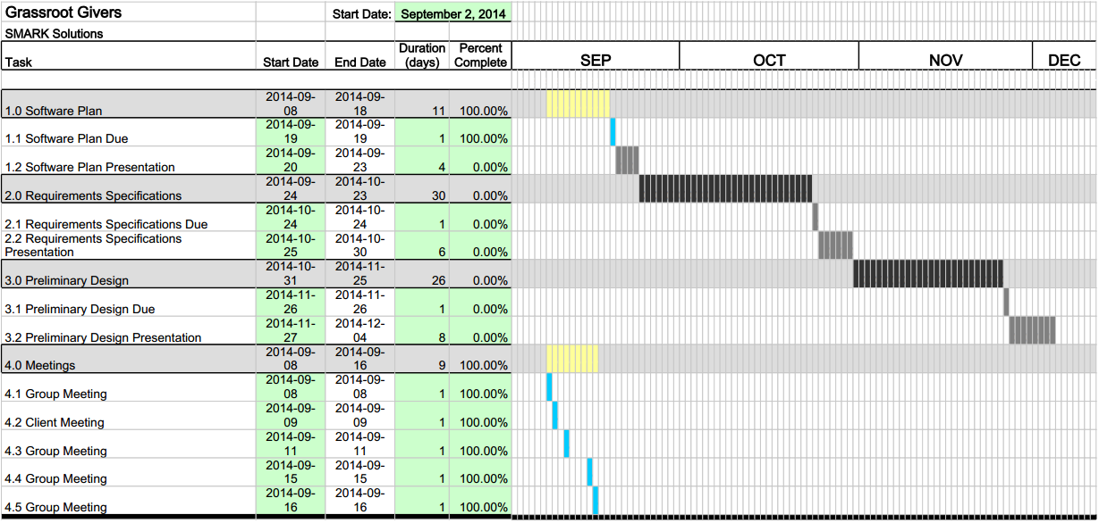
Project Timeline

Slide 15
Mission Statement
SMARK Solutions hopes to achieve successful completion of its software to provide technology to enhance the efforts of Grassroot Givers without altering the current system. With the new technologies we hope to provide more time spent on advancement within their mission.

