Slide 1
S.W.I.F.T.
Requirement Specification
SMARK Solutions
October 30, 2014
SMARKSOLUTIONS BE INTUITIVE.BE EFFICIENT.BE SMARK.

Slide 2
Welcome
Clients:
Mary Partridge-Brown
Roberta Sandler
Guests:
Dr. Meg Fryling
Dr. Darren Lim
SMARK SOLUTIONS BE INTUITIVE. BE EFFICIENT. BE SMARK.

Slide 3
Team Introduction
Salvatore Baisley - Database Manager
Mary Ritchie - Webmaster
Anna Grant - Team Lead
Ryan Martin - Chief QA/Testing
Kathryn Egan - Lead Programmer
“Providing technologies to make what matters most to you possible, that’s SMARK.”
SMARKSOLUTIONS BE INTUITIVE.BE EFFICIENT.BE SMARK.

Slide 4
Project Overview
Grassroot Givers’ Community Store
“Shop with Dignity”
S.W.I.F.T.
Simple Web Inventory For Tracking
SMARKSOLUTIONS BE INTUITIVE.BE EFFICIENT.BE SMARK.

Slide 5
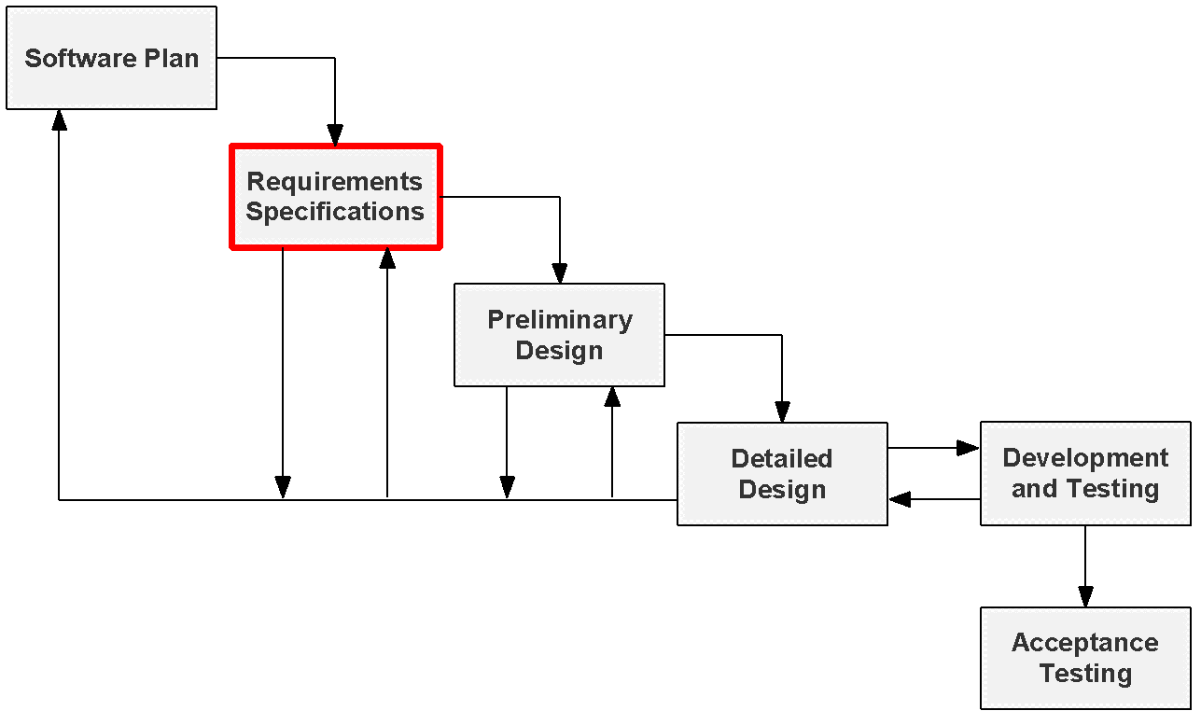
Project Status
SMARKSOLUTIONS BE INTUITIVE.BE EFFICIENT.BE SMARK.

Slide 6
Use Case Narratives
Explains abilities of each user
Outlines interactions with S.W.I.F.T.
SMARKSOLUTIONS BE INTUITIVE.BE EFFICIENT.BE SMARK.

Slide 7
Volunteer
Log in/unique username
Create customer accounts
View customers’ history
Checkout customers
Record donations/produce receipts
SMARKSOLUTIONS BE INTUITIVE.BE EFFICIENT.BE SMARK.

Slide 8
Director
Log in/one director account
Create customer accounts
View customers’ history
Checkout customers
Record donation/produce receipts
Modify/delete customer data
Modify/delete donor data
Manage volunteer accounts
SMARKSOLUTIONS BE INTUITIVE.BE EFFICIENT.BE SMARK.

Slide 9
Use Case Diagram
Visual representation of interactions within S.W.I.F.T.
SMARKSOLUTIONS BE INTUITIVE.BE EFFICIENT.BE SMARK.

Slide 10
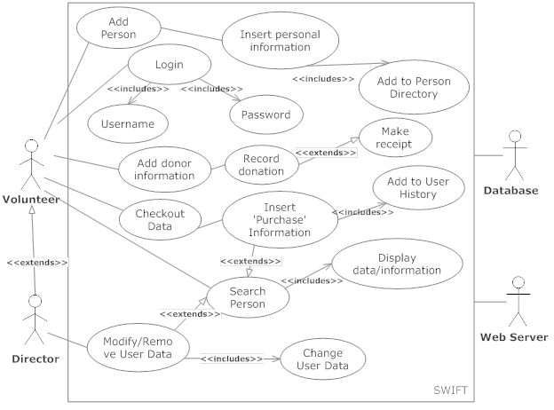
UML Use Case Diagram
SMARKSOLUTIONS BE INTUITIVE.BE EFFICIENT.BE SMARK.

Slide 11
Data Flow Diagrams
Visual representation of how data flows through S.W.I.F.T.
Multiple levels of detail
SMARKSOLUTIONS BE INTUITIVE.BE EFFICIENT.BE SMARK.

Slide 12
Context Diagram
High level overview of data flow through S.W.I.F.T.
SMARKSOLUTIONS BE INTUITIVE.BE EFFICIENT.BE SMARK.

Slide 13
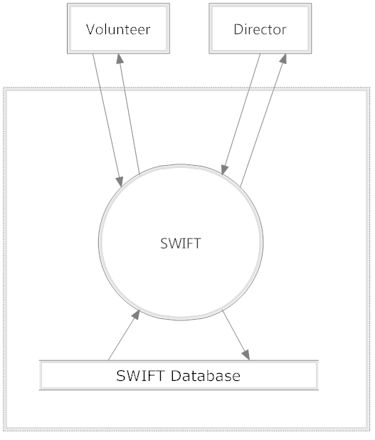
Context Diagram
SMARKSOLUTIONS BE INTUITIVE.BE EFFICIENT.BE SMARK.

Slide 14
Level 0 Diagram
Displays all system processes for users
SMARKSOLUTIONS BE INTUITIVE.BE EFFICIENT.BE SMARK.

Slide 15
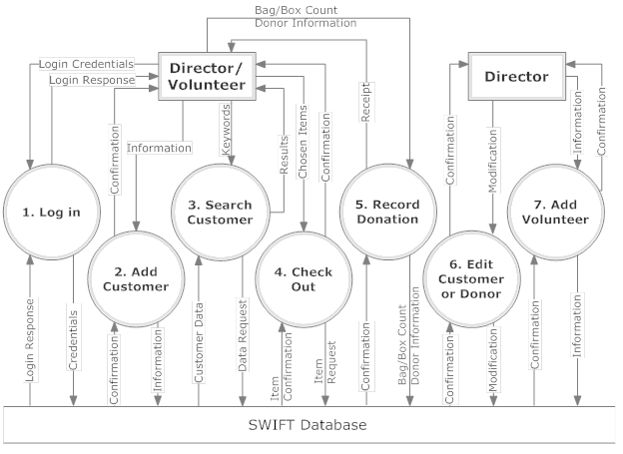
Level 0 Diagram
SMARKSOLUTIONS BE INTUITIVE.BE EFFICIENT.BE SMARK.

Slide 16
Level 1 Diagram
Focuses on data flow through individual processes
SMARKSOLUTIONS BE INTUITIVE.BE EFFICIENT.BE SMARK.

Slide 17
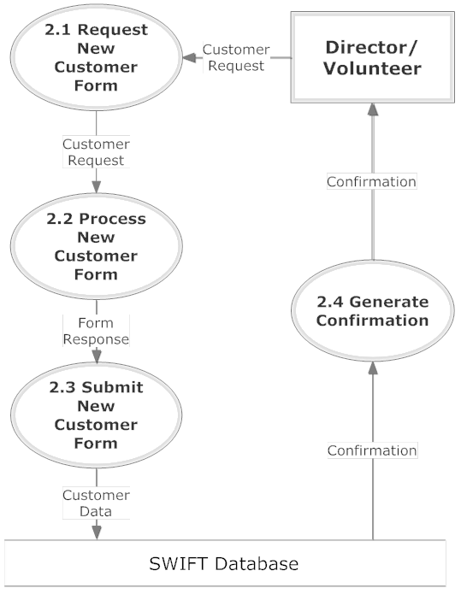
Add Customer Diagram
SMARKSOLUTIONS BE INTUITIVE.BE EFFICIENT.BE SMARK.

Slide 18
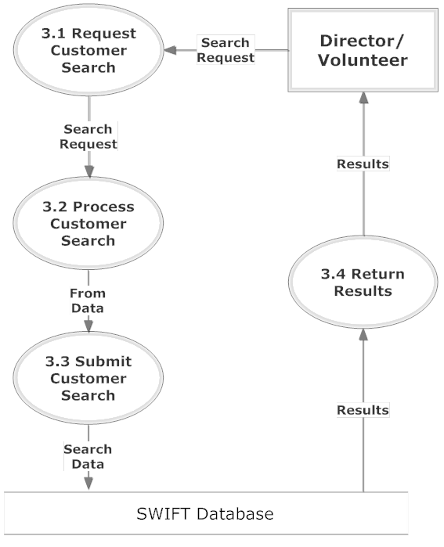
Search Customer Diagram
SMARKSOLUTIONS BE INTUITIVE.BE EFFICIENT.BE SMARK.

Slide 19
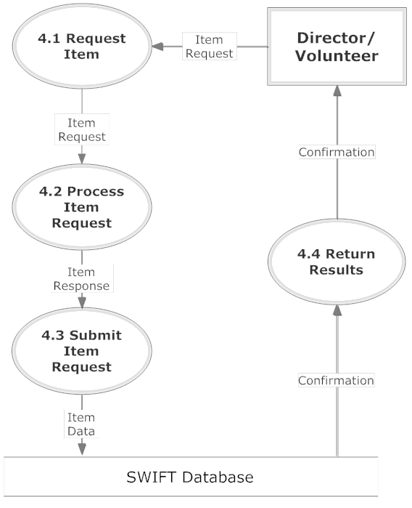
Check Out Diagram
SMARKSOLUTIONS BE INTUITIVE.BE EFFICIENT.BE SMARK.

Slide 20
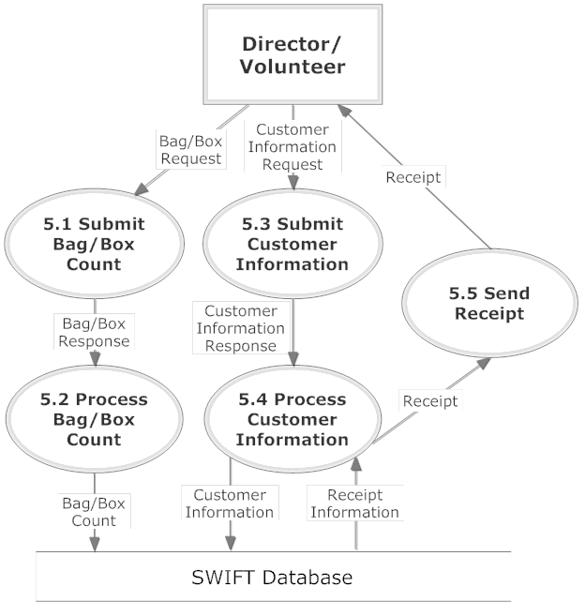
Record Donation Diagram
SMARKSOLUTIONS BE INTUITIVE.BE EFFICIENT.BE SMARK.

Slide 21
Functional Requirements
General outline of users access within S.W.I.F.T.
Compatible across major web browsers
SMARKSOLUTIONS BE INTUITIVE.BE EFFICIENT.BE SMARK.

Slide 22
Volunteer
Login/logout
Search donors/customers
Checkout items
Produce receipts
Insert:
Customer information
Purchase information
Donor information
SMARKSOLUTIONS BE INTUITIVE.BE EFFICIENT.BE SMARK.

Slide 23
Director
Inherits capabilities of the volunteers
Edit existing data
Delete existing data
Add volunteer accounts
Delete volunteer accounts
SMARKSOLUTIONS BE INTUITIVE.BE EFFICIENT.BE SMARK.

Slide 24
Non-Functional Requirements
List what the system is intended to do
Non-specific features of S.W.I.F.T.
SMARKSOLUTIONS BE INTUITIVE.BE EFFICIENT.BE SMARK.

Slide 25
Non-Functional Requirements
S.W.I.F.T. will be:
User friendly
Easily maintained
Stable
Easy to access
SMARKSOLUTIONS BE INTUITIVE.BE EFFICIENT.BE SMARK.

Slide 26
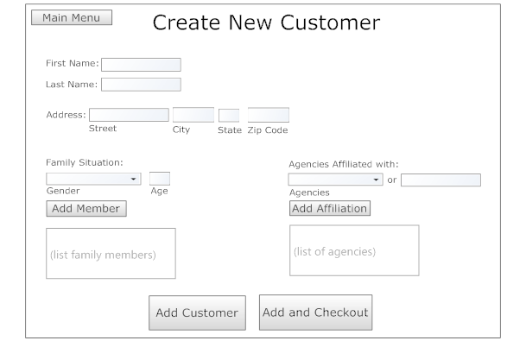
Add Customer Prototype
SMARKSOLUTIONS BE INTUITIVE.BE EFFICIENT.BE SMARK.

Slide 27
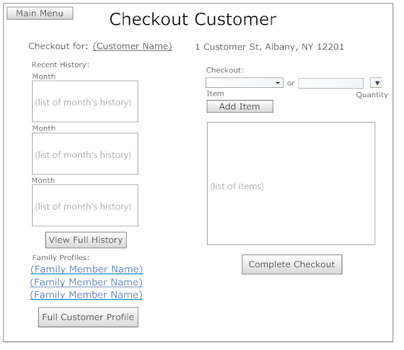
Checkout Prototype
SMARKSOLUTIONS BE INTUITIVE.BE EFFICIENT.BE SMARK.

Slide 28
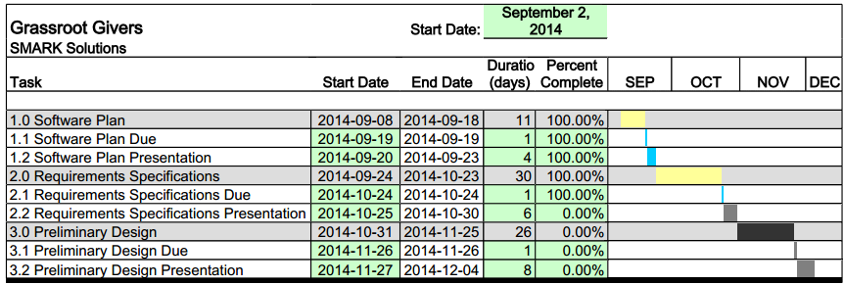
Project Timeline
SMARKSOLUTIONS BE INTUITIVE.BE EFFICIENT.BE SMARK.

Slide 29
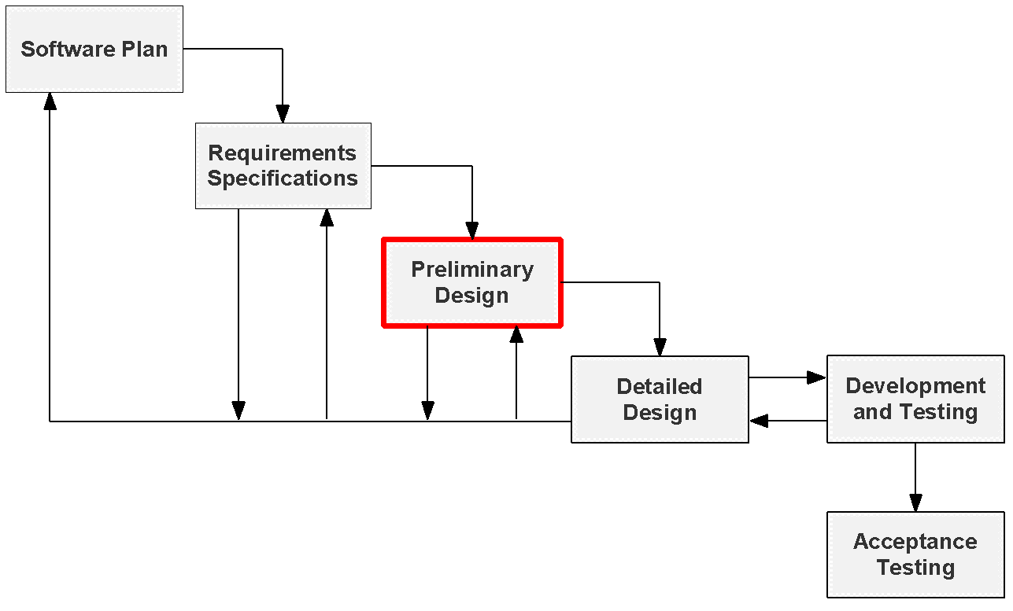
Next Step
SMARKSOLUTIONS BE INTUITIVE.BE EFFICIENT.BE SMARK.

Slide 30
QUESTIONS?
SMARKSOLUTIONS BE INTUITIVE.BE EFFICIENT.BE SMARK.

