Slide 1
S.W.I.F.T.
Preliminary Design
SMARK Solutions
December 4, 2014
SMARKSOLUTIONS BE INTUITIVE.BE EFFICIENT.BE SMARK.

Slide 2
Welcome
Clients:
Mary Partridge-Brown
Roberta Sandler
Guests:
Dr. Meg Fryling
Dr. Darren Lim
SMARKSOLUTIONS BE INTUITIVE.BE EFFICIENT.BE SMARK.

Slide 3
Team Introduction
Salvatore Baisley - Database Manager
Mary Ritchie - Webmaster
Anna Grant - Team Lead
Ryan Martin - Chief QA/Testing
Kathryn Egan - Lead Programmer
“Providing technologies to make what matters most to you possible, that’s SMARK.”
SMARKSOLUTIONS BE INTUITIVE.BE EFFICIENT.BE SMARK.

Slide 4
Project Overview
Grassroot Givers’ Community Store
“Shop with Dignity”
S.W.I.F.T.
Simple Web Inventory For Tracking
SMARKSOLUTIONS BE INTUITIVE.BE EFFICIENT.BE SMARK.

Slide 5
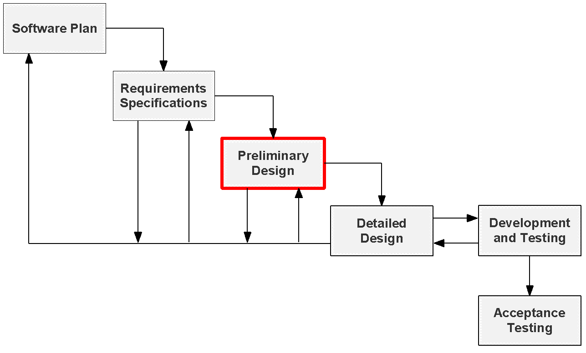
Project Status
SMARKSOLUTIONS BE INTUITIVE.BE EFFICIENT.BE SMARK.

Slide 6
Use Case Narratives
Explains abilities of each user
Outlines interactions with S.W.I.F.T.
SMARKSOLUTIONS BE INTUITIVE.BE EFFICIENT.BE SMARK.

Slide 7
Volunteer
Log in/unique username
Create customer accounts
View customers’ history
Checkout customers
Record donations/produce receipts
SMARKSOLUTIONS BE INTUITIVE.BE EFFICIENT.BE SMARK.

Slide 8
Director
Log in/one director account
Create customer accounts
View customers’ history
Checkout customers
Record donation/produce receipts
Modify/delete customer data
Modify/delete donor data
Manage volunteer accounts
SMARKSOLUTIONS BE INTUITIVE.BE EFFICIENT.BE SMARK.

Slide 9
Use Case Diagram
Visual representation of interactions within S.W.I.F.T.
SMARKSOLUTIONS BE INTUITIVE.BE EFFICIENT.BE SMARK.

Slide 10
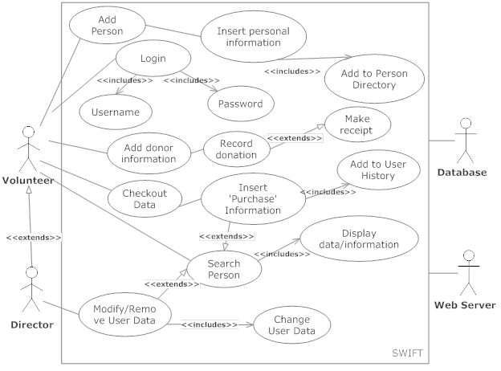
Use Case Diagram
SMARKSOLUTIONS BE INTUITIVE.BE EFFICIENT.BE SMARK.

Slide 11
Deployment Diagram
Deployment Diagram
Models the physical connection between the hardware and software environments of S.W.I.F.T.
SMARKSOLUTIONS BE INTUITIVE.BE EFFICIENT.BE SMARK.

Slide 12
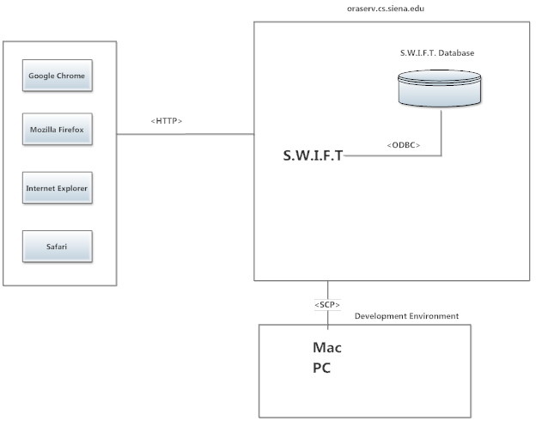
Deployment Diagram
SMARKSOLUTIONS BE INTUITIVE.BE EFFICIENT.BE SMARK.

Slide 13
Activity Diagram
Represents the step by step actions possible for a single process of S.W.I.F.T.
SMARKSOLUTIONS BE INTUITIVE.BE EFFICIENT.BE SMARK.

Slide 14
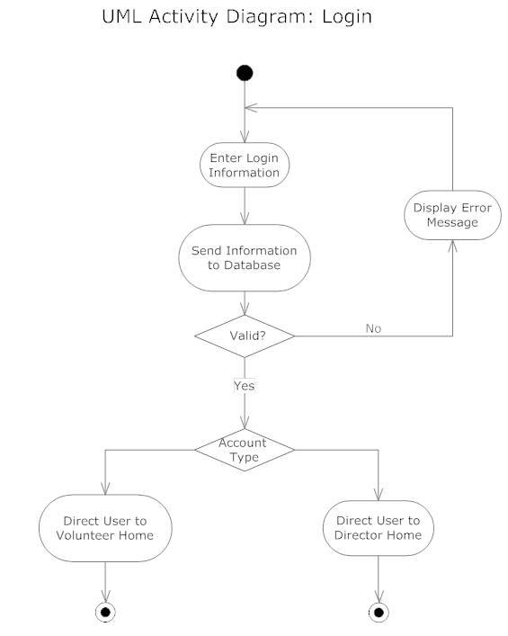
Login
SMARKSOLUTIONS BE INTUITIVE.BE EFFICIENT.BE SMARK.

Slide 15
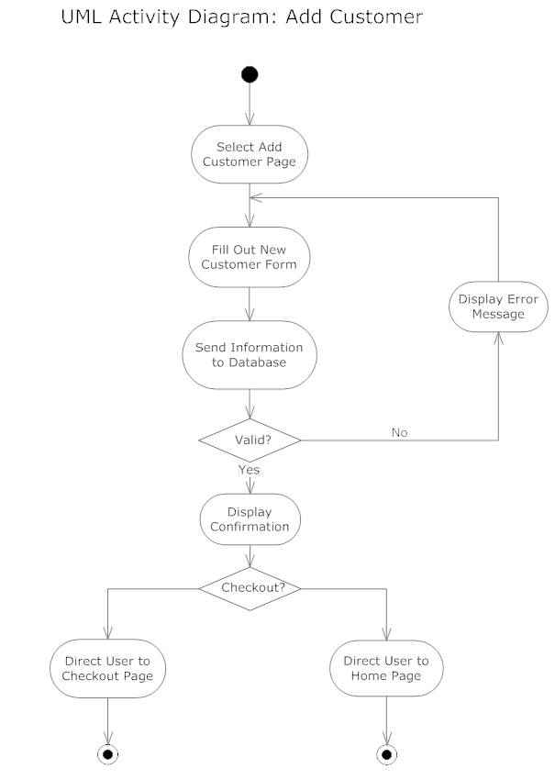
Add Customer
SMARKSOLUTIONS BE INTUITIVE.BE EFFICIENT.BE SMARK.

Slide 16
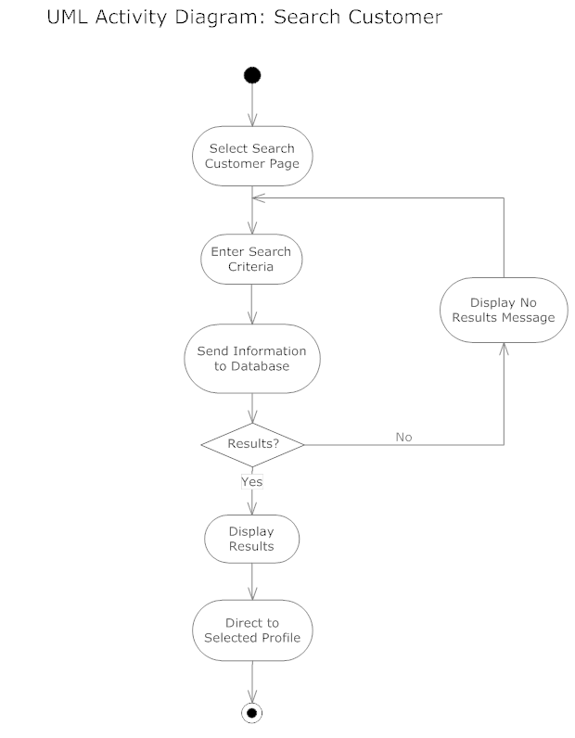
Search Customer
SMARKSOLUTIONS BE INTUITIVE.BE EFFICIENT.BE SMARK.

Slide 17
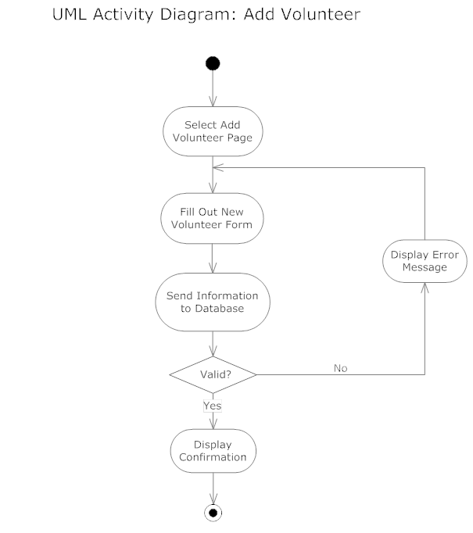
Add Volunteer
SMARKSOLUTIONS BE INTUITIVE.BE EFFICIENT.BE SMARK.

Slide 18
Website Map
Displays the accessible pages to users from a main landing page
SMARKSOLUTIONS BE INTUITIVE.BE EFFICIENT.BE SMARK.

Slide 19
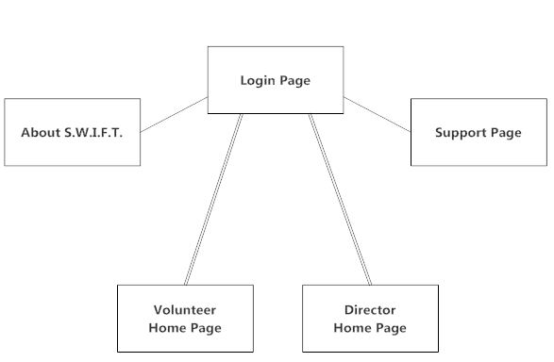
Home
SMARKSOLUTIONS BE INTUITIVE.BE EFFICIENT.BE SMARK.

Slide 20
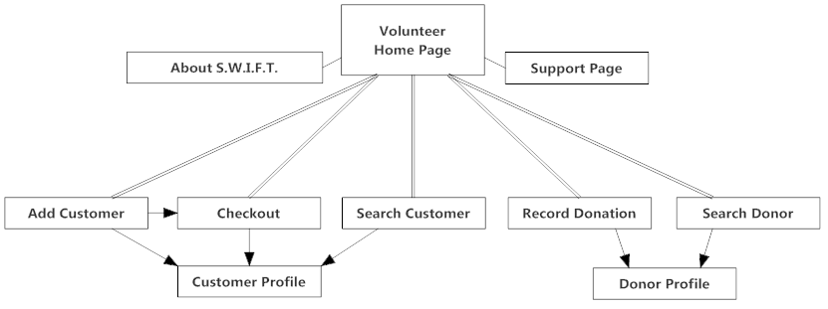
Volunteer
SMARKSOLUTIONS BE INTUITIVE.BE EFFICIENT.BE SMARK.

Slide 21
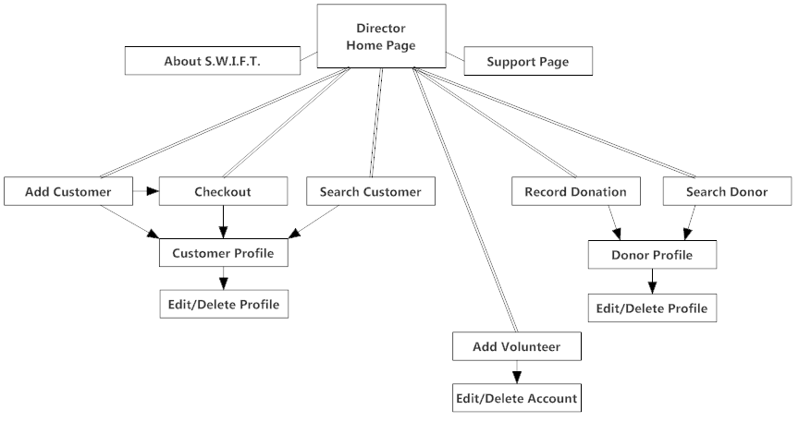
Director
SMARKSOLUTIONS BE INTUITIVE.BE EFFICIENT.BE SMARK.

Slide 22
Data Flow Diagrams
Visual representation of how data flows through S.W.I.F.T.
Multiple levels of detail
SMARKSOLUTIONS BE INTUITIVE.BE EFFICIENT.BE SMARK.

Slide 23
Context Diagram
High level overview of data flow through S.W.I.F.T.
SMARKSOLUTIONS BE INTUITIVE.BE EFFICIENT.BE SMARK.

Slide 24
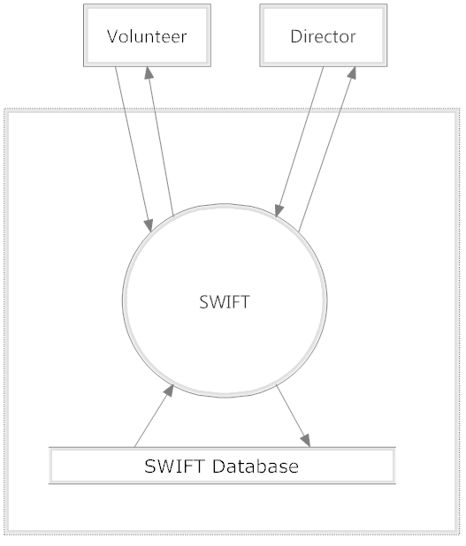
Context Diagram
SMARKSOLUTIONS BE INTUITIVE.BE EFFICIENT.BE SMARK.

Slide 25
Level 0 Diagram
Displays all S.W.I.F.T. processes for users
SMARKSOLUTIONS BE INTUITIVE.BE EFFICIENT.BE SMARK.

Slide 26
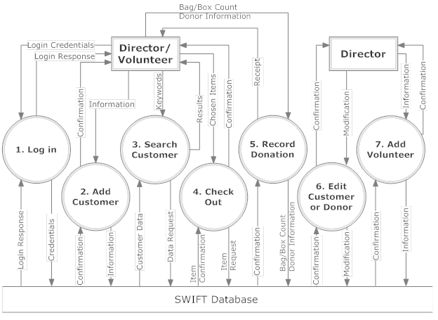
Level 0 Diagram
SMARKSOLUTIONS BE INTUITIVE.BE EFFICIENT.BE SMARK.

Slide 27
Level 1 Diagram
Focuses on data flow through individual processes
SMARKSOLUTIONS BE INTUITIVE.BE EFFICIENT.BE SMARK.

Slide 28
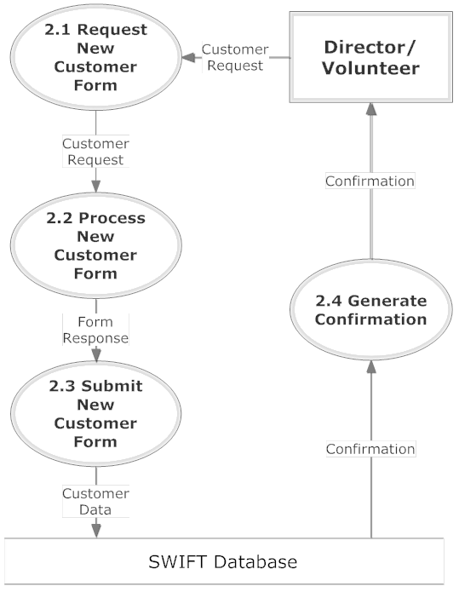
Add Customer
SMARKSOLUTIONS BE INTUITIVE.BE EFFICIENT.BE SMARK.

Slide 29
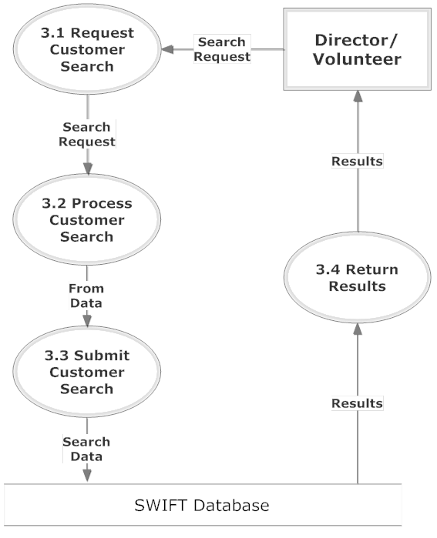
Search Customer
SMARKSOLUTIONS BE INTUITIVE.BE EFFICIENT.BE SMARK.

Slide 30
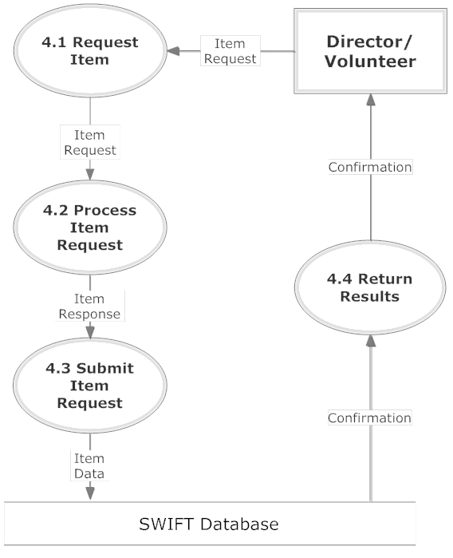
Check Out
SMARKSOLUTIONS BE INTUITIVE.BE EFFICIENT.BE SMARK.

Slide 31
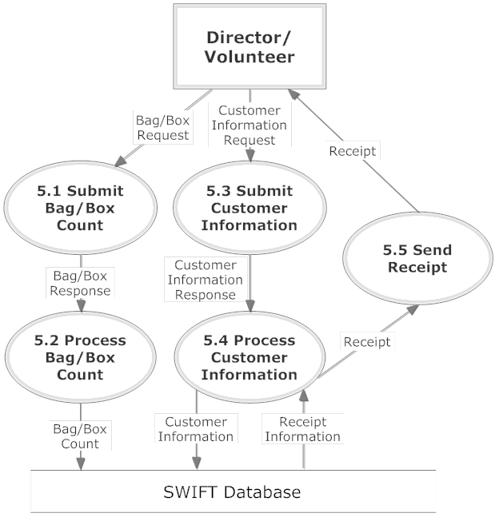
Record Donation
SMARKSOLUTIONS BE INTUITIVE.BE EFFICIENT.BE SMARK.

Slide 32
Structure Diagram
Structure Diagrams show the hierarchy of all the elements involved in S.W.I.F.T.
SMARKSOLUTIONS BE INTUITIVE.BE EFFICIENT.BE SMARK.

Slide 33
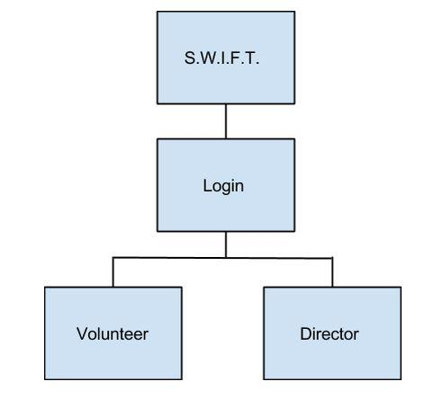
Login Structure
This diagram shows the login structure of the S.W.I.F.T system that allows access to components of the system depending on your role.
SMARKSOLUTIONS BE INTUITIVE.BE EFFICIENT.BE SMARK.

Slide 34
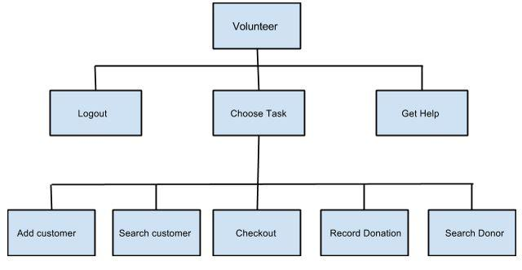
Volunteer Structure
The Volunteer Structure shows what components of S.W.I.F.T. the volunteer has access to.
SMARKSOLUTIONS BE INTUITIVE.BE EFFICIENT.BE SMARK.

Slide 35
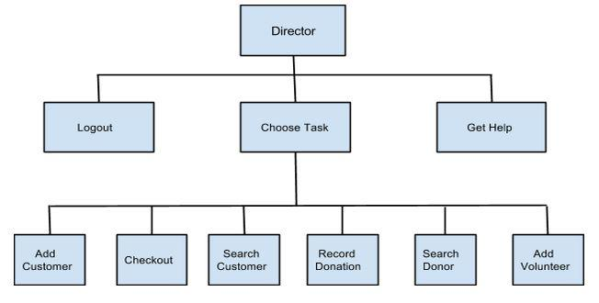
Director Structure
The Director Structure shows what components of S.W.I.F.T. the director has access to.
SMARKSOLUTIONS BE INTUITIVE.BE EFFICIENT.BE SMARK.

Slide 36
Functional Requirements
General outline of users access within S.W.I.F.T.
Compatible across major web browsers
SMARKSOLUTIONS BE INTUITIVE.BE EFFICIENT.BE SMARK.

Slide 37
Volunteer
Login/logout
Search donors/customers
Checkout items
Produce receipts
Insert:
Customer information
Purchase information
Donor information
SMARKSOLUTIONS BE INTUITIVE.BE EFFICIENT.BE SMARK.

Slide 38
Director
Inherits capabilities of the volunteers
Edit existing data
Delete existing data
Add volunteer accounts
Delete volunteer accounts
SMARKSOLUTIONS BE INTUITIVE.BE EFFICIENT.BE SMARK.

Slide 39
Logical Data Dictionary
Collection of data objects and descriptions needed for S.W.I.F.T. processes
SMARKSOLUTIONS BE INTUITIVE.BE EFFICIENT.BE SMARK.

Slide 40
Data Name | Synonym | Applicable to | Data Type | Data Size | Description | Acceptable Input | Example | Notes
affiliation | customers affiliation with agencies | adding a customer to the system, viewing a customer in the system | Varchar | 1-30 Characters | Agencies the customers are affiliated with | ASCII char 32 (space), -, A-Z, a-z, ', `, ASCII char 128 to ASCII char 165 | AA
cust_address | Customer's current address | Adding Customer to system, viewing customer in system | Varchar | 1-70 Characters | Customer's current address | ASCII char 32 (space), -, A-Z, a-z, ', `, ASCII char 128 to ASCII char 165 | 555 Anystreet Drive, Albany, NY, 12206
cust_firstname | Customer First Name | Adding Customer to system, searching for customer within system | Varchar | 1-30 characters | Customers first name | ASCII char 32 (space), -, A-Z, a-z, ', `, ASCII char 128 to ASCII char 165 | Joe
cust_lastname | Customer Last Name | Adding Customer to system, searching for customer within system | Varchar | 1-30 Characters | Customer's last name | ASCII char 32 (space), -, A-Z, a-z, ', `, ASCII char 128 to ASCII char 165 | Smith
dep_firstname | Dependent's first name | adding customer information to the system, viewing customer in the system | Varchar | 1-30 Characters | Dependent's first name | ASCII char 32 (space), -, A-Z, a-z, ', `, ASCII char 128 to ASCII char 165 | Bob

Slide 41
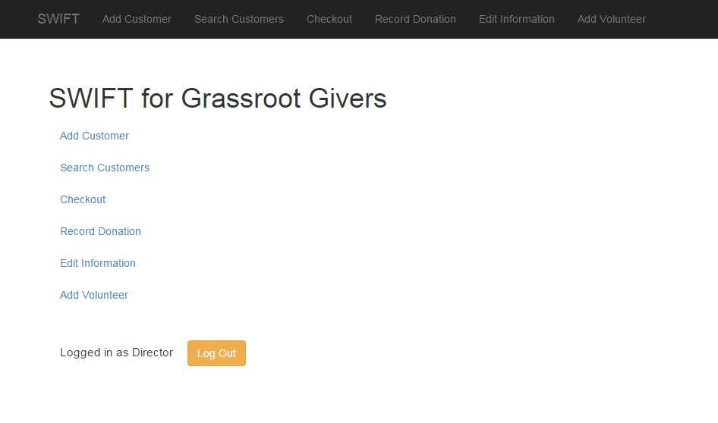
Home Prototype
SMARKSOLUTIONS BE INTUITIVE.BE EFFICIENT.BE SMARK.

Slide 42
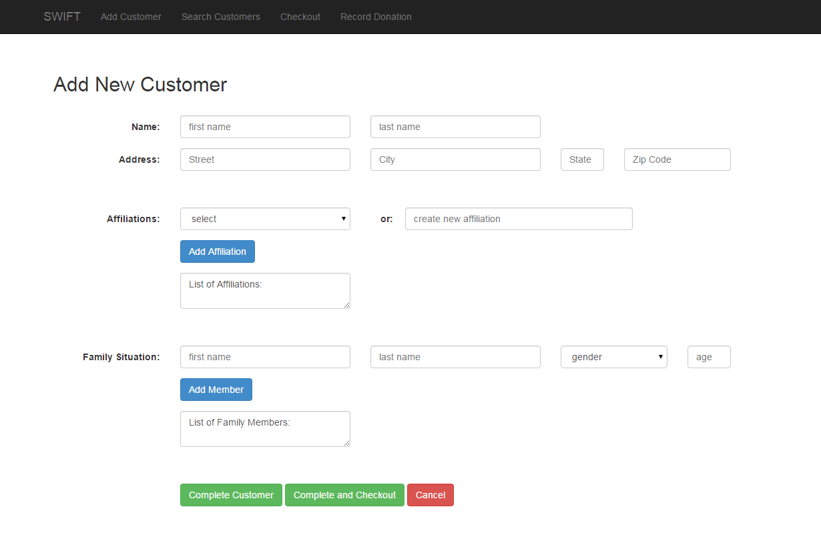
Add Customer Prototype
SMARKSOLUTIONS BE INTUITIVE.BE EFFICIENT.BE SMARK.

Slide 43
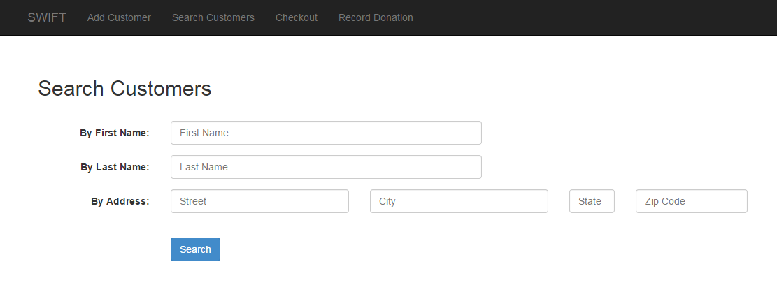
Search Customer Prototype
SMARKSOLUTIONS BE INTUITIVE.BE EFFICIENT.BE SMARK.

Slide 44
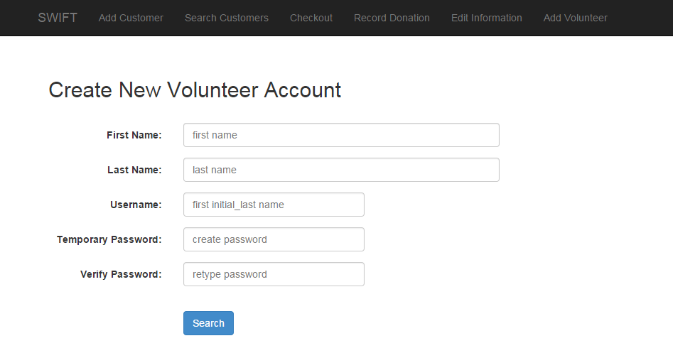
Add Volunteer Prototype
SMARKSOLUTIONS BE INTUITIVE.BE EFFICIENT.BE SMARK.

Slide 45
Testing Plan
Will help verify what components of S.W.I.F.T. are functioning properly
In each case, there are specific guidelines in how to properly test the functionality of the process being tested
SMARKSOLUTIONS BE INTUITIVE.BE EFFICIENT.BE SMARK.

Slide 46
Login Unit Test
Pass/Fail Status | Test Number | Description | Action to perform test (input) | Steps to be Executed | State Before Test | Expected result | Observed result | Comments | Tested By | Test Date
 | 1.001 | Null username Null password | pass null username and passwords | click login with null fields | login form | failed login
 | 1.002 | Not Null username Null password | pass a username and null a password | click login with a username but not a password | login form | failed login
 | 1.003 | Null username Not Null Password | pass a null username and a password | click login with a username but not a password | login form | failed login
 | 1.004 | Incorrect username | pass invalid username with a correct password | click login with a random username but valid password | login form | failed login

Slide 47
Add Customer Unit Test
Pass/Fail Status | Test Number | Description | Action to perform test (input) | Steps to be Executed | State Before Test | Expected result | Observed result | Comments | Tested By | Test Date
 | 1.001 | ValidFirstName | Add Valid First Name | Enter First Name in form | Create Customer Form | First Name Added to Database
 | 1.002 | ValidLastName | Add Valid Last Name | Enter Last Name in Form | Create Customer Form | Last Name Added to Database
 | 1.003 | ValidAddress | Add Valid Address Information | Enter Address consisting of the customer's full street address, must be under 70 characters | Create Customer Form | Address Added to Database
 | 1.004 | ValidDepFirstName | Add Dependent First Name | Enter Dependent First Name in Form | Create Customer Form | Dependent's First Name Added to Database

Slide 48
Search Customer Unit Test
Pass/Fail Status | Test Number | Description | Action to perform test (input) | Steps to be Executed | State Before Test | Expected result | Observed result | Comments | Tested By | Test Date
 | 1.001 | ValidCustName | Enter a customer first name or last name that meets the criteria stated in the add customer test | Enter customer's name into search input | Search Page | Return Customer's information
 | 1.002 | InvalidCustName | Enter a customer first name or last name that does NOT the criteria stated in the add customer test | Enter invalid customer name into search input | Search Page | Error Returned
 | 1.003 | SingleLetter | Enter a single alphabetical letter in search bar | Enter Letter in search | Search Page | Return Customer names that include this letter

Slide 49
Add Volunteer Unit Test
Pass/Fail Status | Test Number | Description | Action to perform test (input) | Steps to be Executed | State Before Test | Expected result | Observed result | Comments | Tested By | Test Date
 | 1.001 | ValidFirstName | Add Valid First Name | Enter First Name in form | Create Volunteer Form | First Name Added to Database
 | 1.002 | ValidLastName | Add Valid Last Name | Enter Last Name in Form | Create Volunteer Form | Last Name Added to Database
 | 1.003 | ValidUsername | Add Valid username | Enter username consisting of first initial and last name into form | Create Volunteer Form | Username Added to Database
 | 1.004 | ValidPassword | Add Valid Temporary Password | Password containing at least one capital letter and one number | Create Volunteer Form | Temporary Password Added to Database

Slide 50
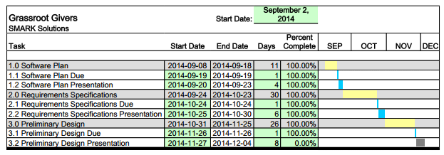
Project Timeline
SMARKSOLUTIONS BE INTUITIVE.BE EFFICIENT.BE SMARK.

Slide 51
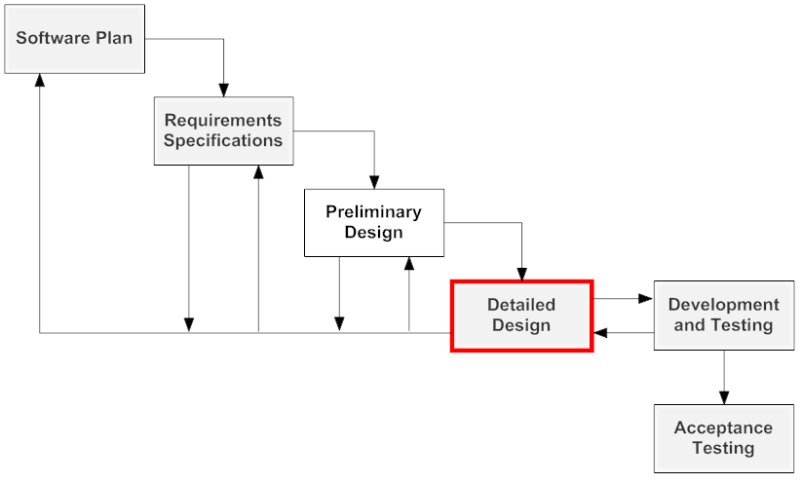
Next Step
SMARKSOLUTIONS BE INTUITIVE.BE EFFICIENT.BE SMARK.

Slide 52
QUESTIONS?
SMARKSOLUTIONS BE INTUITIVE.BE EFFICIENT.BE SMARK.

