Slide 1
S.W.I.F.T.
Detailed Design
SMARK Solutions
March 8, 2014
SMARK SOLUTIONS BE INTUITIVE.BE EFFICIENT.BE SMARK.

Slide 2
Welcome
Clients:
Mary Partridge-Brown
Roberta Sandler
Guests:
Dr. Meg Fryling
Dr. Darren Lim
SMARK SOLUTIONS BE INTUITIVE.BE EFFICIENT.BE SMARK.

Slide 3
Team Introduction
Salvatore Baisley - Database Manager
Mary Ritchie - Webmaster
Anna Grant - Programmer
Ryan Martin - Team Lead
Kathryn Egan - Lead Programmer
“Providing technologies to make what matters most to you possible, that’s SMARK.”
SMARK SOLUTIONS BE INTUITIVE.BE EFFICIENT.BE SMARK.

Slide 4
Project Overview
Grassroot Givers’ Community Store
“Shop with Dignity”
S.W.I.F.T.
Simple Web Inventory For Tracking
SMARK SOLUTIONS BE INTUITIVE.BE EFFICIENT.BE SMARK.

Slide 5
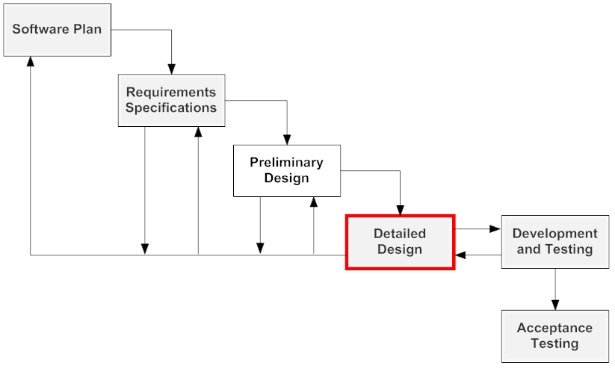
Project Status
SMARK SOLUTIONS BE INTUITIVE.BE EFFICIENT.BE SMARK.

Slide 6
Entity-Relationship Diagram
An Entity-Relationship Diagram is a data modeling technique that is used:
As the foundation of a relational database.
As a graphical representation of an information system.
SMARK SOLUTIONS BE INTUITIVE.BE EFFICIENT.BE SMARK.

Slide 7
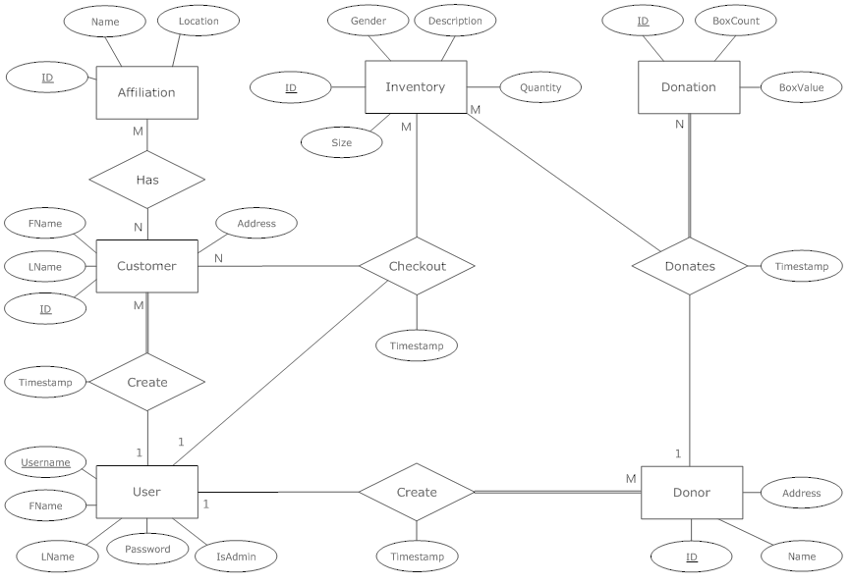
Entity-Relationship Diagram
SMARK SOLUTIONS BE INTUITIVE.BE EFFICIENT.BE SMARK.

Slide 8
Relational Schema
The logical definition of a table.
Gives the names of the table and of each of the columns in a table.
Shows the dependencies in the database.
SMARK SOLUTIONS BE INTUITIVE.BE EFFICIENT.BE SMARK.

Slide 9
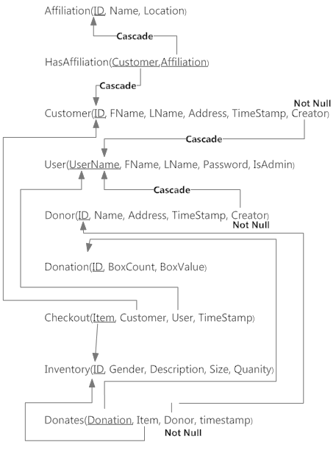
SMARK SOLUTIONS BE INTUITIVE.BE EFFICIENT.BE SMARK.

Slide 10
Prototypes
Includes some preliminary screen design ideas for a couple of the S.W.I.F.T. forms.

Slide 11
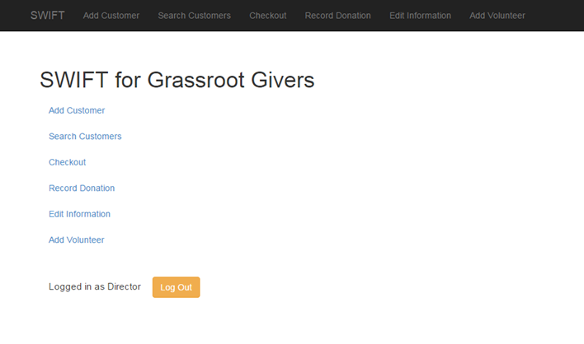
Home Prototype
SMARK SOLUTIONS BE INTUITIVE.BE EFFICIENT.BE SMARK.

Slide 12
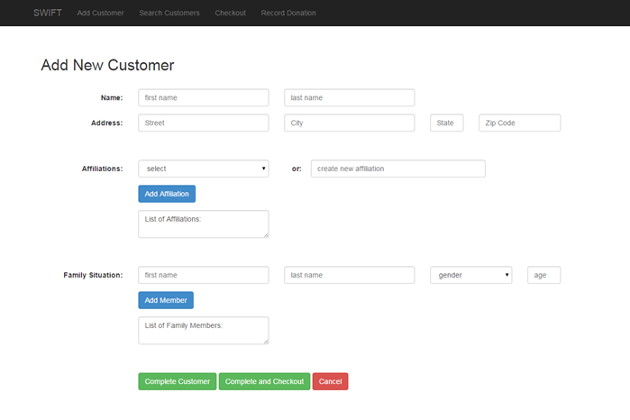
Add Customer Prototype
SMARK SOLUTIONS BE INTUITIVE.BE EFFICIENT.BE SMARK.

Slide 13
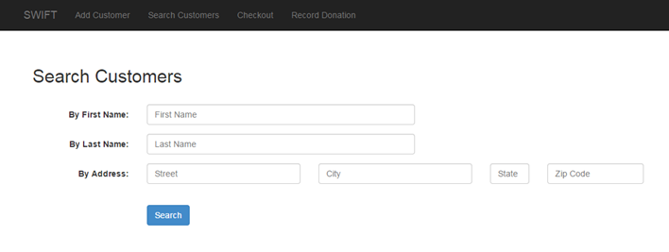
Search Customer Prototype
SMARK SOLUTIONS BE INTUITIVE.BE EFFICIENT.BE SMARK.

Slide 14
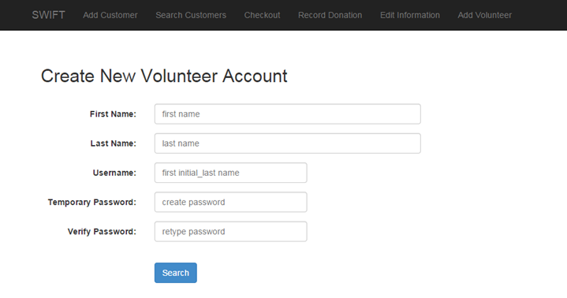
Add Volunteer Prototype
SMARK SOLUTIONS BE INTUITIVE.BE EFFICIENT.BE SMARK.
SMARK SOLUTIONS BE INTUITIVE.BE EFFICIENT.BE SMARK.

Slide 15
Pseudocode
A notation resembling a simplified programming language, used in program design.
Lay out what functions logically do, while making it easy to read and understand before translating it into actual code.
SMARK SOLUTIONS BE INTUITIVE.BE EFFICIENT.BE SMARK.

Slide 16
Login Pseudocode
Get the username typed by the user
Get the password typed by the user
Check both username and password in mysql database
If username and password do not match
Print out invalid username and password error message
If username matches but password does not match
Print out invalid password error message
If username does not match but password does match
Print out invalid username error message
If both match
Start session and go to default redirect after login
SMARK SOLUTIONS BE INTUITIVE.BE EFFICIENT.BE SMARK.

Slide 17
Search Customer Pseudocode
Get the search from customer page
Convert criteria to sql and search in mysql database
If there are results to display
Display them
If there are no results
Display message telling the user there are no results
SMARK SOLUTIONS BE INTUITIVE.BE EFFICIENT.BE SMARK.

Slide 18
Add Volunteer Pseudocode
Get the first name typed by the user and check if it meets the requirements
if it does continue
if it does not then print out an error message
Get the last name typed by the user and check if it meets the requirements
if it does continue
if it does not then print out an error message
Get the username typed by the user and check if it meets the requirements
if it does continue
if it does not then print out an error message
Get the password typed by the user and check if it meets the requirements
if it does continue
if it does not then print out an error message
Get the verify password typed by the user and check if it meets the requirements
if it does continue
if it does not then print out an error message
If all requirements are met, add all information into mysql database when submitted
SMARK SOLUTIONS BE INTUITIVE.BE EFFICIENT.BE SMARK.

Slide 19
Unit Testing
Unit tests are tests that will be run to ensure that our application is working properly.
Each test will test an individual aspect of one of the major processes to show what inputs will work and and what ones will not/should not work.
SMARK SOLUTIONS BE INTUITIVE.BE EFFICIENT.BE SMARK.

Slide 20
Login Unit Test
Pass/Fail Status | Test Number | Description | Action to perform test (input) | Steps to be Executed | State Before Test | Expected result | Observed result | Comments | Tested By | Test Date
 | 1.001 | Null username Null password | pass null username and passwords | click login with null fields | login form | failed login
 | 1.002 | Not Null username Null password | pass a username and null a password | click login with a username but not a password | login form | failed login
 | 1.003 | Null username Not Null Password | pass a null username and a password | click login with a username but not a password | login form | failed login
 | 1.004 | Incorrect username | pass invalid username with a correct password | click login with a random username but valid password | login form | failed login

Slide 21
Add Customer Unit Test
Pass/Fail Status | Test Number | Description | Action to perform test (input) | Steps to be Executed | State Before Test | Expected result | Observed result | Comments | Tested By | Test Date
 | 1.001 | ValidFirstName | Add Valid First Name | Enter First Name in form | Create Customer Form | First Name Added to Database
 | 1.002 | ValidLastName | Add Valid Last Name | Enter Last Name in Form | Create Customer Form | Last Name Added to Database
 | 1.003 | ValidAddress | Add Valid Address Information | Enter Address consisting of the customer's full street address, must be under 70 characters | Create Customer Form | Address Added to Database
 | 1.004 | ValidDepFirstName | Add Dependent First Name | Enter Dependent First Name in Form | Create Customer Form | Dependent's First Name Added to Database

Slide 22
Search Customer Unit Test
Pass/Fail Status | Test Number | Description | Action to perform test (input) | Steps to be Executed | State Before Test | Expected result | Observed result | Comments | Tested By | Test Date
 | 1.001 | ValidCustName | Enter a customer first name or last name that meets the criteria stated in the add customer test | Enter customer's name into search input | Search Page | Return Customer's information
 | 1.002 | InvalidCustName | Enter a customer first name or last name that does NOT the criteria stated in the add customer test | Enter invalid customer name into search input | Search Page | Error Returned
 | 1.003 | SingleLetter | Enter a single alphabetical letter in search bar | Enter Letter in search | Search Page | Return Customer names that include this letter

Slide 23
Add Volunteer Unit Test
Pass/Fail Status | Test Number | Description | Action to perform test (input) | Steps to be Executed | State Before Test | Expected result | Observed result | Comments | Tested By | Test Date
 | 1.001 | ValidFirstName | Add Valid First Name | Enter First Name in form | Create Volunteer Form | First Name Added to Database
 | 1.002 | ValidLastName | Add Valid Last Name | Enter Last Name in Form | Create Volunteer Form | Last Name Added to Database
 | 1.003 | ValidUsername | Add Valid username | Enter username consisting of first initial and last name into form | Create Volunteer Form | Username Added to Database
 | 1.004 | ValidPassword | Add Valid Temporary Password | Password containing at least one capital letter and one number | Create Volunteer Form | Temporary Password Added to Database

Slide 24
System Test
System testing will be run on S.W.I.F.T. to ensure our application meets all of the set requirements, both functional and non-functional
Black-box testing will be used
This means that when various inputs are entered in, certain outputs should or should not be seen, ensuring our application works properly
SMARK SOLUTIONS BE INTUITIVE.BE EFFICIENT.BE SMARK.

Slide 25
Integration Test
Integration testing will be conducted on
S.W.I.F.T. to ensure each of the different components interact as they should with each other
This will be completed through tests built into our unit and system testing to make sure everything works and cooperates properly
SMARK SOLUTIONS BE INTUITIVE.BE EFFICIENT.BE SMARK.

Slide 26
Regression Test
Regression testing conducted on S.W.I.F.T. will take place after the application is completed
For this, both integration tests and the unit tests should be re-run to ensure the application is fully functional
SMARK SOLUTIONS BE INTUITIVE.BE EFFICIENT.BE SMARK.

Slide 27
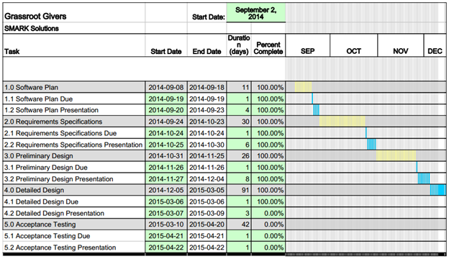
Project Timeline
SMARK SOLUTIONS BE INTUITIVE.BE EFFICIENT.BE SMARK.

Slide 28
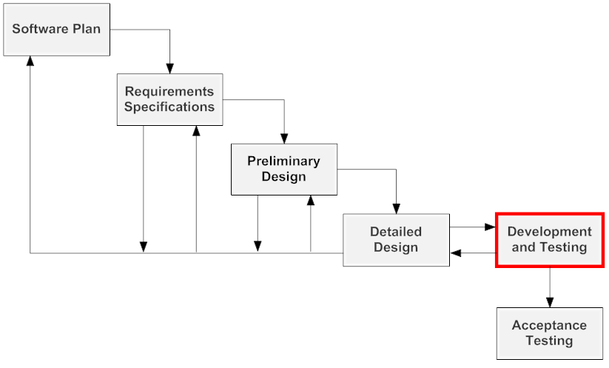
Next Step
SMARKSOLUTIONS BE INTUITIVE.BE EFFICIENT.BE SMARK.

Slide 29
QUESTIONS?
SMARKSOLUTIONS BE INTUITIVE.BE EFFICIENT.BE SMARK.

