Slide 1
S.W.I.F.T.
Acceptance Test
SMARK Solutions
April 22, 2015
SMARK SOLUTIONS BE INTUITIVE.BE EFFICIENT.BE SMARK.

Slide 2
Welcome
Clients:
Mary Partridge-Brown
Roberta Sandler
Guests:
Dr. Meg Fryling
Dr. Darren Lim
SMARK SOLUTIONS BE INTUITIVE.BE EFFICIENT.BE SMARK.

Slide 3
Team Introduction
Mary Ritchie - Webmaster
Anna Grant - Lead Programmer
Ryan Martin - Team Lead
Salvatore Baisley - Database Manager
“Providing technologies to make what matters most to you possible, that’s SMARK.”
SMARK SOLUTIONS BE INTUITIVE.BE EFFICIENT.BE SMARK.

Slide 4
Project Overview
Grassroot Givers’ Community Store
“Shop with Dignity”
S.W.I.F.T.
Simple Web Inventory For Tracking
SMARK SOLUTIONS BE INTUITIVE.BE EFFICIENT.BE SMARK.

Slide 5
Solution Strategy
Web application that allows tracking of customers, donations, and important inventory.
SMARK SOLUTIONS BE INTUITIVE.BE EFFICIENT.BE SMARK.

Slide 6
Testing Overview
Conducted a series of strict unit test, followed by integration testing.
Ensured that the software was able of passing the Ivory Snow test.
SMARK SOLUTIONS BE INTUITIVE.BE EFFICIENT.BE SMARK.

Slide 7
Unit Testing Results
Currently being run
Current passing percentage: 94.54%
SMARK SOLUTIONS BE INTUITIVE.BE EFFICIENT.BE SMARK.

Slide 8
Integration Testing
Designed to ensure that units that interact with another unit work together.
Integration testing was done after each unit and its testing was completed.
SMARK SOLUTIONS BE INTUITIVE.BE EFFICIENT.BE SMARK.

Slide 9
Directory of Unit Tests
https://docs.google.com/a/siena.edu/spreadsheets/d/1SX-5rtmBr4jzof8y6G9UGbf74wp-0xqVbdIOu76zh0k/edit#gid=608570437
SMARK SOLUTIONS BE INTUITIVE.BE EFFICIENT.BE SMARK.

Slide 10
Functional Requirements
General outline of users access within
S.W.I.F.T.
Compatible across major web browsers
SMARK SOLUTIONS BE INTUITIVE.BE EFFICIENT.BE SMARK.

Slide 11
Volunteer
Login/logout
Search donors/customers
Checkout items
Produce receipts
Insert:
Customer information
Purchase information
Donor information
SMARK SOLUTIONS BE INTUITIVE.BE EFFICIENT.BE SMARK.

Slide 12
Director
Inherits capabilities of the volunteers
Edit existing data
Delete existing data
Add volunteer accounts
Delete volunteer accounts
SMARK SOLUTIONS BE INTUITIVE.BE EFFICIENT.BE SMARK.

Slide 13
Have the Requirements Been Met?
SWIFT meets a majority of the requirements that the client had for the software.
The software is currently unable to print out receipts for the donors.
SMARK SOLUTIONS BE INTUITIVE.BE EFFICIENT.BE SMARK.

Slide 14
Future Enhancements
Ability to print out receipts after a donation is processed or at a later date.
Clients want to add a credit system for the customers based upon working at the shop.
SMARK SOLUTIONS BE INTUITIVE.BE EFFICIENT.BE SMARK.

Slide 15
Product Demonstration
http://oraserv.cs.siena.edu/~perm_smark/SWIFT/index2.php#no-back-button
SMARK SOLUTIONS BE INTUITIVE.BE EFFICIENT.BE SMARK.

Slide 16
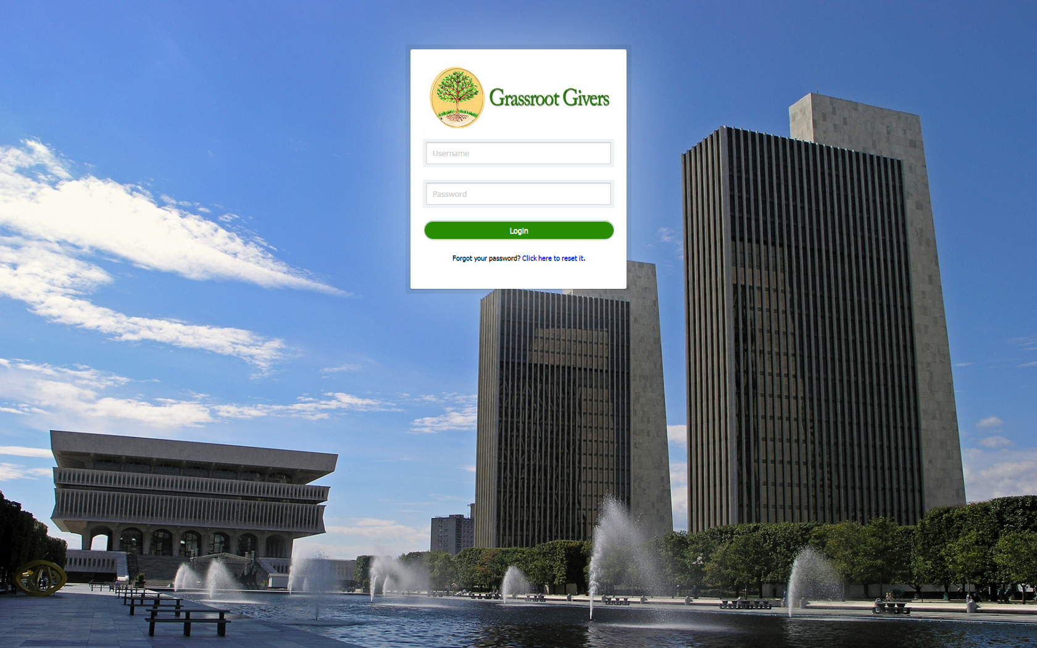
Product Demonstration
SMARK SOLUTIONS BE INTUITIVE.BE EFFICIENT.BE SMARK.

Slide 17
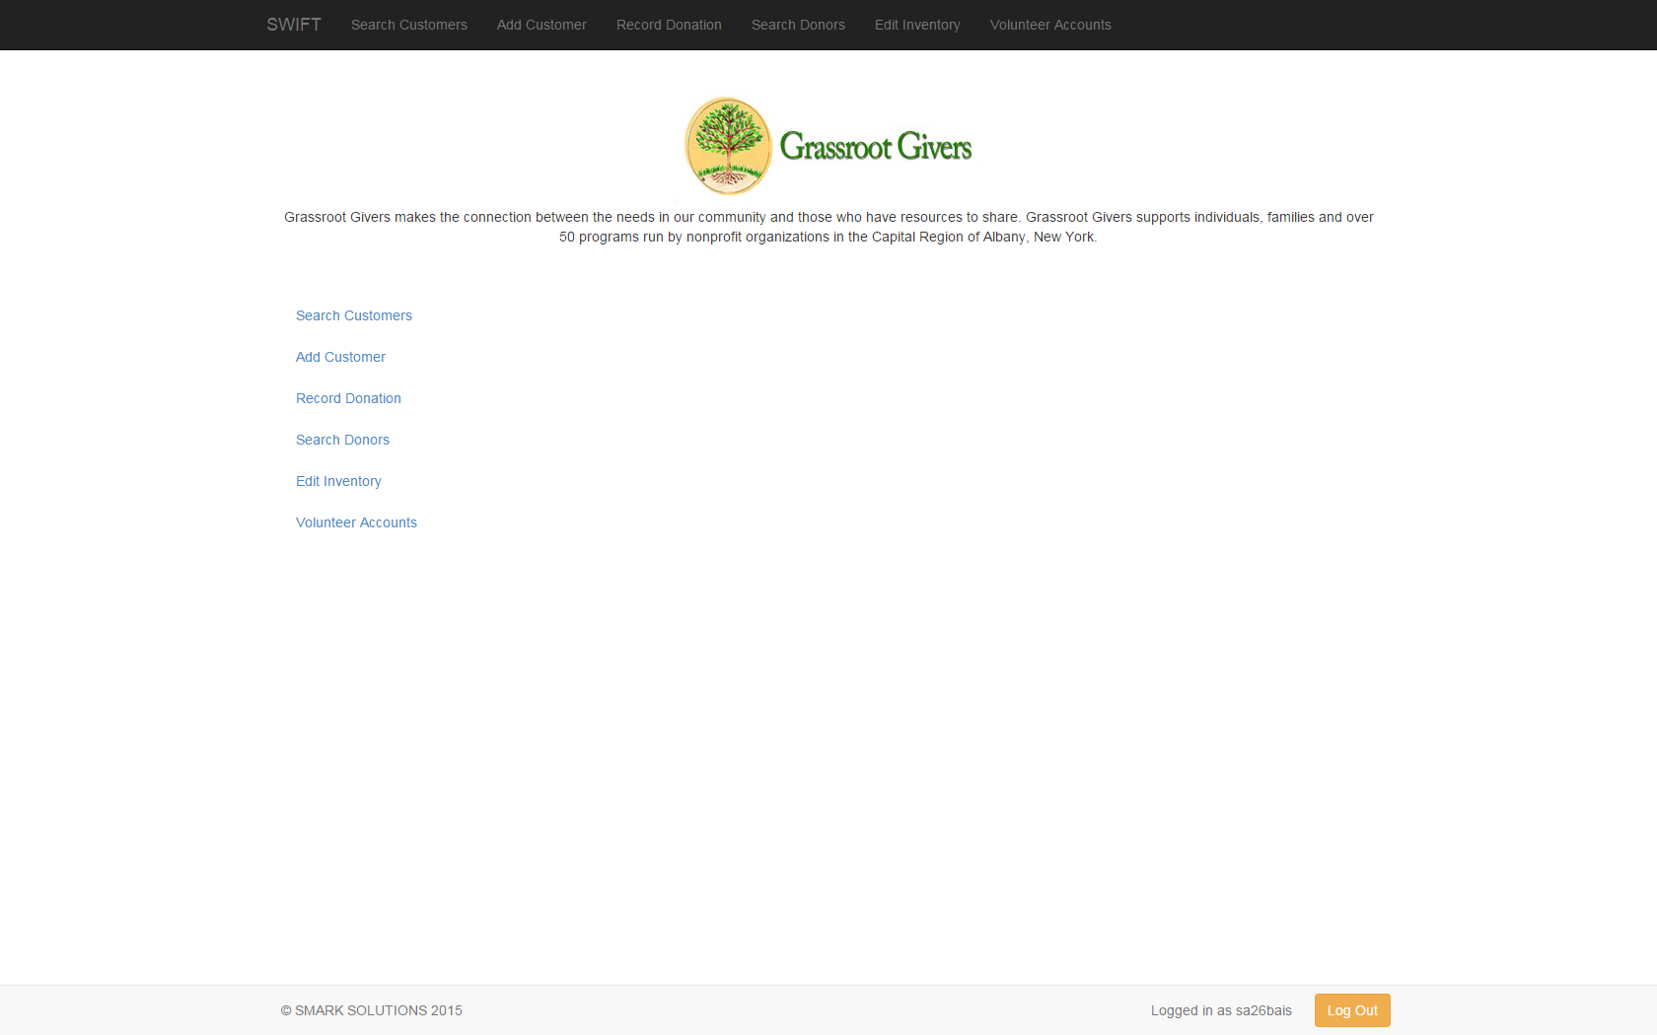
SMARK SOLUTIONS BE INTUITIVE.BE EFFICIENT.BE SMARK.

Slide 18
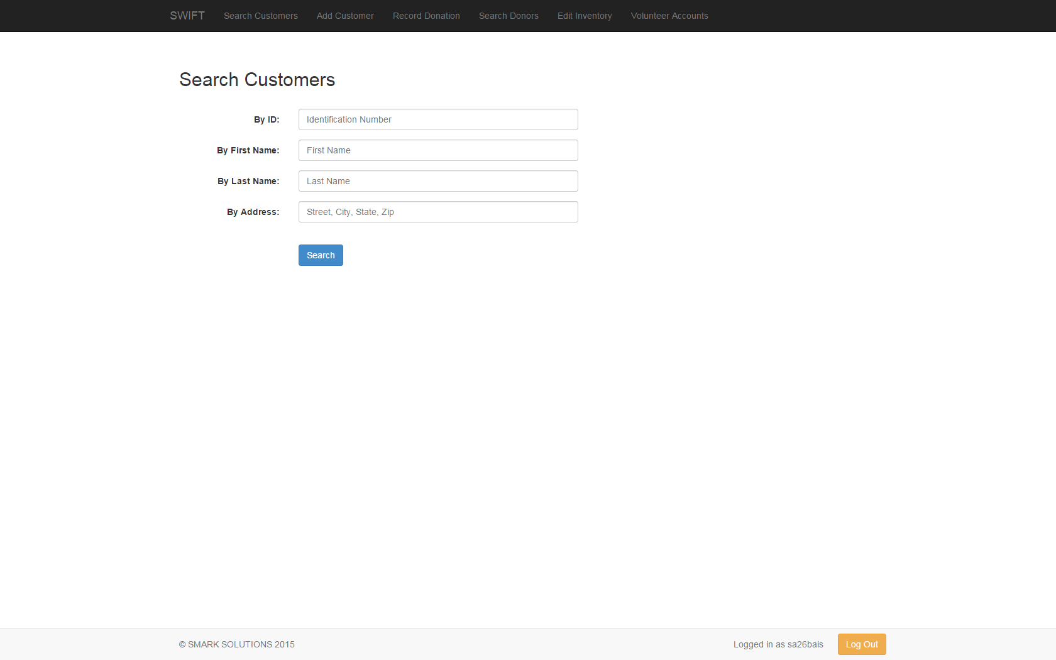
Deliverables
We will have all of the files that are needed on a flash drive for the clients.
SMARK SOLUTIONS BE INTUITIVE.BE EFFICIENT.BE SMARK.

Slide 19
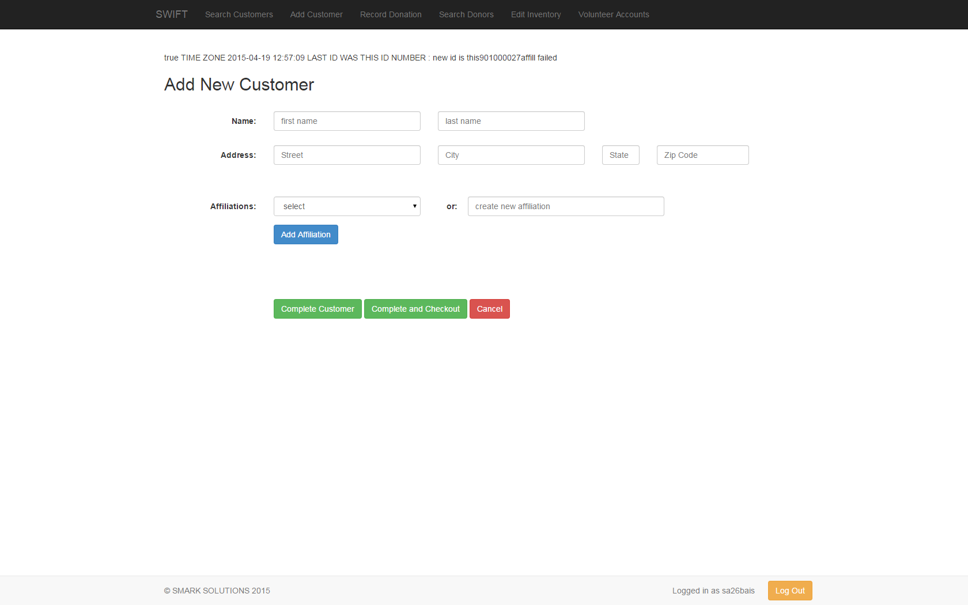
Deliverables
We will have all of the files that are needed on a flash drive for the clients.
SMARK SOLUTIONS BE INTUITIVE.BE EFFICIENT.BE SMARK.

Slide 20
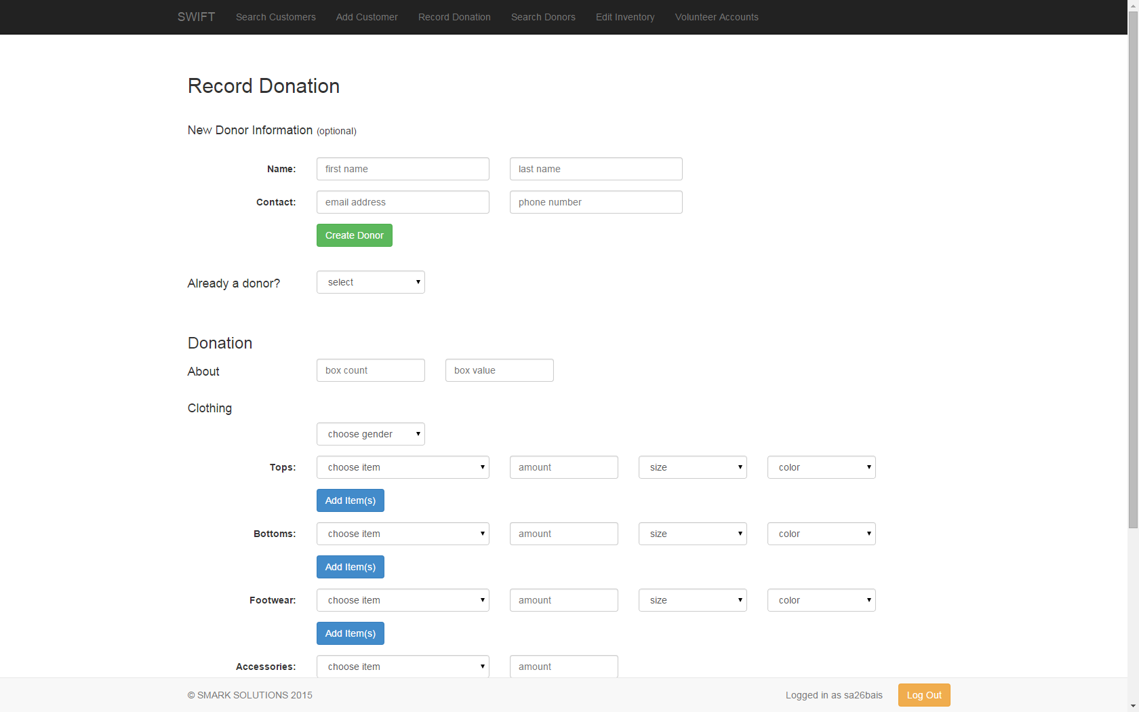
Deliverables
We will have all of the files that are needed on a flash drive for the clients.
SMARK SOLUTIONS BE INTUITIVE.BE EFFICIENT.BE SMARK.

Slide 21
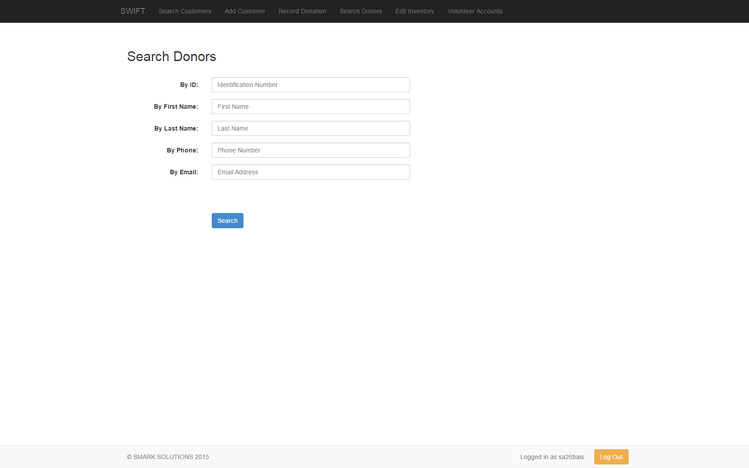
Deliverables
We will have all of the files that are needed on a flash drive for the clients.
SMARK SOLUTIONS BE INTUITIVE.BE EFFICIENT.BE SMARK.

Slide 22
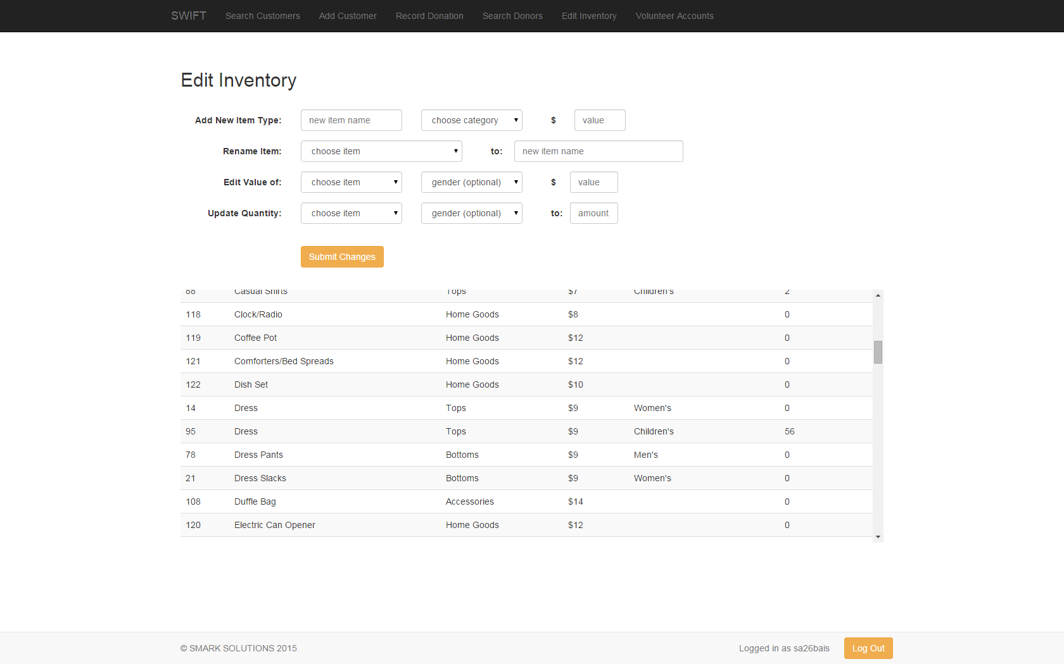
Deliverables
We will have all of the files that are needed on a flash drive for the clients.
SMARK SOLUTIONS BE INTUITIVE.BE EFFICIENT.BE SMARK.

Slide 23
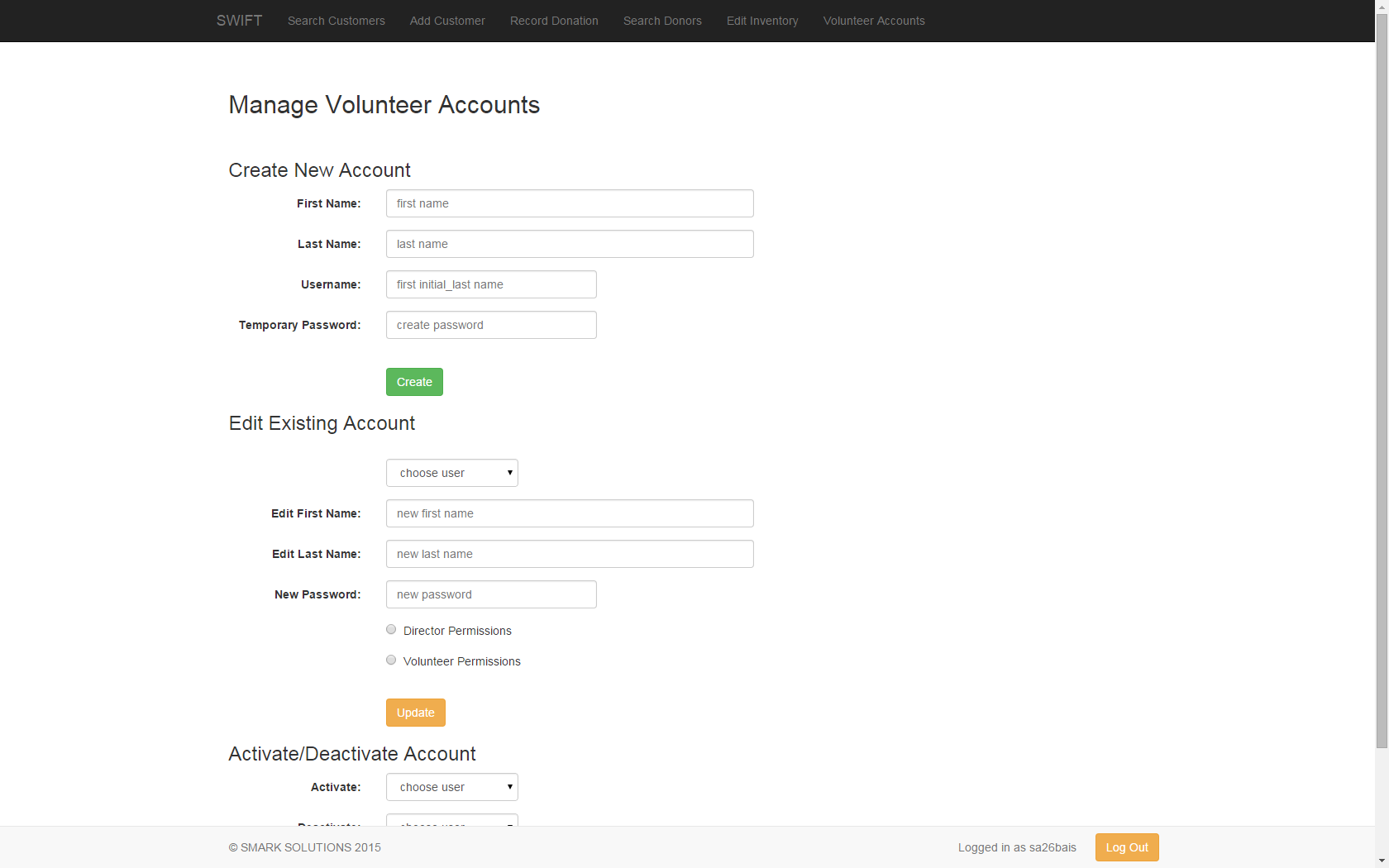
Deliverables
We will have all of the files that are needed on a flash drive for the clients.
SMARK SOLUTIONS BE INTUITIVE.BE EFFICIENT.BE SMARK.

Slide 24
Deliverables
We will have all of the files that are needed on a flash drive for the clients.
The clients will be able to place the files on the web server of their choice.
SMARK SOLUTIONS BE INTUITIVE.BE EFFICIENT.BE SMARK.

Slide 25
What’s Next?
End of the year software party on Monday April 27th.
Ensuring that the software is successfully deployed to the clients.
Entering the workforce, except Sal.
SMARK SOLUTIONS BE INTUITIVE.BE EFFICIENT.BE SMARK.

Slide 26
Lessons Learned
Sometimes there are challenges that are not expected that must be faced.
If there is a solid timeline that must be met, there might be better development models.
SMARK SOLUTIONS BE INTUITIVE.BE EFFICIENT.BE SMARK.

Slide 27
QUESTIONS?
SMARK SOLUTIONS BE INTUITIVE.BE EFFICIENT.BE SMARK.

