Slide 1
CCRS Comprehensive Conference Registration System
Software Plan
September 21st, 2012

Slide 2
Welcome
Our Client:
Dr. Darren Lim
Professor of Computer Science, Siena College
Co-Chair of Consortium of Computing Sciences in Colleges - Northeastern Region (CCSCNE)

Slide 3
Agenda
Introduction
Problem Definition
System Justification
System Goals
System Constraints
Resources
Model
Timeline
3

Slide 4
Introduction
Kelly Bedard Team Leader
Tyler Mann System Admin Co-Webmaster | Jess Reinhardt Document Developer & Analyst
Brett Rudloff Visionary Leader | Carl Tompkins Webmaster

Slide 5
Agenda
Introduction
Problem Definition
System Justification
System Goals
System Constraints
Resources
Model
Timeline

Slide 6
Problem Definition
The registration process is inadequate
System needs defined reviewer selection process
Users need cleaner interface
Need permissions based on roles

Slide 7
Agenda
Introduction
Problem Definition
System Justification
System Goals
System Constraints
Resources
Model
Timeline

Slide 8
System Justification
CCSCNE needs comprehensive conference registration system
Key features would allow:
Users see necessary information during registration
Complete paper/workshop submission and review process
System easily navigated and understandable

Slide 9
Agenda
Introduction
Problem Definition
System Justification
System Goals
System Constraints
Resources
Model
Timeline

Slide 10
System Goals
Plan to create a
Simple and elegant interface
System that will assign appropriate reviewers
Clean and easy registration process
Secure database of conference materials

Slide 11
Agenda
Introduction
Problem Definition
System Justification
System Goals
System Constraints
Resources
Model
Timeline

Slide 12
Constraints
Designed with PHP
Data stored in MySQL database

Slide 13
Agenda
Introduction
Problem Definition
System Justification
System Goals
System Constraints
Resources
Model
Timeline

Slide 14
Resources
Software:
Microsoft Office, Safari, Chrome, Firefox, Internet Explorer, NetBeans
Hardware:
Computers in Software engineering lab
Team members personal computers
Languages:
HTML, CSS, PHP, SQL, JavaScript (jQuery)

Slide 15
Agenda
Introduction
Problem Definition
System Justification
System Goals
System Constraints
Resources
Model
Timeline

Slide 16
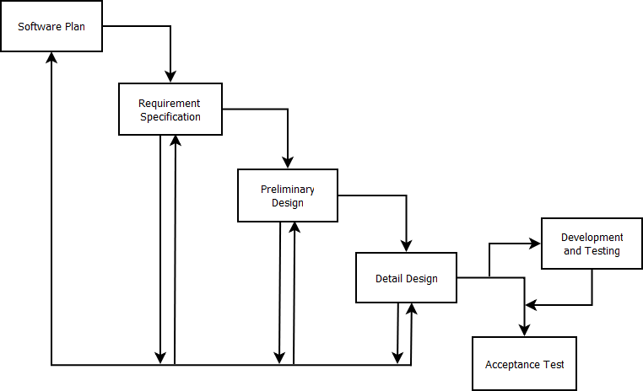
Development Model

Slide 17
Agenda
Introduction
Problem Definition
System Justification
System Goals
System Constraints
Resources
Model
Timeline

Slide 18
Timeline

Slide 19
What’s Next
Requirement Specification – October 2012
Preliminary Design – December 2012
Detailed Design – Spring 2013
Acceptance Test – Spring 2013

Slide 20
Thank You
Questions?

