Slide 1
CCRS Comprehensive Conference Registration System Preliminary Design December 7th, 2012

Slide 2
Welcome
Our Client:
Dr. Darren Lim
Professor of Computer Science
Siena College
2

Slide 3
Agenda
Introductions
Problem Overview
Project Progression
User Case Narratives
UML Use Case Diagram
UML Deployment Diagram
Website Map
UML Activity Diagrams
Data Flow Diagrams
Requirements Inventory
Data Dictionary
Testing
Development Environment
Prototype Screens
What’s Next
S.E.E. Solutions
3

Slide 4
Introduction
Kelly Bedard Team Leader
Tyler Mann System Admin Co-Webmaster | Jess Reinhardt Document Developer & Analyst
Brett Rudloff Visionary Leader | Carl Tompkins Webmaster
S.E.E. Solutions
4

Slide 5
Agenda
Problem Overview
Project Progression
User Case Narratives
UML Use Case Diagram
UML Deployment Diagram
Website Map
UML Activity Diagrams
Data Flow Diagrams
Requirements Inventory
Data Dictionary
Testing
Development Environment
Prototype Screens
What’s Next

Slide 6
Problem Overview
Create a comprehensive registration system for CCSCNE
Account for multiple types of users
Main processes include:
Registering
Reviewing
Submitting
Scheduling
6

Slide 7
Agenda
Project Progression
User Case Narratives
UML Use Case Diagram
UML Deployment Diagram
Website Map
UML Activity Diagrams
Data Flow Diagrams
Requirements Inventory
Data Dictionary
Testing
Development Environment
Prototype Screens
What’s Next
S.E.E. Solutions
7

Slide 8
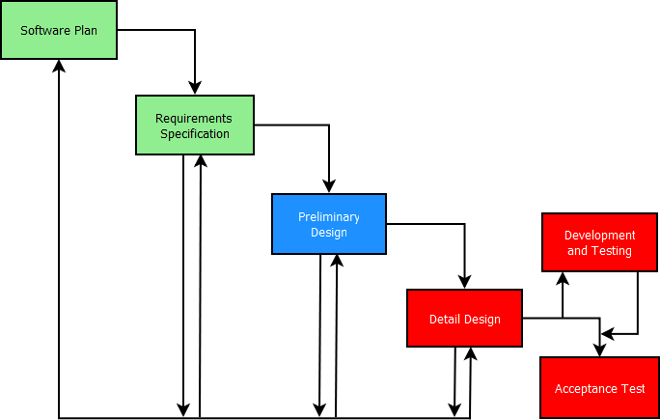
Project Progression
S.E.E. Solutions
8

Slide 9
Agenda
User Case Narratives
UML Use Case Diagram
UML Deployment Diagram
Website Map
UML Activity Diagrams
Data Flow Diagrams
Requirements Inventory
Data Dictionary
Testing
Development Environment
Prototype Screens
What’s Next
S.E.E. Solutions
9

Slide 10
User Case Narratives
Gives brief description of each type of user
Describes how each user will interact with CCRS
S.E.E. Solutions
10

Slide 11
All Users - User Case Narrative
Logs in/out
Change Password
S.E.E. Solutions
11

Slide 12
Attendee - User Case Narrative
Registers for conference
Supplies personal, meal and payment information
Receives confirmation communication
S.E.E. Solutions
12

Slide 13
Conference Chair - User Case Narrative
Has access to all conference information
Can configure all conference settings
Can create accounts for others
Can change the schedule
S.E.E. Solutions
13

Slide 14
Reviewer - User Case Narrative
Downloads submissions
Uploads reviews
S.E.E. Solutions
14

Slide 15
Submitter - User Case Narrative
Uploads submissions
Receives acceptance or rejection notification
S.E.E. Solutions
15

Slide 16
Agenda
UML Use Case Diagram
UML Deployment Diagram
Website Map
UML Activity Diagrams
Data Flow Diagrams
Requirements Inventory
Data Dictionary
Testing
Development Environment
Prototype Screens
What’s Next
S.E.E. Solutions
16

Slide 17
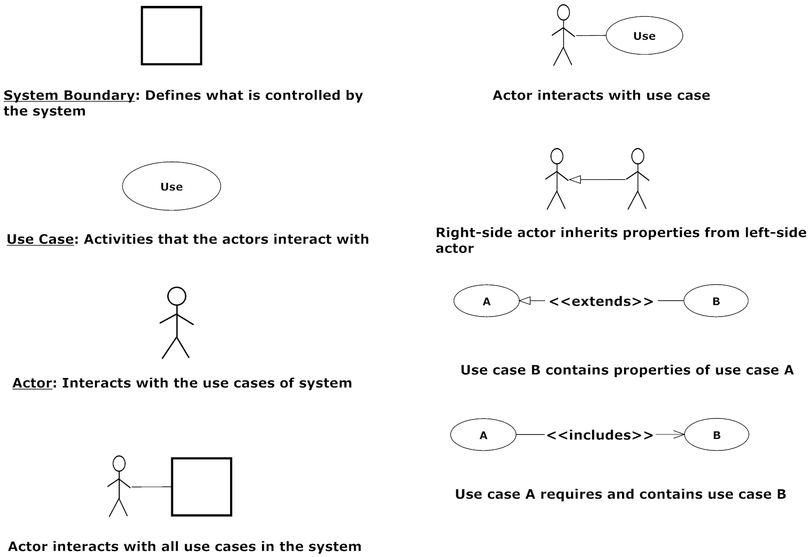
UML Use Case Diagram Legend
S.E.E. Solutions
17

Slide 18
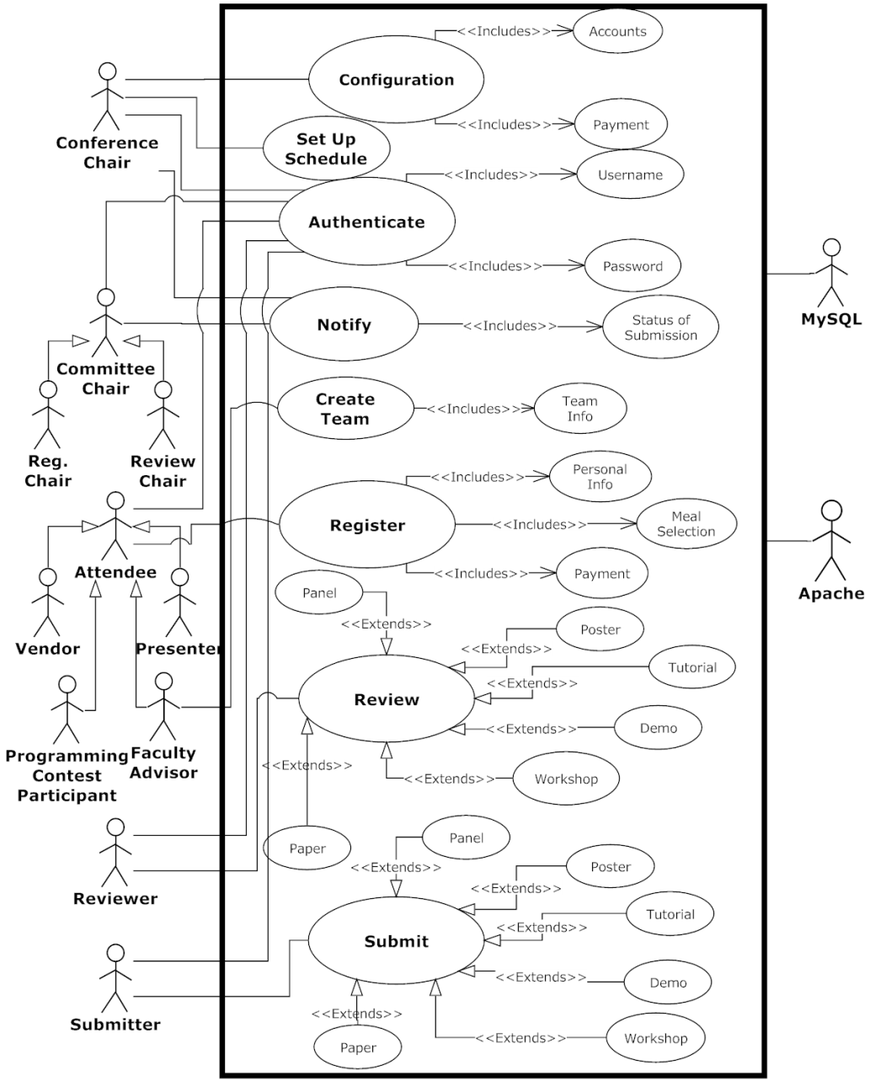
UML Use Case Diagram
S.E.E. Solutions
18

Slide 19
Agenda
UML Deployment Diagram
Website Map
UML Activity Diagrams
Data Flow Diagrams
Requirements Inventory
Data Dictionary
Testing
Development Environment
Prototype Screens
What’s Next
S.E.E. Solutions
19

Slide 20
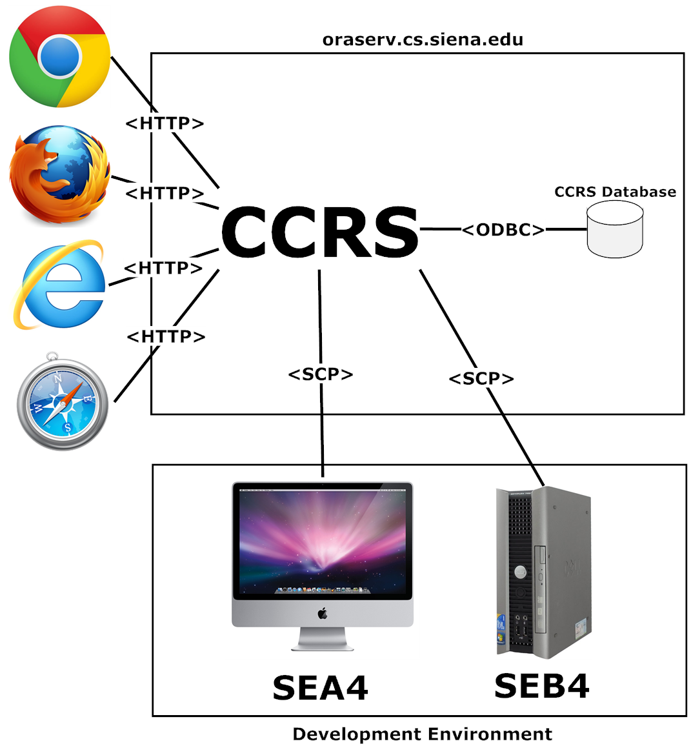
UML Deployment Diagram
S.E.E. Solutions
20

Slide 21
Agenda
Website Map
UML Activity Diagrams
Data Flow Diagrams
Requirements Inventory
Data Dictionary
Testing
Development Environment
Prototype Screens
What’s Next
S.E.E. Solutions
21

Slide 22
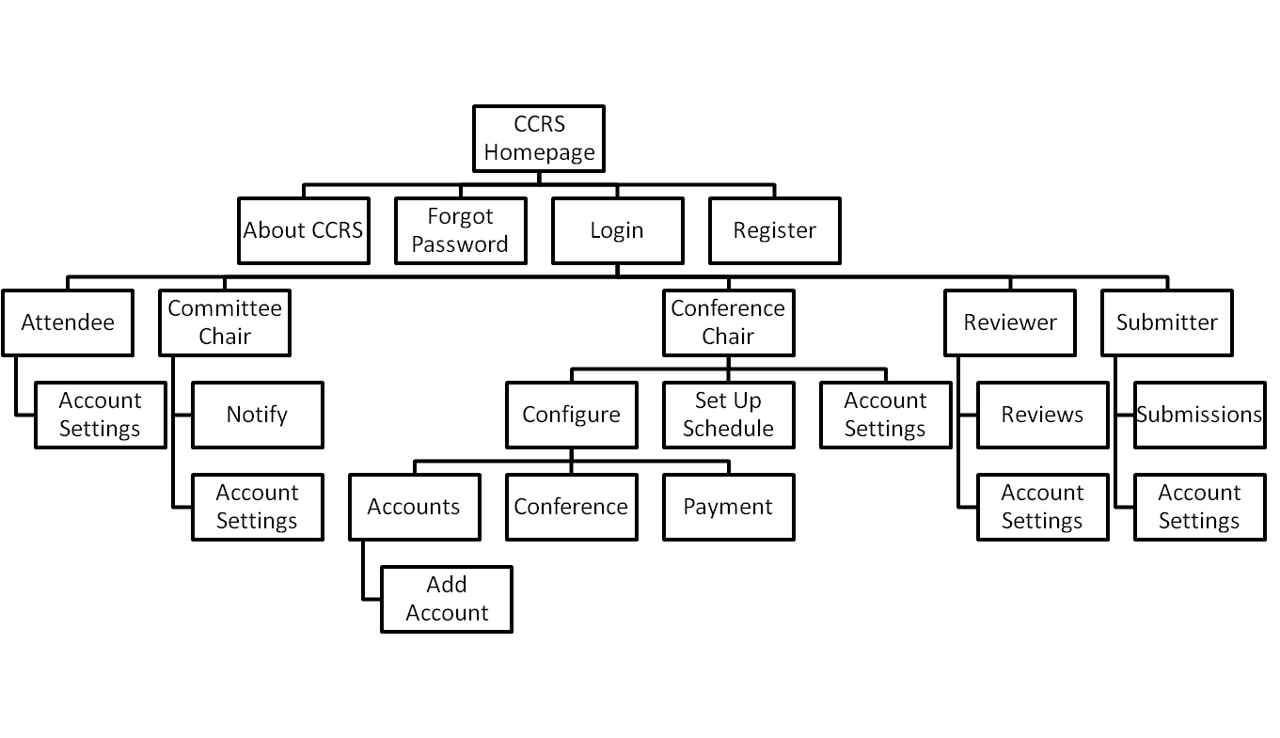
Website Map
S.E.E. Solutions
22

Slide 23
Agenda
UML Activity Diagrams
Data Flow Diagrams
Requirements Inventory
Data Dictionary
Testing
Development Environment
Prototype Screens
What’s Next
S.E.E. Solutions
23

Slide 24
UML Activity Diagram Legend
Shows the flow of control through the processes
S.E.E. Solutions
24

Slide 25
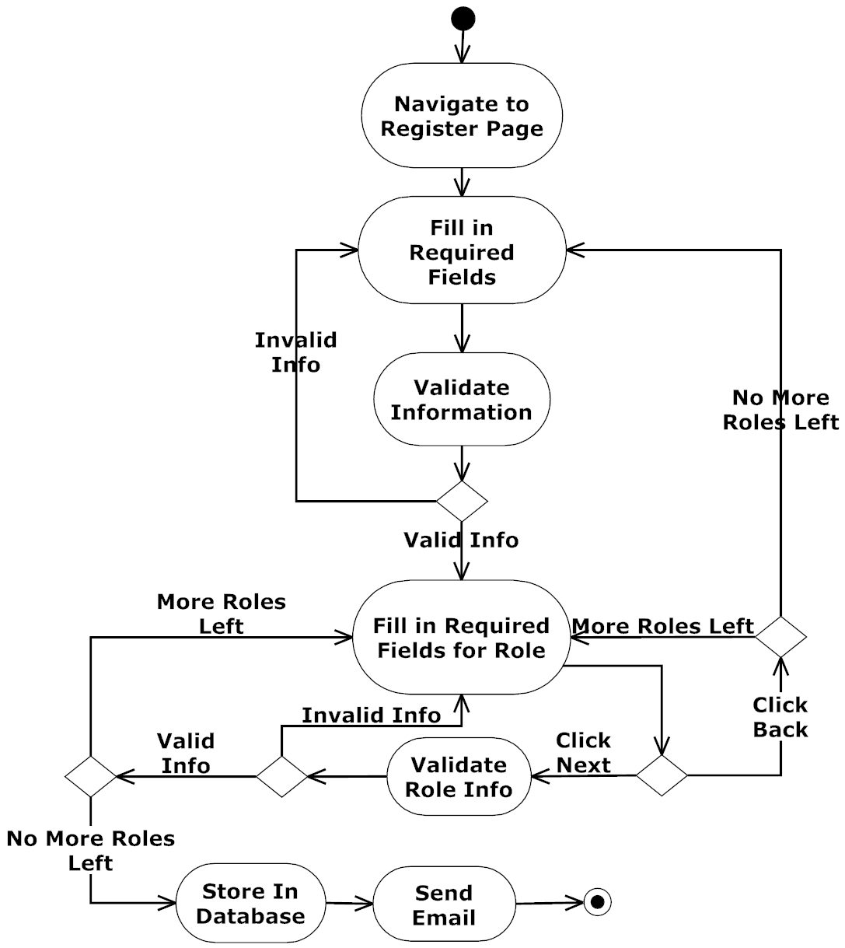
Register Activity Diagram
S.E.E. Solutions
25

Slide 26
Agenda
Data Flow Diagrams
Requirements Inventory
Data Dictionary
Testing
Development Environment
Prototype Screens
What’s Next
S.E.E. Solutions
26

Slide 27
Data Flow Diagrams
Illustrate the movement of data within CCRS
Show how CCRS:
Creates data
Moves data
Stores data
Transforms data
S.E.E. Solutions
27

Slide 28
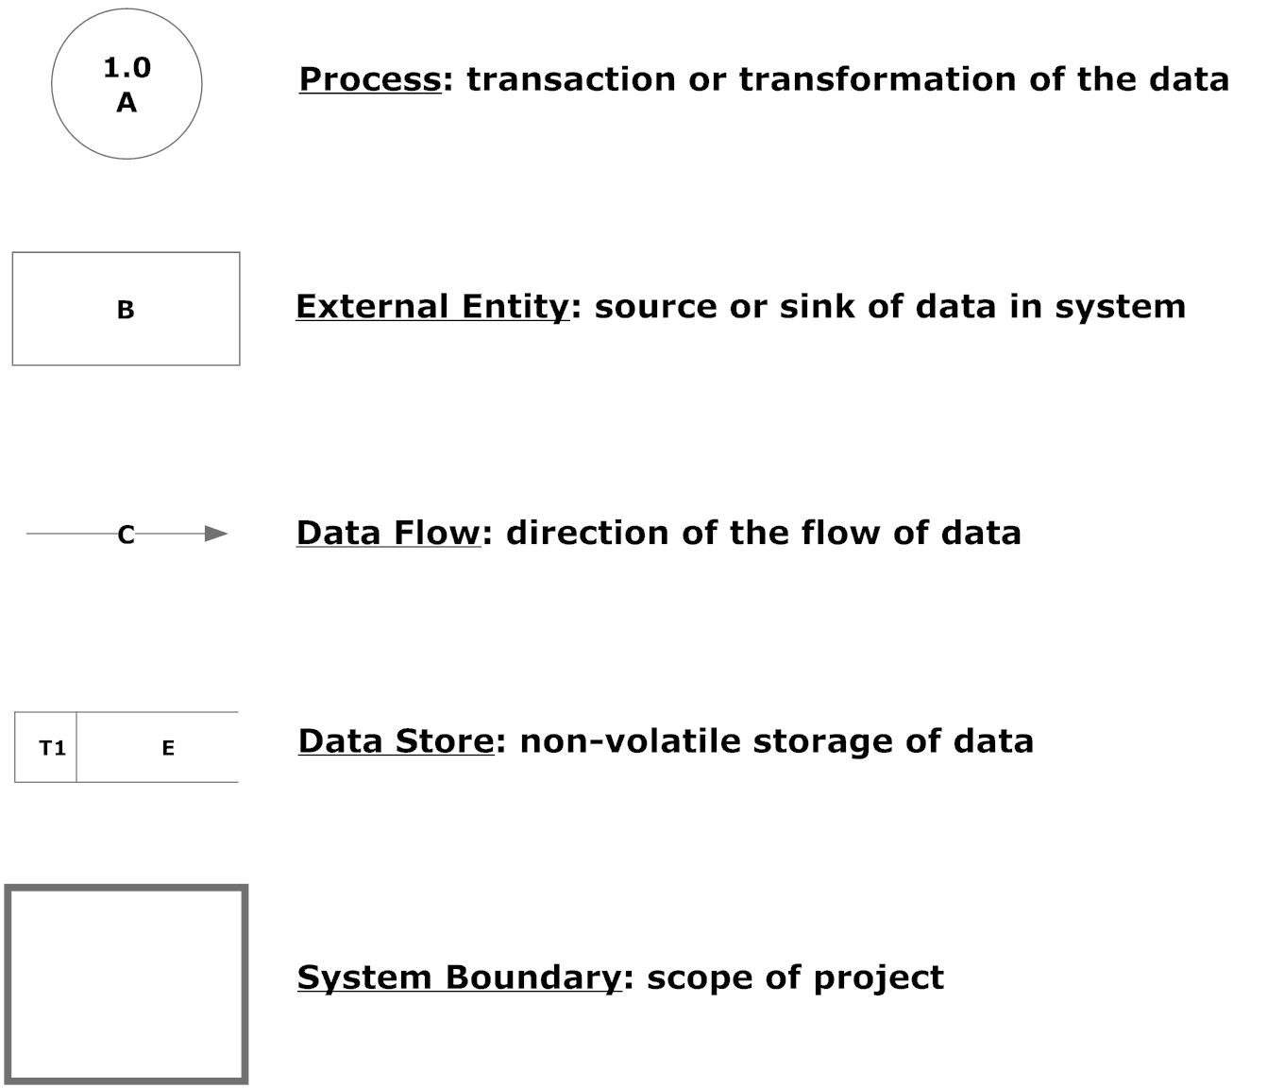
Data Flow Legend
S.E.E. Solutions
28

Slide 29
Context Diagram
S.E.E. Solutions
29

Slide 30
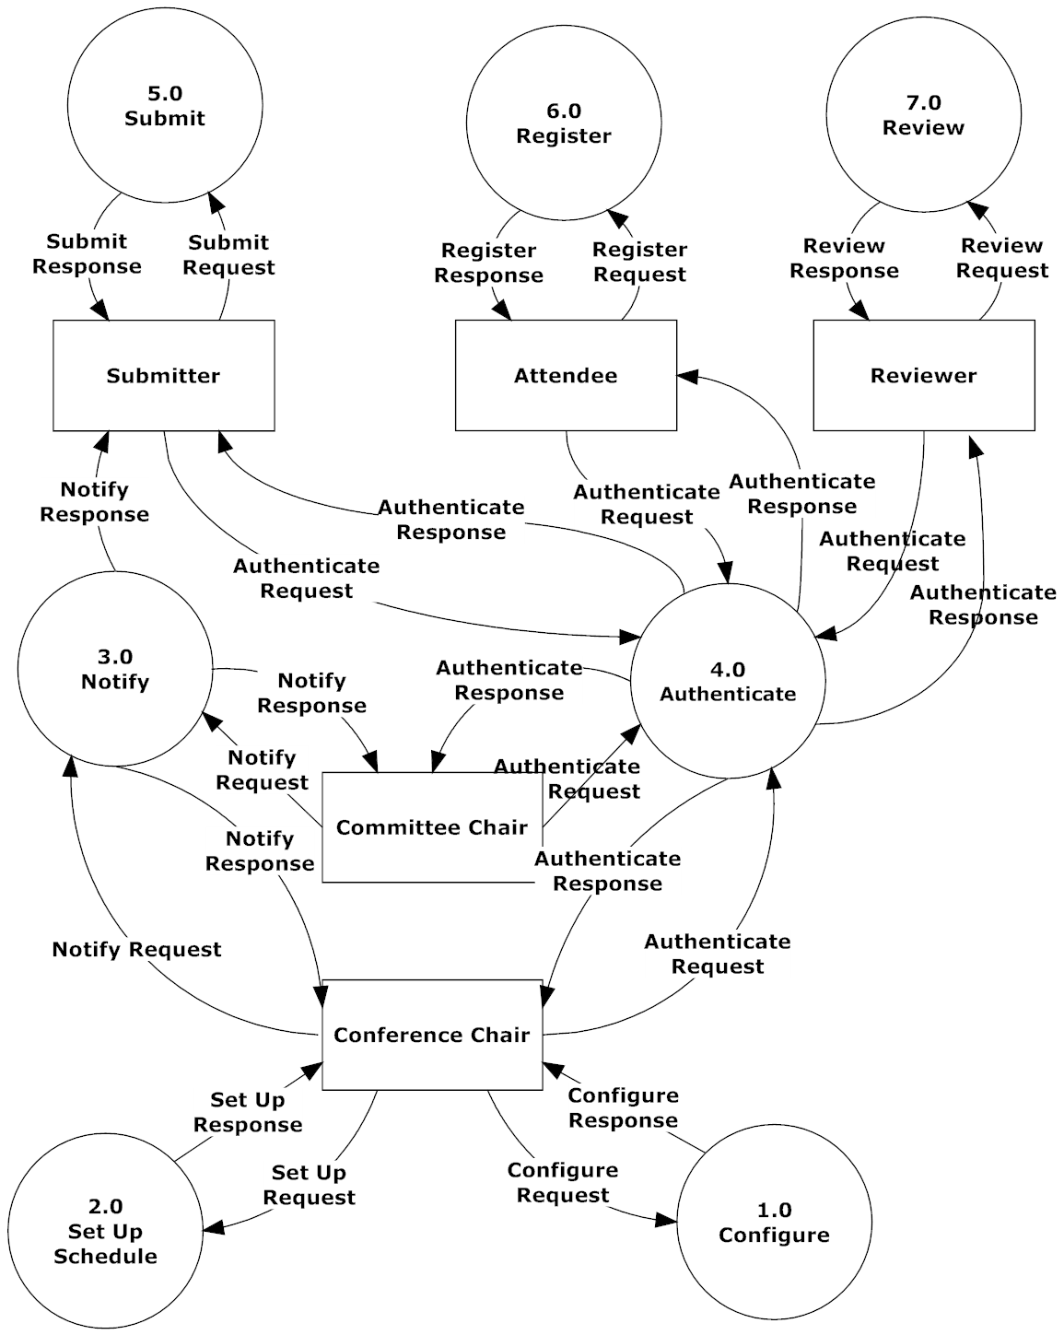
Level 0 Data Flow Diagram (DFD)
S.E.E. Solutions
30

Slide 31
Configure 1.0 Level 1 DFD
S.E.E. Solutions
31

Slide 32
Configure 1.1 Level 2 DFD
S.E.E. Solutions
32

Slide 33
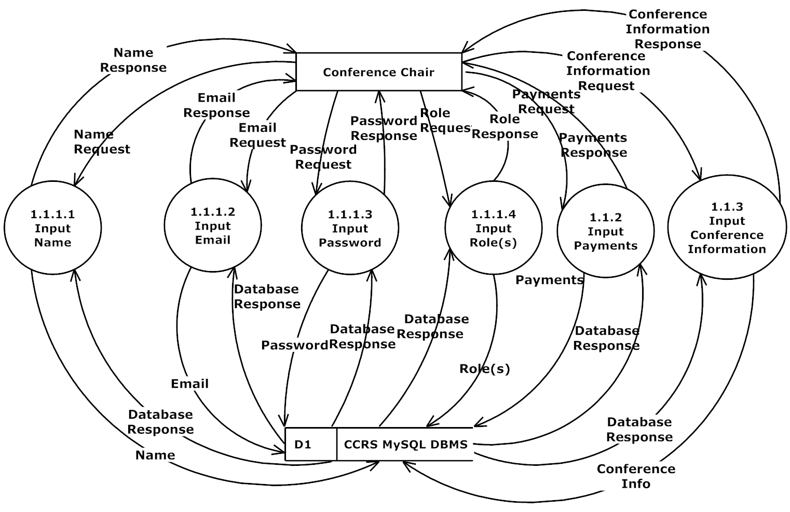
Configure Accounts 1.1.1 Level 3 DFD
S.E.E. Solutions
33

Slide 34
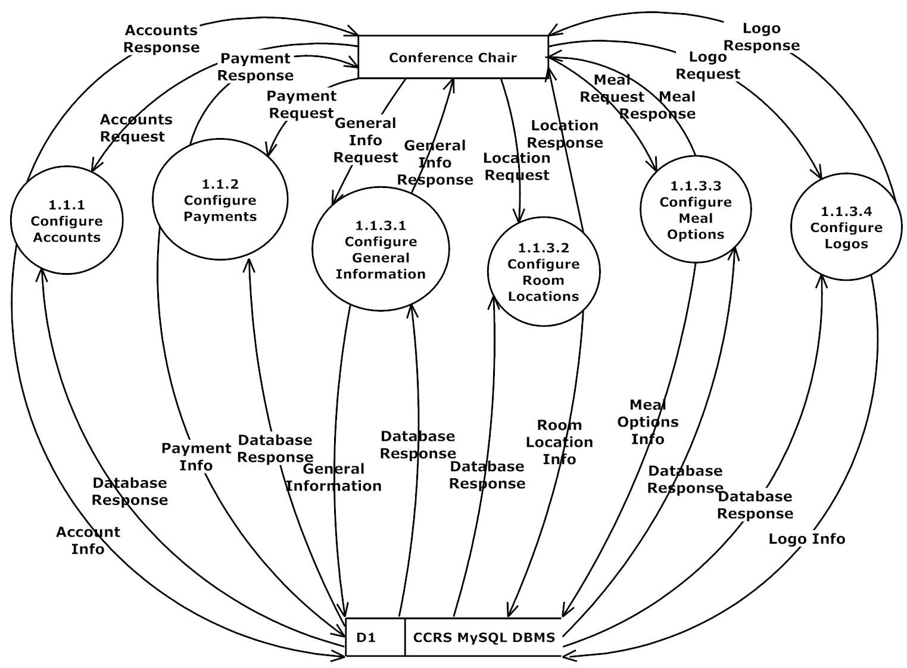
Configure Conference 1.1.3 Level 3 DFD
S.E.E. Solutions
34

Slide 35
Agenda
Requirements Inventory
Data Dictionary
Testing
Development Environment
Prototype Screens
What’s Next
S.E.E. Solutions
35

Slide 36
Requirements Inventory
Non-Functional Requirements
Not Easily Testable
Functional Requirements
Easily Testable
System Requirements
Specific to system rather than role
S.E.E. Solutions
36

Slide 37
Non-Functional Requirements
The system will be:
Easily maintained
Stable
User friendly
Run efficiently
S.E.E. Solutions
37

Slide 38
Conference Chair - Functional Requirements
Will be able to:
Configure user accounts
Configure payments for users
Configure and/or edit schedule
Configure meal options
Notify reviewer and vendor application status
S.E.E. Solutions
38

Slide 39
Attendee – Functional Requirements
Will be able to
Register for the conference
Personal information
Meal selection
Payment
S.E.E. Solutions
39

Slide 40
System Requirements
The system will be able to:
Automatically generate a schedule
Have drag and drop capabilities
Assign Reviewers to submissions
Change Submitter to Presenter when accepted
E-mail users when role accepted
S.E.E. Solutions
40

Slide 41
Agenda
Data Dictionary
Testing
Development Environment
Prototype Screens
What’s Next
S.E.E. Solutions
41

Slide 42
Data Dictionary
Repository of data within CCRS
Includes info about data
Format
Usage
Examples
S.E.E. Solutions
42

Slide 43
Example Data – Data Dictionary
Data Name | Applicable To | Data Type | Data Size | Description | Acceptable Input | Good Example of Input | Bad Example of Input
loginEmail | Authenticate | VARCHAR | Up to 254 chars | Username for Logging In | ASCII 32-126 | ac14tell@siena.edu | ac14tell.72.c
userPass | Authenticate | VARCHAR | 8-32 chars | Password for Logging In | ASCII 32-126 | P@$sw0rd | 3, abc, 123
S.E.E. Solutions
43

Slide 44
Agenda
Testing
Development Environment
Prototype Screens
What’s Next
S.E.E. Solutions
44

Slide 45
Testing
Will be tested on the four major browsers
Non-Functional Requirements
Functional Requirements
Broken down into modules
Each tested separately
Tested as a whole
Will be completed in Detailed Design
S.E.E. Solutions
45

Slide 46
Log In – Unit Test
 | Test Cases
Pass/Fail Status | Test Number |  | Description | Action to perform test (input) | Steps to be Executed | State Before Test | Expected result | Observed result | Comments | Tested By |  | Test Date
F | 1.001 |  | Null Username Field | Leave Username Field Blank | Fill out remainder of form and press submit | Empty Form | Message: "Please enter a username."
F | 1.002 |  | Null Password Field | Leave Password Field Blank | Fill out remainder of form and press submit | Empty Form | Message: "Please enter a password."
F | 1.003 |  | Incorrect Password for Given Username | Input an Invalid Username and Password Combination | Fill out remainder of form and press submit | Empty Form | Message: "Incorrect username or password."
F | 1.004 |  | Nonexisting Username | Input a Nonexisting Username | Fill out remainder of form and press submit | Empty Form | Message: "Incorrect username."
F | 1.005 |  | Correct Username and Password | Enter Valid Username and Password | Press Submit | Empty Form | No error message. Redirected to user homepage
F | = Unit Summary |  |  | 0% | passing | 0 | passed |  | Date of last test = |  |  | 1/0/00
 | 5 | tests |  |  |  | 5 | failed
S.E.E. Solutions
46

Slide 47
Agenda
Development Environment
Prototype Screens
What’s Next
S.E.E. Solutions
47

Slide 48
Development Environment
Using SEA4 and SEB4 in software lab
Netbeans
Using oraserv
Apache, version 2.2.9
PHP, version 5.2.6
MySQL, version 5.0.45
Languages
PHP, Twig, jQuery, HTML
S.E.E. Solutions
48

Slide 49
Agenda
Prototype Screens
What’s Next
S.E.E. Solutions
49

Slide 50
Prototypes
Provide a basic look for system
Show what users can see
Login Page
Registration Page
Submission Page
S.E.E. Solutions
50

Slide 51
Login Page Prototype
S.E.E. Solutions
51

Slide 52
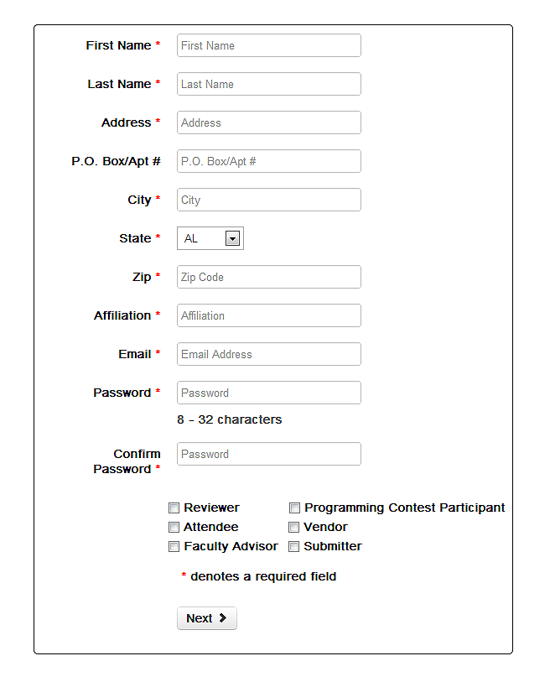
Registration Page Prototype
S.E.E. Solutions
52

Slide 53
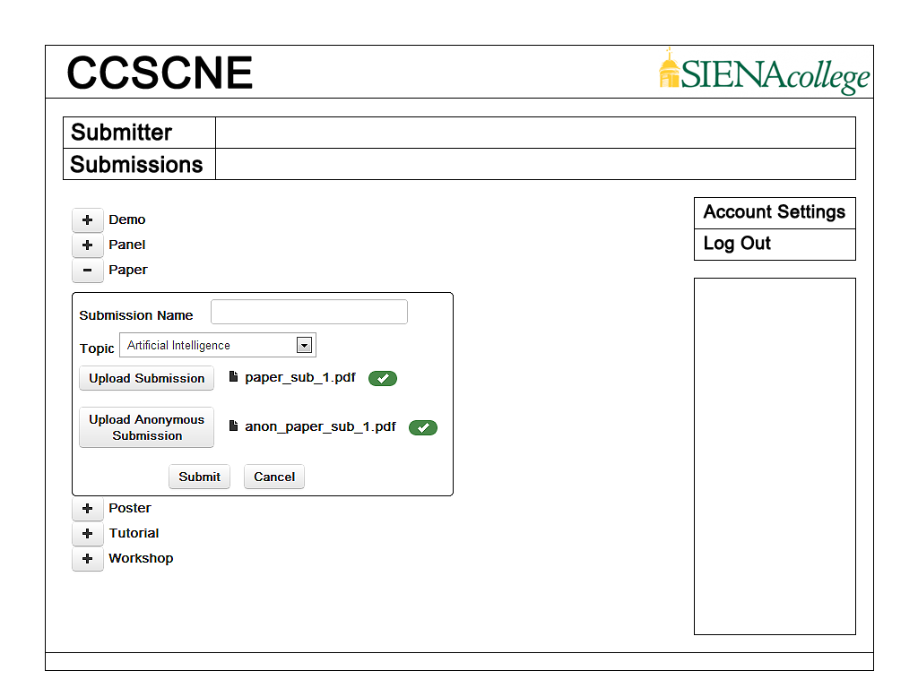
Submission Page Prototype
S.E.E. Solutions
53

Slide 54
Agenda
What’s Next
S.E.E. Solutions
54

Slide 55
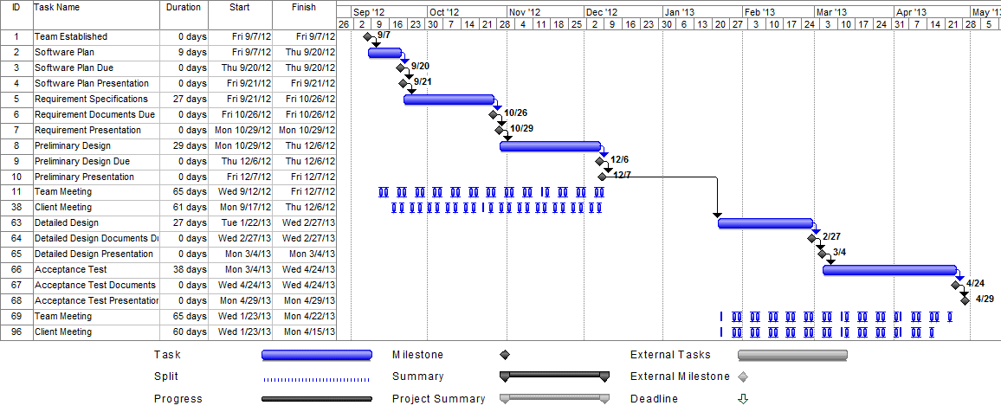
What’s Next
Detailed Design ……………… March 2013
Acceptance Test ………….. April 2013
S.E.E. Solutions
55

Slide 56
Questions?
S.E.E. Solutions
56

