Slide 1
Title
Software Linked Interactive Competitive Environment
Software Requirements Specification
November 2nd, 2011
1

Slide 2
Welcome
Our Client:
Dr. Darren Lim
Associate Professor
Siena College
2

Slide 3
Agenda
Introduction
Restatement of Problem
Project Progression
User Case Narratives
Use Case Diagram
Data Flow Diagrams
Requirements Inventory
Prototypes
Next Steps
3

Slide 4
Introduction
Our Team
Zachary Fitzsimmons
Team Leader
Michael Pepe
Lieutenant
Anthony Parente
Systems Administrator
Matthew Ferritto
Lead Webmaster
Renee Solheim
Document Analyst

Slide 5
Agenda
Introduction
Restatement of Problem
Project Progression
User Case Narratives and Use Case Diagram
Data Flow Diagrams
Requirements Inventory
Prototypes
Next Steps

Slide 6
Restatement of the Problem
Competitive Programming Contests
Problem submission/timing
Messaging between participants/judges
Scoreboard

Slide 7
Agenda
Introduction
Restatement of Problem
Project Progression
User Case Narratives
Use Case Diagram
Data Flow Diagrams
Requirements Inventory
Prototypes
Next Steps

Slide 8
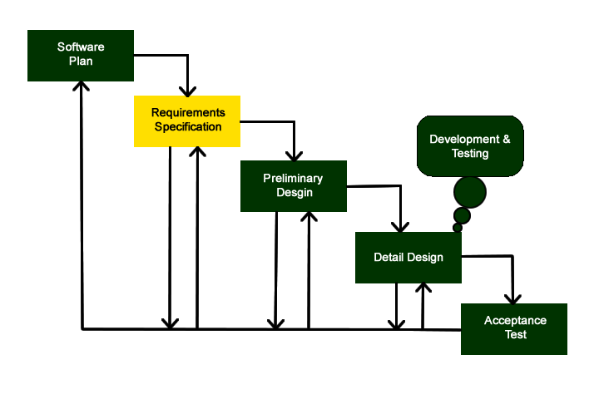
Project Progression

Slide 9
Agenda
Introduction
Restatement of Problem
Project Progression
User Case Narratives
Use Case Diagram
Data Flow Diagrams
Requirements Inventory
Prototypes
Next Steps

Slide 10
User Case Narratives
Describes what a user can do as a story
Provides a description of how each user interacts with the system

Slide 11
User Case Narratives
Participant User Case Narrative
Log In/Authenticate
Receive Username and Password
View the Contest Scoreboard While Active
Submit Problem Submission Sourcecode
Send Clarification-Requests to Judges
Receive Publically Broadcasted Messages

Slide 12
User Case Narratives
Team Advisor User Case Narrative
Log In/Authenticate
Receive Username and Password
View the Contest Scoreboard While Active
Receive Publically Broadcasted Messages

Slide 13
User Case Narratives
Team Advisor User Case Narrative
Log In/Authenticate
Receive Username and Password
View the Contest Scoreboard While Active
Receive Publically Broadcasted Messages

Slide 14
User Case Narratives
Judge User Case Narrative
Log In/Authenticate
Receive Username and Password
View the Contest Scoreboard At Any Point
Review Participant Problem Submissions
Answer Participant Clarification-Requests
Send and Receive Publically Broadcasted Messages

Slide 15
User Case Narratives
Scoreboard Judge
A Judge with Extra Permissions
Able to Update the Contest Scoreboard
Receive Data From Judges Concerning Participant Problem Submissions

Slide 16
User Case Narratives
Administrator User Case Narrative
Log In/Authenticate
Receive Username and Password
Send Publically Broadcasted Messages
Able to Complete the Initial Contest Set-Up
Create All Other User Accounts
Grant One Judge User, Scoreboard Judge Permissions
Upload Contest Problem Input/Output
Set Contest Start and Stop Times
Choose Allowed Programming Languages
Set the Times the contest Scoreboard is Active

Slide 17
Agenda
Introduction
Restatement of Problem
Project Progression
User Case Narratives
Use Case Diagram
Data Flow Diagrams
Requirements Inventory
Prototypes
Next Steps

Slide 18
Use Case Diagrams
UML (Unified Modeling Language ) Use Case Diagrams present a graphical overview of the functionality for a system. It uses ‘Actors’ (human and non-human) to represent the users, and their goals, represented by ‘Uses’, as well as any dependencies or inheritance between them, represented by specific lines or arrows. The diagram shows what system functions are the performed by each actor

Slide 19
Use Case Diagram: Legend
System Boundary:
Where the users, human and non-human, located on the outside of the boundary, interact with the uses, located on the inside of the boundary, within the system
Uses:
The Activities that interact with the actors outside of the system

Slide 20
Left Actor:
Human users which interact with the uses within the system
Right Actor:
Non-Human users which interact with the uses within the system
Includes Arrow:
Specific items that are included within the connected
Inherits Arrow:
Shows subuses of the given uses or actors which are not necessarily accessed when the parent is accessed

Slide 21
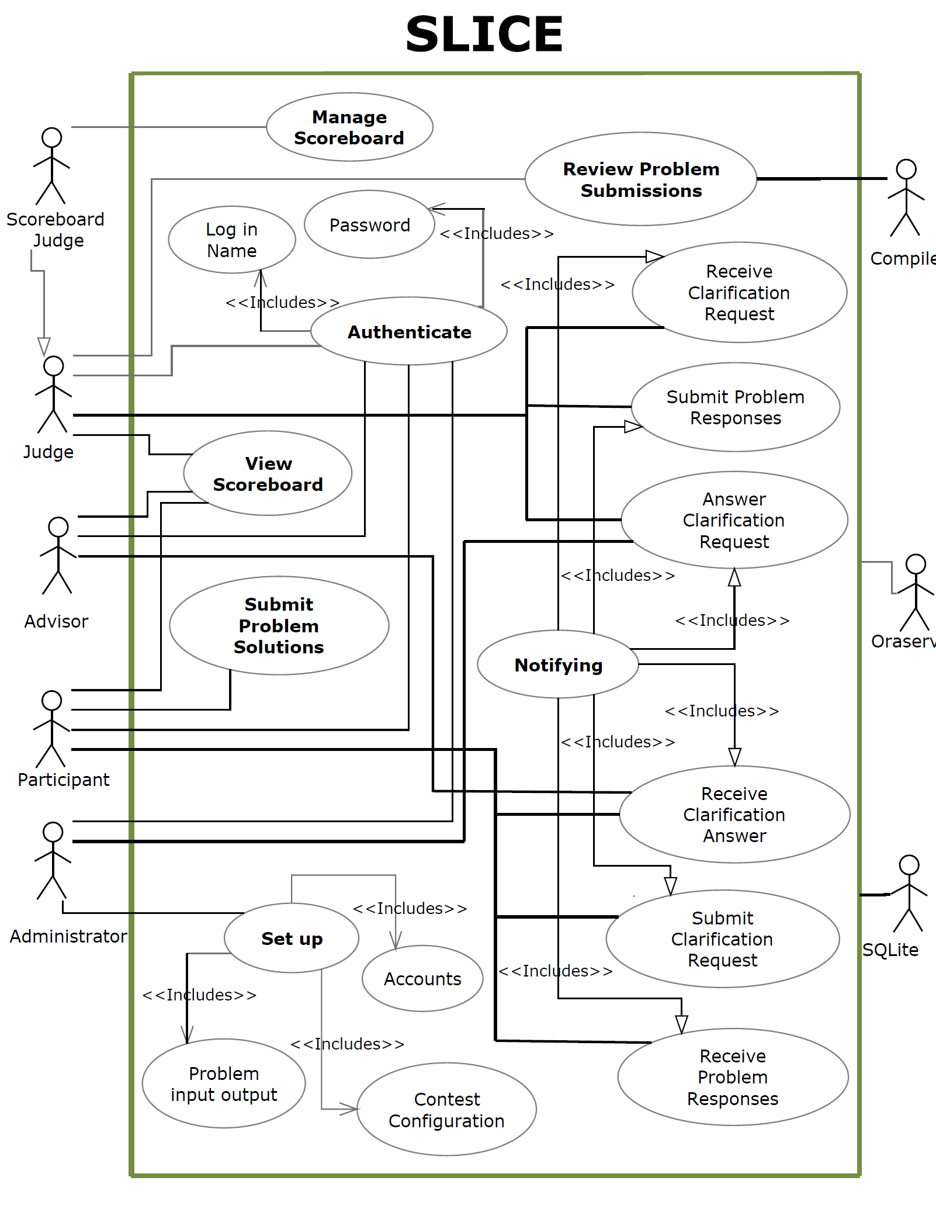

Slide 22
Agenda
Introduction
Restatement of Problem
Project Progression
User Case Narratives
Use Case Diagram
Data Flow Diagrams
Requirements Inventory
Prototypes
Next Steps

Slide 23
Data Flow Diagrams
Data Flow Diagram show how data flows and is transformed in SLICE

Slide 24
Data Flow: Legend
Process
Data Flow
Data Store
Entity

Slide 25
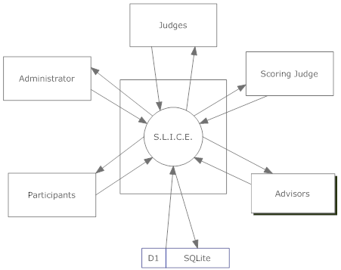
Context Diagram

Slide 26
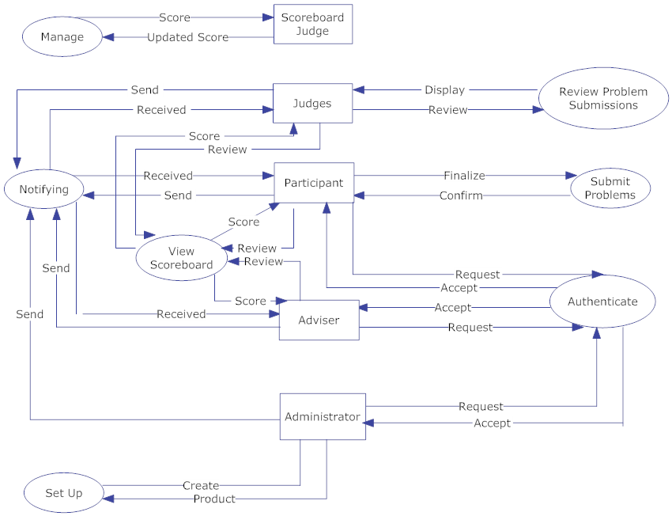
Level 0

Slide 27
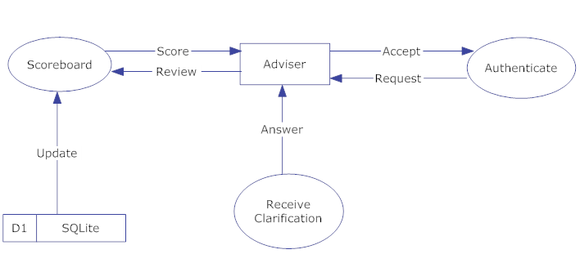
Level 1

Slide 28
Agenda
Introduction
Restatement of Problem
Project Progression
User Case Narratives
Use Case Diagram
Data Flow Diagrams
Requirements Inventory
Prototypes
Next Steps

Slide 29
Requirements Inventory
Functional Requirements – Participant User
Logs onto and off of SLICE
Views contest scoreboard
Submits problem submission sourcecode
Participates in messaging capabilities with judges
Receives publically broadcasted messages

Slide 30
Requirements Inventory
Functional Requirements – Team Advisor User
Logs onto SLICE
Views contest scoreboard
Receives publically broadcasted messages

Slide 31
Requirements Inventory
Functional Requirements – Judge User
Logs onto and off of SLICE
Views contest scoreboard
Reviews Participant problem submissions
Participates in messaging capabilities with Participants
Sends publically broadcasted messages

Slide 32
Requirements Inventory
Functional Requirements – Scoreboard Judge
Judge user with extra permissions
Receives correct problem submissions
Updates contest scoreboard

Slide 33
Requirements Inventory
Functional Requirements – Administrative User
Log onto and off of SLICE
Participate in messaging capabilities with users
Complete initial contest set-up

Slide 34
Requirements Inventory
Non-Functional Requirements
The system will be easily maintained
The system will be stable
The system will be viewable on multiple browsers
The system will run efficiently
The system will be user friendly

Slide 35
Agenda
Introduction
Restatement of Problem
Project Progression
User Case Narratives
Use Case Diagram
Data Flow Diagrams
Requirements Inventory
Prototypes
Next Steps

Slide 36
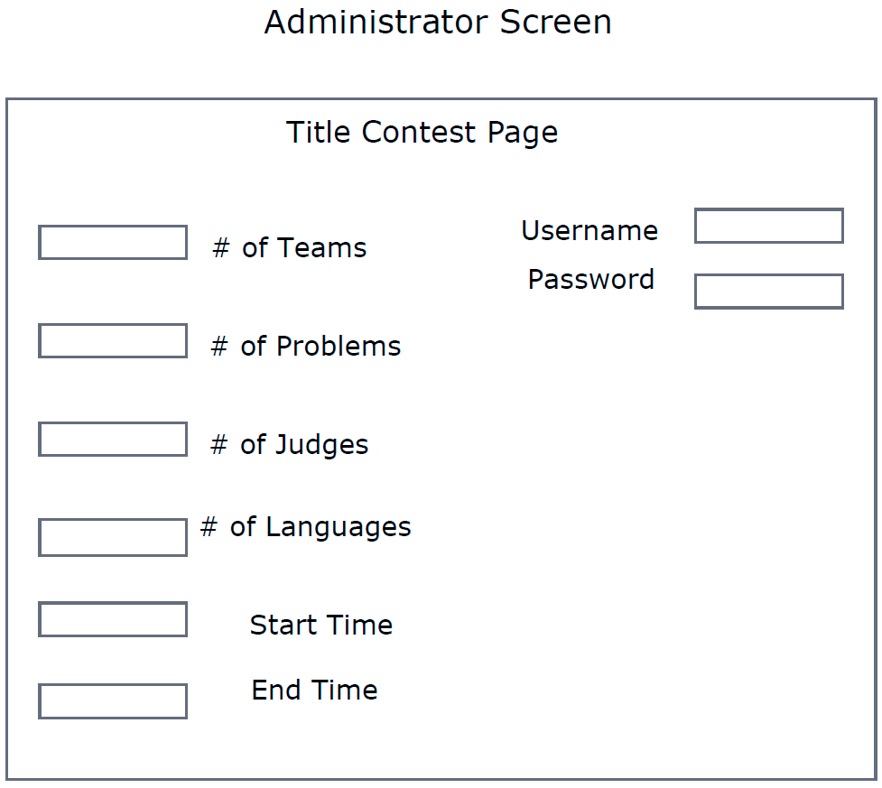
Prototypes

Slide 37
Agenda
Introduction
Restatement of Problem
Project Progression
User Case Narratives
Use Case Diagram
Data Flow Diagrams
Requirements Inventory
Prototypes
Next Steps

Slide 38
Next Steps
Preliminary Design – December 2010
Detailed Design – Spring 2011
Acceptance Test – Spring 2011

Slide 39
Thank You
Any Questions??

