Slide 1
Title
Software Linked Interactive Competitive Environment
Preliminary Design
November 7th, 2011
1

Slide 2
Welcome
Our Client:
Dr. Darren Lim
Associate Professor
Siena College
2

Slide 3
Introduction
Our Team
Zachary Fitzsimmons
Team Leader
Michael Pepe
Lieutenant
Anthony Parente
Systems Administrator
Matthew Ferritto
Lead Webmaster
Renee Solheim
Document Analyst

Slide 4
Agenda
Introduction
Restatement of Problem
Project Progression
User Case Narratives
Use Case Diagram
Deployment Diagram
Website Map
Activity Diagram
Data Flow Diagrams
Requirements Inventory
Data Dictionary
Testing Plan
Development and Production Environments
Prototype Screens
Project Timeline
4

Slide 5
Restatement of the Problem
Competitive Programming Contests
Problem submission and compilation
Messaging between participants/judges
Scoreboard

Slide 6
Agenda
Introduction
Restatement of Problem
Project Progression
User Case Narratives
Use Case Diagram
Deployment Diagram
Website Map
Activity Diagram
Data Flow Diagrams
Requirements Inventory
Data Dictionary
Testing Plan
Development and Production Environments
Prototype Screens
Project Timeline
6

Slide 7
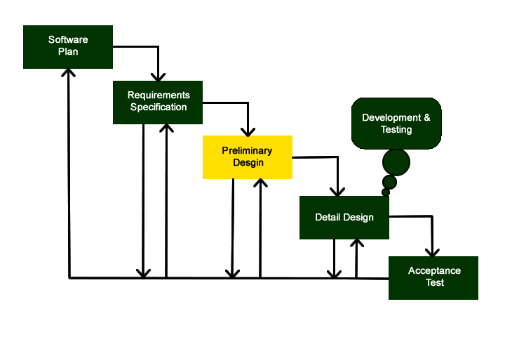
Project Progression

Slide 8
Agenda
Introduction
Restatement of Problem
Project Progression
User Case Narratives
Use Case Diagram
Deployment Diagram
Website Map
Activity Diagram
Data Flow Diagrams
Requirements Inventory
Data Dictionary
Testing Plan
Development and Production Environments
Prototype Screens
Project Timeline
8

Slide 9
User Case Narratives
Describes what a user can do as a story
Provides a description of how each user interacts with the system

Slide 10
User Case Narratives
Administrator User Case Narrative Changes
View Scoreboard
Set the Times the contest Scoreboard is Active
Although only the Scoreboard Judge can edit it

Slide 11
Agenda
Introduction
Restatement of Problem
Project Progression
User Case Narratives
Use Case Diagram
Deployment Diagram
Website Map
Activity Diagram
Data Flow Diagrams
Requirements Inventory
Data Dictionary
Testing Plan
Development and Production Environments
Prototype Screens
Project Timeline
11

Slide 12
Use Case Diagram: Legend
System Boundary:
Where the users, human and non-human, located on the outside of the boundary, interact with the uses, located on the inside of the boundary, within the system
Uses:
The Activities that interact with the actors outside of the system

Slide 13
Legend Cont.
Left Actor:
Human users which interact with the uses within the system
Right Actor:
Non-Human users which interact with the uses within the system
Includes Arrow:
Specific items that are included within the connected
Inherits Arrow:
Shows subuses of the given uses or actors which are not necessarily accessed when the parent is accessed

Slide 14
Use Case Diagram

Slide 15
Agenda
Introduction
Restatement of Problem
Project Progression
User Case Narratives
Use Case Diagram
Deployment Diagram
Website Map
Activity Diagram
Data Flow Diagrams
Requirements Inventory
Data Dictionary
Testing Plan
Development and Production Environments
Prototype Screens
Project Timeline
15

Slide 16
Deployment Diagram

Slide 17
Agenda
Introduction
Restatement of Problem
Project Progression
User Case Narratives
Use Case Diagram
Deployment Diagram
Website Map
Activity Diagram
Data Flow Diagrams
Requirements Inventory
Data Dictionary
Testing Plan
Development and Production Environments
Prototype Screens
Project Timeline
17

Slide 18
Website Map Legend

Slide 19
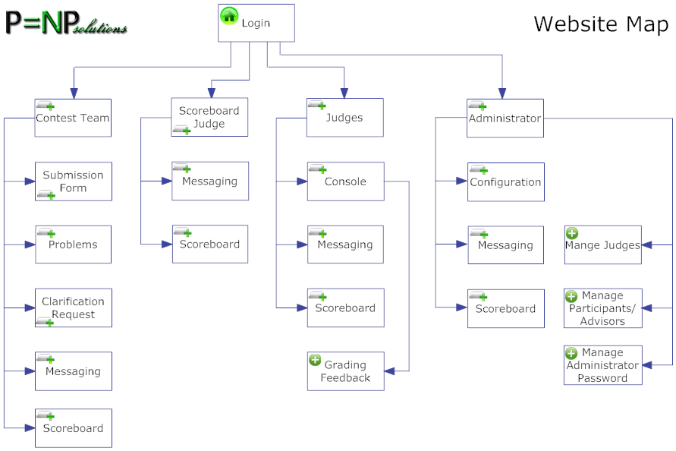
Website Map

Slide 20
Agenda
Introduction
Restatement of Problem
Project Progression
User Case Narratives
Use Case Diagram
Deployment Diagram
Website Map
Activity Diagram
Data Flow Diagrams
Requirements Inventory
Data Dictionary
Testing Plan
Development and Production Environments
Prototype Screens
Project Timeline
20

Slide 21
Activity Diagram – Solution Submission

Slide 22
Agenda
Introduction
Restatement of Problem
Project Progression
User Case Narratives
Use Case Diagram
Deployment Diagram
Website Map
Activity Diagram
Data Flow Diagrams
Requirements Inventory
Data Dictionary
Testing Plan
Development and Production Environments
Prototype Screens
Project Timeline
22

Slide 23
Data Flow: Legend
Process: transforms or manipulates data
Data Flow: represents the movement of data
Data Store: represents some location where data is temporarily held
Entity :External entities are sources/sinks which contribute data or information to the system or which receive information from it

Slide 24
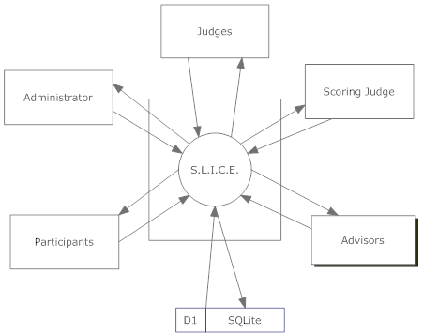
Context Diagram

Slide 25
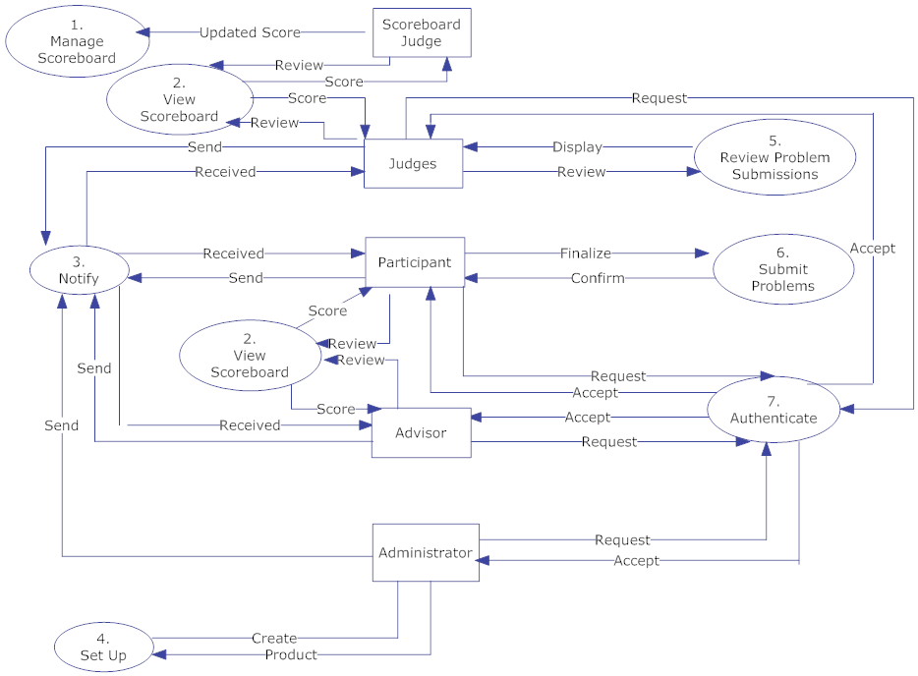
Level 0

Slide 26
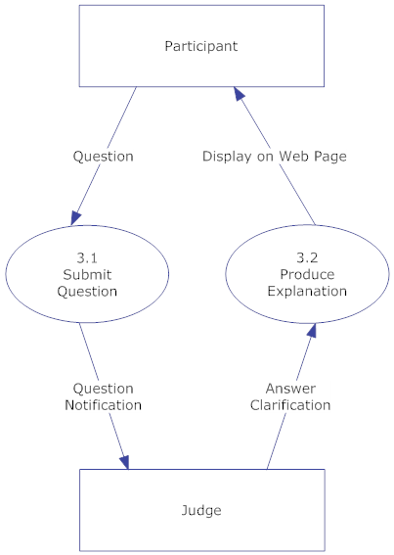
Level 1

Slide 27
Level 2

Slide 28
Level 3

Slide 29
Agenda
Introduction
Restatement of Problem
Project Progression
User Case Narratives
Use Case Diagram
Deployment Diagram
Website Map
Activity Diagram
Data Flow Diagrams
Requirements Inventory
Data Dictionary
Testing Plan
Development and Production Environments
Prototype Screens
Project Timeline
29

Slide 30
Requirements Inventory
Team Advisor User
Now multiple accounts, not necessarily linked to a Participant User
Scoreboard Judge
Judge user with extra permissions
Edits contest scoreboard

Slide 31
Requirements Inventory
Non-Functional Requirements
The system will be easily maintained
The system will be stable
The system will be viewable on multiple browsers
The system will run efficiently
The system will be user friendly

Slide 32
Agenda
Introduction
Restatement of Problem
Project Progression
User Case Narratives
Use Case Diagram
Deployment Diagram
Website Map
Activity Diagram
Data Flow Diagrams
Requirements Inventory
Data Dictionary
Testing Plan
Development and Production Environments
Prototype Screens
Project Timeline
32

Slide 33
Data Dictionary
Table Columns:
Data Name - The name of the data entity
Applicable to - The views that the data is used or displayed in
Data Type - How the data entity will be stored
Data Size - How large that data entity can be
Description - What the data entity is used for
Acceptable Input - A descriptor of allowed input
Good Example of Input - An acceptable example input
Notes - Additional comments on an entity

Slide 34
Data Dictionary
Types of Data:
String
List of Strings
2D array of Strings
Boolean
Enum
(String, String) Tuple

Slide 35
Agenda
Introduction
Restatement of Problem
Project Progression
User Case Narratives
Use Case Diagram
Deployment Diagram
Website Map
Activity Diagram
Data Flow Diagrams
Requirements Inventory
Data Dictionary
Testing Plan
Development and Production Environments
Prototype Screens
Project Timeline
35

Slide 36
Testing Plan
Unit Tests:
User Login
Problem Submission
Judging

Slide 37
Agenda
Introduction
Restatement of Problem
Project Progression
User Case Narratives
Use Case Diagram
Deployment Diagram
Website Map
Activity Diagram
Data Flow Diagrams
Requirements Inventory
Data Dictionary
Testing Plan
Development and Production Environments
Prototype Screens
Project Timeline
37

Slide 38
Development and Production Environments
Upgrade Python 2.4.3 -> Python 2.7.1
Install mod_wsgi Apache Module
Install setuptools 0.6 for Python package management
Install Django 1.3.1 Web Framework

Slide 39
Agenda
Introduction
Restatement of Problem
Project Progression
User Case Narratives
Use Case Diagram
Deployment Diagram
Website Map
Activity Diagram
Data Flow Diagrams
Requirements Inventory
Data Dictionary
Testing Plan
Development and Production Environments
Prototype Screens
Project Timeline
39

Slide 40
Prototypes
Login Screen for SLICE

Slide 41
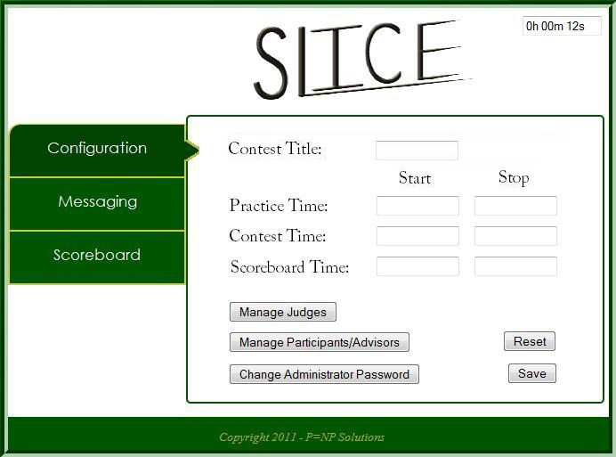
Prototypes
Contest Configuration Page

Slide 42
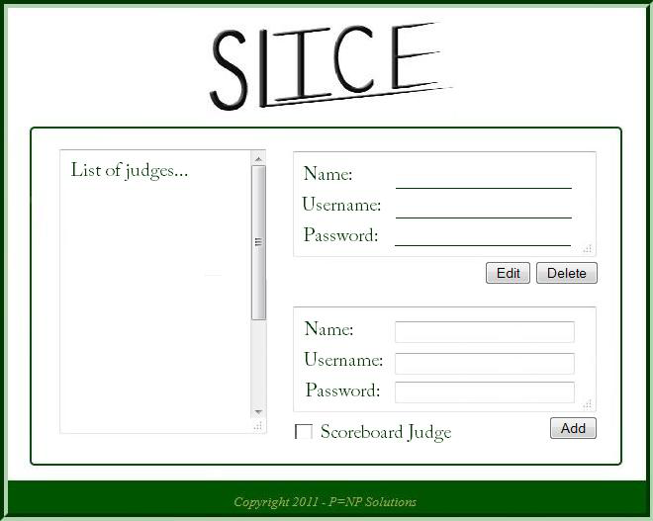
Prototypes
Pop-Up for the Manage Participants/Advisors Button

Slide 43
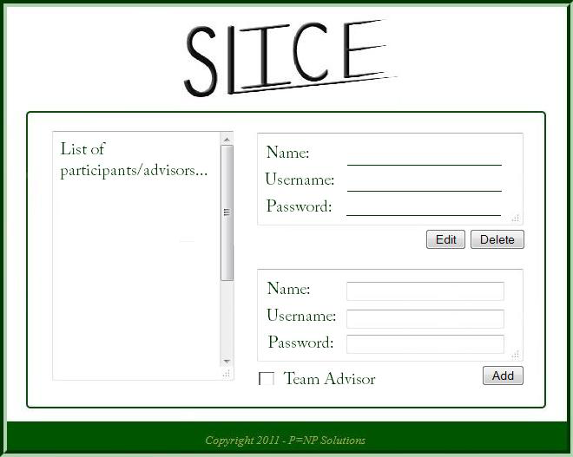
Prototypes
Pop-Up for the Manage Participants/Advisors Button

Slide 44
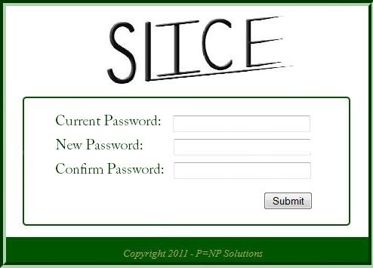
Prototypes
Pop-Up for the Change Password Button

Slide 45
Prototypes
Administrative Messaging View

Slide 46
Prototypes
Administrative Scoreboard View

Slide 47
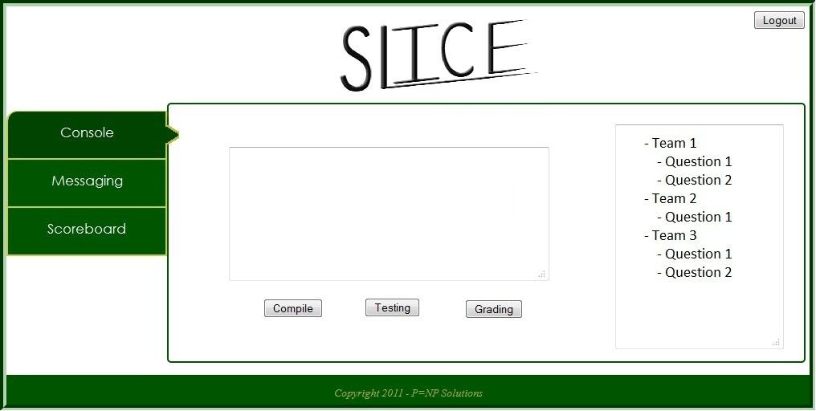
Prototypes
Judge Console View

Slide 48
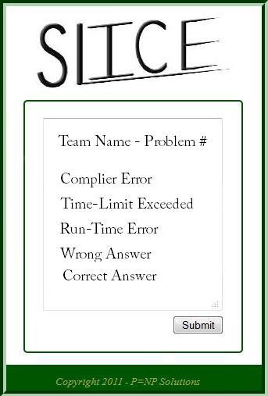
Prototypes
Pop-Up for Problem Grading

Slide 49
Prototypes
Judge Messaging View

Slide 50
Prototypes
Scoreboard Judge Scoreboard View

Slide 51
Prototypes
Participant Submission View

Slide 52
Prototypes
Participant Problem View

Slide 53
Prototypes
Participant Clarication Request View

Slide 54
Prototypes
Participant Messaging View

Slide 55
Prototypes
Participant Scoreboard View

Slide 56
Agenda
Introduction
Restatement of Problem
Project Progression
User Case Narratives
Use Case Diagram
Deployment Diagram
Website Map
Activity Diagram
Data Flow Diagrams
Requirements Inventory
Data Dictionary
Testing Plan
Development and Production Environments
Prototype Screens
Project Timeline
56

Slide 57
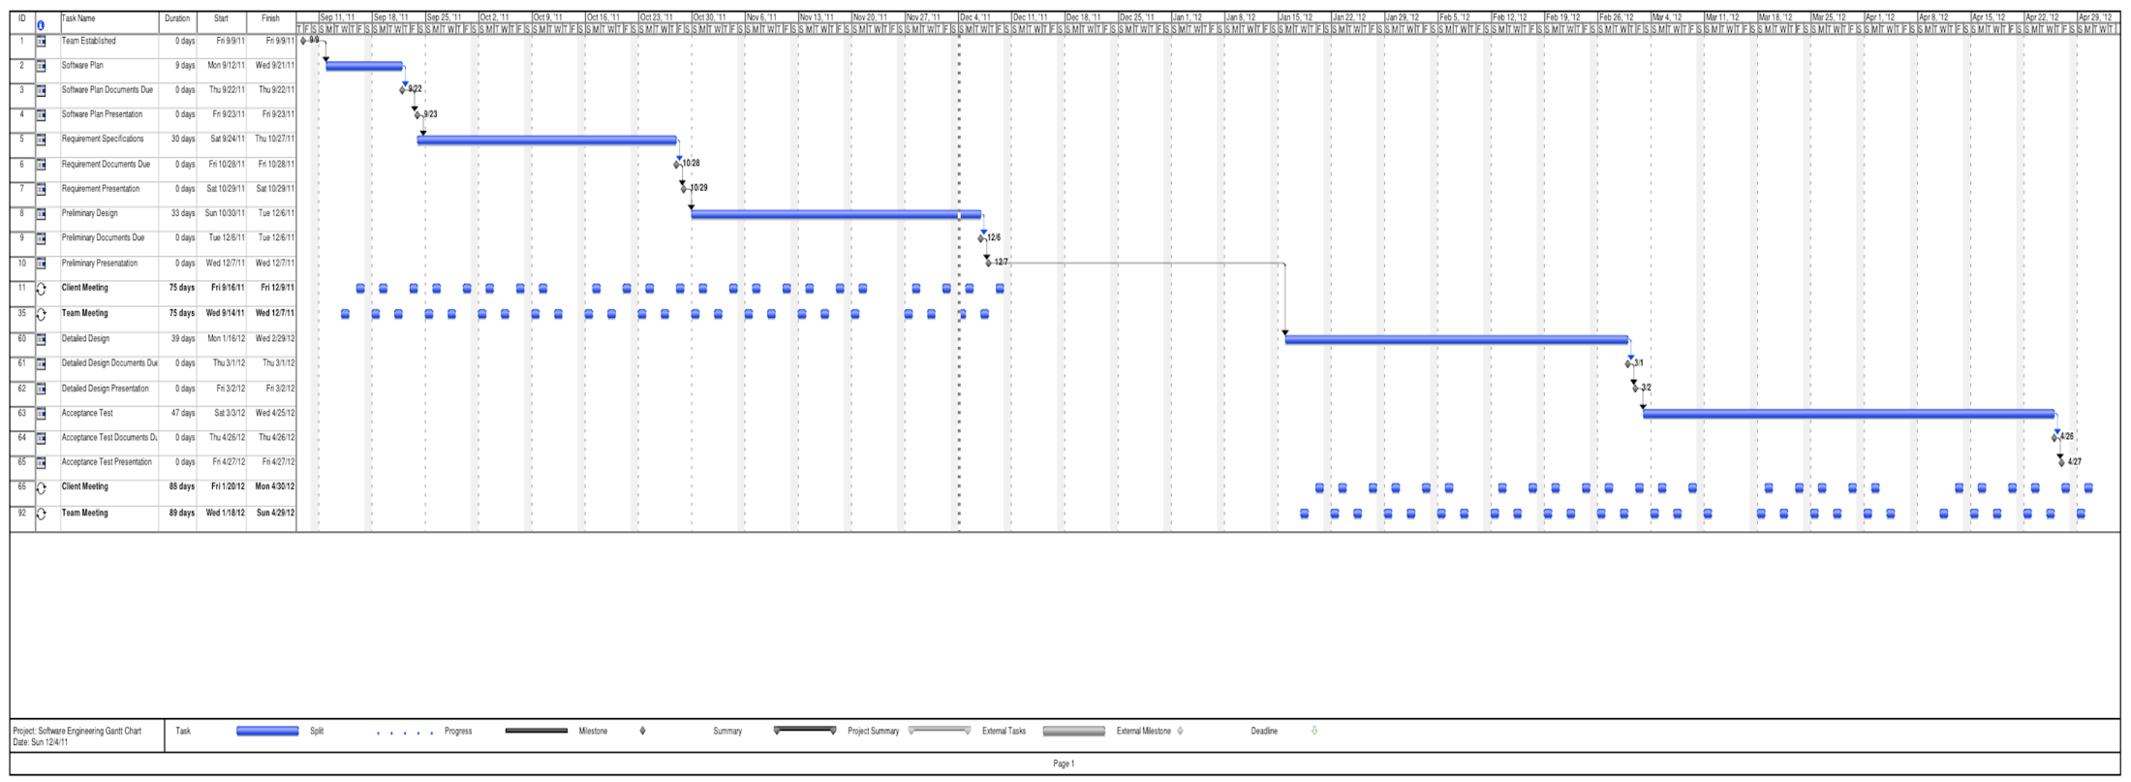
Project Timeline
Detailed Design: March 2nd
Acceptance Test: April 27th

Slide 58
Thank You
Any Questions??

