Slide 1

NOVA Tech
Preliminary Design: Iteration 1

Slide 2
Welcome
Client: Dr. Erik Eddy
  CEO of TEAMS 101
Guest: Dr. Meg Fryling
Guest: Dr. Darren Lim

Slide 3
Agenda
Introduction
Development and Production Environment
Data Flow Diagrams
Test Plans
Website Map
UML Activity Diagrams
UML Deployment Diagrams
Team Website
Prototype
What’s Next

Slide 4
Introduction
Emma Bostian – Team Lead
Kevin Conner – Web Master
Dave Hall – Database Administrator
Sara Pinti – System Administrator
Justin Rose – Software Engineer

Slide 5
Problem Overview
Client: Dr. Erik Eddy
Team Evaluation: Application on the TEAMS 101 Portal
  Currently no website for teammates to provide group evaluations
  Groups only provide feedback after project has terminated

Slide 6
Agenda
Introduction
Development and Production Environment
Data Flow Diagrams
Test Plans
Website Map
UML Activity Diagrams
UML Deployment Diagrams
Team Website
Prototype
Timeline

Slide 7
Development Environment

Slide 8
Production Environment

Slide 9
Agenda
Introduction
Development and Production Environment
Data Flow Diagrams
Test Plans
Website Map
UML Activity Diagrams
UML Deployment Diagrams
Team Website
Prototype
Timeline

Slide 10
Data Flow Diagrams
Data Flow Diagram Legend
Context Diagram
Level 0 - Student/Faculty/System Administrator
Level 0 - Faculty Member/System Administrator
Level 1 - Create Account
Level 1 - Login
Level 1 - Evaluate Teammate
Level 1 - View Individual Report
Level 1 - View Team Report
Level 1 - Establish Class Roster/Team Profile
Level 1 - Manage Team Evaluations
Level 1 - Manage User Permissions

Slide 11
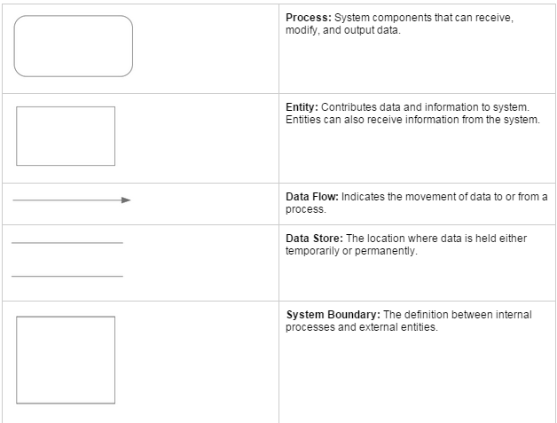
Data Flow Diagrams
Data Flow Diagram Legend

Slide 12
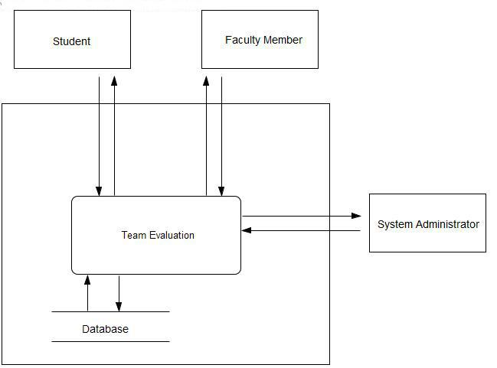
Data Flow Diagrams
Context Diagram

Slide 13
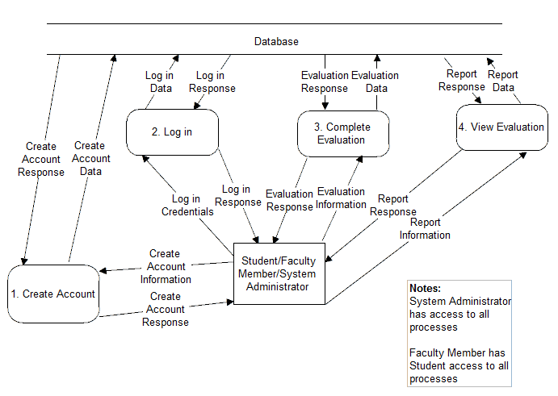
Data Flow Diagrams
Level 0 - Student/Faculty Member/System Administrator

Slide 14
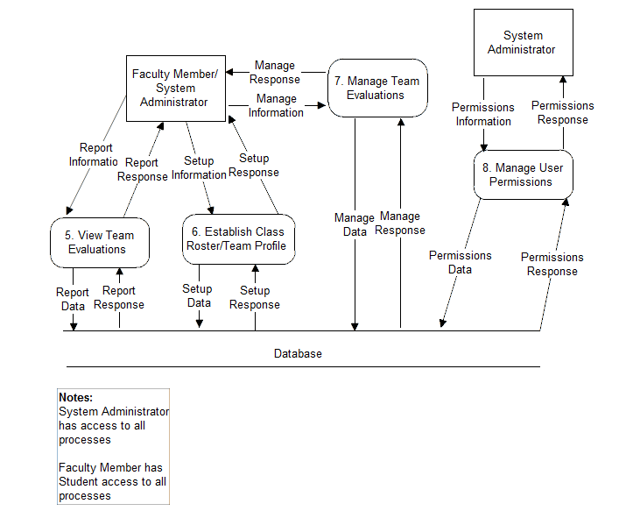
Data Flow Diagrams
Level 0 - Faculty Member/System Administrator

Slide 15
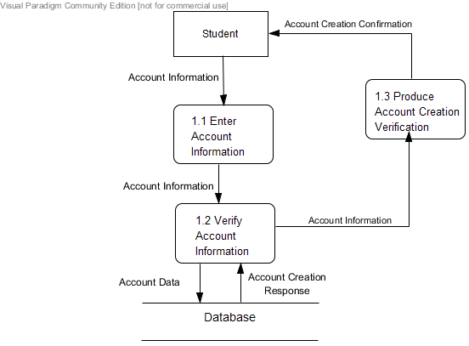
Data Flow Diagrams
Level 1 - Create Account

Slide 16
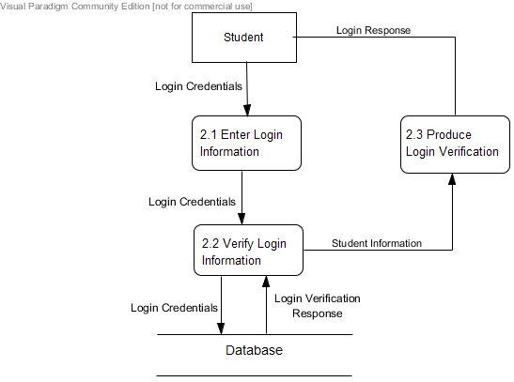
Data Flow Diagrams
Level 1 - Login

Slide 17
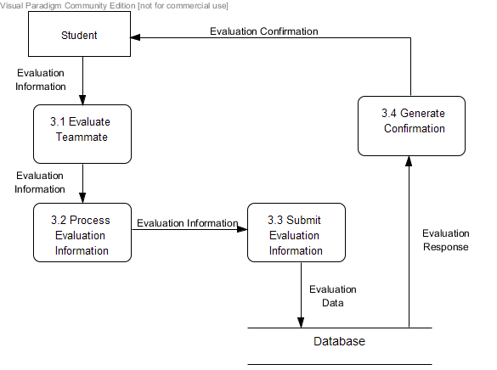
Data Flow Diagrams
Level 1 - Evaluate Teammate

Slide 18
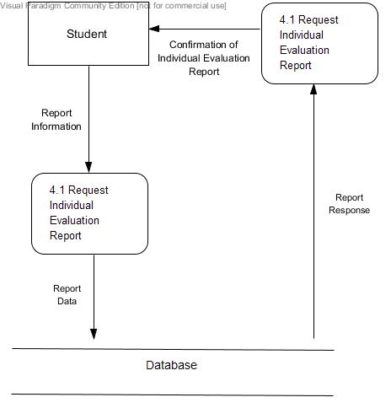
Data Flow Diagrams
Level 1 - View Individual Report

Slide 19
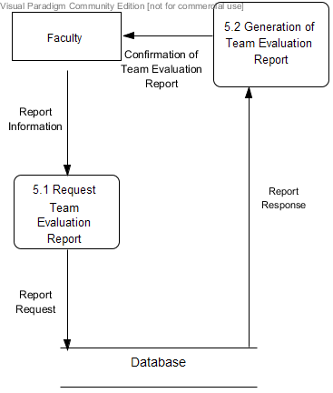
Data Flow Diagrams
Level 1 - View Team Report

Slide 20
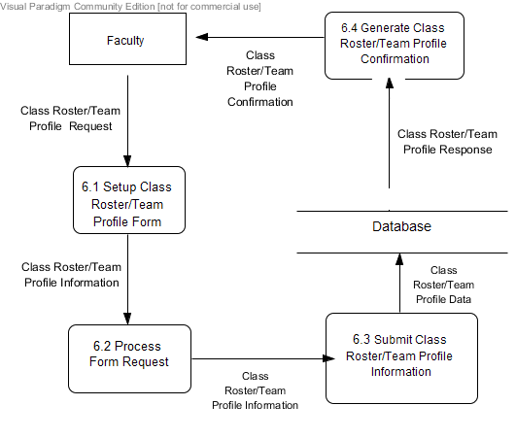
Data Flow Diagrams
Level 1 - Establish Class Roster/Team Profile

Slide 21
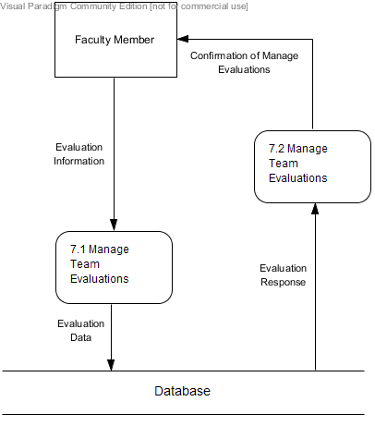
Data Flow Diagrams
Level 1 - Manage Team Evaluations

Slide 22
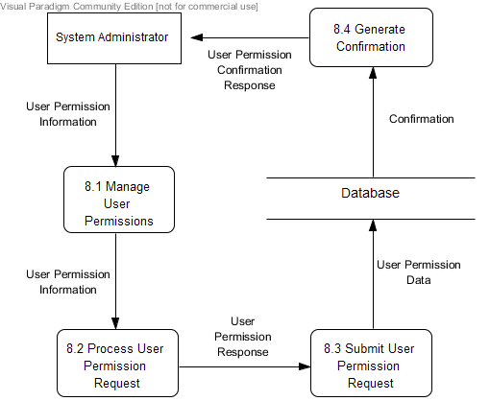
Data Flow Diagrams
Level 1 - Manage User Permissions

Slide 23
Agenda
Introduction
Development and Production Environment
Data Flow Diagrams
Test Plans
Website Map
UML Activity Diagrams
UML Deployment Diagrams
Team Website
Prototype
Timeline

Slide 24
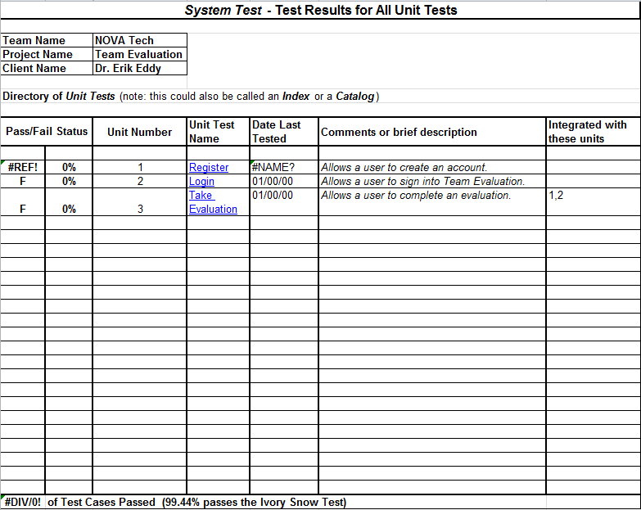
Test Directory

Slide 25
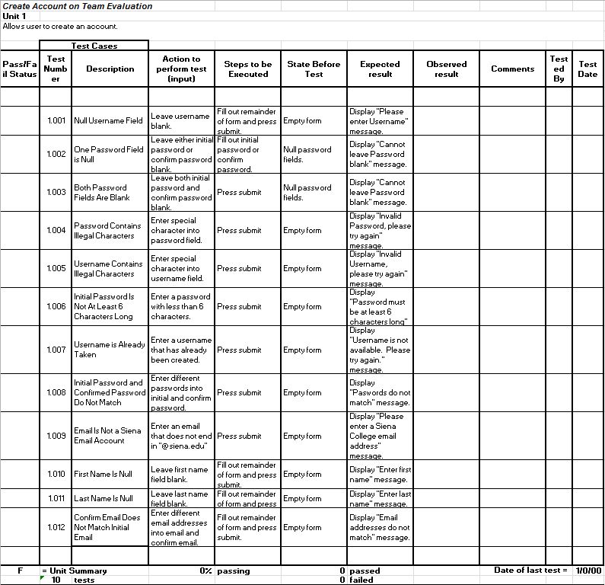
Unit Test 1

Slide 26
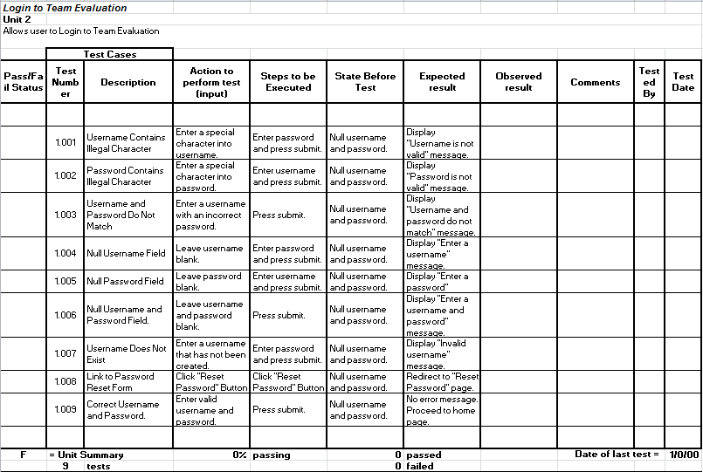
Unit Test 2

Slide 27
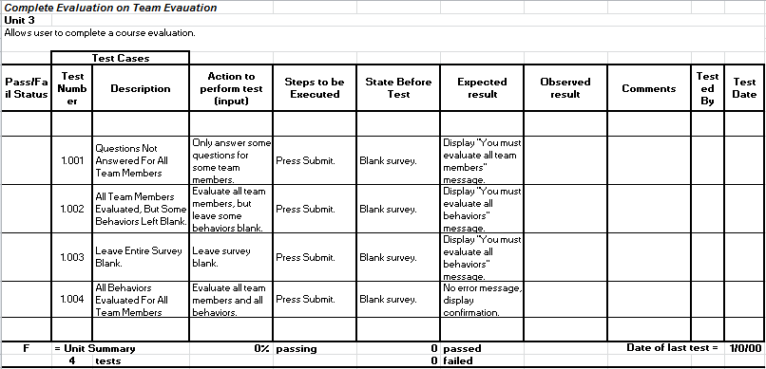
Unit Test 3

Slide 28
Agenda
Introduction
Development and Production Environment
Data Flow Diagrams
Test Plans
Website Map
UML Activity Diagrams
UML Deployment Diagrams
Team Website
Prototype
Timeline

Slide 29






Website Map Legend
Home Page: The first page a use accesses when navigating to T.E.A.M.S. 101
System Interaction: Option visible on current web page for user to interact with
Web Page: Name of web page user is currently accessing
System Action: Action being carried out by system
Page Redirect: Relocates a user to another web page
Link: Connection between web pages and system interactions

Slide 30
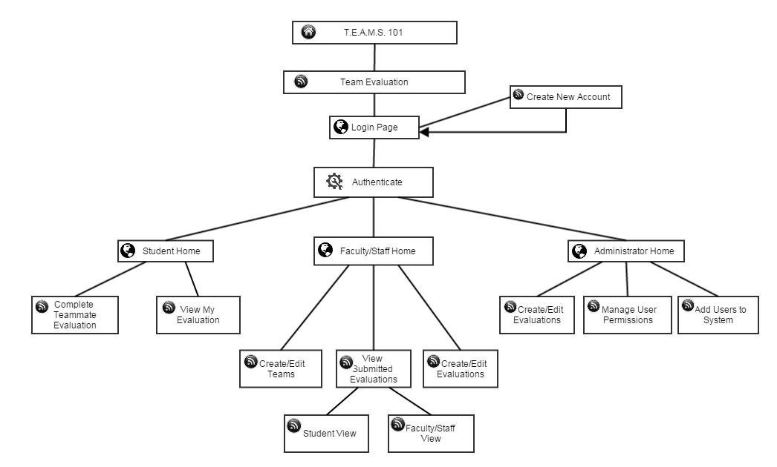
Login Website Map

Slide 31
Agenda
Introduction
Development and Production Environment
Data Flow Diagrams
Test Plans
Website Map
UML Activity Diagrams
UML Deployment Diagrams
Team Website
Prototype
Timeline

Slide 32
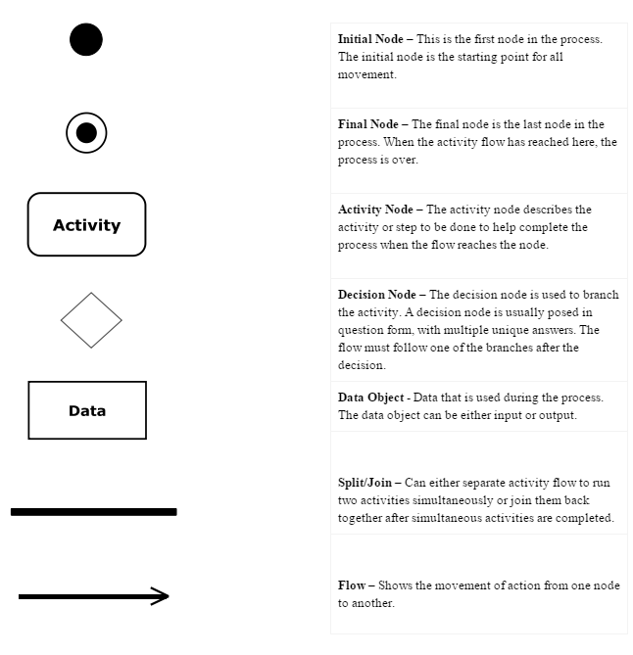
Activity Diagram Legend
Notes:
To reiterate a few of the highlights of the software, Teammate Evaluation will be an easily accessible website. It will provide student the opportunity to utilize the evaluations without the constraint of obtaining a new username and password. The administrator will be able to toggle between administrator view, where they can alter the teams, view individual evaluations, etc. and student view where they can use the site as a student. Another goal of the software is to give administrators the ability to email the Team Evaluation link to their students, and have them access it through their email accounts. As the students complete the evaluations, participation grades will be generated and updated on Blackboard.

Slide 33
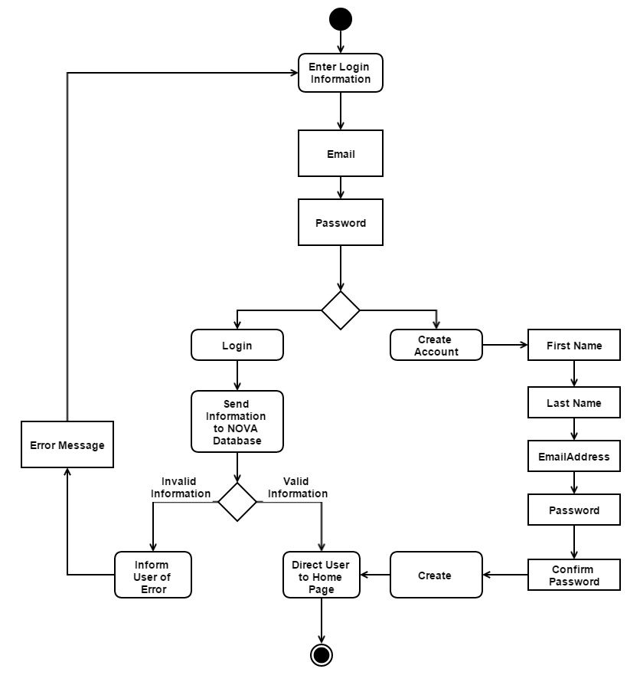
Login Activity Diagram
Notes:
To reiterate a few of the highlights of the software, Teammate Evaluation will be an easily accessible website. It will provide student the opportunity to utilize the evaluations without the constraint of obtaining a new username and password. The administrator will be able to toggle between administrator view, where they can alter the teams, view individual evaluations, etc. and student view where they can use the site as a student. Another goal of the software is to give administrators the ability to email the Team Evaluation link to their students, and have them access it through their email accounts. As the students complete the evaluations, participation grades will be generated and updated on Blackboard.

Slide 34
Agenda
Introduction
Development and Production Environment
Data Flow Diagrams
Test Plans
Website Map
UML Activity Diagrams
UML Deployment Diagrams
Team Website
Prototype
Timeline

Slide 35

Deployment Diagram Legend
<HTTP> HTTP - Hypertext Transfer Protocol defines how messages are formatted and transmitted, and what actions web servers and browsers should take in response to various commands
<SCP> SCP - Securely transfers computer files between a local host and a remote host
<ODBC> ODBC - Open Database Connectivity is a standard programming language middleware for accessing database management systems
System Boundary - This is where all the interactions occur. Represents what is within the system and outside of it.
Connection - Displays a relationship between boundaries.

Slide 36
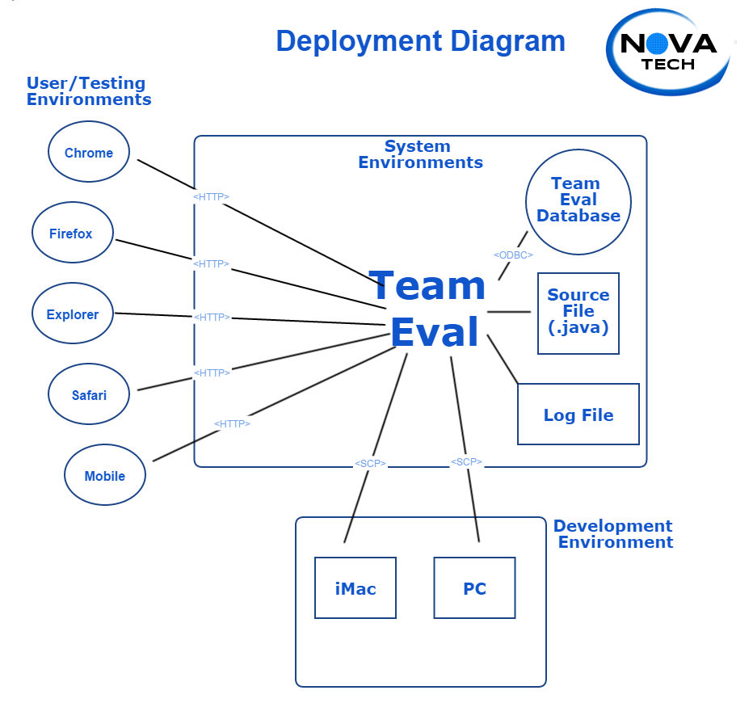
Deployment Diagram

Slide 37
Agenda
Introduction
Development and Production Environment
Data Flow Diagrams
Test Plans
Website Map
UML Activity Diagrams
UML Deployment Diagrams
Team Website
Prototype
Timeline

Slide 38
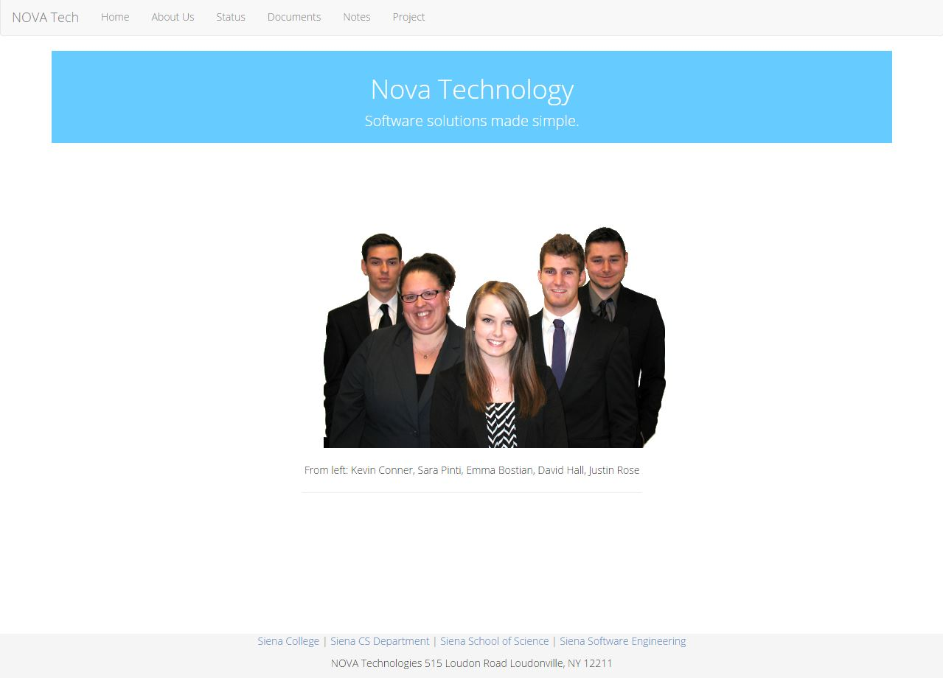
NOVA Home Page

Slide 39
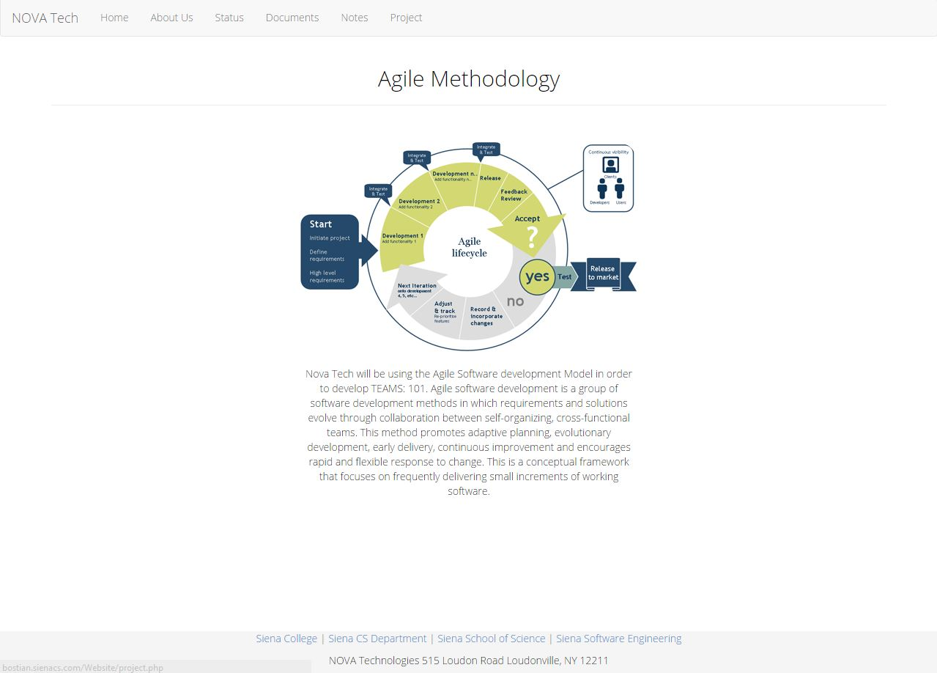
NOVA Status Page

Slide 40
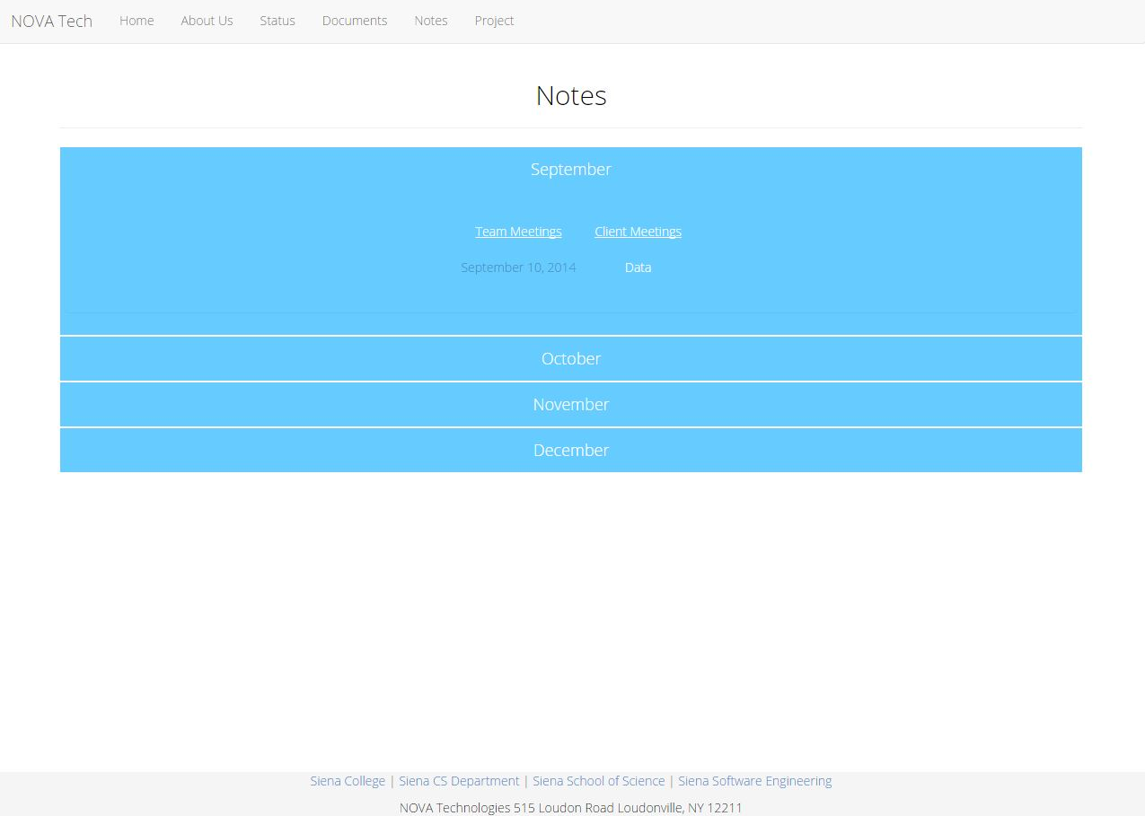
NOVA Notes Page

Slide 41
Agenda
Introduction
Development and Production Environment
Data Flow Diagrams
Test Plans
Website Map
UML Activity Diagrams
UML Deployment Diagrams
Team Website
Prototype
Timeline

Slide 42
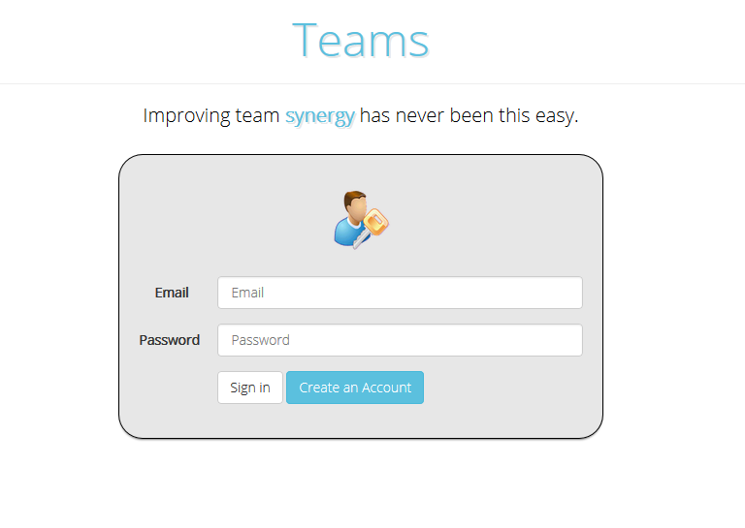
Prototype: Login Page
Notes:
The fall semester is primarily planning. We have established weekly team meeting do divide up the work. We also have bi-weekly client meetings to ensure that our software will meet the requirements Dr. Eddy desires.

Slide 43
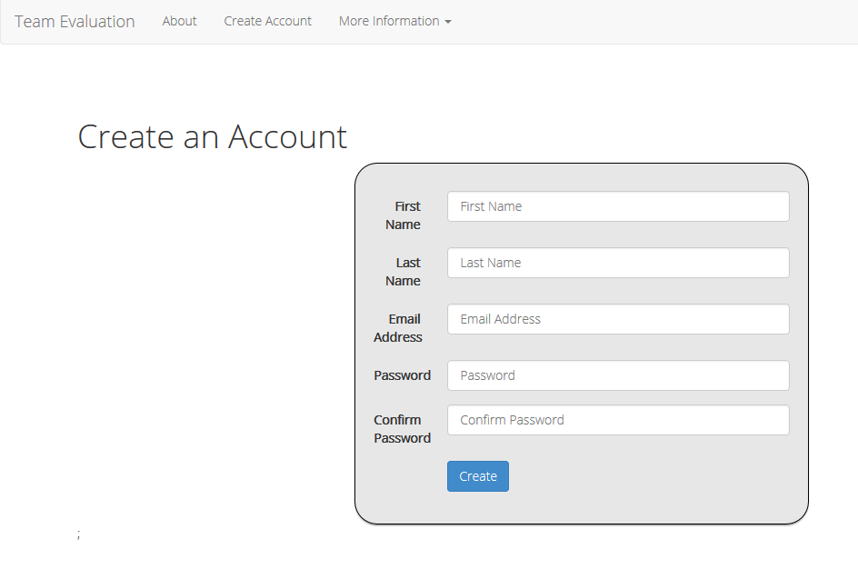
Prototype: Create Account
Notes:
The fall semester is primarily planning. We have established weekly team meeting do divide up the work. We also have bi-weekly client meetings to ensure that our software will meet the requirements Dr. Eddy desires.

Slide 44
Agenda
Introduction
Development and Production Environment
Data Flow Diagrams
Test Plans
Website Map
UML Activity Diagrams
UML Deployment Diagrams
Team Website
Prototype
Timeline

Slide 45
Timeline: Fall Semester

Slide 46
Conclusion
Questions?

