Slide 1
C.S.-A.C.T.I.O.N.S
Detailed Design
by MAKER Technologies

Slide 2
Introduction
Kaitlyn Boomhower – Team Leader
Marissa Bianchi – Database Administrator
Ryan Clancy – Lead Developer
Andrew Reynolds – Webmaster

Slide 3
Product Overview
An easy to use web application that keeps track of Siena College Computer Science Alumni.
All users can view and interact with the map
Administrators control everything
Goals:
Allow current Siena CS students & prospective students to see what career paths Siena CS Alumni have taken
Keep Siena College Computer Science Alumni connected to each other!

Slide 4
Project Progression
Software Plan
Requirements Specification
Development and Testing
Preliminary Design
Detailed Design
Acceptance Test

Slide 5
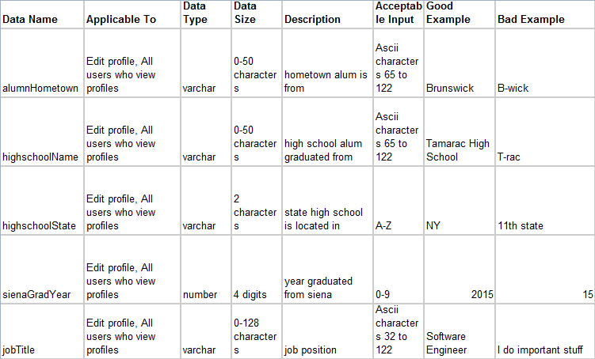
Data Dictionary

Slide 6
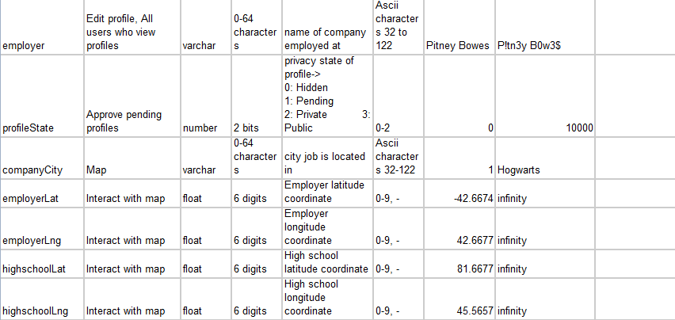
Data Dictionary (cont.)

Slide 7
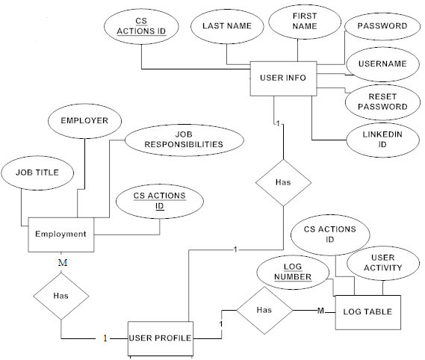
ER Diagram

Slide 8
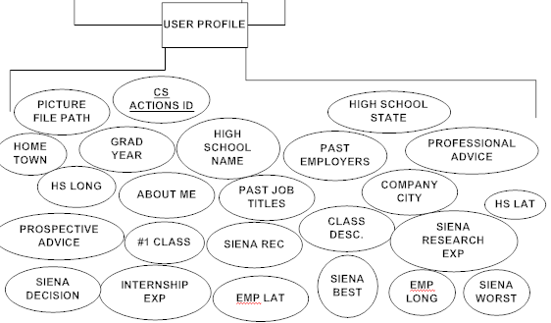
ER Diagram Cont.

Slide 9
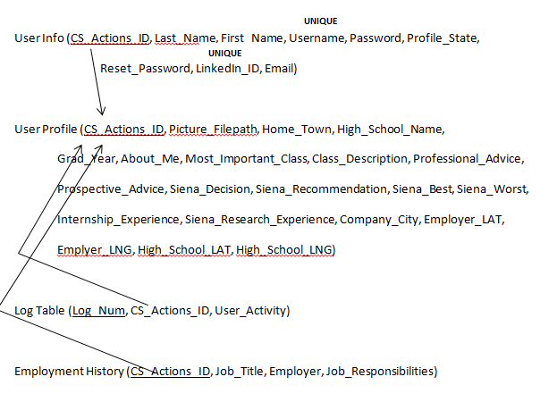
Relational Schema

Slide 10
Application Demo
http://oraserv.cs.siena.edu/~perm_maker/working/live/

Slide 11
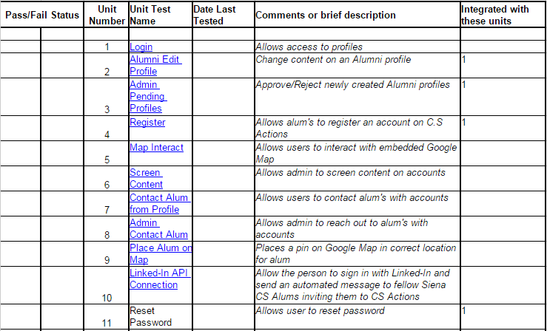
Unit Tests

Slide 12
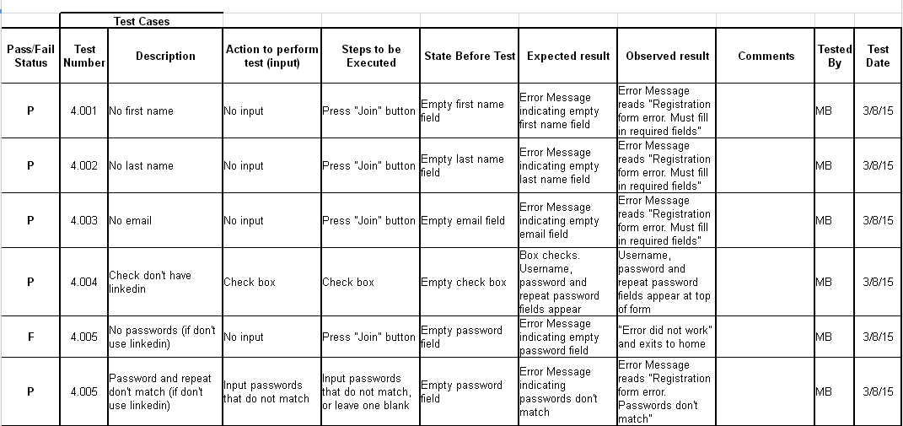
Unit Tests: Register Alumni

Slide 13
Unit Tests: Register Alumni Cont.

Slide 14
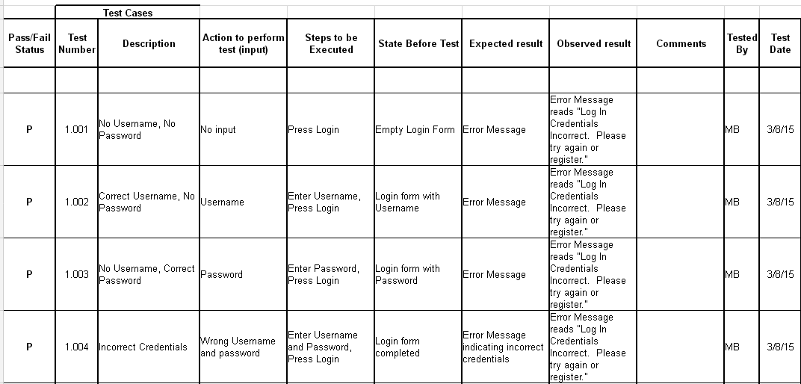
Unit Tests: Login

Slide 15
Unit Tests: Login continued

Slide 16
What’s Next?
Software Plan
Requirements Specification
Development and Testing
Preliminary Design
Detailed Design
Acceptance Test

