Slide 1

Hobb-IT
Hobby Information Tracker
By Illumination Technologies
Requirements Specification
October 28rd 2013

Slide 2
WELCOME
Client: Dr. Darren Lim
Associate Professor Computer Science
Guest: Dr. Tim Lederman
Guest: Dr. Meg Fryling

Slide 3
AGENDA
Introduction
Status of Project
Data Flow Diagrams(DFD)
User Case Narrative
UML Use Case Diagram
Functional Requirements Inventory
Prototype screens
What is next?

Slide 4
Introduction
Karl Appel – Team Leader
Connor Blakely – Head Developer
Jackie Hausmann – Database Administrator
Bryan Leicht – Information Specialist
Katie Sitaro – Web Developer

Slide 5
AGENDA
Introduction
Status of Project
Data Flow Diagrams(DFD)
User Case Narrative
UML Use Case Diagram
Functional Requirements Inventory
Prototype screens
What is next?

Slide 6
Status of Project
Completed:
Software Plan
Defined Problem and created a Solution Strategy
Requirement Specifications
    Developed understanding of features and functionality required
Not Started
Preliminary Design
Detailed Design
Testing and Development
Acceptance Test

Slide 7
status: Software Plan
Problem Definition
Track Magic the Gathering card prices
Goal for the System and Project
System to automatically track prices
Solution Strategy
Waterfall Model
Sources of Information
Websites given by client
Acceptance Criteria
Website and System to track prices automatically

Slide 8
Status: requirements Specification
Data Flow Diagrams
Processes and Information Flow
User Case Narrative
The story of users’ usage of Hobb-IT
UML Use Case Diagram
Shows process interaction with entities in Hobb-IT
Functional Requirements
The measurable requirements fulfilled by Hobb-IT
Prototypes for Discovery
Model for Requirements and Existence Test

Slide 9
AGENDA
Introduction
Status of Project
Data Flow Diagrams(DFD)
User Case Narrative
UML Use Case Diagram
Functional Requirements Inventory
Prototype screens
What is next?

Slide 10
Data Flow Diagrams
The following diagrams show the movement of data within the system and entities outside.

Slide 11
Data Flow Diagram Legend
External Entity: Represents outside sources of data to the system
Data Flow: Represents the movement of data
Data Store: Represents data that is not moving or at rest
Process: Represents an activity that manipulates the data

Slide 16
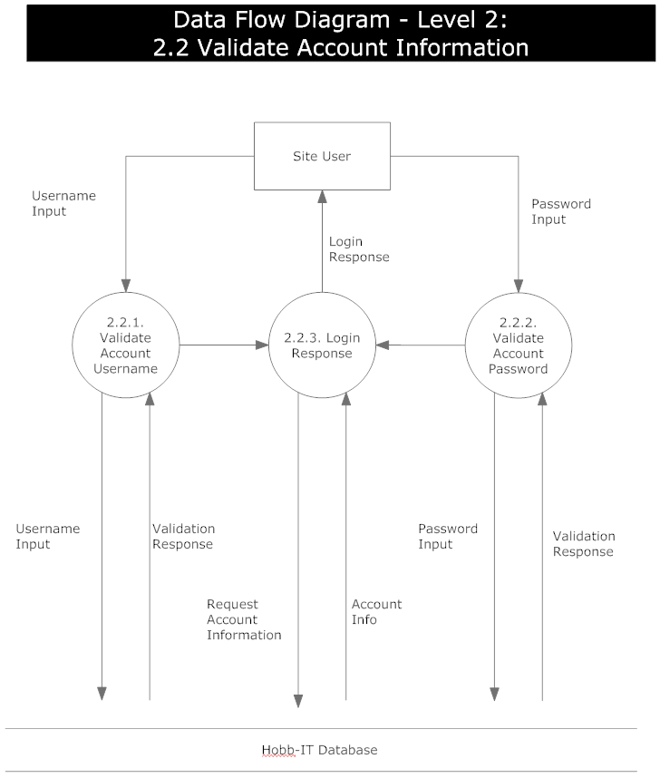

Slide 17
AGENDA
Introduction
Status of Project
Data Flow Diagrams(DFD)
User Case Narrative
UML Use Case Diagram
Functional Requirements Inventory
Prototype screens
What is next?

Slide 18
Administrator
One administrator account
Update how website’s information is parsed
Access search history of all users
View and edit all login credentials
Change default website for Guest User

Slide 19
Advanced user
Login to system
View card’s price from multiple websites
Add cards to saved lists
View search history
View visual representation of price fluctuations

Slide 20
Guest User
Search for real-time price of cards
One card per search
Can only access one website’s information
Website is determined by Administrator

Slide 21
AGENDA
Introduction
Status of Project
Data Flow Diagrams(DFD)
User Case Narrative
UML Use Case Diagram
Functional Requirements Inventory
Prototype screens
What is next?

Slide 22
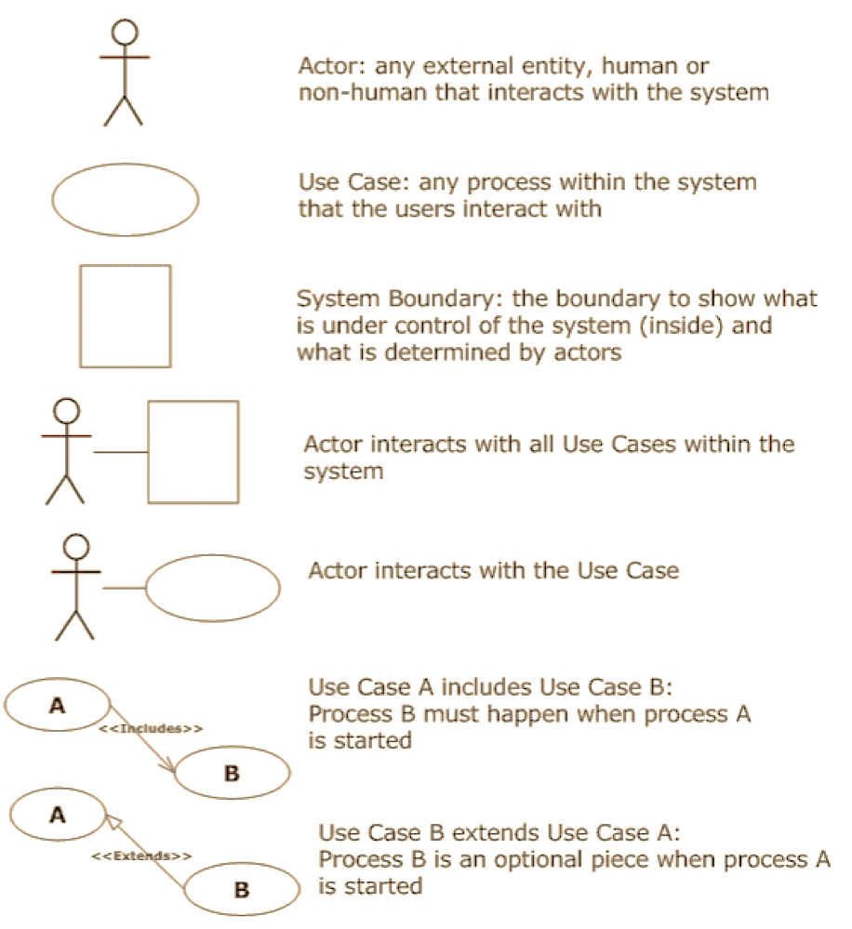
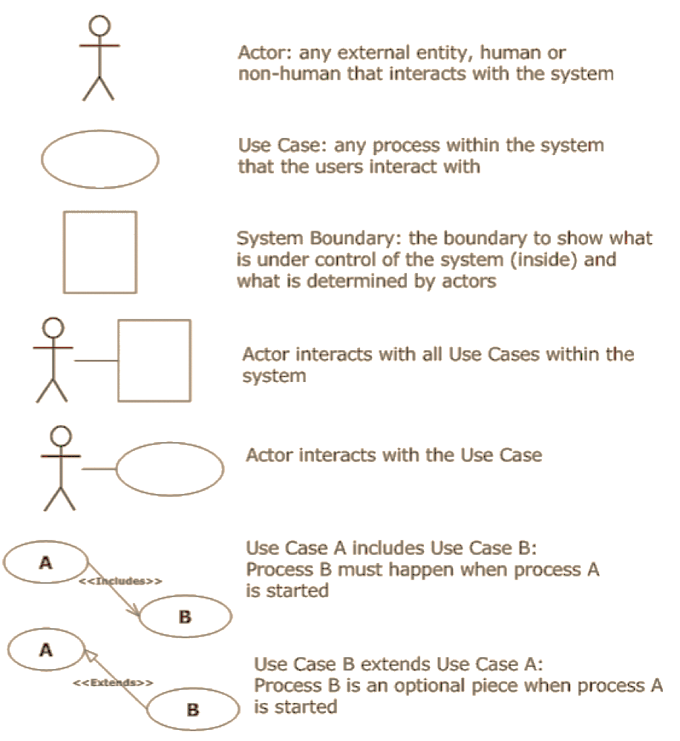
UML USE CASE DIAGRAM LEGEND
Actor interacts with all Use Cases
Actor
Actor interacts with the Use Case
Use Case
Use Case A includes Use Case B
System Boundary
Use Case B extends Use Case A

Slide 23
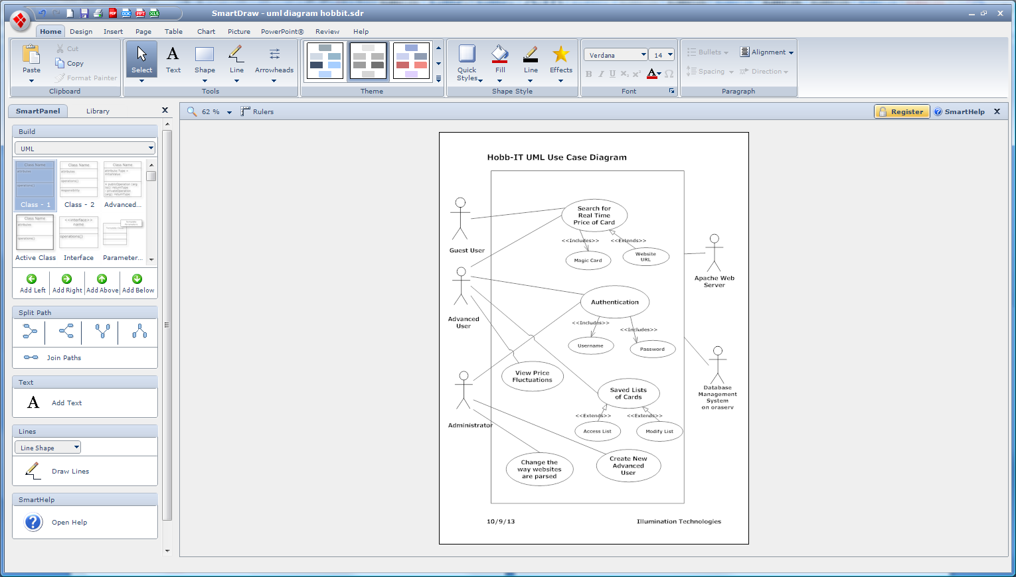

Slide 24
AGENDA
Introduction
Status of Project
Data Flow Diagrams(DFD)
User Case Narrative
UML Use Case Diagram
Functional Requirements Inventory
Prototype screens
What is next?

Slide 25
Functional Requirements for administrator
Access all data stored on database
Access search history of all users
Create Advanced User accounts
Edit website’s template for parsing data
View and change login credentials
Change default website for Guest User

Slide 26
Functional requirements for advanced user
Login to Hobb-It
Search for real-time price of cards
Save and edit lists of cards
Access their search history
View visual representation of price fluctuations

Slide 27
Functional requirements for guest user
Access system without login credentials
View price and condition of card
Website is specified by Administrator
Default website is TrollandToad.com

Slide 28
Nonfunctional requirements
Easy to change a website’s template
Efficient
Stable
User friendly
Follow all laws for parsing data

Slide 29
AGENDA
Introduction
Status of Project
Data Flow Diagrams(DFD)
User Case Narrative
UML Use Case Diagram
Functional Requirements Inventory
Prototype Screens
What is next?

Slide 30
Scraping Prototype
Must be able to scrape specified list of websites
Using Jsoup, a Java package for scraping websites
Must get 5 attributes from the website
    Card Name
    Edition
    Condition
    Price
    Quantity

Slide 31
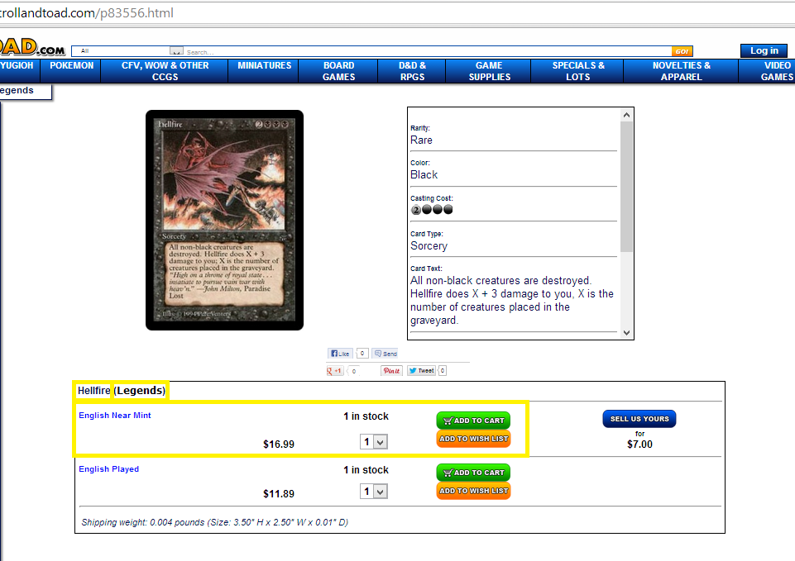
Scraping Prototype (trollandtoad.com)

Slide 32
Code Snippet
Document doc =
Jsoup.connect("http://www.trollandtoad.com/p83556.html").get();
Elements conditions =
doc.getElementsByClass("productquantity");
Elements prices =
doc.getElementsByAttributeValue("class" , "productprice");
Elements cardNames =
doc.getElementsByAttributeValue("class" , "pname1");
String cardName =
cardNames.get(0).text();

Slide 33
Scraping Prototype (trollandtoad.com)
The Result (10/22/13):
Card name = Hellfire
Edition = Legends
Condition = English Near Mint
Price = $16.99
Quantity = 1 in stock

Slide 34
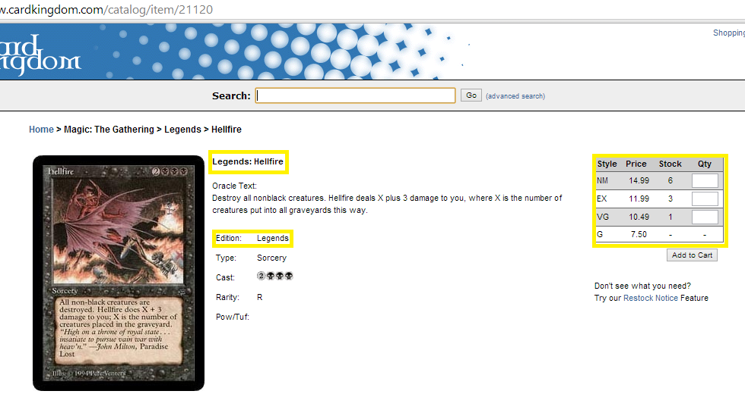
Scraping Prototype (cardkingdom.com)

Slide 35
Code Snippet
String website =
"http://www.cardkingdom.com/catalog/item/21120";
Document doc =
Jsoup.connect(website).get();
Elements conditions =
doc.select(".grid tbody tr");
Elements names =
doc.select("td b");
String name =
names.get(1).text().substring(names.get(1).text().indexOf(":") +1);
String edition =
conditions.get(1).text().split(" ")[1];

Slide 36
Scraping Prototype (cardkingdom.com)
The Result (10/22/13):
Card name = Hellfire
Edition = Legends
Condition = NM
Price = 14.99
Quantity = 6

Slide 37
Main menu Screen

Slide 38
Guest user welcome

Slide 39
Advanced user welcome

Slide 40
Initial Graphs Screen

Slide 41
Visualized Graph Screen

Slide 42
Wish List

Slide 43
Tracked Cards list

Slide 44
Past searches

Slide 45
Administrator Welcome

Slide 46
Manage account

Slide 47
Update website

Slide 48
AGENDA
Introduction
Status of Project
Data Flow Diagrams(DFD)
User Case Narrative
UML Use Case Diagram
Functional Requirements Inventory
Prototype screens
What is next?

Slide 49
What is next?
Preliminary Design Presentation
  December 2, 2013
Detailed Design
  Spring 2014
Acceptance Test
  Spring 2014

Slide 50
Questions?

