Slide 1
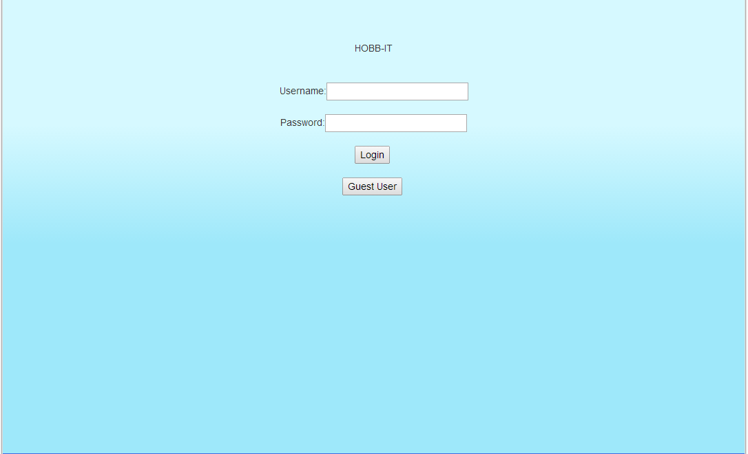
Login design

Slide 2
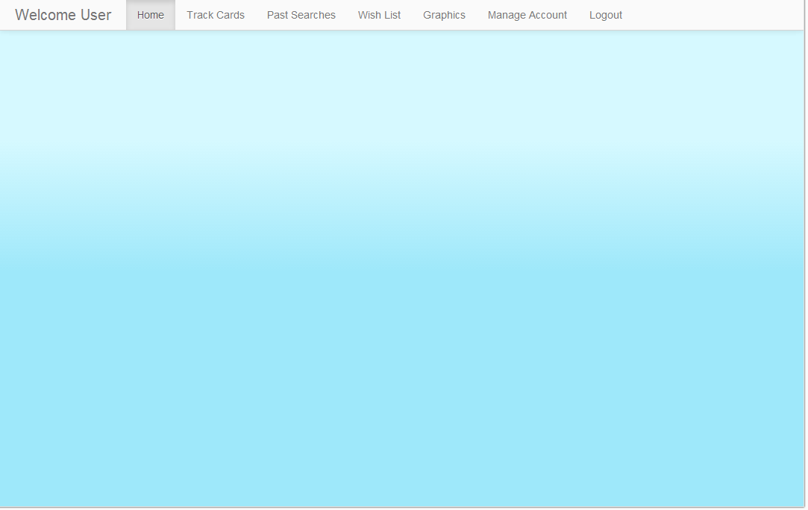
Advanced User

Slide 3
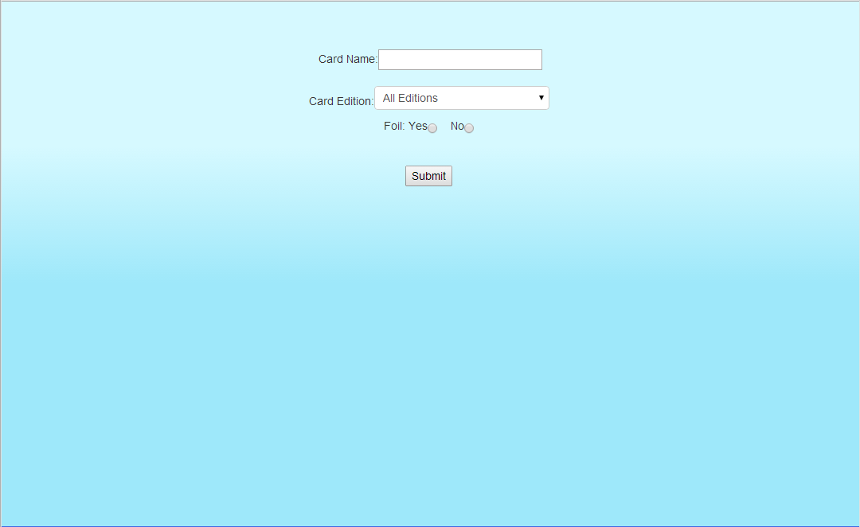
Guest layout

Slide 4
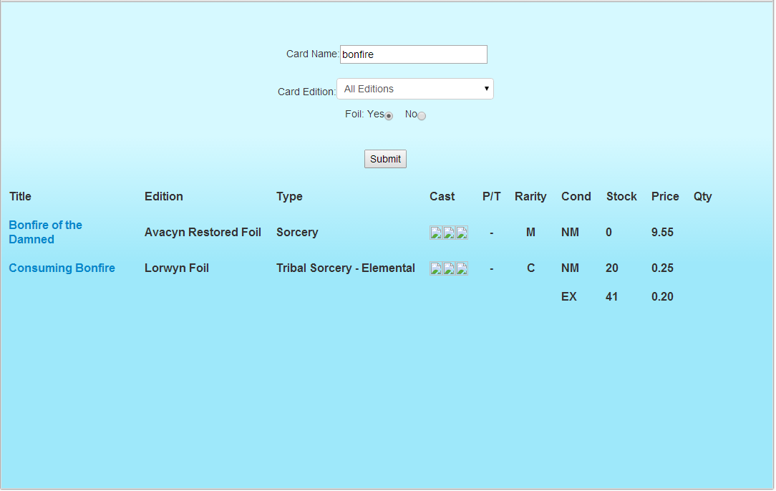
Guest User Search (foil)

Slide 5
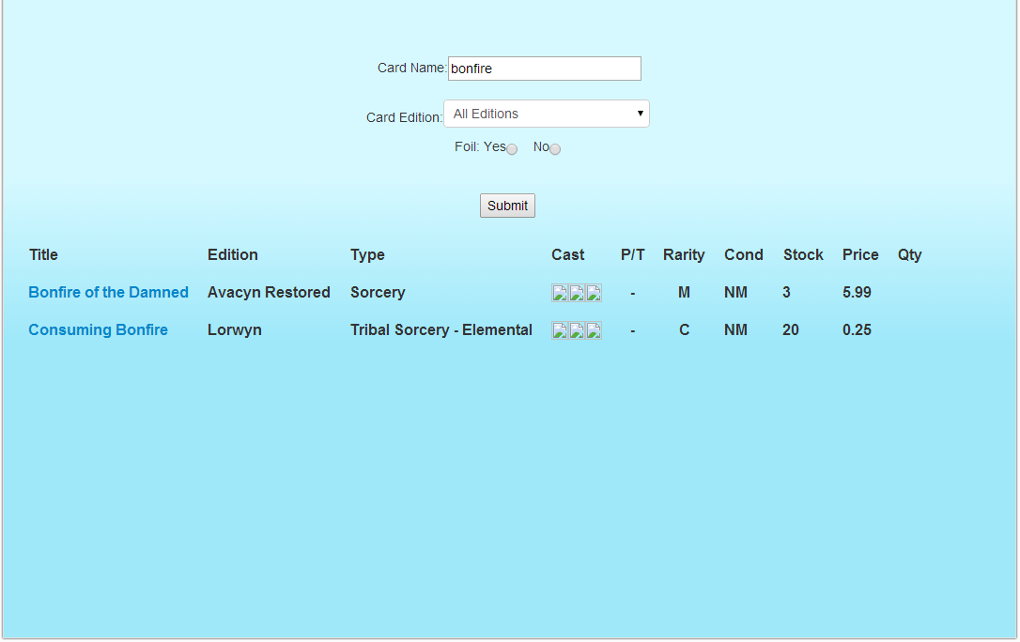
Guest user search (non-foil)

Slide 6
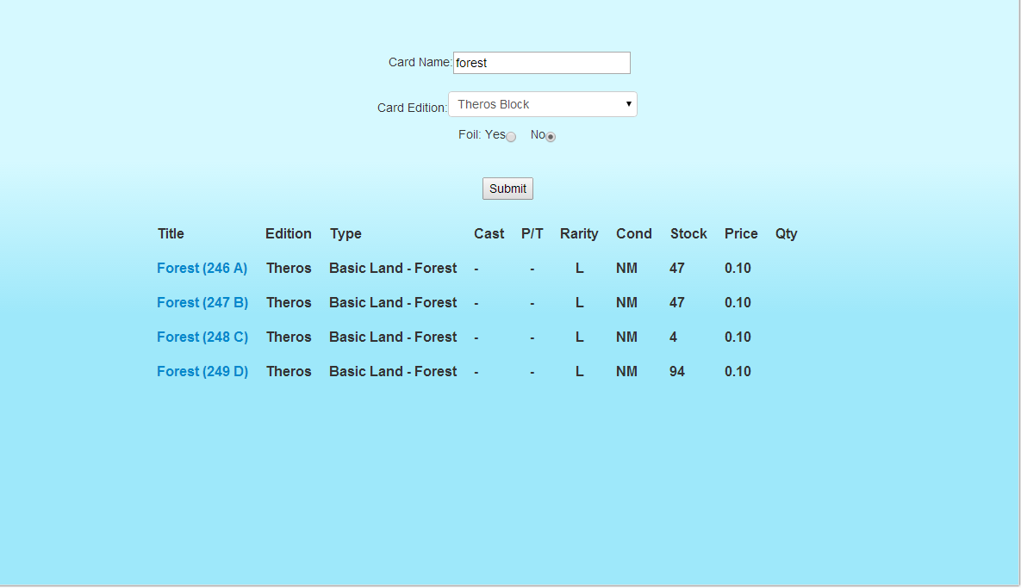
Guest user search (edition and non-foil)

Slide 7
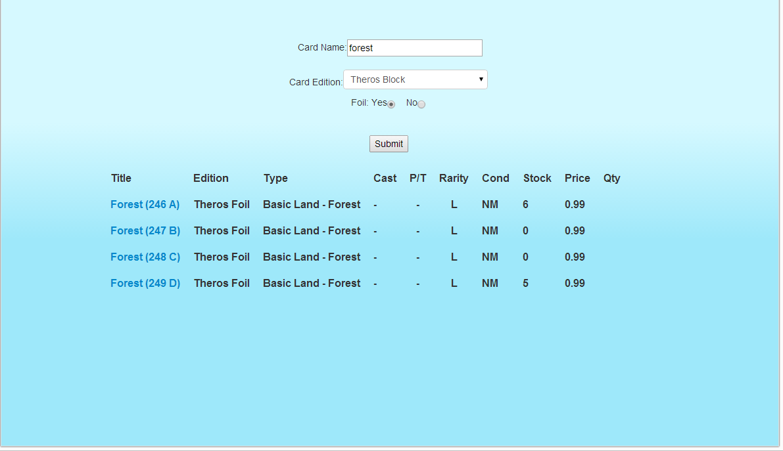
Guest user search (Edition + foil)

Slide 8
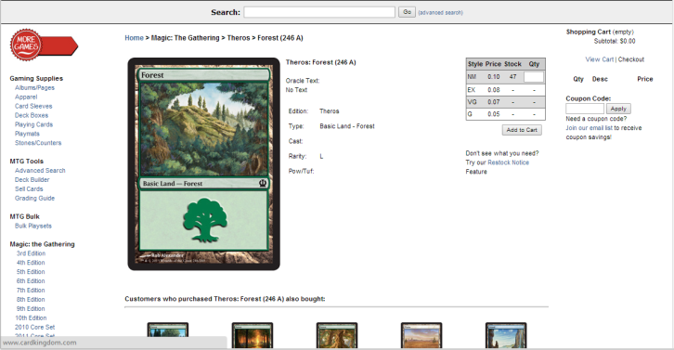
Magic card Page link

