Slide 1

Hobb-IT
Hobby Information Tracker
By Illumination Technologies
Preliminary Design
December 2nd 2013

Slide 2
WELCOME
Client: Dr. Darren Lim
Associate Professor Computer Science
Guest: Dr. Tim Lederman
Guest: Dr. Meg Fryling

Slide 3
AGENDA
AGENDA
Introduction
Status of Project
Data Flow Diagrams(DFD)
User Case Narrative
UML Diagrams
Development and Production Environments
Functional Requirements Inventory
Website Map
Testing Overview and Data Dictionary
Prototype screens
What is next?
3

Slide 4
Introduction
Karl Appel – Team Leader
Connor Blakely – Head Developer
Jackie Hausmann – Database Administrator
Bryan Leicht – Information Specialist
Katie Sitaro – Web Developer

Slide 5
AGENDA
AGENDA
Introduction
Status of Project
Data Flow Diagrams(DFD)
User Case Narrative
UML Diagrams
Development and Production Environments
Functional Requirements Inventory
Website Map
Testing Overview and Data Dictionary
Prototype screens
What is next?
5

Slide 6
Status of Project
Completed:
Software Plan
Defined Problem and created a Solution Strategy
Requirement Specifications
          Developed understanding of features and functionality required
Preliminary Design
    Develop initial design for user interface and identify data entities
Not Started
Detailed Design
Testing and Development
Acceptance Test

Slide 7
status: Software Plan
Problem Definition
Track Magic the Gathering card prices
Goal for the System and Project
System to automatically track prices
Solution Strategy
Waterfall Model
Sources of Information
Websites given by client
Acceptance Criteria
Website and System to track prices automatically

Slide 8
Status: requirements Specification
Data Flow Diagrams
Processes and Information Flow
User Case Narrative
The story of users’ usage of Hobb-IT
UML Use Case Diagram
Shows process interaction with entities in Hobb-IT
Functional Requirements
The measurable requirements fulfilled by Hobb-IT
Prototypes for Discovery
Model for Requirements and Existence Test

Slide 9
STATUS: Preliminary Design (Part I)
UML Diagrams
Use Case Diagram , Deployment Diagram, Activity Diagram
Website Map/Structure Diagram
Map of Website Navigation
Data Flow Diagrams
Context Diagram, Levels 0-3
Functional Requirements
The measurable requirements fulfilled by Hobb-IT

Slide 10
STATUS: Preliminary Design (Part II)
Logical Dictionary
Describes the data entities within the system
Prototypes
Model for Requirements and Existence Test
Testing Plan
Overview/Strategy, Acceptance Test, Unit Tests, Test Cases

Slide 11
AGENDA
AGENDA
Introduction
Status of Project
Data Flow Diagrams(DFD)
User Case Narrative
UML Diagrams
Development and Production Environments
Functional Requirements Inventory
Website Map
Testing Overview and Data Dictionary
Prototype screens
What is next?
11

Slide 12
Data flow diagrams
The following diagrams show the movement of data within the system and entities outside the system

Slide 13
Data flow diagram legend
External Entity: Represents outside sources of data to the system
Data Flow: Represents the movement of data
Data Store: Represents data that is not moving or at rest
Process: Represents an activity that manipulates the data

Slide 15
15

Slide 16
16

Slide 17
17

Slide 18
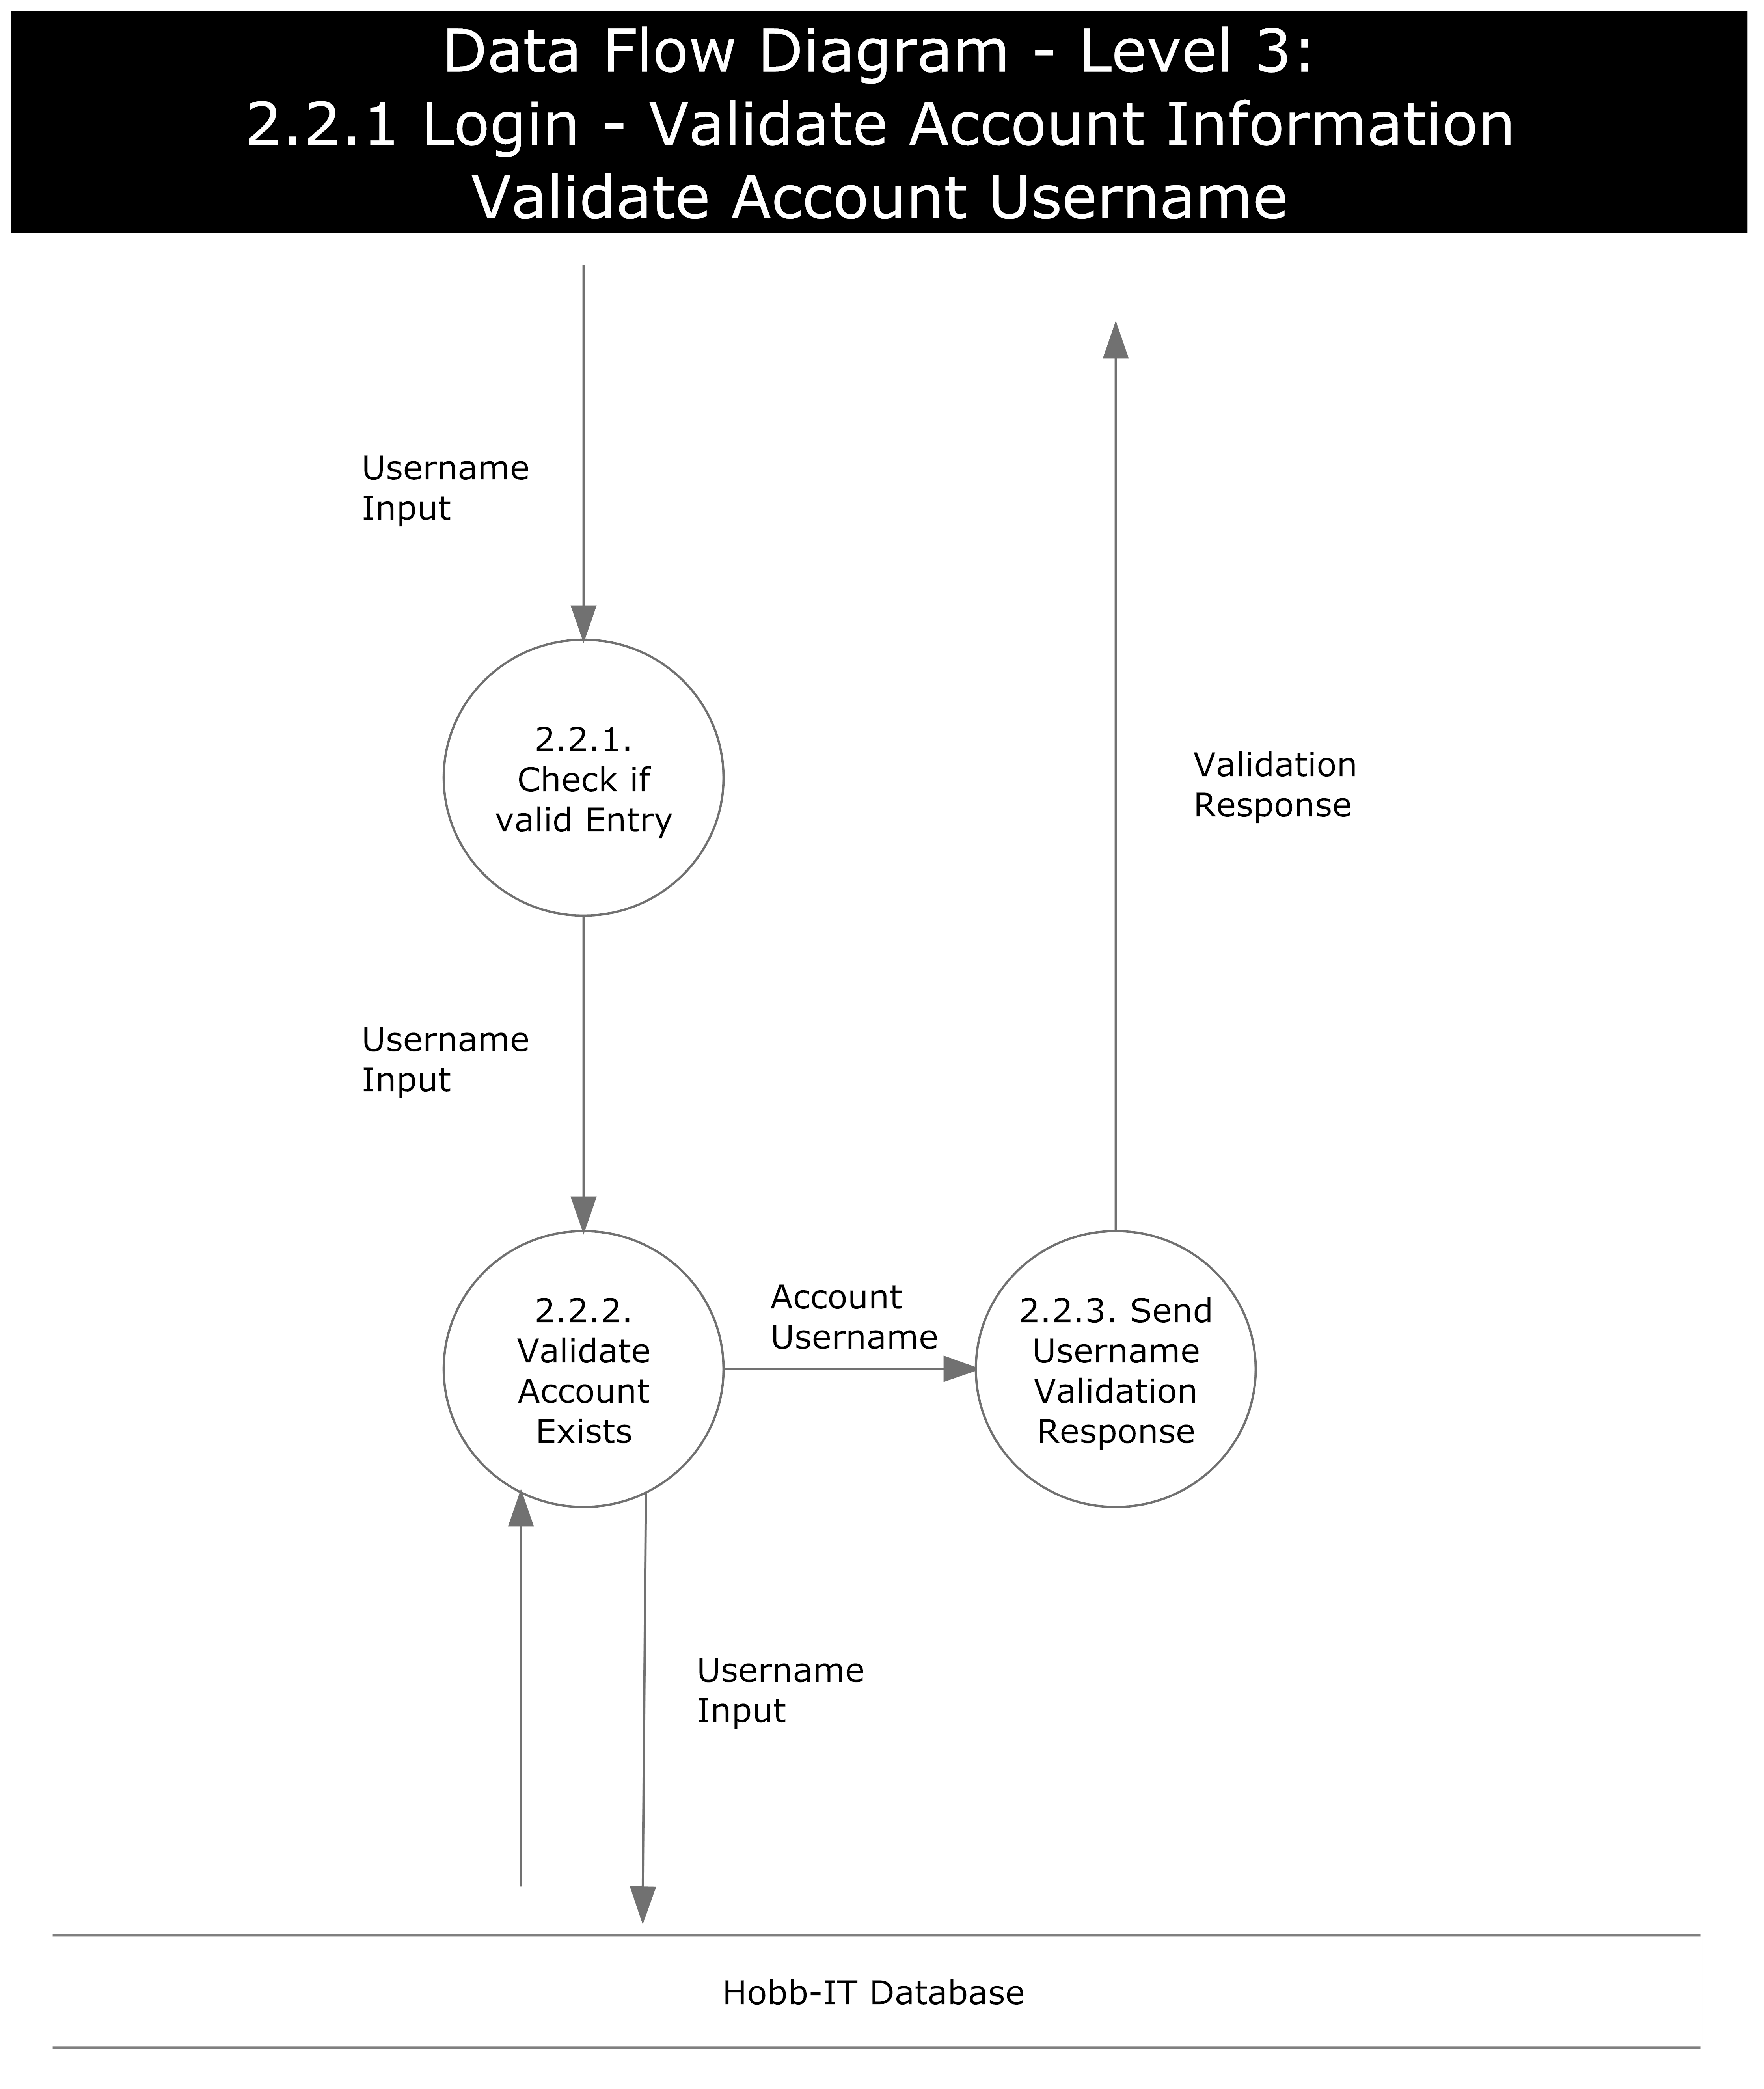
18

Slide 19
AGENDA
AGENDA
Introduction
Status of Project
Data Flow Diagrams(DFD)
User Case Narrative
UML Diagrams
Development and Production Environments
Functional Requirements Inventory
Website Map
Testing Overview and Data Dictionary
Prototype screens
What is next?
19

Slide 20
Administrator
One administrator account
Update how website’s information is parsed
Access search history of all users
View and edit all login credentials
Change default website for Guest User

Slide 21
Advanced user
Login to system
View card’s price from multiple websites
Add cards to saved lists
View search history
View visual representation of price fluctuations

Slide 22
Guest User
Search for real-time price of cards
One card per search
Can only access one website’s information
Website is determined by Administrator

Slide 23
AGENDA
AGENDA
Introduction
Status of Project
Data Flow Diagrams(DFD)
User Case Narrative
UML Diagrams
Development and Production Environments
Functional Requirements Inventory
Website Map
Testing Overview and Data Dictionary
Prototype screens
What is next?
23

Slide 24
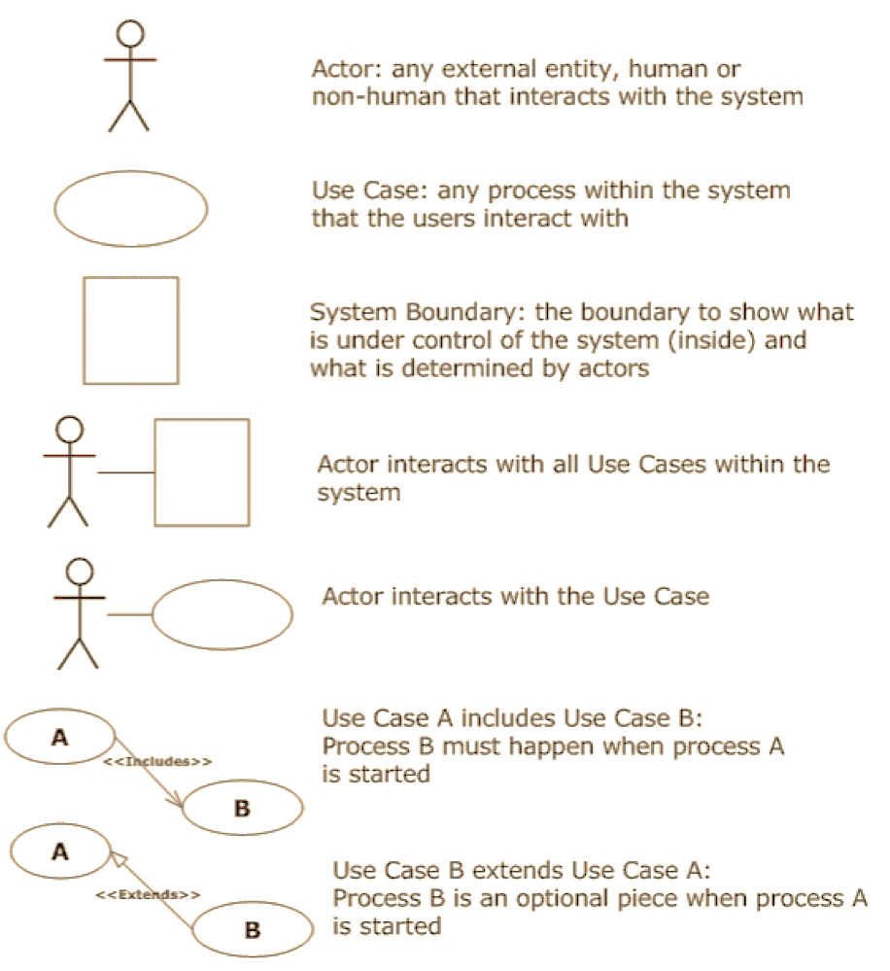
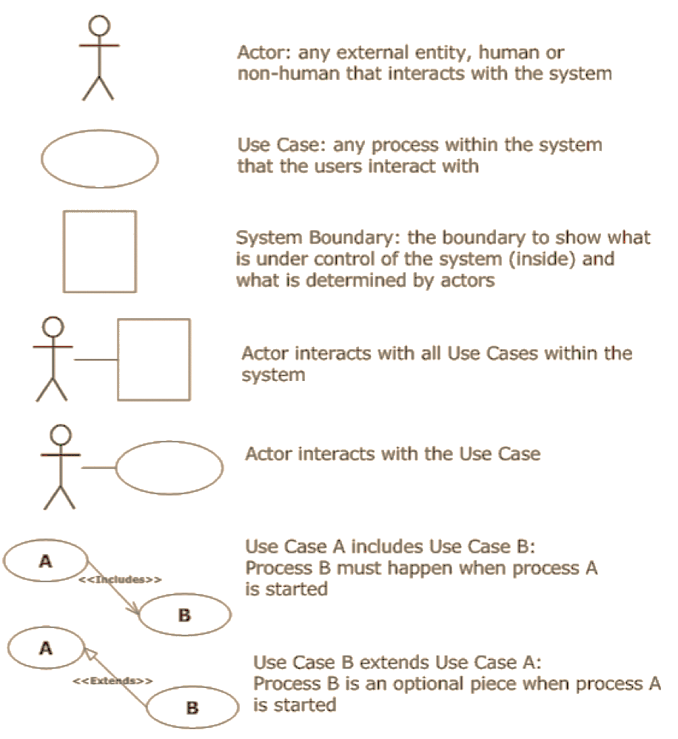
UML USE CASE DIAGRAM LEGEND
Actor interacts with all Use Cases
Actor
Actor interacts with the Use Case
Use Case
Use Case A includes Use Case B
System Boundary
Use Case B extends Use Case A

Slide 25
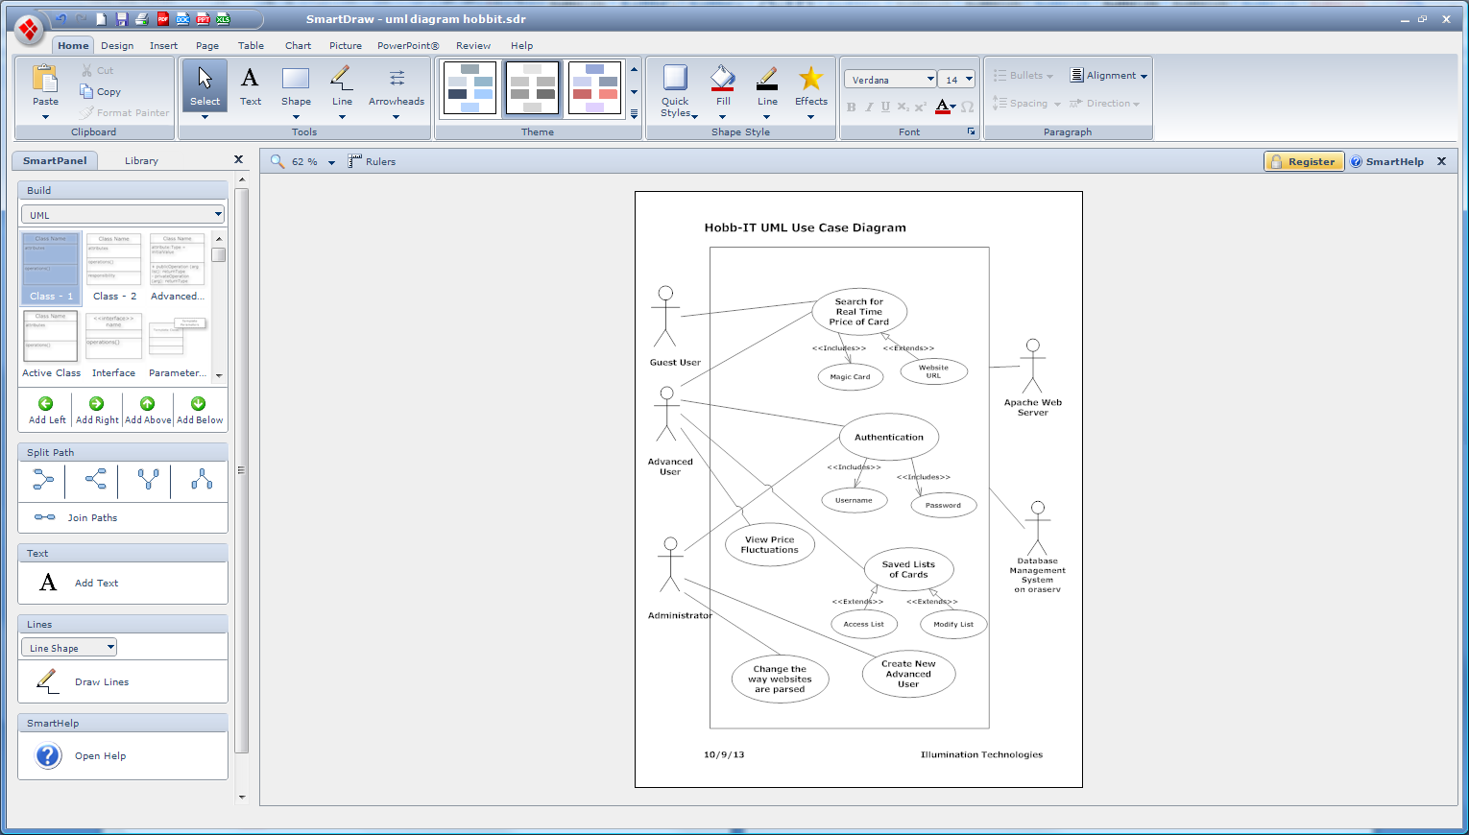
25

Slide 26
UML ACTIVTY DIAGRAM LEGEND

Slide 27
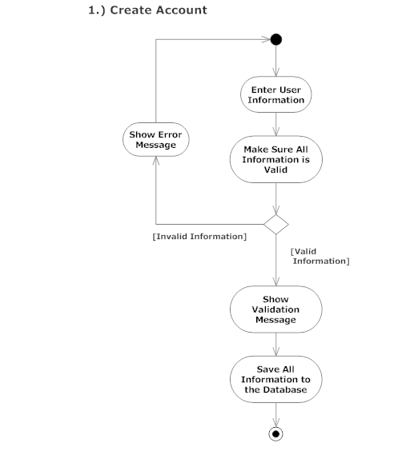
1.) CREATE ACCOUNT

Slide 28
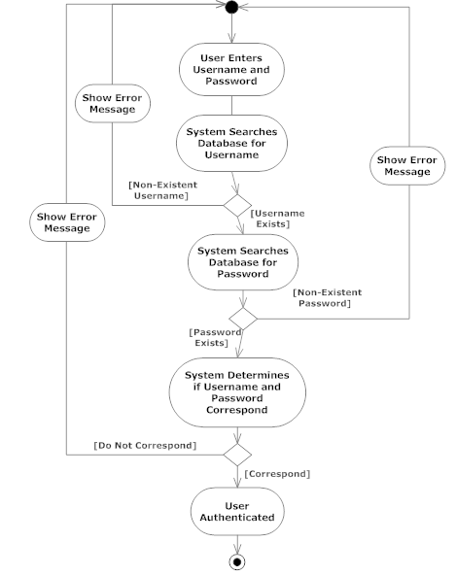
2.) LOGIN

Slide 29
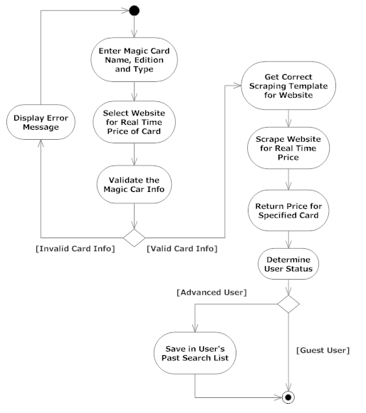
3.) GET REAL TIME PRICE

Slide 30
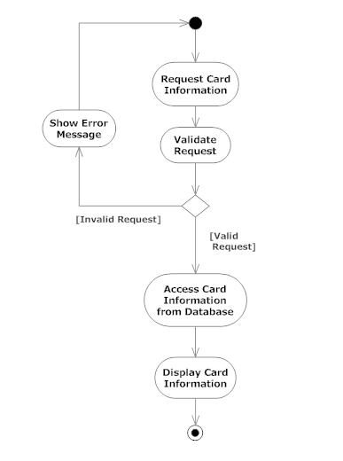
4.) ACCESS CARD
Illumination Technologies

Slide 31
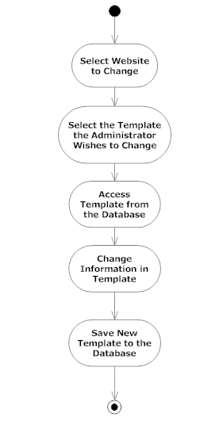
5.) CHANGE PARSE TEMPLATE

Slide 32
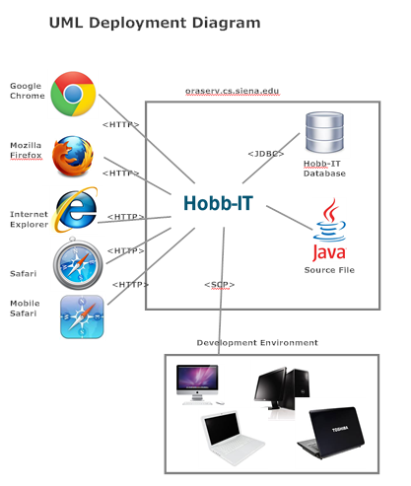
DEPLOYMENT DIAGRAM

Slide 33
AGENDA
AGENDA
Introduction
Status of Project
Data Flow Diagrams(DFD)
User Case Narrative
UML Diagrams
Development and Production Environments
Functional Requirements Inventory
Website Map
Testing Overview and Data Dictionary
Prototype screens
What is next?
33

Slide 34
Development environment
Macintosh Computer:
Operating System: OSX Version 10.7.4
Model: Mac
Processor: Intel Core i5 @ 2.5Ghz
Memory: 4GB 1333 MHz DDR3
HD Size: 500GB
Windows Computer:
Operating System: Windows Vista
Model: Dell
Processor: Intel Core 2 Duo E7500 @ 2.93GHz
Memory: 4.00 GB
HD Size: 297GB
Windows Computer:
Operating System: Windows 8
Model: ASUS
Processor: Intel Core i5 2.4Ghz
Memory: 4GB 1333MHz DDR3
HD Size: 450GB
34

Slide 35
Production environment
Operating System: CentOS 5.2, Kernal 2.6.18-92e15
Server Name: oraserv.cs.siena.edu
CPU Type: Intel Xeon 2.66 GHz
Memory: 8GB Memory
Illumination Technologies

Slide 36
AGENDA
AGENDA
Introduction
Status of Project
Data Flow Diagrams(DFD)
User Case Narrative
UML Diagrams
Development and Production Environments
Functional Requirements Inventory
Website Map
Testing Overview and Data Dictionary
Prototype screens
What is next?
36

Slide 37
Functional Requirements for administrator
Access all data stored on database
Access search history of all users
Create Advanced User accounts
Edit website’s template for parsing data
View and change login credentials
Change default website for Guest User

Slide 38
Functional requirements for advanced user
Login to Hobb-It
Search for real-time price of cards
Save and edit lists of cards
Access their search history
View visual representation of price fluctuations

Slide 39
Functional requirements for guest user
Access system without login credentials
View price and condition of card
Website is specified by Administrator
Default website is TrollandToad.com

Slide 40
Nonfunctional requirements
Easy to change a website’s template
Efficient
Stable
User friendly
Follow all laws for parsing data

Slide 41
AGENDA
AGENDA
Introduction
Status of Project
Data Flow Diagrams(DFD)
User Case Narrative
UML Diagrams
Development and Production Environments
Functional Requirements Inventory
Website Map
Testing Overview and Data Dictionary
Prototype screens
What is next?
41

Slide 42
WEBSITE MAP
The following diagrams show the structure of Hobb-IT and how a user can interact with the system.
Illumination Technologies

Slide 43
Website map Legend

Slide 44
44

Slide 45
AGENDA
AGENDA
Introduction
Status of Project
Data Flow Diagrams(DFD)
User Case Narrative
UML Diagrams
Development and Production Environments
Functional Requirements Inventory
Website Map
Testing Overview and Data Dictionary
Prototype screens
What is next?
45

Slide 46
Testing Overview
Unit Tests – Checks to see all major processes work properly
- Made up of Test Cases
Test Case – An individual test within a component of the software usually for one process
Acceptance Test – Does the software provide the functionality the client needs?

Slide 47
Unit Testing and data dictionary
On Excel Sheet

Slide 48
AGENDA
AGENDA
Introduction
Status of Project
Data Flow Diagrams(DFD)
User Case Narrative
UML Diagrams
Development and Production Environments
Functional Requirements Inventory
Website Map
Testing Overview and Data Dictionary
Prototype screens
What is next?
48

Slide 49
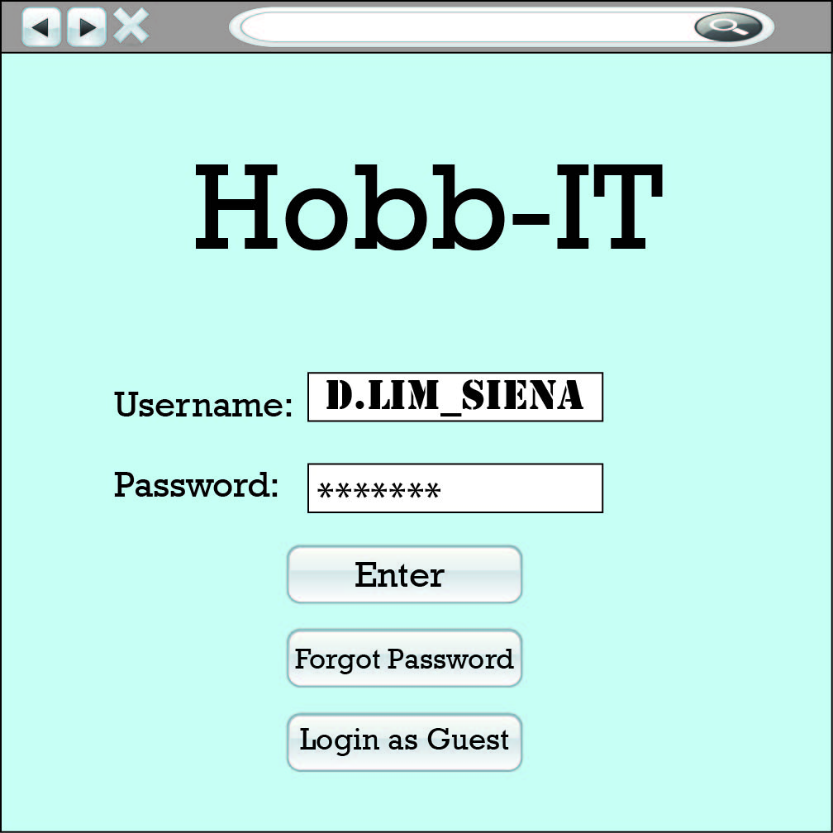
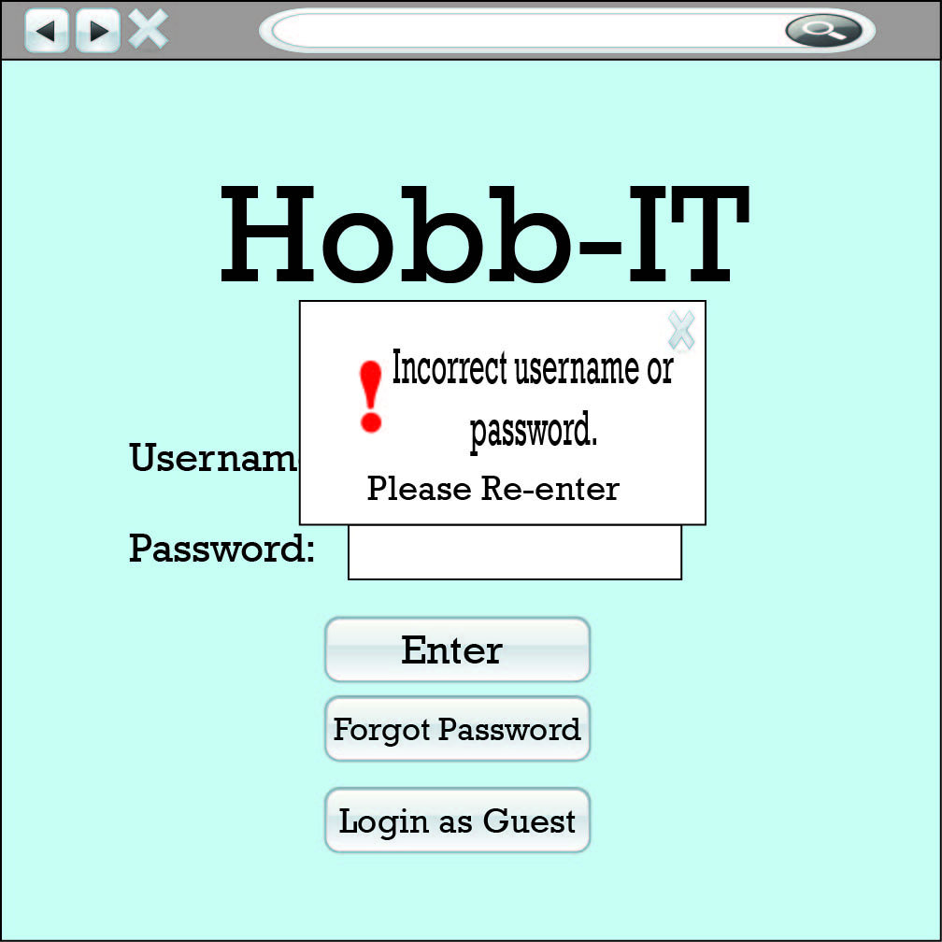
Home Page

Slide 50
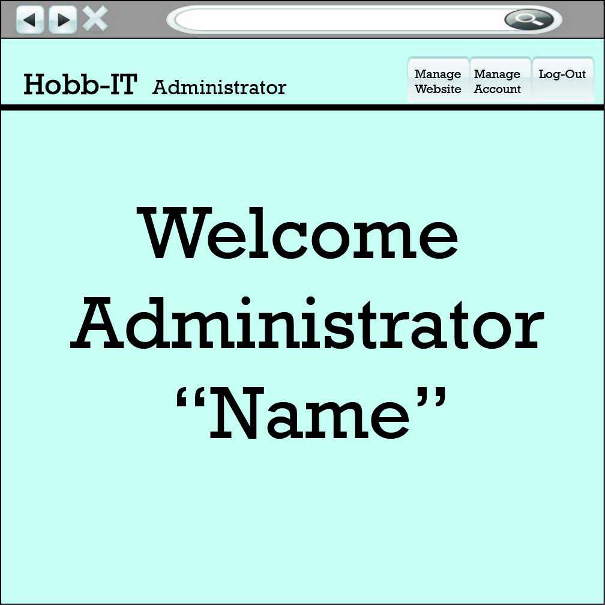
Administrator Welcome

Slide 51
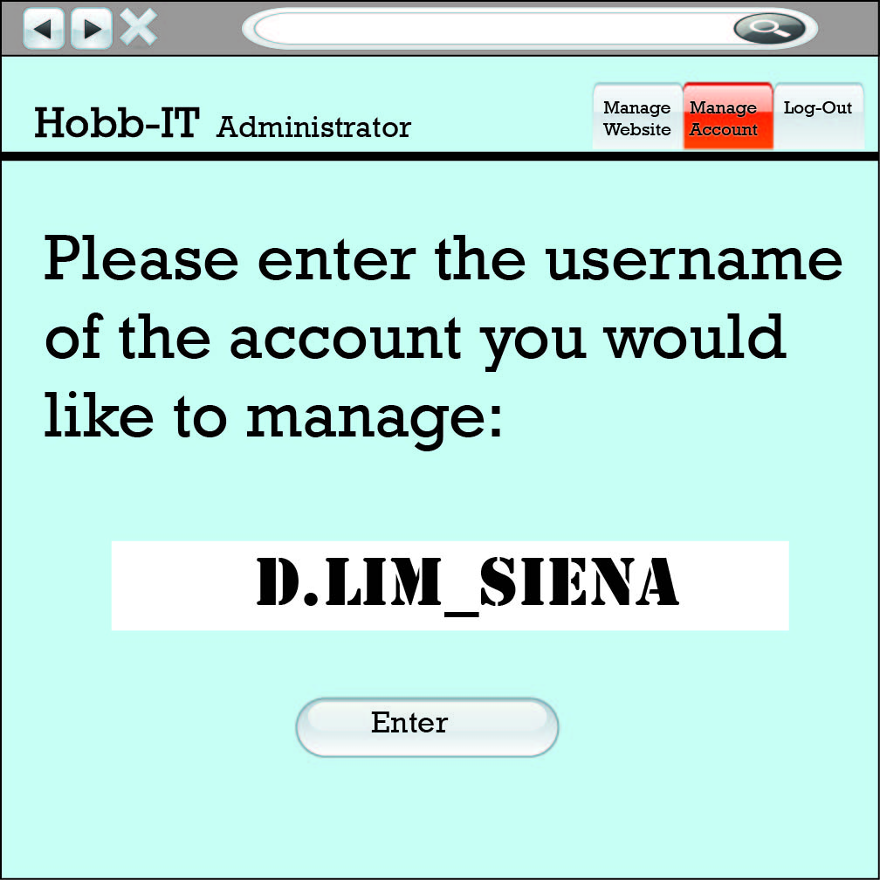
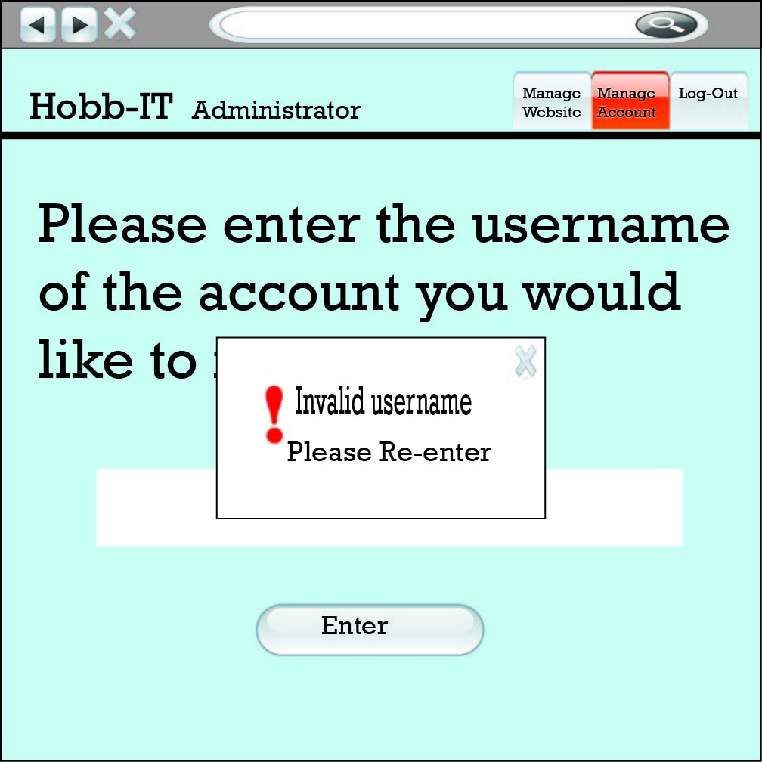
Administrator Manage Account

Slide 52
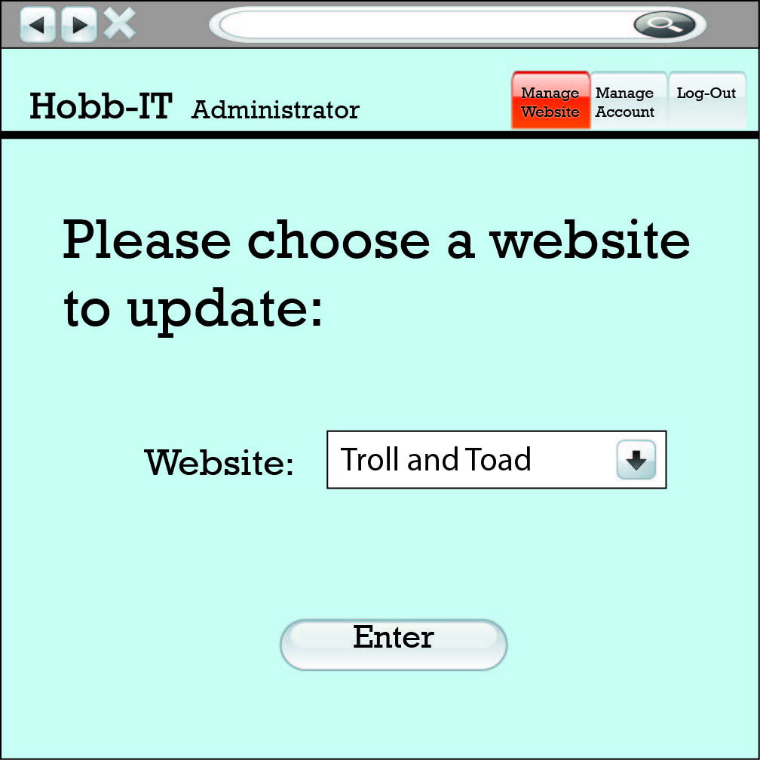
Administrator update website

Slide 53
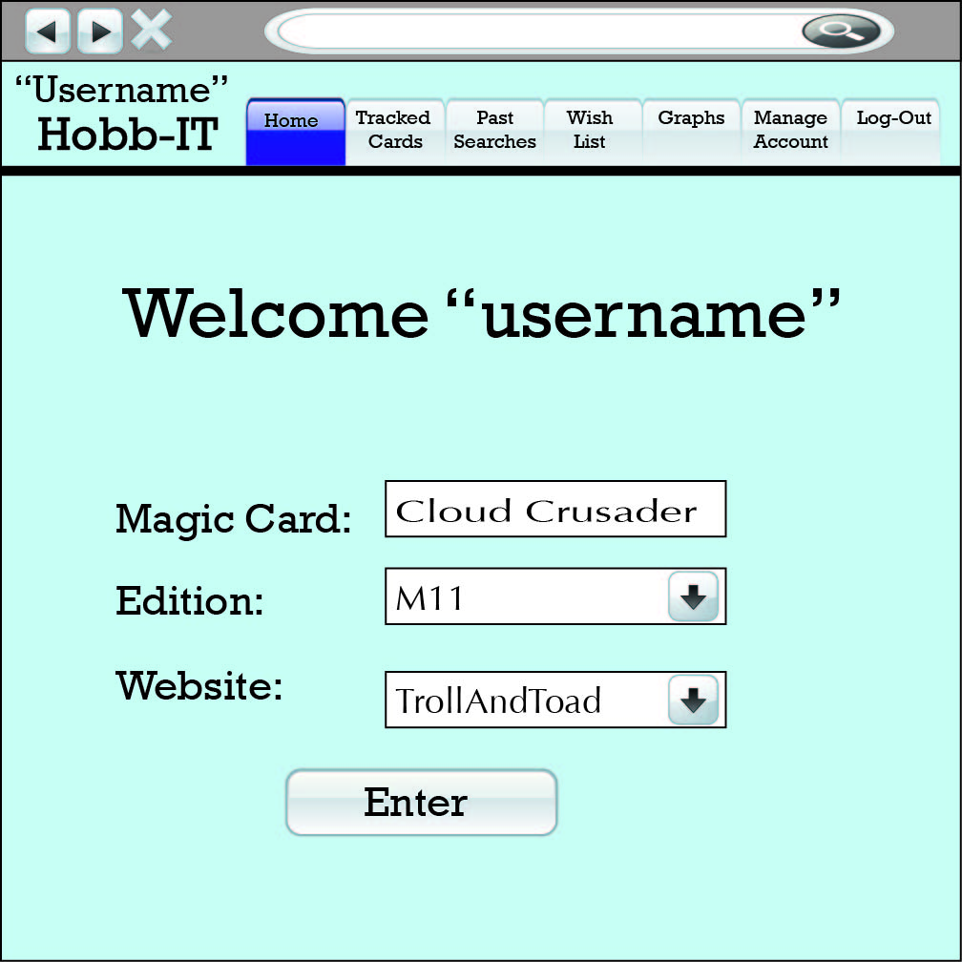
Advanced User Home

Slide 54
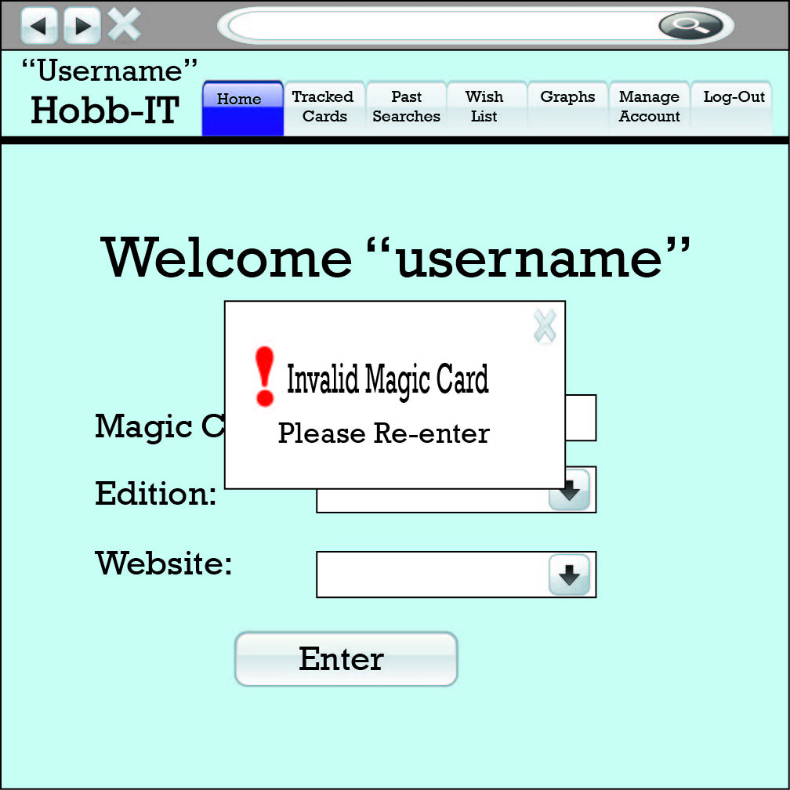

Advanced User Home Errors

Slide 55
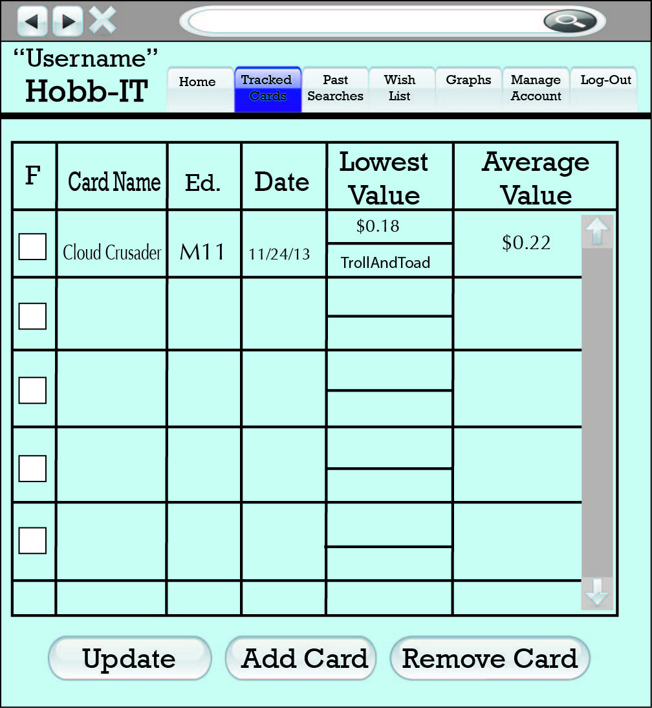
Advanced user tracked Cards

Slide 56
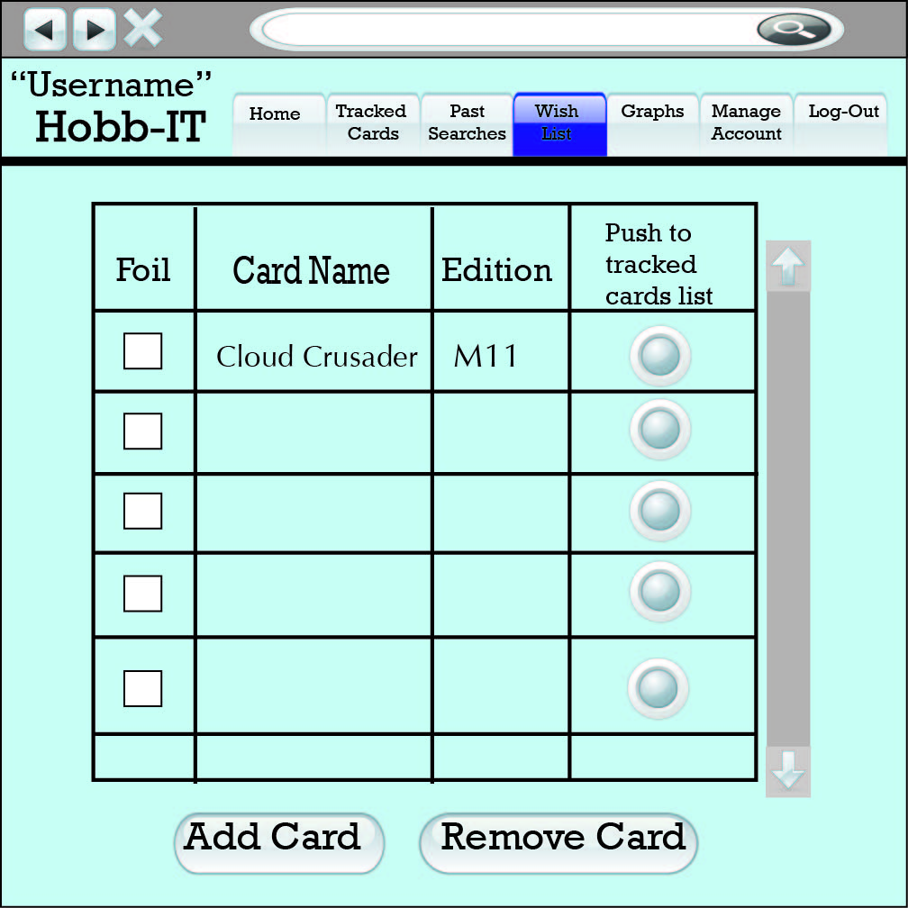
Advanced user Wish list

Slide 57
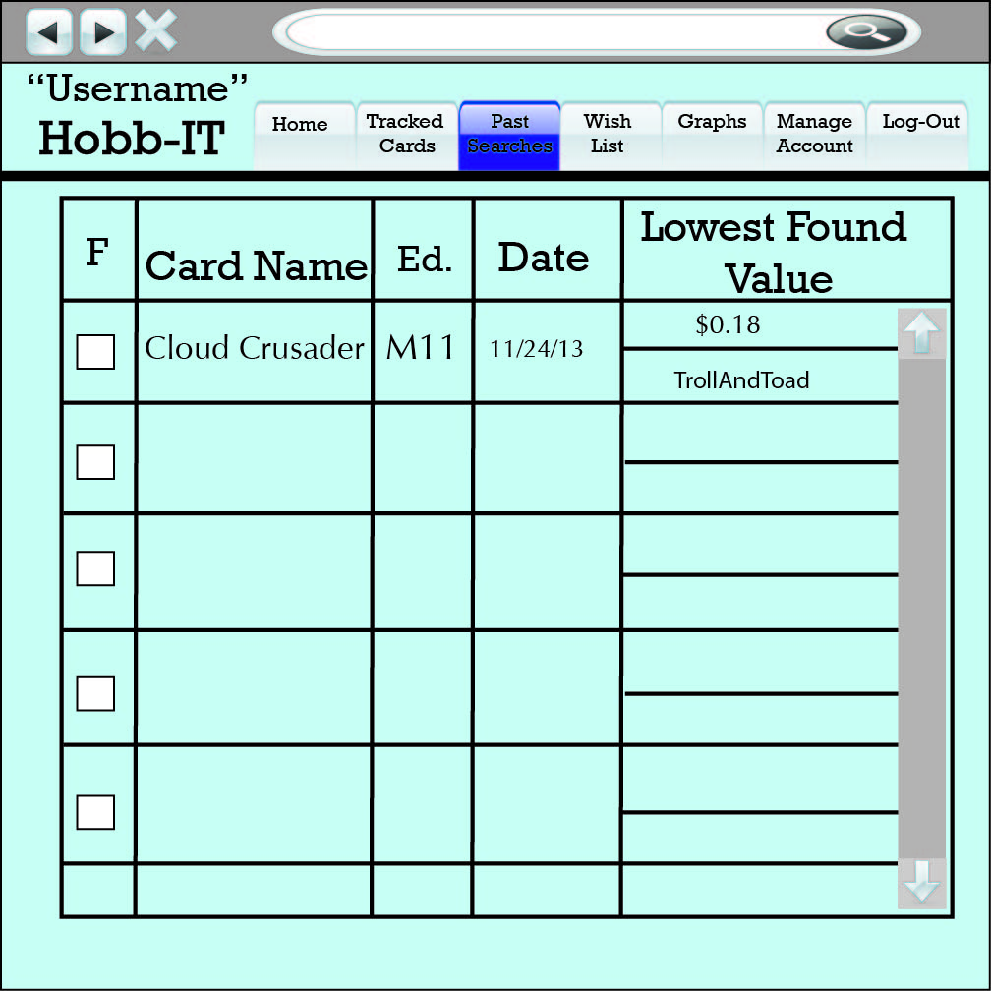
Advanced User Past Searches

Slide 58
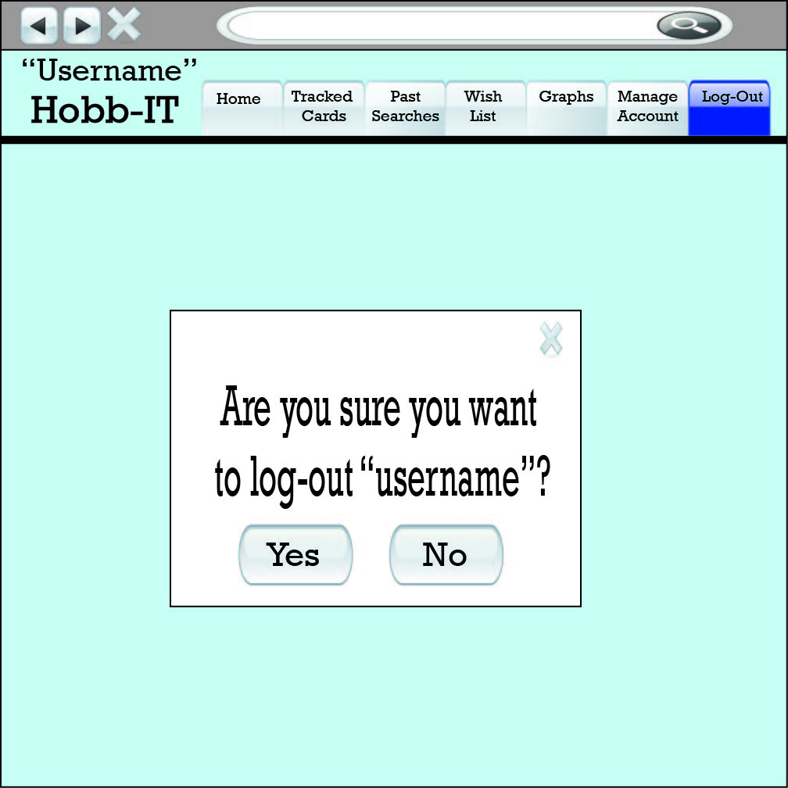
Advanced User Log-out

Slide 59
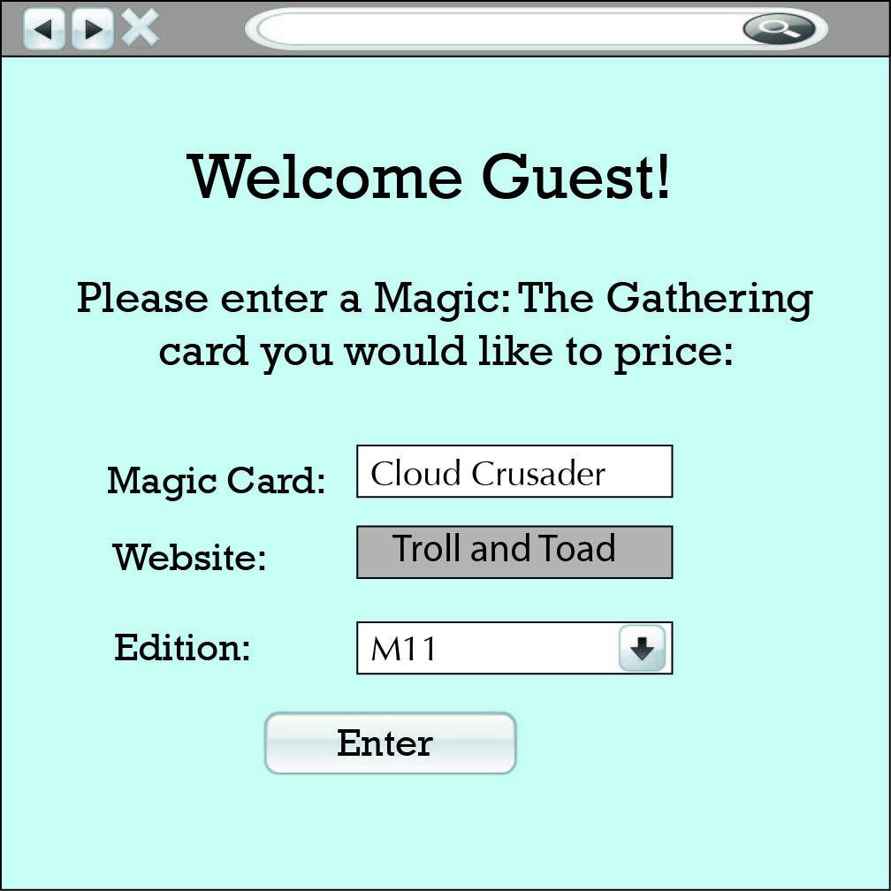
Guest Welcome

Slide 60
Scraping Prototype
Must be able to scrape specified list of websites
Using Jsoup, a Java package for scraping websites
Must get 5 attributes from the website
    Card Name
    Edition
    Condition
    Price
    Quantity

Slide 61
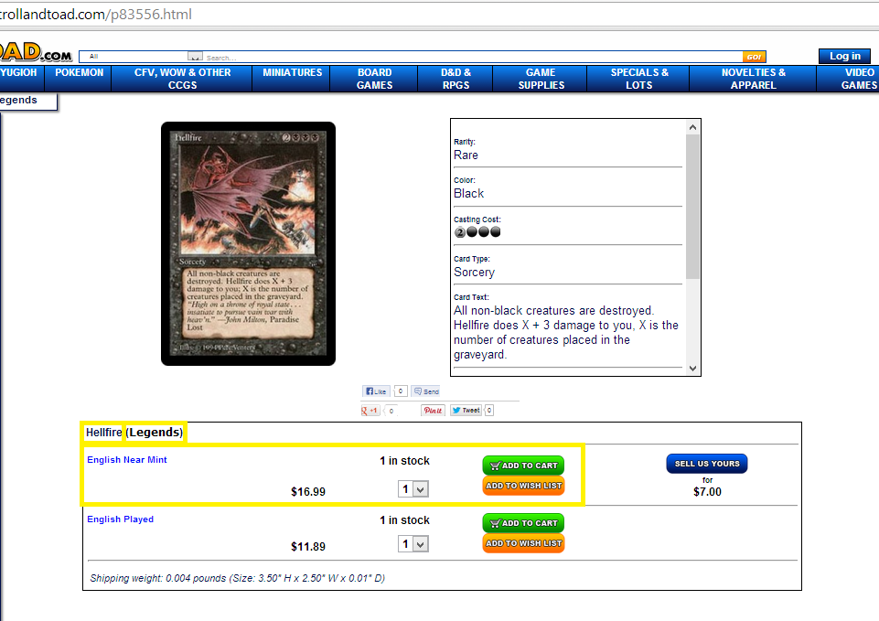
Scraping Prototype (trollandtoad.com)

Slide 62
Code Snippet
Document doc =
Jsoup.connect("http://www.trollandtoad.com/p83556.html").get();
Elements conditions =
doc.getElementsByClass("productquantity");
Elements prices =
doc.getElementsByAttributeValue("class" , "productprice");
Elements cardNames =
doc.getElementsByAttributeValue("class" , "pname1");
String cardName =
cardNames.get(0).text();

Slide 63
Scraping Prototype (trollandtoad.com)
The Result (11/22/13):
Card name = Hellfire
Edition = Legends
Condition = English Near Mint
Price = $16.99
Quantity = 1 in stock

Slide 64
AGENDA
AGENDA
Introduction
Status of Project
Data Flow Diagrams(DFD)
User Case Narrative
UML Diagrams
Development and Production Environments
Functional Requirements Inventory
Website Map
Testing Overview and Data Dictionary
Prototype screens
What is next?
64

Slide 65
What is next?
Detailed Design
  Spring 2014
Acceptance Test
  Spring 2014

Slide 66
Questions?

