Slide 1
Hobb-IT
Hobby Information Tracker
By Illumination Technologies
Detailed Design
March 19, 2014

Slide 2
WELCOME
Client: Dr. Darren Lim
Associate Professor Computer Science
Guest: Dr. Tim Lederman
Guest: Dr. Meg Fryling

Slide 3
AGENDA
AGENDA
Introduction
Product Overview
Data Dictionary
Entity Relationship Diagram
Data Design
Database Tables
Prototype Screens
Testing
Unit Test
Acceptance Test
What is next?
3

Slide 4
Introduction
Katie Sitaro – Team Leader
Karl Appel – Head Developer
Connor Blakely – Webmaster
Jackie Hausmann – Database Administrator
Bryan Leicht – Information Specialist

Slide 5
AGENDA
Introduction
Product Overview
Data Dictionary
Entity Relationship Diagram
Data Design
Database Tables
Prototype Screens
Testing
Unit Test
Acceptance Test
What is next?
5

Slide 6
Product overview
Magic: The Gathering playing cards
Scrape data from a variety of websites
Track changes in prices between days
Compare prices between websites

Slide 7
AGENDA
AGENDA
Introduction
Product Overview
Data Dictionary
Entity Relationship Diagram
Data Design
Database Tables
Prototype Screens
Testing
Unit Test
Acceptance Test
What is next?
7

Slide 8
Data Dictionary
On Excel Sheet

Slide 9
AGENDA
AGENDA
Introduction
Product Overview
Data Dictionary
Entity Relationship Diagram
Data Design
Database Tables
Prototype Screens
Testing
Unit Test
Acceptance Test
What is next?
9

Slide 10
E-R Diagram legend
Entity
Entity: Something in the database that exists on its own and is uniquely identified
Relationship: Connects two entities and describes how they are related
Primary Key Attribute: uniquely identifies the entity along with any other primary key
Attribute: any data associated with an entity
Relationship
Primary Key Attribute
Attribute

Slide 11
E-R Diagram
11

Slide 12
AGENDA
AGENDA
Introduction
Product Overview
Data Dictionary
Entity Relationship Diagram
Data Design
Database Tables
Prototype Screens
Testing
Unit Test
Acceptance Test
What is next?
12

Slide 13
Relational Schema
Visual Representation of the database
Boxes around each table
Describes attributes of each table
Arrows connecting tables to show relationships

Slide 14
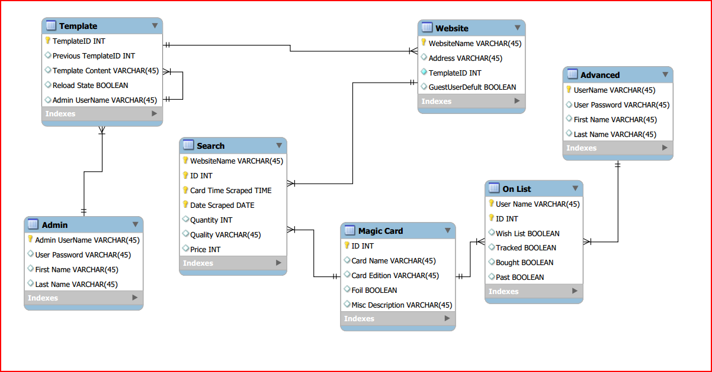
Relational Schema
14

Slide 15
AGENDA
AGENDA
Introduction
Product Overview
Data Dictionary
Entity Relationship Diagram
Data Design
Database Tables
Prototype Screens
Testing
Unit Test
Acceptance Test
What is next?
15

Slide 16
Database Tables: Website
Website Name | Primary Key, varChar
Address | varChar
Template ID | Foreign Key, Unique, Not Null, int
Guest User Default | boolean

Slide 17
Database Tables: Template
Template ID | Primary Key, int
Previous Template Id | Foreign Key, Unique, int
Template Content | varChar
Reload State | boolean

Slide 18
Database Tables: administrator
Admin User Name | Primary Key, varChar
User Password | varChar
First Name | varChar
Last Name | varChar

Slide 19
Database Tables: Magic Card
ID | Primary Key, int
Card Name | varChar
Card Edition | varChar
Foil | boolean
Misc Description | varChar

Slide 20
Database Tables: Advanced
User Name | Primary Key, varChar
User Password | varChar
First Name | varChar
Last Name | varChar

Slide 21
Database Tables: Search
Website Name | Primary Key, Foreign Key, varChar
ID | Primary Key, Foreign Key, int
Card Time Scraped | Primary Key, Time
Date Scraped | Primary, Date
Quantity | Int
Quality | varChar
Price | Int

Slide 22
Database Tables: on List
User Name | Primary Key, Foreign Key, varChar
ID | Primary Key, Foreign Key, int
Wish List | boolean
Tracked | boolean
Bought | boolean
Past | boolean

Slide 23
AGENDA
AGENDA
Introduction
Product Overview
Data Dictionary
Entity Relationship Diagram
Data Design
Database Tables
Prototype Screens
Testing
Unit Test
Acceptance Test
What is next?
23

Slide 24
AGENDA
AGENDA
Introduction
Product Overview
Data Dictionary
Entity Relationship Diagram
Data Design
Database Tables
Prototype Screens
Testing
Unit Test
Acceptance Test
What is next?
24

Slide 25
Testing Overview
Unit Tests – Checks to see all major processes work properly
- Made up of Test Cases
Test Case – An individual test within a component of the software usually for one process
Acceptance Test – Does the software provide the functionality the client needs?

Slide 26
AGENDA
AGENDA
Introduction
Product Overview
Data Dictionary
Entity Relationship Diagram
Data Design
Database Tables
Prototype Screens
Testing
Unit Test
Acceptance Test
What is next?
26

Slide 27
Unit TestS
On Excel Sheet

Slide 28
AGENDA
AGENDA
Introduction
Product Overview
Data Dictionary
Entity Relationship Diagram
Data Design
Database Tables
Prototype Screens
Testing
Unit Test
Acceptance Test
What is next?
28

Slide 29
Acceptance Test
Functional Requirements
Three different users
Nonfunctional Requirements
Easy to change a website’s template
Efficient, Stable, User friendly
Follow all laws for parsing data

Slide 30
AGENDA
AGENDA
Introduction
Product Overview
Data Dictionary
Entity Relationship Diagram
Data Design
Database Tables
Prototype Screens
Testing
Unit Test
Acceptance Test
What is next?
30

Slide 31
What is next?
Acceptance Test Presentation
April 30, 2014
End of the Year Party
May 5, 2014

Slide 32
Questions?

