Slide 1
Detailed Design: Smart Scheduling
Client: Dr. Robert Yoder

Slide 2
Welcome
Dr. Robert Yoder (client)
Head of the Computer Science Department at Siena College
Dr. Timoth Lederman
Our Professor

Slide 3
Agenda
Software Engineering Team
Restatement of Problem
Project Progression
Entity – Relationship Diagram
Relational Schema
Unit Test
Acceptance Test
Development Environment
Prototype Screens
What’s Next
Questions

Slide 4
Empire Unlimited
Meghan Servello – Team Leader
Jason Czajkowski – Systems Analyst
Thomas Mottola – Head Programmer
Brian Maxwell – Project Manager
Jonathan Smith – Support and Quality Manager
Collin Lefeber – Web Developer

Slide 5
Agenda
Software Engineering Team
Restatement of Problem
Project Progression
Entity – Relationship Diagram
Relational Schema
Unit Test
Acceptance Test
Development Environment
Prototype Screens
What’s Next
Questions

Slide 6
The Problem
Scheduling classrooms, labs, courses, and professors.
Currently scheduling is done in a cumbersome fashion.
Lack of a self-checking system.
There are constraints set by Siena College.
Schedules can be difficult to read.

Slide 7
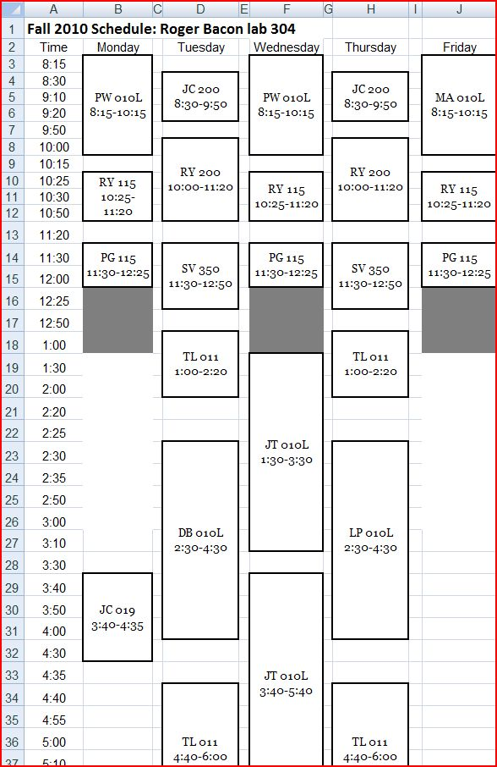
Examples

Slide 8
Agenda
Software Engineering Team
Restatement of Problem
Project Progression
Entity – Relationship Diagram
Relational Schema
Unit Test
Acceptance Test
Development Environment
Prototype Screens
What’s Next
Questions

Slide 9
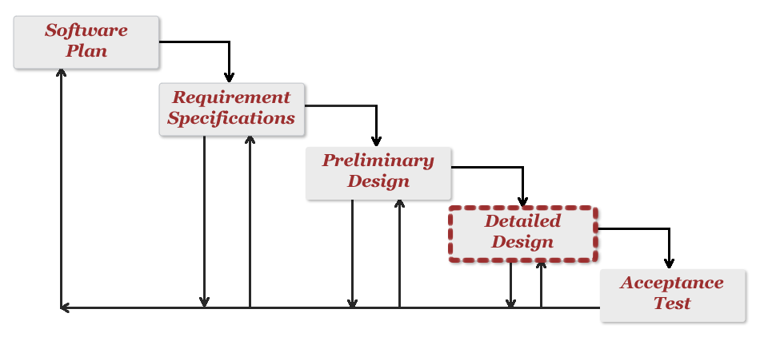
Project Progression

Slide 10
Agenda
Software Engineering Team
Restatement of Problem
Project Progression
Entity – Relationship Diagram
Relational Schema
Unit Test
Acceptance Test
Development Environment
Prototype Screens
What’s Next
Questions

Slide 11
Entity-Relationship Diagram (ERD)

Slide 12
Agenda
Software Engineering Team
Restatement of Problem
Project Progression
Entity – Relationship Diagram
Relational Schema
Unit Test
Acceptance Test
Development Environment
Prototype Screens
What’s Next
Questions

Slide 13
Relational Schema

Slide 14
Agenda
Software Engineering Team
Restatement of Problem
Project Progression
Entity – Relationship Diagram
Relational Schema
Unit Test
Acceptance Test
Development Environment
Prototype Screens
What’s Next
Questions

Slide 15
Unit Testing - Directory

Slide 16
Unit Testing – Add Faculty Member

Slide 17
Unit Testing – View Current Courses

Slide 18
Unit Testing – New Course

Slide 19
Agenda
Software Engineering Team
Restatement of Problem
Project Progression
Entity – Relationship Diagram
Relational Schema
Unit Test
Acceptance Test
Development Environment
Prototype Screens
What’s Next
Questions

Slide 20
Acceptance Test
Functional Requirements
Non-Functional Requirements
Tested on four major internet browsers
Tested on both windows and macs

Slide 21
Agenda
Software Engineering Team
Restatement of Problem
Project Progression
Entity – Relationship Diagram
Relational Schema
Unit Test
Acceptance Test
Development Environment
Prototype Screens
What’s Next
Questions

Slide 22
Development Environment
Rails Version 3.0.3
Ruby Revision 30365
Ubuntu 10.10 run on VM Virtual Box

Slide 23
Agenda
Software Engineering Team
Restatement of Problem
Project Progression
Entity – Relationship Diagram
Relational Schema
Unit Test
Acceptance Test
Development Environment
Prototype Screens
What’s Next
Questions

Slide 24
Prototypes
http://simple-sword-779.heroku.com/

Slide 25
Agenda
Software Engineering Team
Restatement of Problem
Project Progression
Entity – Relationship Diagram
Relational Schema
Unit Test
Acceptance Test
Development Environment
Prototype Screens
What’s Next
Questions

Slide 26
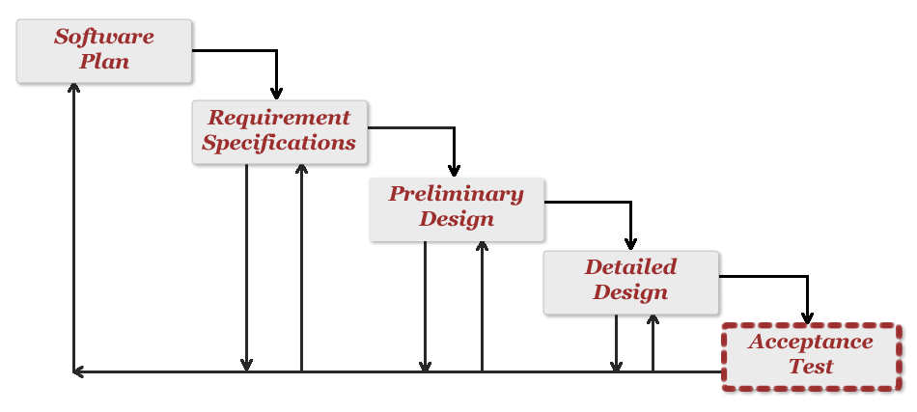
What’s Next
Acceptance Test
Tentative March 1st – April 26th

Slide 27
The End
Thank you.
Questions or Comments?

