Slide 1
Elite Sprint 3
February 17th, 2016
Andrew Ashline, Filipe Coutinho, Joe Faresta,
Hemraj Persaud, Kirby O’Keefe, Dan Wilson

Slide 2
Project Overview
Create an application to help users practice deductive reasoning
Utilize an instructor/student structure like blackboard
Allow instructors to create proof problems and quizzes
Allow students to take quizzes and practice proofs
Incorporate statistics tracking within the database

Slide 3
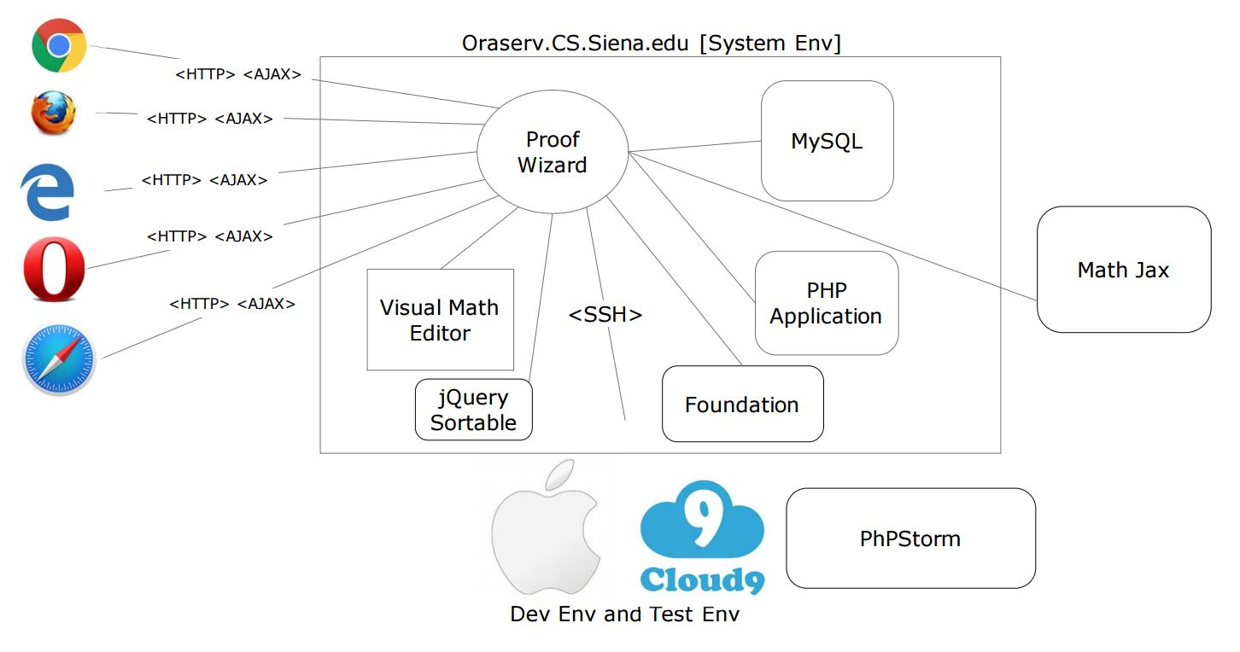

Slide 4
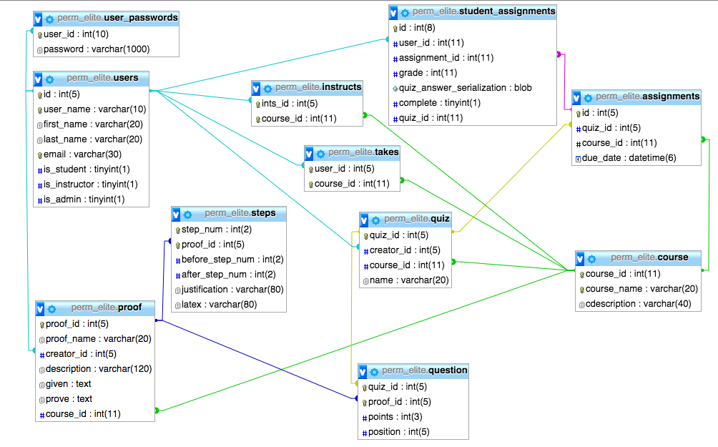
Database Design

Slide 5
Assign Quiz

Slide 6
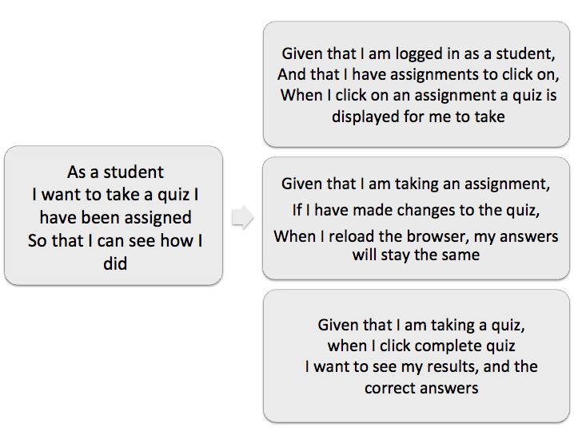
Take Quiz

Slide 7
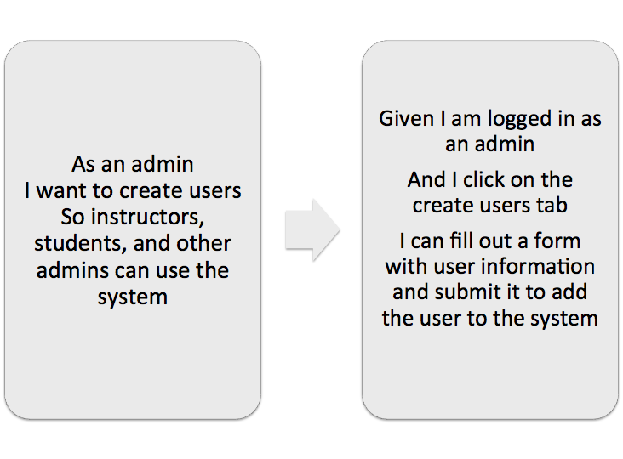
Create Users

Slide 8
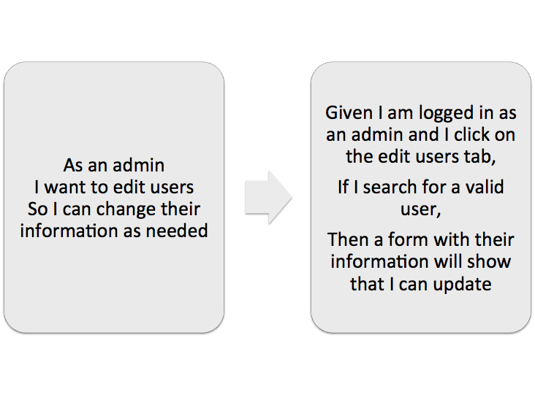
Edit Users

Slide 9
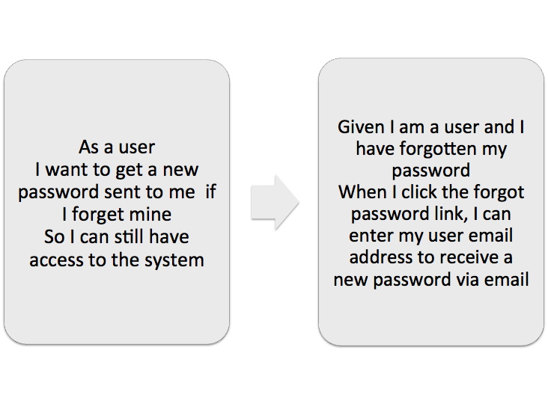
Forgot Password

Slide 10
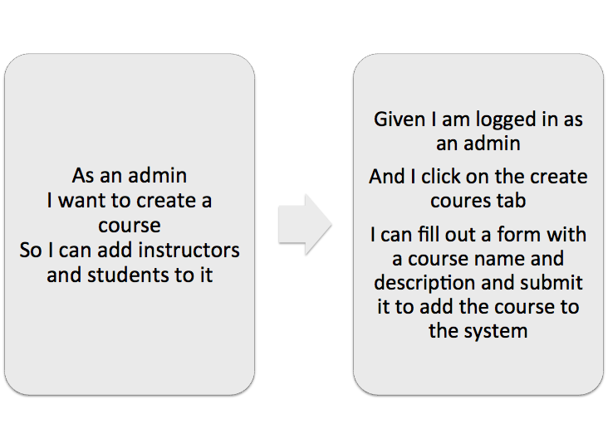
Create Course

Slide 11
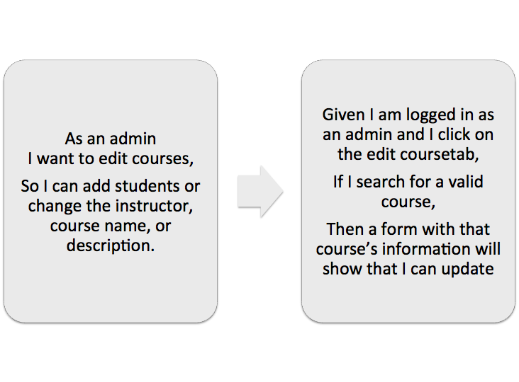
Edit Course
**Adding students pushed to next sprint

Slide 12
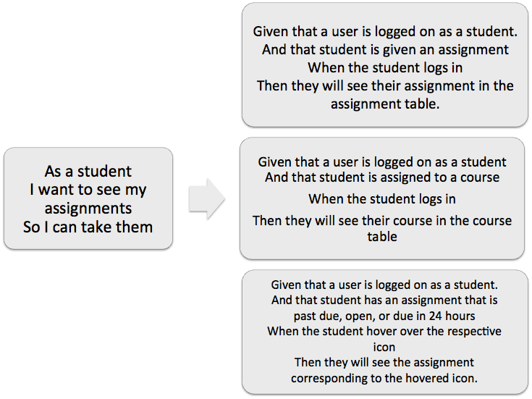
Student Dashboard

Slide 13
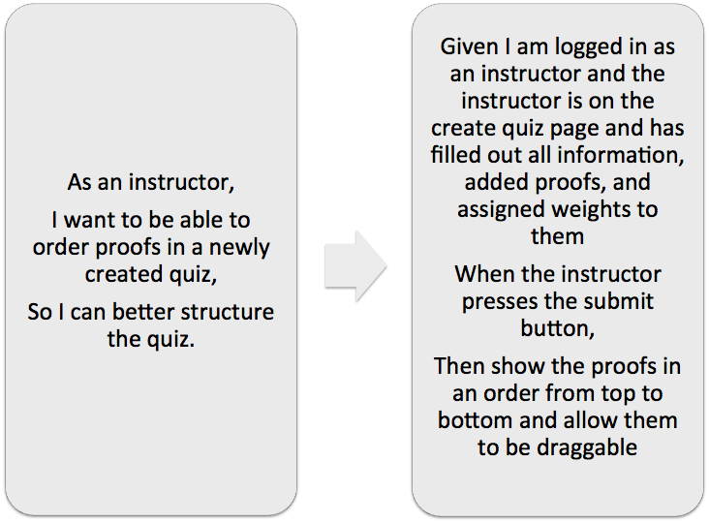
Pushed
to
Next
Sprint:

Slide 14
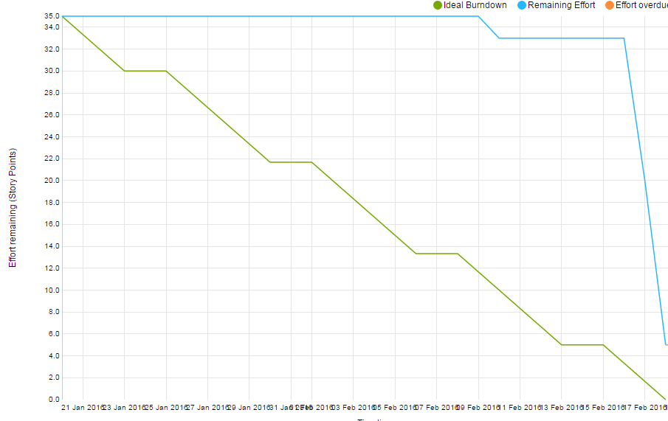

Slide 15
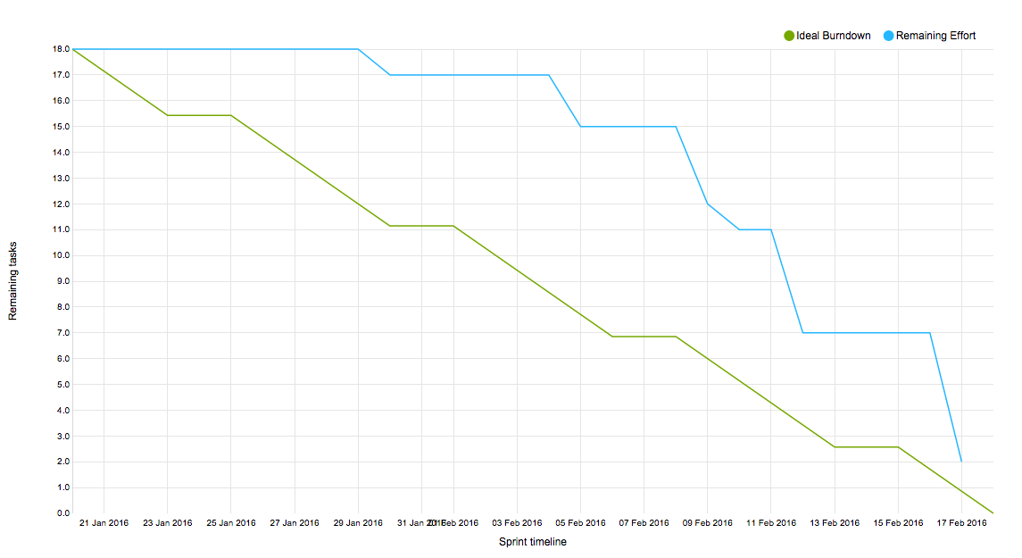
Sprint Burndown Chart
Sprint 3 Velocity = 30

Slide 16
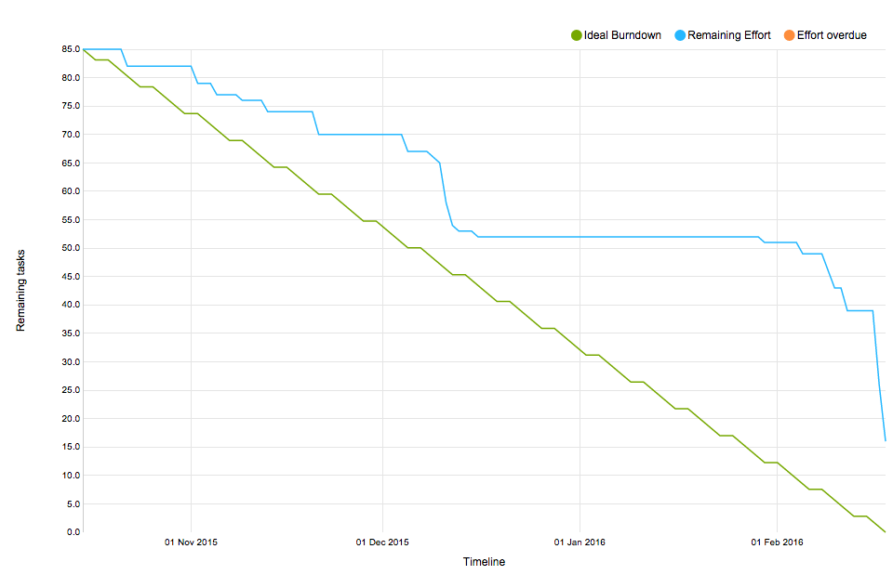
Average Project Velocity = 18
Total Project Velocity = 54
Sprint 1 = 11
Sprint 2 = 13
Sprint 3 = 30

Slide 17
DEMO

Slide 18
Reflection and Retrospective
Actions made for Sprint 3 | Actions to make for Sprint 4
Be sure to manually verify stories so they show up on YouTrack burndown chart Thoroughly think of all tasks before starting sprint Have formal stand up meetings more frequently | Be sure to specify all story points at beginning of sprint Don’t add more tasks during sprint - stick to what we plan on at the start Focus on project more in the beginning of the sprint

Slide 19
Feedback
Adding multiple students to a course at a time
Change our data base course table
have groups of courses
use sections to differentiate between the “classes”

