Slide 1
Chevrolet Advance-Design Series Paint Visualizer Detailed Design
Y
O
S
Your Dream, Our Solution

Slide 2
Agenda
Introduction
Problem Overview
Project Progression
Test Plan
Data Design
Prototype Screens
What’s Next?
Questions

Slide 3
Team introduction
Kerrie Daley– Team Leader
Frank Schroeder – Project Manager
Troy Valle – Lead Programmer
Grady McBride – Database Manager
Matt Mainello – Webmaster

Slide 4
Agenda
Introduction
Problem Overview
Project Progression
Test Plan
Data Design
Prototype Screens
What’s Next?
Questions

Slide 5
Problem Overview
Dr. Timoth Lederman is a General Motors Truck enthusiast. Several years ago, he found a web application on the Internet that allowed him to custom design trucks. Unfortunately, the website is no longer in existence. Dr. Lederman has expressed his want for a new web application that will allow users to custom design 1947-1955 Chevrolet trucks. This project will be called Chevrolet Advance-Design Series Paint Visualizer (CADS Paint Visualizer).

Slide 6
Agenda
Introduction
Problem Overview
Project Progression
Test Plan
Data Design
Prototype Screens
What’s Next?
Questions

Slide 7
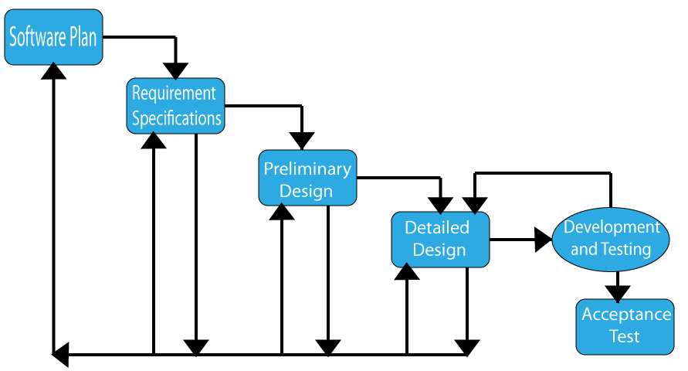
Project Progression

Slide 8
Agenda
Introduction
Problem Overview
Project Progression
Test Plan
Data Design
Prototype Screens
What’s Next?
Questions

Slide 9
Our Test Strategy
Break the project up into units
Unit Testing: Testing concerned with an individual program.
Integration Testing: Testing concerned with testing that each system component, consisting of individual units that have already been tested independently, function properly when they are put together to perform a high order function.
Acceptance Testing: Testing concerned with validating the functional and non-functional requirements of a system.

Slide 10
Functional Requirements Inventory
10
1947 Pickup Truck-
A split flat windshield
No vent window
An air scoop window on the cowl
Curved bedsides
Bumper dip
1947 Cab Over Engine-
A split flat windshield
No vent window
An air scoop on the cowl
Flat bed
1948 Pickup Truck-
A split flat windshield
No vent window
An air scoop window on the cowl
Curved bedsides
1948 Cab Over Engine-
A split flat windshield
No vent window
An air scoop on the cowl
Flat bed
1949 Pickup Truck-
A split flat windshield
No vent window
An air scoop window
on the cowl
Curved bedsides
1949 Cab Over Engine-
A split flat windshield
No vent window
An scoop vent on the cowl
Flat bed

Slide 11
1950 Pickup Truck-
A split flat windshield
No vent window
An air scoop on the cowl
Curved bedsides
1950 Cab Over Engine-
A split flat windshield
No vent window
An air scoop on the cowl
Flat bed
1951 Pickup Truck-
A split flat windshield
Vent window
No air scoop on the cowl
Curved bedsides
1951 Cab Over Engine-
A split flat windshield
Vent window
No air scoop on the cowl
Flat bed
1952 Pickup Truck-
A split flat windshield
Vent window
No air scoop on the cowl
Curved bedsides
1952 Cab Over Engine-
A split flat windshield
Vent window
No air scoop on the cowl
Flat bed

Slide 12
1953 Pickup Truck-
A split flat windshield
Vent window
No air scoop on the cowl
Curved bedsides
1953 Cab Over Engine-
A split flat windshield
Vent window
No air scoop on the cowl
Flat bed
1954 Pickup Truck-
A single-curved windshield
Vent Window
No air scoop on the cowl
Flat top on bedsides
Dip in the bumper
1954 Cab Over Engine-
A single-curved windshield
Vent Window
No air scoop on the cowl
Flat bed
Dip in the bumper
1955 Pickup Truck-
A single-curved windshield
Vent window
No air scoop on the cowl
Flat top on bedsides
Dip in the bumper
1955 Cab Over Engine-
A single-curved windshield
Vent window
No air scoop on the cowl
Flat bed
Dip in the bumper

Slide 13
Can the user switch between controller panels (save, load, factory, custom)?
Does the system allow a user to save a truck using a unique code word?
Does the system allow a user to load a truck using a unique code word?
Does the correct truck image load when the user selects the body, year, and model?

Slide 14
Non-Functional Requirements
The system must be easy to use
The system must be intuitive

Slide 15
UNIT TESTS

Slide 16
Agenda
Introduction
Problem Overview
Project Progression
Test Plan
Data Design
Prototype Screens
What’s Next?
Questions

Slide 17
Logical Data dictionary
Key
Data Name: The name of the data entity being stored, whether it be in a database or not.
Applicable to: The screens that this data entity will apply to.
Data Type: The type of data for a data entity.
Data Size: The size of the data in terms of it's data type.
Description: A description of what data this entity is storing.
Acceptable Input: What must be inputted by a user in order for the system to accept the data.
Good Example of Input: An example of data that would be accepted by the system.
Notes: Additional important information about the data.

Slide 18
Data Name | Applicable to | Data Type | Data Size | Description | Acceptable Input | Good Example of Input | Notes
truckName | Save Truck, Load Library | Char | 1-20 Characters | The name used to save the truck for future use (editing or viewing) | ASCII Chars from Decimal 32 to Decimal 126 inclusive, allowed | TRuck233 | Must be unique and can not be null.
color | Change Color | Char | 3-30 Characters | The name used for each factory color. | ASCII Chars from Decimal 32 to Decimal 126 inclusive, allowed | Red | Must be unique and can not be null.
redValue | Change Color, Save Truck | Byte | 3 digit number | The value that will represent how much red will be used in a certain color. | Any integer ranging from 0 to 255 | 120 | It doesn't have to be unique. It can not be null.
greenValue | Change Color, Save Truck | Byte | 3 digit number | The value that will represent how much green will be used in a certain color. | Any integer ranging from 0 to 255 | 120 | It doesn't have to be unique. It can not be null.
blueValue | Change Color, Save Truck | Byte | 3 digit number | The value that will represent how much blue will be used in a certain color. | Any integer ranging from 0 to 255 | 120 | It doesn't have to be unique. It can not be null.
partName | Change Color, Save Truck | Char | 3-15 Characters | A specific part that is on each truck. Each truck will have all of the same parts but we will need to store which part has which color for when we save the truck | ASCII Chars from Decimal 32 to Decimal 126 inclusive, allowed | Fender | It doesn't have to be unique. It can not be null.

Slide 19
Data Name | Applicable to | Data Type | Data Size | Description | Acceptable Input | Good Example of Input | Notes
Year | Change Color, Save Truck, Change View, Select Year | Int | 4 digit number | Year of the truck | Any integer ranging from 1947-1955 | 1948 | It doesn't have to be unique. It can not be null.
cabStyle | Save Truck, Change View, Change Year | Char | 1-15 Characters | Cab Style of the truck. Different years may have different selections of CAB styles | ASCII Chars from Decimal 32 to Decimal 126 inclusive, allowed | Crew Cab | It doesn't have to be unique. It can not be null.
windowStyle | Save Truck, Change View, Change Year | Char | 1-15 Characters | Window Style of the truck. Different years may have different selections of Window styles | ASCII Chars from Decimal 32 to Decimal 126 inclusive, allowed | Traditional | It doesn't have to be unique. It can not be null.

Slide 20
Entity- Relationship Diagram
Provides a graphical representation of the system database
Entities: tables in the database
Attributes: data associated with each entity/relationship
Primary Key: an underlined attribute; how a table is retrieved
Relationship: interaction between two entities
Shows cardinality and weak relationships

Slide 21
ER Diagram Key

Slide 22
ER DIAGRAM

Slide 23
Relational Schema

Slide 24
Agenda
Introduction
Problem Overview
Project Progression
Test Plan
Data Design
Prototype Screens
What’s Next?
Questions

Slide 25
1947-1950
1951-1953
1954-1955

Slide 27
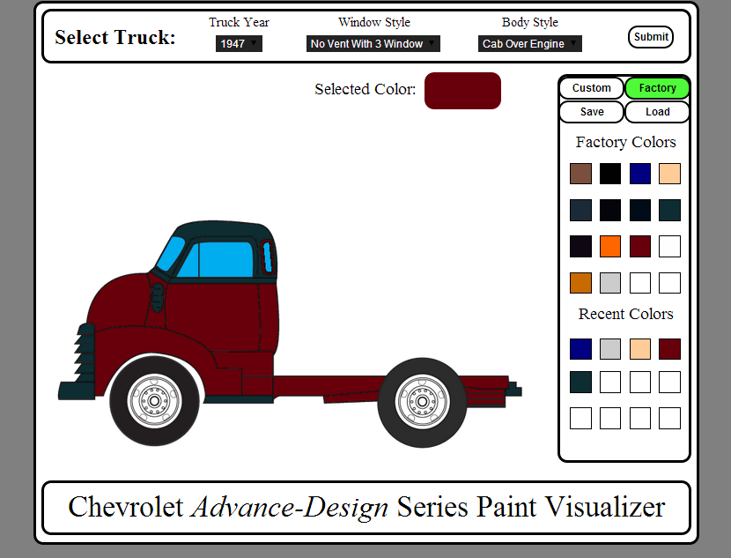

Slide 30
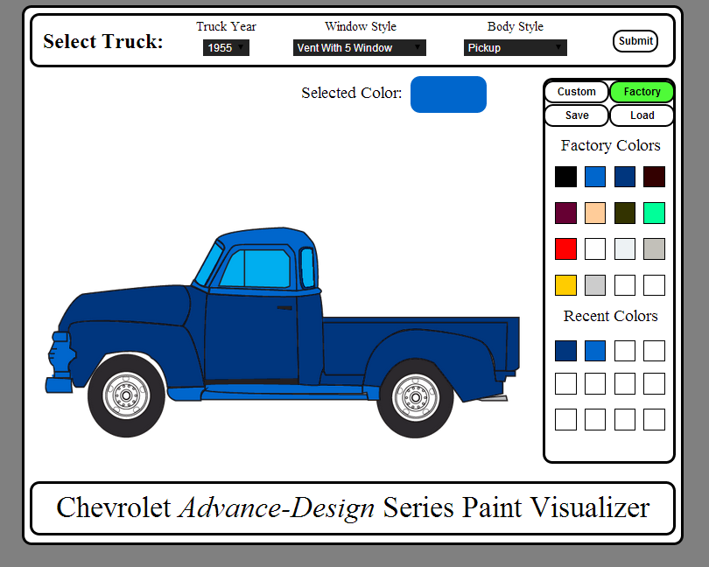

Slide 31
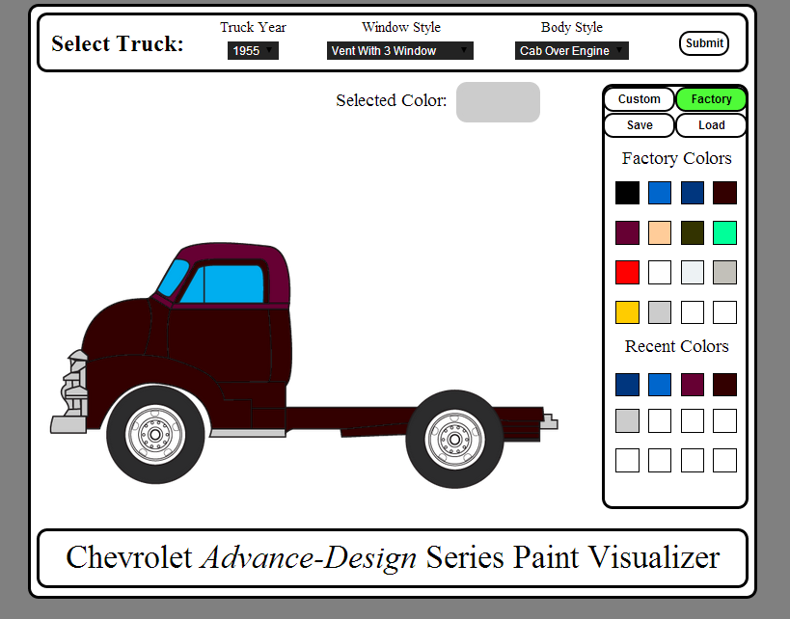

Slide 33
Agenda
Introduction
Problem Overview
Project Progression
Test Plan
Data Design
Prototype Screens
What’s Next?
Questions

Slide 35
The Schedule…
Wednesday March 26th: Wine Etiquette Dinner
Wednesday April 30th: Acceptance Test Presentations
Friday May 2nd: Academic Celebration

Slide 36
Agenda
Introduction
Problem Overview
Project Progression
Test Plan
Data Design
Prototype Screens
What’s Next?
Questions

Slide 37
QUESTIONS?

