Slide 1
Chevrolet Advance-Design Series Paint Visualizer Detailed Design
Y
O
S
Your Dream, Our Solution

Slide 2
Agenda
Introduction
Problem Overview
Project Progression
User Case Narratives
Testing
Demonstration
Deliverables
Future Enhancements
What’s Next?

Slide 3
Team introduction
Kerrie Daley– Team Leader
Frank Schroeder – Project Manager
Troy Valle – Lead Programmer
Grady McBride – Database Manager
Matt Mainello – Webmaster

Slide 4
Agenda
Introduction
Problem Overview
Project Progression
User Case Narratives
Testing
Demonstration
Deliverables
Future Enhancements
What’s Next?

Slide 5
Problem Overview
Dr. Timoth Lederman is a General Motors Truck enthusiast. Several years ago, he found a web application on the Internet that allowed him to custom design trucks. Unfortunately, the website is no longer in existence. Dr. Lederman has expressed his want for a new web application that will allow users to custom design 1947-1955 Chevrolet trucks. This project will be called Chevrolet Advance-Design Series Paint Visualizer (CADS Paint Visualizer).

Slide 6
Agenda
Introduction
Problem Overview
Project Progression
User Case Narratives
Testing
Demonstration
Deliverables
Future Enhancements
What’s Next?

Slide 7
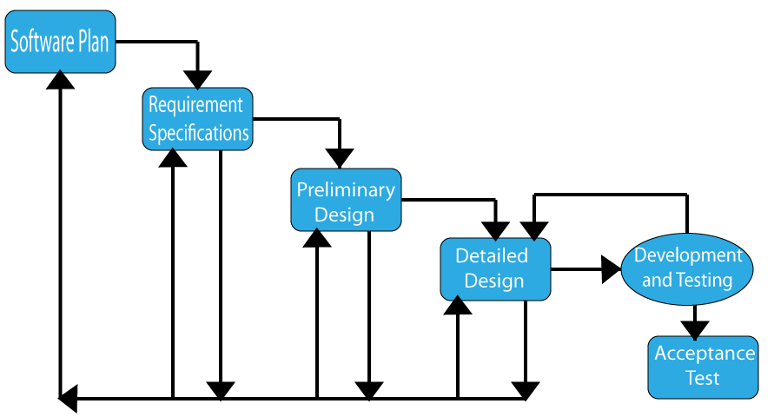
Project Progression

Slide 8
Agenda
Introduction
Problem Overview
Project Progression
User Case Narratives
Testing
Demonstration
Deliverables
Future Enhancements
What’s Next?

Slide 9
User Case Narratives
CADS has three users that will be using the application:
The main users can be classified as a restorer or a customizer.
A user may also be classified as a casual user.

Slide 10
Agenda
Introduction
Problem Overview
Project Progression
User Case Narratives
Testing
Demonstration
Deliverables
Future Enhancements
What’s Next?

Slide 11
Unit Tests

Slide 12
Agenda
Introduction
Problem Overview
Project Progression
User Case Narratives
Testing
Demonstration
Deliverables
Future Enhancements
What’s Next?

Slide 13
Demonstration

Slide 14
Agenda
Introduction
Problem Overview
Project Progression
User Case Narratives
Testing
Demonstration
Deliverables
Future Enhancements
What’s Next?

Slide 15
Deliverables
15
CD-ROM with the following deliverables included:
A full copy of all of the team files from the team directory. This includes all website files, folders, and images
README.txt files that explain what every file, folder, and image is and where they are used/located
The lyrics to the team song, a copy of the music file for the team song, and the audio/visual recording of the team song

Slide 16
Agenda
Introduction
Problem Overview
Project Progression
User Case Narratives
Testing
Demonstration
Deliverables
Future Enhancements
What’s Next?

Slide 17
Future Enhancements
17
The future enhancements for CADS Paint Visualizer are as follows:
The user will have access to side-view and rear-view images of the Chevrolet trucks in addition to the already existing front-view images.

Slide 18
Agenda
Introduction
Problem Overview
Project Progression
User Case Narratives
Testing
Demonstration
Deliverables
Future Enhancements
What’s Next?

Slide 19
What’s Next?
19
May 2nd : Acedemic Celebration
May 5th : End of the Semester Party
May 18th : Commencement

