Slide 1
CCRS Comprehensive Conference Registration System Requirements Specification
October 29th, 2012

Slide 2
Welcome
Our Client:
Dr. Darren Lim
Professor of Computer Science
Siena College

Slide 3
Agenda
Introduction
Problem Overview
Project Progression
User Case Narratives
UML Diagram
Data Flow Diagrams
Requirements Inventory
What’s Next

Slide 4
Introduction
Kelly Bedard Team Leader
Tyler Mann System Admin Co-Webmaster | Jess Reinhardt Document Developer & Analyst
Brett Rudloff Visionary Leader | Carl Tompkins Webmaster

Slide 5
Agenda
Introduction
Problem Overview
Project Progression
User Case Narratives
UML Diagram
Data Flow Diagrams
Requirements Inventory
What’s Next

Slide 6
Problem Overview
Create a comprehensive registration system for CCSCNE
Account for multiple different users
Three main features
Registering
Reviewing
Scheduling

Slide 7
Agenda
Introduction
Problem Overview
Project Progression
User Case Narratives
UML Diagram
Data Flow Diagrams
Requirements Inventory
What’s Next

Slide 8
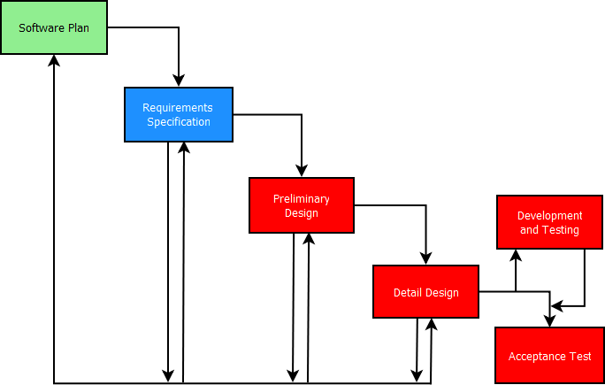
Project Progression

Slide 9
Agenda
Introduction
Problem Overview
Project Progression
User Case Narratives
UML Diagram
Data Flow Diagrams
Requirements Inventory
What’s Next

Slide 10
User Case Narratives
Gives brief description of each type of user
Describes how each user will interact with CCRS

Slide 11
User Case Narratives All Users
Logs in/out
Change Password

Slide 12
User Case Narratives Conference Chair
Has access to all conference information
Can create accounts for others
Can change the schedule

Slide 13
User Case Narratives Committee Chair
Helps decide accepted submissions
Tells system what notifications to send

Slide 14
User Case Narratives Review Committee Chair
Keeps track of reviews for each submission
Ability to send reminders
Ability to assign reviewers

Slide 15
User Case Narratives Registration Committee Chair
Keeps track of registration information
Keeps track of payment information
Ability to send out payment reminders

Slide 16
User Case Narratives Attendee
Registers for conference
Supplies personal, meal, and payment information
Receives confirmation communication

Slide 17
User Case Narratives Programming Contest Participant
Registers for conference
Specifies participation in programming contest

Slide 18
User Case Narratives Faculty Advisor
Registers programming contest team
Specifies team members

Slide 19
User Case Narratives Submitter
Uploads submissions
Receives acceptance or rejection notification

Slide 20
User Case Narratives Presenter
Originally notified if accepted
See time and place for presentation

Slide 21
User Case Narratives Reviewer
Downloads submissions
Uploads reviews

Slide 22
User Case Narratives Vendor
Views scheduled time and place
Supplies information and requests on what they need
Space, audio, visual

Slide 23
Agenda
Introduction
Problem Overview
Project Progression
User Case Narratives
UML Diagram
Data Flow Diagrams
Requirements Inventory
What’s Next

Slide 24
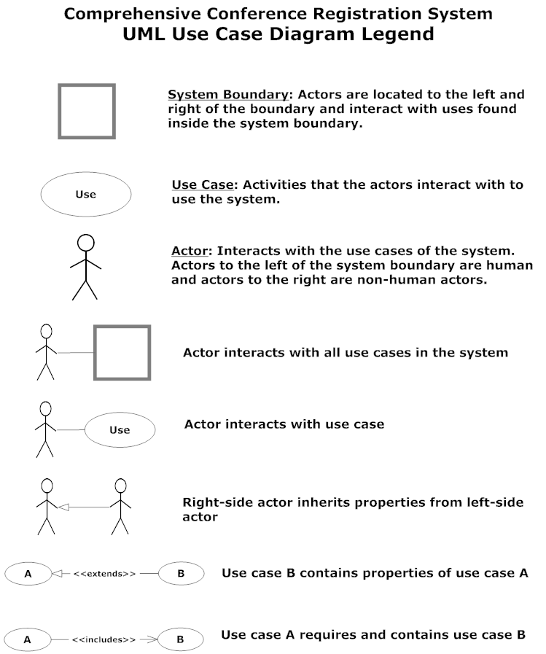
UML Diagram Legend

Slide 25
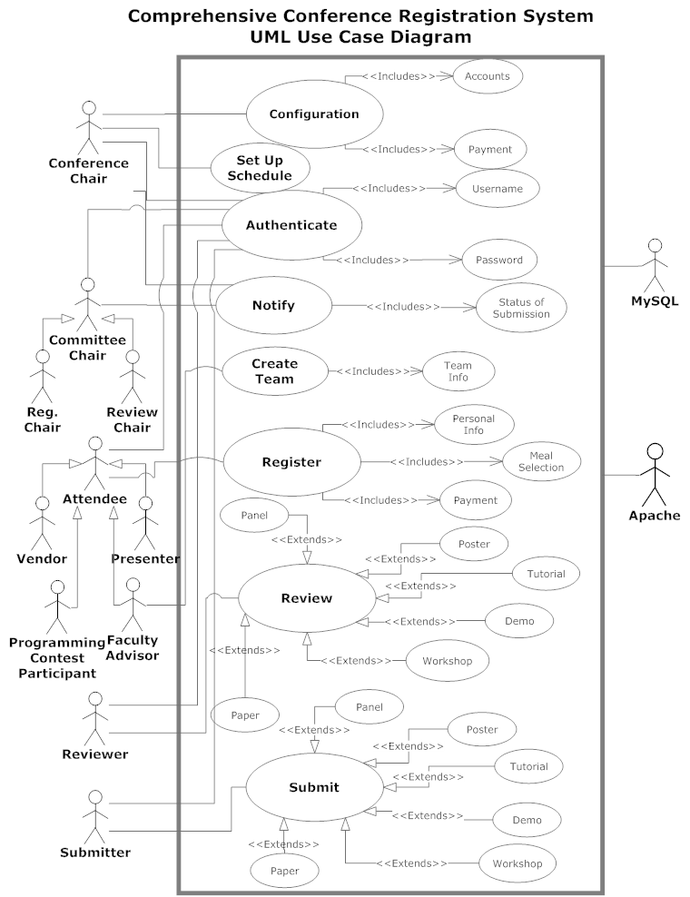
UML Diagram

Slide 26
Agenda
Introduction
Problem Overview
Project Progression
User Case Narratives
UML Diagram
Data Flow Diagrams
Requirements Inventory
What’s Next

Slide 27
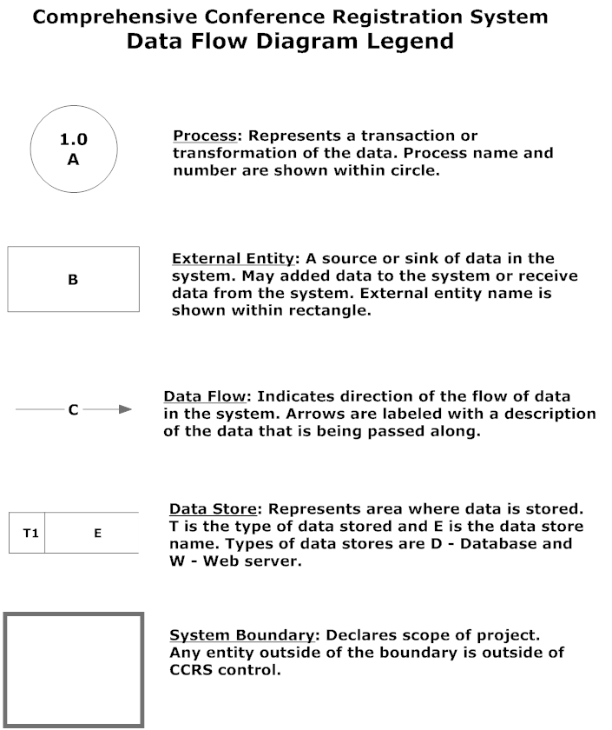
Data Flow Diagram Legend

Slide 28
Context Diagram

Slide 29
Level 0 Diagram

Slide 30
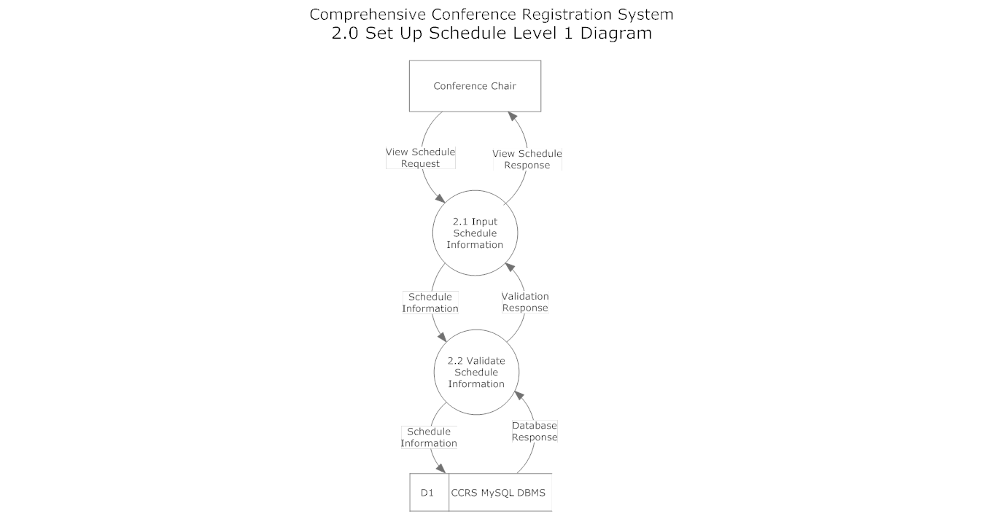
Schedule Level 1

Slide 31
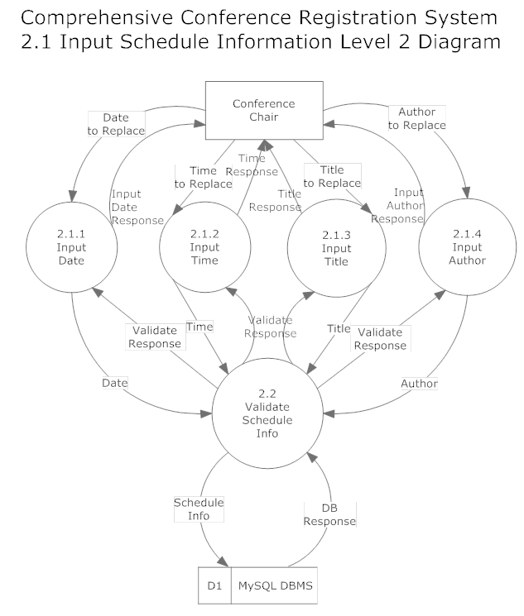
Schedule Level 2

Slide 32
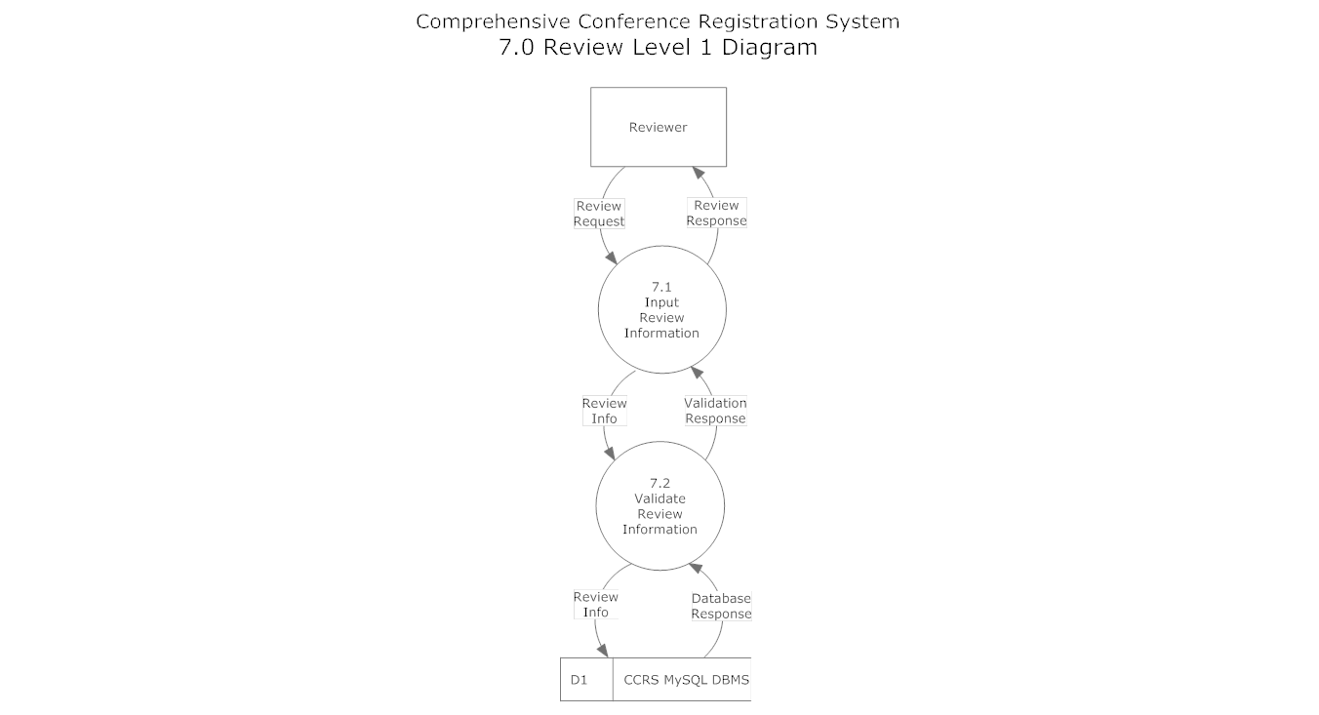
Review Level 1

Slide 33
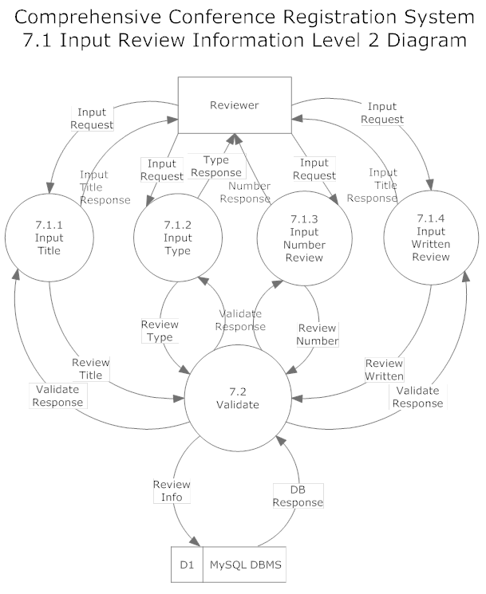
Review Level 2

Slide 34
Agenda
Introduction
Problem Overview
Project Progression
User Case Narratives
UML Diagram
Data Flow Diagrams
Requirements Inventory
What’s Next

Slide 35
Requirements Inventory
Non-Functional Requirements
Not easily testable
Functional Requirements
Easily testable

Slide 36
Non-Functional Requirements
The system will be:
Easily maintained
Stable
Viewable on multiple browsers
Run efficiently
User friendly

Slide 37
Functional Requirements System
Assign reviewers for submissions
Set up conference schedule

Slide 38
Functional Requirements Conference Chair
Log on/off
Manage schedule
Send notifications
Manage accounts

Slide 39
Functional Requirements Attendee
Register for conference
All required fields checked for proper input
Error message produced for issues

Slide 40
Agenda
Introduction
Problem Overview
Project Progression
User Case Narratives
UML Diagram
Data Flow Diagrams
Requirements Inventory
What’s Next

Slide 41
What’s Next
Preliminary Design – December 7, 2012
Detailed Design – Spring 2013
Acceptance Test – Spring 2013

Slide 42
Questions?

