Slide 1
CCRS Comprehensive Conference Registration System Detailed Design March 6th, 2013

Slide 2
Welcome
Our Client:
Dr. Darren Lim
Professor of Computer Science
Siena College
2

Slide 3
Agenda
Introductions
Problem Overview
Project Progression
User Case Narratives
Entity Relationship (ER) Diagram
Data Dictionary
Testing
Prototypes
What’s Next
S.E.E. Solutions
3

Slide 4
Introduction
Kelly Bedard Document Developer & Analyst
Tyler Mann Database Administrator | Jess Reinhardt Team Leader and Co-Webmaster
Brett Rudloff Team Leader and Co-Webmaster | Carl Tompkins Lead Developer
S.E.E. Solutions
4

Slide 5
Agenda
Introductions
Problem Overview
Project Progression
User Case Narratives
Entity Relationship (ER) Diagram
Data Dictionary
Testing
Prototypes
What’s Next
S.E.E. Solutions
5

Slide 6
Problem Overview
Create a comprehensive registration system for CCSCNE
Account for multiple types of users
Main processes include:
Registering
Reviewing
Submitting
Scheduling
6

Slide 7
Agenda
Introductions
Problem Overview
Project Progression
User Case Narratives
Entity Relationship (ER) Diagram
Data Dictionary
Testing
Prototypes
What’s Next
S.E.E. Solutions
7

Slide 8
Project Progression
S.E.E. Solutions
8

Slide 9
Agenda
Introductions
Problem Overview
Project Progression
User Case Narratives
Entity Relationship (ER) Diagram
Data Dictionary
Testing
Prototypes
What’s Next
S.E.E. Solutions
9

Slide 10
User Case Narratives
Gives brief description of each type of user
Describes how each user will interact with CCRS
S.E.E. Solutions
10

Slide 11
All Users - User Case Narrative
Logs in/out
Change Password
S.E.E. Solutions
11

Slide 12
Attendee - User Case Narrative
Registers for conference
Supplies personal, meal and payment information
Receives confirmation communication
S.E.E. Solutions
12

Slide 13
Conference Chair - User Case Narrative
Has access to all conference information
Can configure all conference settings
Can create accounts for others
Can change the schedule
S.E.E. Solutions
13

Slide 14
Reviewer - User Case Narrative
Downloads submissions
Uploads reviews
S.E.E. Solutions
14

Slide 15
Submitter - User Case Narrative
Uploads submissions
Receives acceptance or rejection notification
S.E.E. Solutions
15

Slide 16
Agenda
Introductions
Problem Overview
Project Progression
User Case Narratives
Entity Relationship (ER) Diagram
Data Dictionary
Testing
Prototypes
What’s Next
S.E.E. Solutions
16

Slide 17
Entity Relationship (ER) Diagram
An ER Diagram is a representation of the logical format of the database

Slide 18
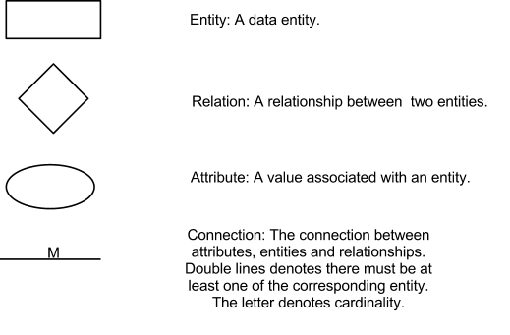
ER Diagram Legend

Slide 19
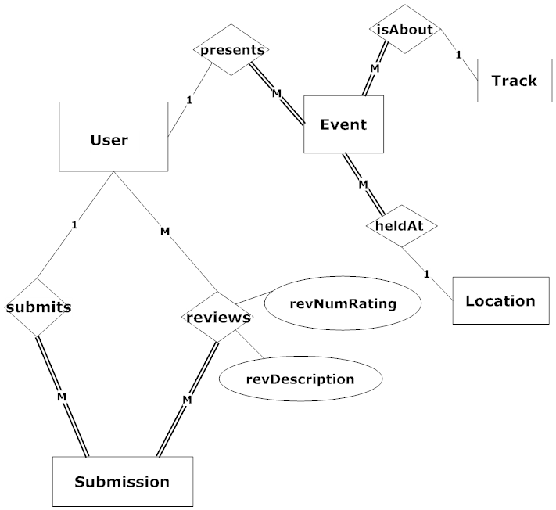
ER Diagram

Slide 20
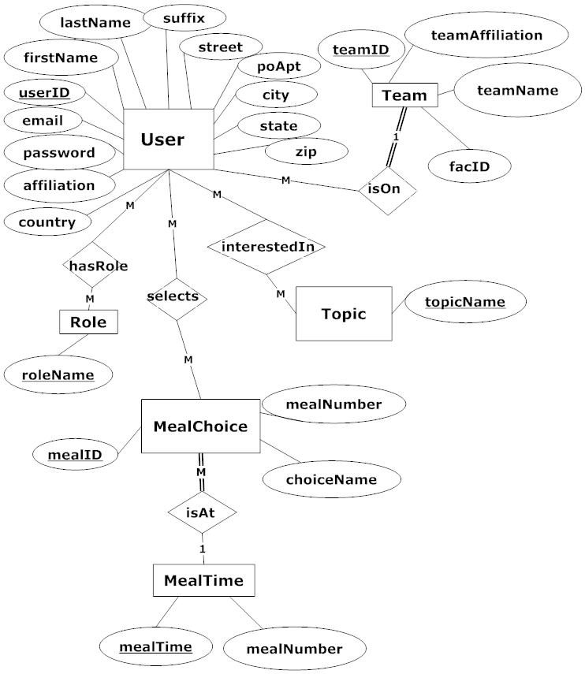
ER Diagram Continued - User

Slide 21
ER Diagram

Slide 22
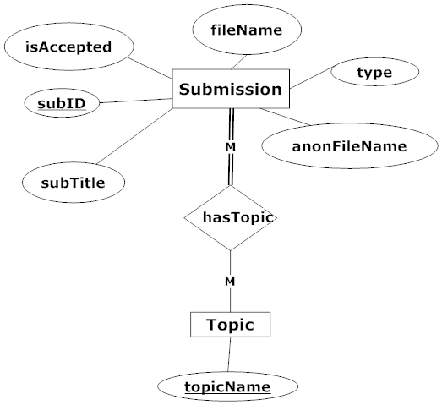
ER Diagram - Submission

Slide 23
ER Diagram

Slide 24
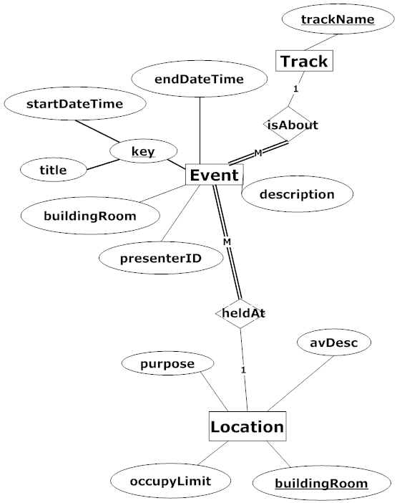
ER Diagram - Event

Slide 25
Agenda
Introductions
Problem Overview
Project Progression
User Case Narratives
Entity Relationship (ER) Diagram
Data Dictionary
Testing
Prototypes
What’s Next
S.E.E. Solutions

Slide 26
Data Dictionary
Repository of data within CCRS
Includes info about data
Format
Usage
Examples
S.E.E. Solutions
26

Slide 27
Agenda
Introductions
Problem Overview
Project Progression
User Case Narratives
Entity Relationship (ER) Diagram
Data Dictionary
Testing
Prototypes
What’s Next
S.E.E. Solutions
27

Slide 28
Testing
Will be tested on the four major browsers
Non-Functional Requirements
Functional Requirements
Broken down into modules
Each tested separately
Tested as a whole
S.E.E. Solutions
28

Slide 29
Unit Test
Units tested separately
Test cases for each process
Test will be measured by pass/fail

Slide 30
14 Unit Tests
Log In
Configure
Payments
Accounts
Topics and Important Dates
Location
Logo
Meals
Set Up Schedule
Dates
Register
Review
Submit
Notify

Slide 31
Log In – Unit Test
 | Test Cases
Pass/Fail Status | Test Number |  | Description | Action to perform test (input) | Steps to be Executed | State Before Test | Expected result | Observed result | Comments | Tested By |  | Test Date
F | 1.001 |  | Null Username Field | Leave Username Field Blank | Fill out remainder of form and press submit | Empty Form | Message: "Please enter a username."
F | 1.002 |  | Null Password Field | Leave Password Field Blank | Fill out remainder of form and press submit | Empty Form | Message: "Please enter a password."
F | 1.003 |  | Incorrect Password for Given Username | Input an Invalid Username and Password Combination | Fill out remainder of form and press submit | Empty Form | Message: "Incorrect username or password."
F | 1.004 |  | Nonexisting Username | Input a Nonexisting Username | Fill out remainder of form and press submit | Empty Form | Message: "Incorrect username."
F | 1.005 |  | Correct Username and Password | Enter Valid Username and Password | Press Submit | Empty Form | No error message. Redirected to user homepage
F | = Unit Summary |  |  | 0% | passing | 0 | passed |  | Date of last test = |  |  | 1/0/00
 | 5 | tests |  |  |  | 5 | failed
S.E.E. Solutions
31

Slide 32
Acceptance Test
Validation of the requirements inventory
Will be measured by MET or UNMET
Tested on 4 major internet browsers

Slide 33
Conference Chair Acceptance Test
Conference Chair
Met | Unmet | Able to configure user accounts for other users
Met | Unmet | Accounts will be inserted into appropriate database tables
Met | Unmet | Able to configure payment for users
Met | Unmet | Proper fields will be updated in database tables
Met | Unmet | Will be able to configure or edit schedule for event
Met | Unmet | Will be able to configure meals options for the conference
Met | Unmet | Will be able to notify applicants if they have been accepted as a reviewer and a vendor

Slide 34
Agenda
Introductions
Problem Overview
Project Progression
User Case Narratives
Entity Relationship (ER) Diagram
Data Dictionary
Testing
Prototypes
What’s Next
S.E.E. Solutions
34

Slide 35
Prototypes
Live Demo

Slide 36
Agenda
Introductions
Problem Overview
Project Progression
User Case Narratives
Entity Relationship (ER) Diagram
Data Dictionary
Testing
Prototypes
What’s Next
S.E.E. Solutions
36

Slide 37
What’s Next

Slide 38
Thank you for attending
Questions?

