Slide 1


Title
Software Linked Interactive Competitive Environment
Software Plan
September 23rd, 2011
1

Slide 2
Welcome
Our Client:
Dr. Darren Lim
Professor of Computer Science
Siena College
2

Slide 3
Agenda
Introduction
Problem Definition
System Justification
Current Solution
System Goals
System Constraints
Resources
Model
Timeline
3

Slide 4
Introduction
Our Team
Zachary Fitzsimmons
Team Leader
Michael Pepe
Lieutenant
Anthony Parente
Systems Administrator
Matthew Ferritto
Lead Webmaster
Renee Solheim
Document Analyst

Slide 5
Agenda
Introduction
Problem Definition
System Justification
Current Solution
System Goals
System Constraints
Resources
Model
Timeline

Slide 6
Problem Definition
Competitive Programming Contests
  Problem submission/timing
  Messaging between participants/judges
  Scoreboard

Slide 7
Agenda
Introduction
Problem Definition
System Justification
Current Solution
System Goals
System Constraints
Resources
Model
Timeline

Slide 8
System Justification
Dr. Lim’s annual programming contest needs reliable software
Current solution
  Is segregated
  Has a difficult to use interface
  Has no security against malicious code

Slide 9
Agenda
Introduction
Problem Definition
System Justification
System Goals
Current Solution
System Constraints
Resources
Model
Timeline

Slide 10
Current Solution

Slide 11
Agenda
Introduction
Problem Definition
System Justification
Current Solution
System Goals
System Constraints
Resources
Model
Timeline

Slide 12
System Goals
Implement an integrated competitive programming environment
  Allow program submission
  Automatic/Manual Judging
  Real-time Messaging

Slide 13
Agenda
Introduction
Problem Definition
System Justification
Current Solution
System Goals
System Constraints
Resources
Model
Timeline

Slide 14
Constraints
Extendable number of participants and judges
Must run on all major web-browsers
  IE, Firefox, Safari, Chrome
Extendable support for languages
  Must support Java
Use central server for submissions

Slide 15
Agenda
Introduction
Problem Definition
System Justification
Current Solution
System Goals
System Constraints
Resources
Model
Timeline

Slide 16
Resources
Languages:
  X(HTML), PHP, CSS, SQL
Hardware:
  Software Engineering Lab (Macs and PCs)
Software:
  Adobe Suite, Microsoft Office Suite, Firefox, Chrome, IE, Safari
Personnel:
  Dr. Darren Lim, Dr. Tim Lederman, Team Members

Slide 17
Agenda
Introduction
Problem Definition
System Justification
Current Solution
System Goals
System Constraints
Resources
Model
Timeline

Slide 18
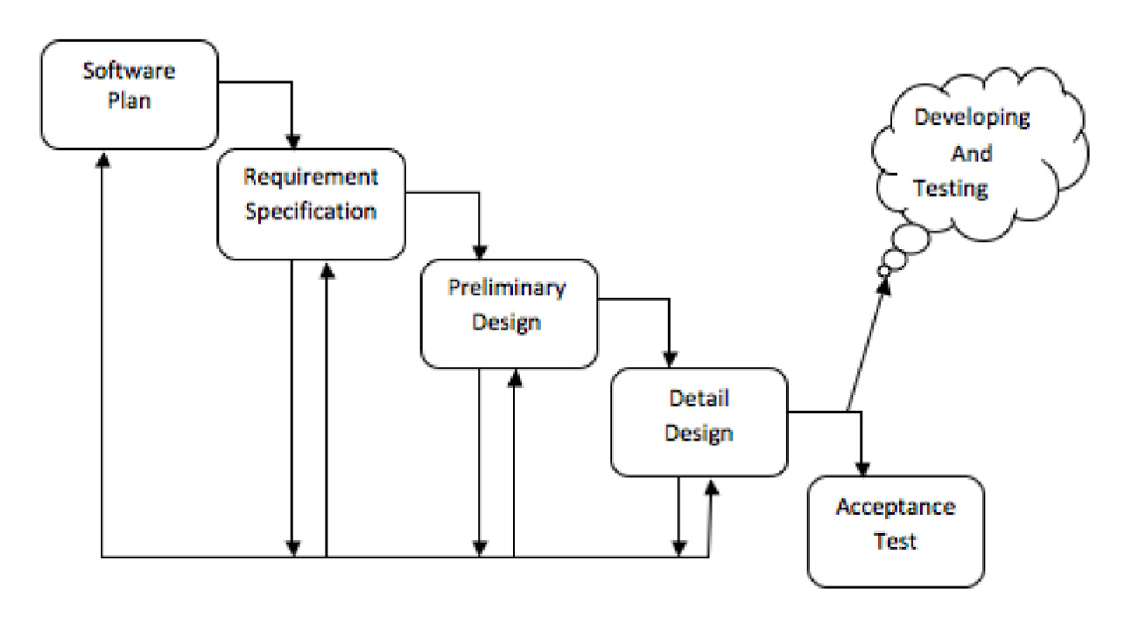
Development Model

Slide 19
Agenda
Introduction
Problem Definition
System Justification
Current Solution
System Goals
System Constraints
Resources
Model
Timeline

Slide 20
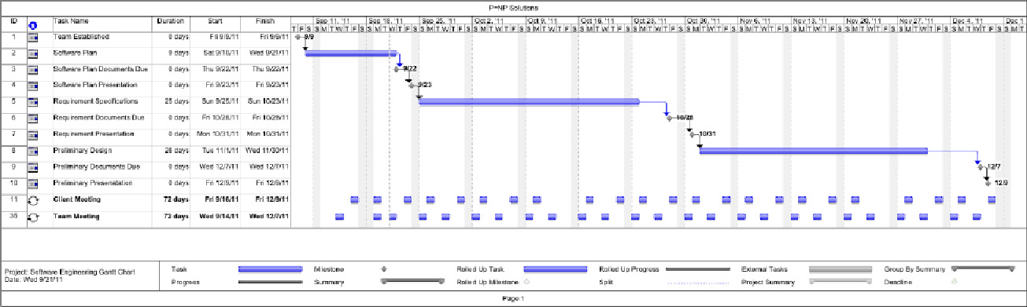
Timeline

Slide 21
What’s Next
Requirement Specification – November 2010
Preliminary Design – December 2010
Detailed Design – Spring 2011
Acceptance Test – Spring 2011

Slide 22
Thank You
Any Questions??

