Slide 1
Title
Software Linked Interactive Competitive Environment
Detailed Design
March 1st, 2012
1

Slide 2
Welcome
Our Client:
Dr. Darren Lim
Associate Professor
Siena College
2

Slide 3
Introduction
Our Team
Renee Solheim
Team Leader
Anthony Parente
System Administrator
Matthew Ferritto
Webmaster
Zachary Fitzsimmons
Lead Developer

Slide 4
Agenda
Introduction
Restatement of Problem
Project Progression
EER Diagrams
Schema Tables
Data Dictionary
Testing Plan
Unit Test
Acceptance Test
Website Map
Prototype Screens
Project Timeline
4

Slide 5
Restatement of the Problem
Competitive Programming Contests
Problem submission and compilation
Messaging between participants/judges
Scoreboard

Slide 6
Agenda
Introduction
Restatement of Problem
Project Progression
EER Diagrams
Schema Tables
Data Dictionary
Testing Plan
Unit Test
Acceptance Test
Website Map
Prototype Screens
Project Timeline
6

Slide 7
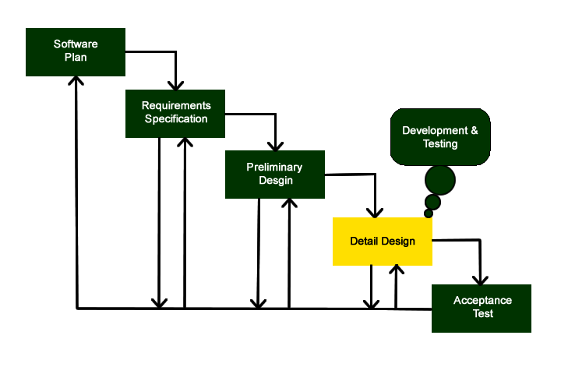
Project Progression

Slide 8
Agenda
Introduction
Restatement of Problem
Project Progression
EER Diagrams
Schema Tables
Data Dictionary
Testing Plan
Unit Test
Acceptance Test
Website Map
Prototype Screens
Project Timeline
8

Slide 9
EER Diagram
An EER diagram or
Enhanced Entity-Relationship Diagram
illustrates relations between
entities in a database
9

Slide 10
EER Legend
Relation: The relation between the two entities
Entity: A Data Entity
Attribute: An attribute associated with an entity or relation
Connection: The connection used between entities, attributes and relations
10

Slide 11
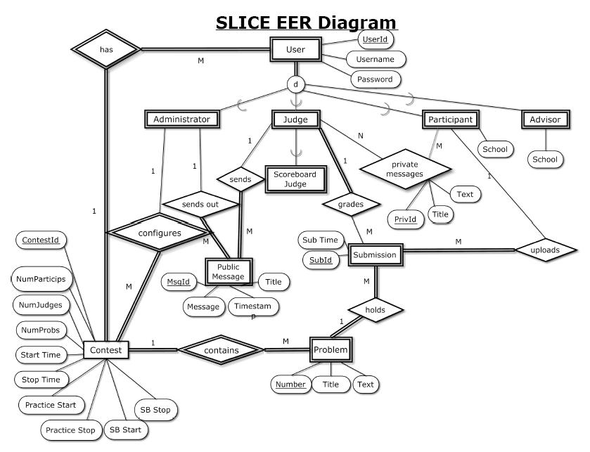
11

Slide 12
Agenda
Introduction
Restatement of Problem
Project Progression
EER Diagrams
Schema Tables
Data Dictionary
Testing Plan
Unit Test
Acceptance Test
Website Map
Prototype Screens
Project Timeline
12

Slide 13
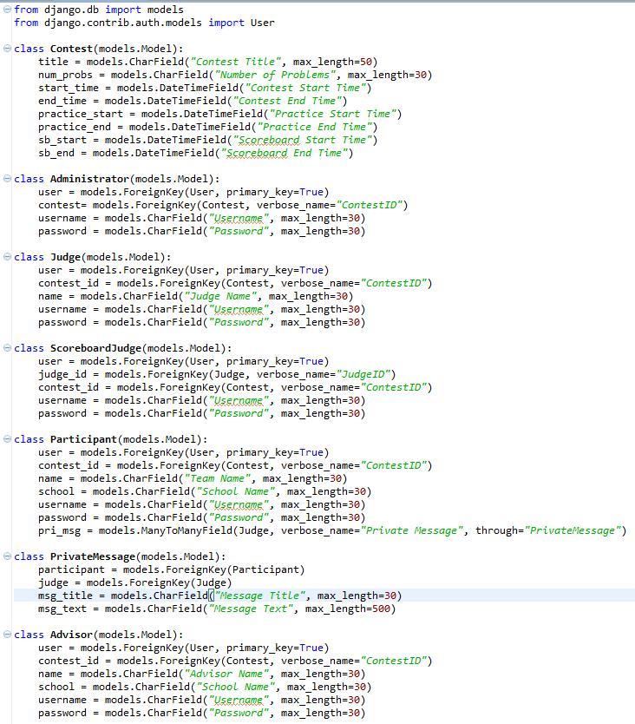
Schema Table
13

Slide 14
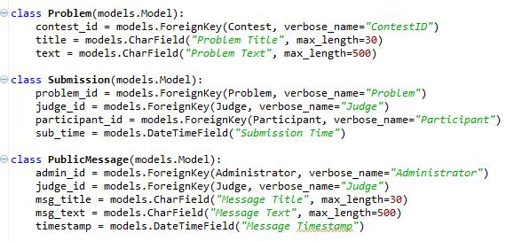
Schema Table cont.
14

Slide 15
Agenda
Introduction
Restatement of Problem
Project Progression
EER Diagrams
Schema Tables
Data Dictionary
Testing Plan
Unit Test
Acceptance Test
Website Map
Prototype Screens
Project Timeline
15

Slide 16
Data Dictionary
Table Columns:
Data Name - The name of the data entity
Applicable to - The views that the data is used or displayed in
Data Type - How the data entity will be stored
Data Size - How large that data entity can be
Description - What the data entity is used for
Acceptable Input - A descriptor of allowed input
Good Example of Input - An acceptable example input
Table- The applicable table in the schema
16

Slide 17
Data Dictionary
Types of Data:
String
Boolean
Integer
Enum
Timestamp
17

Slide 18
Agenda
Introduction
Restatement of Problem
Project Progression
EER Diagrams
Schema Tables
Data Dictionary
Testing Plan
Unit Test
Acceptance Test
Website Map
Prototype Screens
Project Timeline
18

Slide 19
Testing Plan
Make sure all Functional and Non-Functional Requirements are met
Multi-step process that consists of a Unit Test Script
We will meet with ExoNet to test on a small scale
April 12th , both teams and additional volunteers will test on a larger 40 user scale
19

Slide 20
Agenda
Introduction
Restatement of Problem
Project Progression
EER Diagrams
Schema Tables
Data Dictionary
Testing Plan
Unit Test
Acceptance Test
Website Map
Prototype Screens
Project Timeline
20

Slide 21
Unit Test
Consists of Test Cases
Test will either pass or fail
A full system test will be performed once all Unit Tests are passed.
21

Slide 22
8 Unit Tests
User Login
Problem Submission
Contest Setup
Private Messaging
Public Messaging
View Scoreboard
Edit Scoreboard
Logout
22

Slide 23
Agenda
Introduction
Restatement of Problem
Project Progression
EER Diagrams
Schema Tables
Data Dictionary
Testing Plan
Unit Test
Acceptance Test
Website Map
Prototype Screens
Project Timeline
23

Slide 24
Acceptance Test
It will validate the Functional and Non-Functional Requirements
Each will be declared MET or UNMET
It will be tested on Internet Explorer, Mozilla Firefox, Google Chrome and Apple Safari
We will use the Test Plan to explain why and how the project is validated
24

Slide 25
Agenda
Introduction
Restatement of Problem
Project Progression
EER Diagrams
Schema Tables
Data Dictionary
Testing Plan
Unit Test
Acceptance Test
Website Map
Prototype Screens
Project Timeline
25

Slide 26
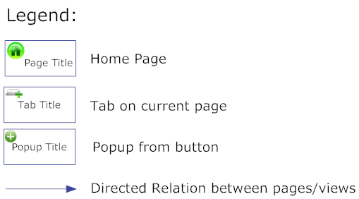
Website Map Legend
26

Slide 27
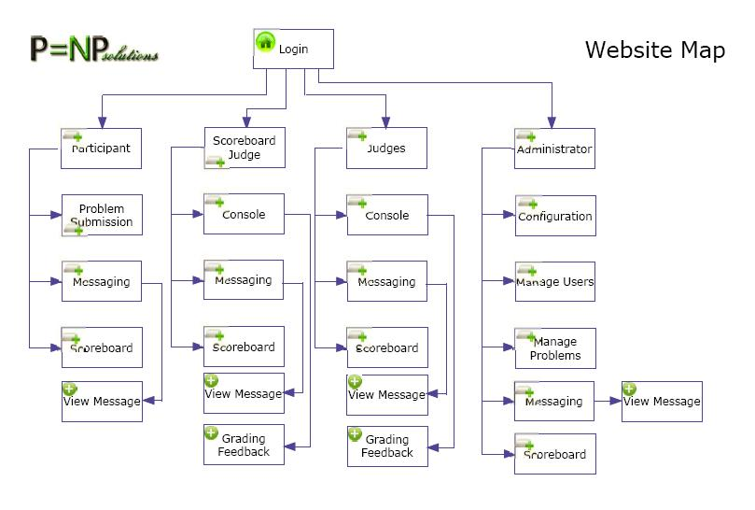
Website Map
27

Slide 28
Agenda
Introduction
Restatement of Problem
Project Progression
Website Map
EER Diagrams
Schema Tables
Data Dictionary
Testing Plan
Unit Test
Test Cases
Acceptance Test
Prototype Screens
Project Timeline
28

Slide 29
Prototypes
Live Demo

Slide 30
Agenda
Introduction
Restatement of Problem
Project Progression
EER Diagrams
Schema Tables
Data Dictionary
Testing Plan
Unit Test
Test Cases
Acceptance Test
Website Map
Prototype Screens
Project Timeline
30

Slide 31
Project Timeline
Detailed Design: March 1st
Acceptance Test: April 27th
Wine Etiquette Dinner: March 7th
Software Party: April 30th
31

Slide 32
Thank You
Any Questions??

