Slide 1
Title
Software Linked Interactive Competitive Environment
Acceptance Test
April 26th , 2012
1

Slide 2
Welcome
Our Client:
Dr. Darren Lim
Associate Professor
Siena College
2

Slide 3
Introduction
Our Team
Renee Solheim
Team Leader
Anthony Parente
Lead Front-end Developer
Matthew Ferritto
Database/Webmaster
Zachary Fitzsimmons
Lead Developer

Slide 4
Agenda
Introduction
Restatement of Problem
Project Progression
Functional Requirements
Non-Functional Requirements
Testing Overview
Demonstration
Deliverables
What’s Next
Questions?
4

Slide 5
Restatement of the Problem
Competitive Programming Contests
Not user friendly
Not integrated
5

Slide 6
Agenda
Introduction
Restatement of Problem
Project Progression
Functional Requirements
Non-Functional Requirements
Testing Overview
Demonstration
Deliverables
What’s Next
Questions?
6

Slide 7
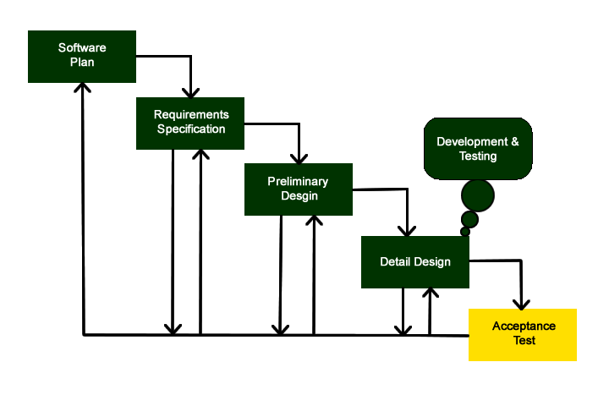
Project Progression

Slide 8
Agenda
Introduction
Restatement of Problem
Project Progression
Functional Requirements
Non-Functional Requirements
Testing Overview
Demonstration
Deliverables
What’s Next
Questions?
8

Slide 9
Functional Requirements
Testable features of our software package that will be reviewed in our Unit Testing
9

Slide 10
Team Advisor
Y/N Will be able to log into SLICE with the Advisor user name and password
Y/N Will be able to view each individual problem
Y/N Will be able to view the scoreboard while active
Y/N Will be able to receive all publically broadcasted contest clarifications
Y/N Will be able to log out of SLICE at any point
10

Slide 11
Judge
Y/N Will be able to log onto SLICE with a given user name and password
Y/N Will be able to view Participant submitted solutions
Y/N Will be able to run the submitted solution using the test
input provided in SLICE that corresponds to the associated question
Y/N Will be able to submit a response to the team stating either
“Correct Solution, Compiler Error, Running Time Error,
Wrong Answer, OR Time-Limit Exceeded”
Y/N Will be able to log out of SLICE at any point
11

Slide 12
Scoreboard Judge
Y/N Will be able to do everything the Judge can do
Y/N Will be able to edit the scoreboard
12

Slide 13
Administrator
Y/N Will be able to log into SLICE with a unique username and password
Y/N Will be able to create the Judge accounts
Y/N Will be able to create the Participant accounts
Y/N Will be able to create the Team Advisor accounts
Y/N Will be able to give Scoreboard Judge abilities to one judge
Y/N Will be able to send broadcast messages to all users
Y/N Will be able to send broadcast messages to any subset of users
13

Slide 14
Admin cont…
Y/N Will be able to manage the set of problems
Y/N Will be able to manage test input
Y/N Will be able to manage correct output for each contest problem
Y/N Will be able to designate the length of the contest
Y/N Will be able to set the contest start time
Y/N Will be able to set the contest stop time
14

Slide 15
Admin cont..
Y/N Will be able to set the practice time for the contest
Y/N Will be able to restrict the view of the scoreboard at a set time towards the end of the contest
Y/N Will be able to choose the list of allowed programming languages
Y/N Will be able to log out of SLICE at any point
15

Slide 16
Participant
Y/N Will be able to log into SLICE with a given user name and password
Y/N Will be able to view the contest scoreboard while active
Y/N Will be able to submit problem-solutions
Y/N Will be able to submit clarification-requests
Y/N Will be able to make a general request
16

Slide 17
Participant cont..
Y/N Will be able to associate a problem with request
Y/N Will be able to select on of the contest problems
Y/N Will be able to select one of a list of programming languages
Y/N Will be able to receive individual clarification responses from any Judge
Y/N Will be able to receive publically broadcasted messages from any Judge or Administrative User.
Y/N Will be able to log out of SLICE at any point
17

Slide 18
Slice
Y/N Will be able to compile submitted problems
Y/N Will be able to provide an appropriate error message when a wrong username and password is entered
Y/N Will be able to handle up to 30 teams

Slide 19
Agenda
Introduction
Restatement of Problem
Project Progression
Functional Requirements
Non-Functional Requirements
Testing Overview
Demonstration
Deliverables
What’s Next
Questions?
19

Slide 20
Non-Functional Requirements
Non-Functional Requirements are what SLICE is and looks like rather than what it does. These are harder to test but just as important as the Functional Requirements.
20

Slide 21
Non-Functional Requirements
Y/N The system will be easily maintained
Y/N The system will be stable.
Y/N The system will be viewable on multiple browsers
Y/N The system will run efficiently
Y/N The system will be user friendly
21

Slide 22
Agenda
Introduction
Restatement of Problem
Project Progression
Functional Requirements
Non-Functional Requirements
Testing Overview
Demonstration
Deliverables
What’s Next
Questions?
22

Slide 23
Test Overview Success
Login
Logout
Submission/Grading
Non-Functional Requirements
23

Slide 24
Test Overview Failures
Administrative/Contest Setup
Messaging
Scoreboard

Slide 25
Agenda
Introduction
Restatement of Problem
Project Progression
Functional Requirements
Non-Functional Requirements
Testing Overview
Demonstration
Deliverables
What’s Next
Questions?
25

Slide 26
Live Demonstration
26

Slide 27
Agenda
Introduction
Restatement of Problem
Project Progression
Functional Requirements
Non-Functional Requirements
Testing Overview
Demonstration
Deliverables
What’s Next
Questions?
27

Slide 28
Deliverables
All files associated with SLICE will be delivered in CD-ROM format on Monday, April 30th, the Software Engineering end of year party.
Python and Template Files for SLICE
Code for Team Website
Team song lyrics and video
README.TXT file describing CD-ROM layout
28

Slide 29
Agenda
Introduction
Restatement of Problem
Project Progression
Functional Requirements
Non-Functional Requirements
Testing Overview
Demonstration
Deliverables
What’s Next
Questions?
29

Slide 30
Project Timeline
Acceptance Test: April 26th
Software Party: April 30th
Academic Celebration: April 27th
Luncheon: May 1st
Senior Software Party: May 12th
30

Slide 31
Thank You
Any Questions??
31

