Slide 1
NOVA Tech
Acceptance Test
Notes:
Kevin

Slide 2
Welcome
Client: Dr. Erik Eddy
CEO of TEAMS 101
Guest: Dr. Meg Fryling
Guest: Dr. Darren Lim
Guest: Other Guests
Notes:
Kevin

Slide 3
Agenda
Introduction
Project Overview/Solution Strategy
Testing Overview
Test Results
Functional Requirements
Non-Functional Requirements
Product Demonstration
Deliverables
What’s Next
Questions
Notes:
Kevin

Slide 4
Introduction
Kevin Conner – Team Lead
Emma Bostian – Web Master
Dave Hall – Database Administrator
Sara Pinti – System Administrator
Justin Rose – Software Engineer
Notes:
Kevin et al

Slide 5
Agenda
Introduction
Project Overview/Solution Strategy
Testing Overview
Test Results
Functional Requirements
Non-Functional Requirements
Product Demonstration
Deliverables
What’s Next
Questions
Notes:
Kevin

Slide 6
Project Overview
Client: Dr. Erik Eddy
Team Evaluation: Application on the TEAMS 101 Portal
Currently no website for teammates to provide group evaluations
Groups only provide feedback after project has terminated
Notes:
Kevin
Teammate Evaluation will be a core web application on the TEAMS 101 (Team Evaluation and Management System) dashboard, and it will give students an easily-accessible interface to provide teammate evaluations periodically during group projects. Dr. Erik Eddy realizes the importance that team evaluations hold within a group dynamic, not only in regards to the final grade for the assignment, but for the overall cohesiveness and harmony of the group. Team Evaluation will not only provide Siena College students with the ability to communicate more productively, it will provide professors and administrators the ability to be better acquainted with the team member’s participation and performance.

Slide 7
Agenda
Introduction
Project Overview/Solution Strategy
Testing Overview
Test Results
Functional Requirements
Non-Functional Requirements
Product Demonstration
Deliverables
What’s Next
Questions
Notes:
Justin

Slide 8
Testing Overview
4 major browsers
Based on each completed module
All Functional and Nonfunctional Requirements
Interaction with other modules
Entire system testing
Notes:
Justin

Slide 9
Agenda
Introduction
Project Overview/Solution Strategy
Testing Overview
Test Results
Functional Requirements
Non-Functional Requirements
Product Demonstration
Deliverables
What’s Next
Questions
Notes:
Justin

Slide 10
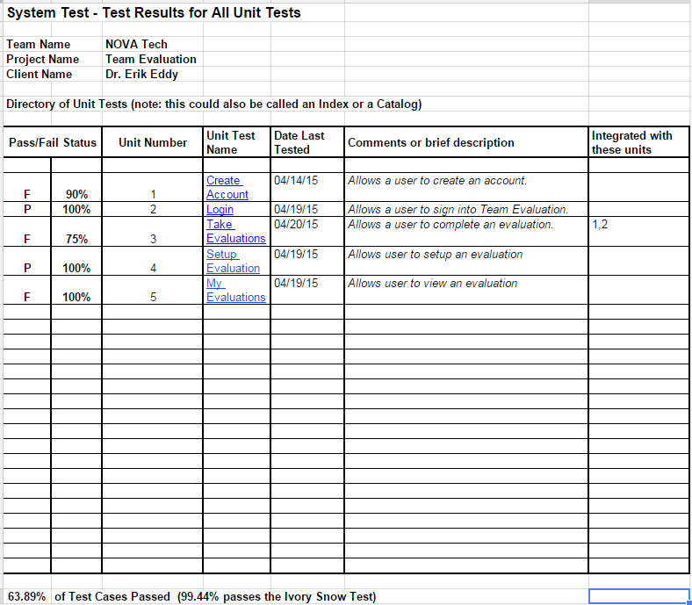
Test Results
Test Directory
Notes:
Justin

Slide 11
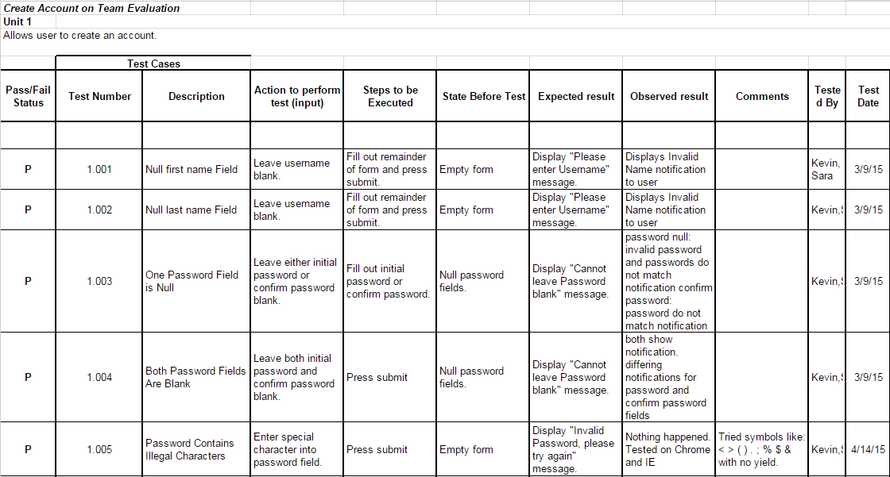
Test Results
Unit Test 1
Notes:
Justin

Slide 12
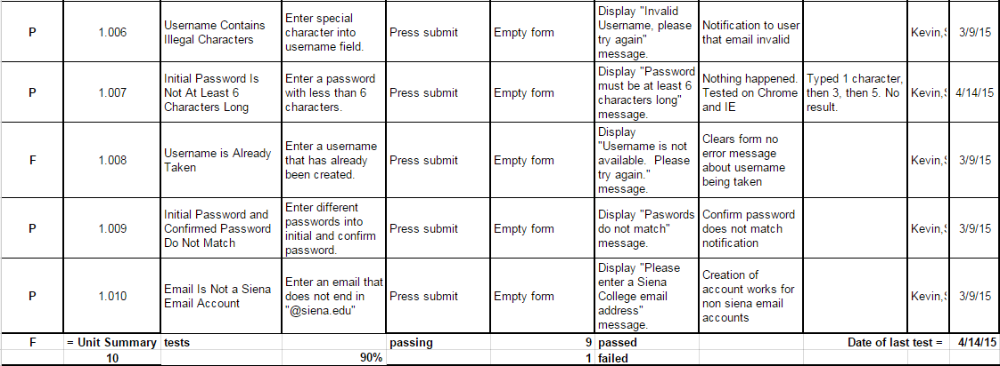
Test Results
Unit Test 1
Notes:
Justin

Slide 13
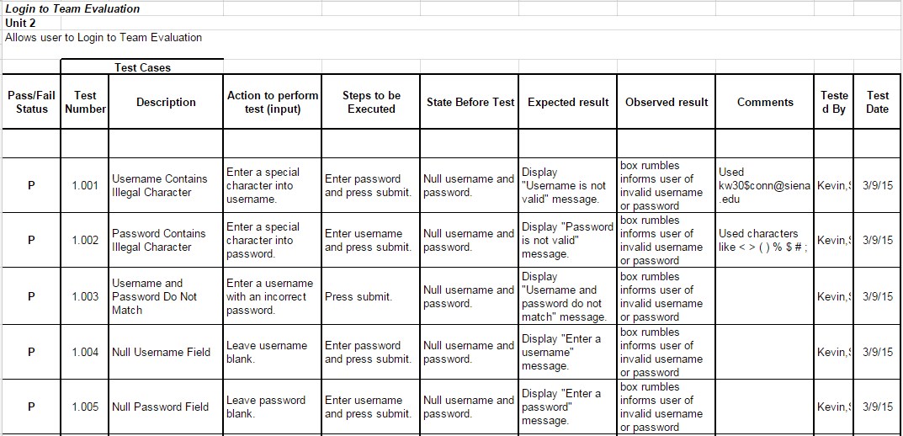
Test Results
Unit Test 2
Notes:
Justin

Slide 14
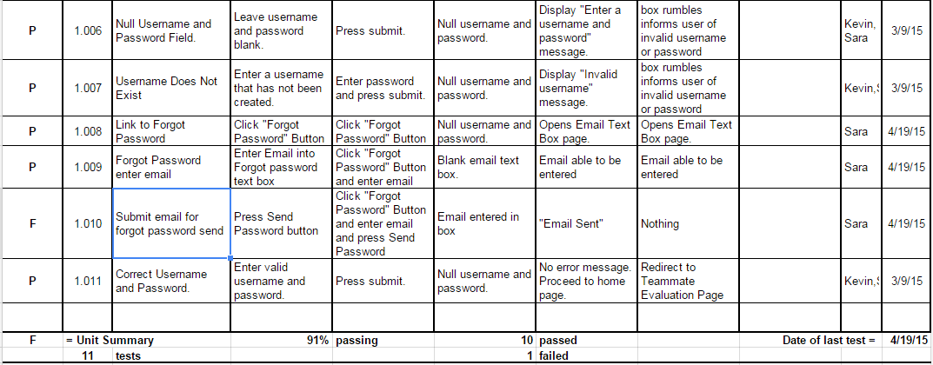
Test Results
Unit Test 2
Notes:
Justin

Slide 15
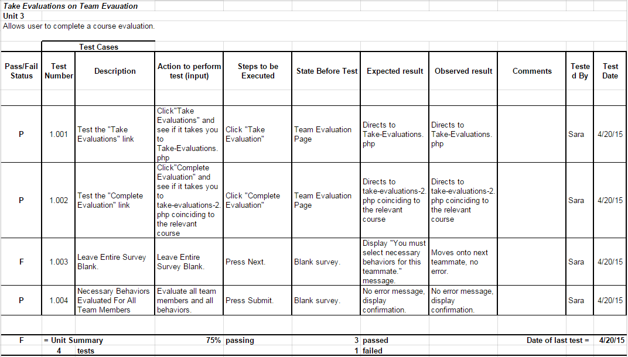
Test Results
Unit Test 3
Notes:
Justin

Slide 16
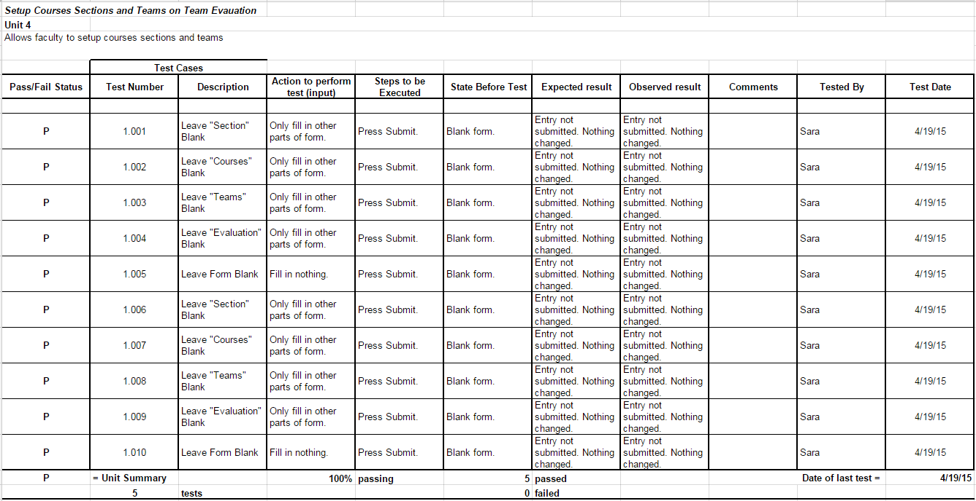
Test Results
Unit Test 4
Notes:
Justin

Slide 17
Test Results
Unit Test 5
Notes:
Justin

Slide 18
Agenda
Introduction
Project Overview/Solution Strategy
Testing Overview
Test Results
Functional Requirements
Non-Functional Requirements
Product Demonstration
Deliverables
What’s Next
Questions
Notes:
Sara

Slide 19
Functional Requirements
Student User Level
Capable of creating an account
Capable of logging onto the system
A failed login will result in an error message
Can fill out teammate evaluation form for each teammate
Can access/view own evaluation report
Cannot access own evaluation report unless three teammates have submitted reports for this user
Can log out of system
Notes:
Sara

Slide 20
Functional Requirements
Faculty User Level
Capable of creating an account
Capable of logging onto the system
A failed login will result in an error message
Can set up/edit courses, sections, teams, and evaluations
Can view student completion of evaluations
Can log out of system
Notes:
Sara

Slide 21
Functional Requirements
Administrator User Level
Capable of creating an account
Capable of logging onto the system
A failed login will result in an error message
Can set up/edit courses, sections, and teams
Can view student completion of evaluations
Can approve faculty member privileges
Can grant administrator privileges to other users
Can log out of system
Notes:
Sara

Slide 22
Agenda
Introduction
Project Overview/Solution Strategy
Testing Overview
Test Results
Functional Requirements
Non-Functional Requirements
Product Demonstration
Deliverables
What’s Next
Questions
Notes:
Sara

Slide 23
Non-Functional Requirements
Efficient
User-friendly
Require little maintenance and will be stable
Easily accessible by all users
Notes:
Sara

Slide 24
Agenda
Introduction
Project Overview/Solution Strategy
Testing Overview
Test Results
Functional Requirements
Non-Functional Requirements
Product Demonstration
Deliverables
What’s Next
Questions
Notes:
Emma and Dave

Slide 25
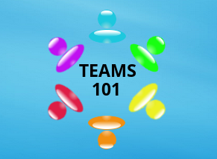
Product Demonstration
Notes:
Emma and Dave

Slide 26
Agenda
Introduction
Project Overview/Solution Strategy
Testing Overview
Test Results
Functional Requirements
Non-Functional Requirements
Product Demonstration
Deliverables
What’s Next
Questions
Notes:
Emma and Dave

Slide 27
Deliverables
A login screen for users
Proper landing pages based on user permissions
Allow for the evaluation of team members maintaining anonymity
Create a customized report based on team member evaluations and send to user
Allow administrators and faculty to see which students have completed evaluations and view them
Notes:
Emma and Dave
A login screen for users
Provide proper landing pages based on user permissions
Allow for the evaluation of team members maintaining anonymity
Create a customized report based on team member evaluations and send to user
Allow administrators to see which students have completed the evaluations and view them
Nova Tech will also provide:
A CD-ROM (or DVD) with the following:
A full copy of your team files from your team directory, including, of course, all website files (all folders, files, images, etc).
The above team files should, of course, include all files associated with your project, including all documentation (e.g. Software Plan, etc) and PowerPoint presentations.
The website files should reference all “local” URLs as relative links. You could have one subdirectory named team-public_html (for the team website files) and other subdirectory named project-public_html (for the project website files).
There should be a README.TXT file that explains what files are where (this README.TXT should be at the highest level directory.
Be sure to provide any needed usernames/passwords (and database names) and documentation related to gaining access to any database(s) that you use as part of your project.
The lyrics to your team song; a copy of a sound/music file for your team song; and, an audio/video recording of your team song. Place these in a subdirectory named SONG.
Blackboard submissions
Acceptance Test document
Acceptance Test presentation
Music Video
Hard copies of the Acceptance Test document
1 for your clients
1 for Academic Celebration
Hard copies of Acceptance Test PowerPoint presentation
1 (or more) for your clients
Evaluation forms, work logs, and (for team leads only) attendance sheets

Slide 28
Agenda
Introduction
Project Overview/Solution Strategy
Testing Overview
Test Results
Functional Requirements
Non-Functional Requirements
Product Demonstration
Deliverables
What’s Next
Questions
Notes:
Kevin

Slide 29
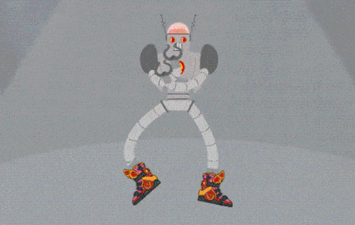
What’s Next?
David Hall will be staying on this summer to complete the TEAMS101 - Team Evaluation with Dr. Eddy
Academic Celebration April 24th
EOY Party April 27th
CD-ROM and ALL FILES Deliverable April 27th
Graduation May 10th!!!
Notes:
Kevin

Slide 30
Agenda
Introduction
Project Overview/Solution Strategy
Testing Overview
Test Results
Functional Requirements
Non-Functional Requirements
Product Demonstration
Deliverables
What’s Next
Questions
Notes:
Kevin

Slide 31
Questions?
Notes:
Kevin

