Slide 1
Status Report: Maltan
Matt Roberts, Andi Elwell, Lucas Silva, Tom Langton, Nick Varlese

Slide 2
Overview
Expected delivery
11-10-2015
Recent progress
Sprint 1 - Complete
Biggest risk
We were unsure of what to expect, being our first Sprint
What the Sprint Entailed
We were to create the databases, Admin pages, and the add tutor and add admin pages.

Slide 3
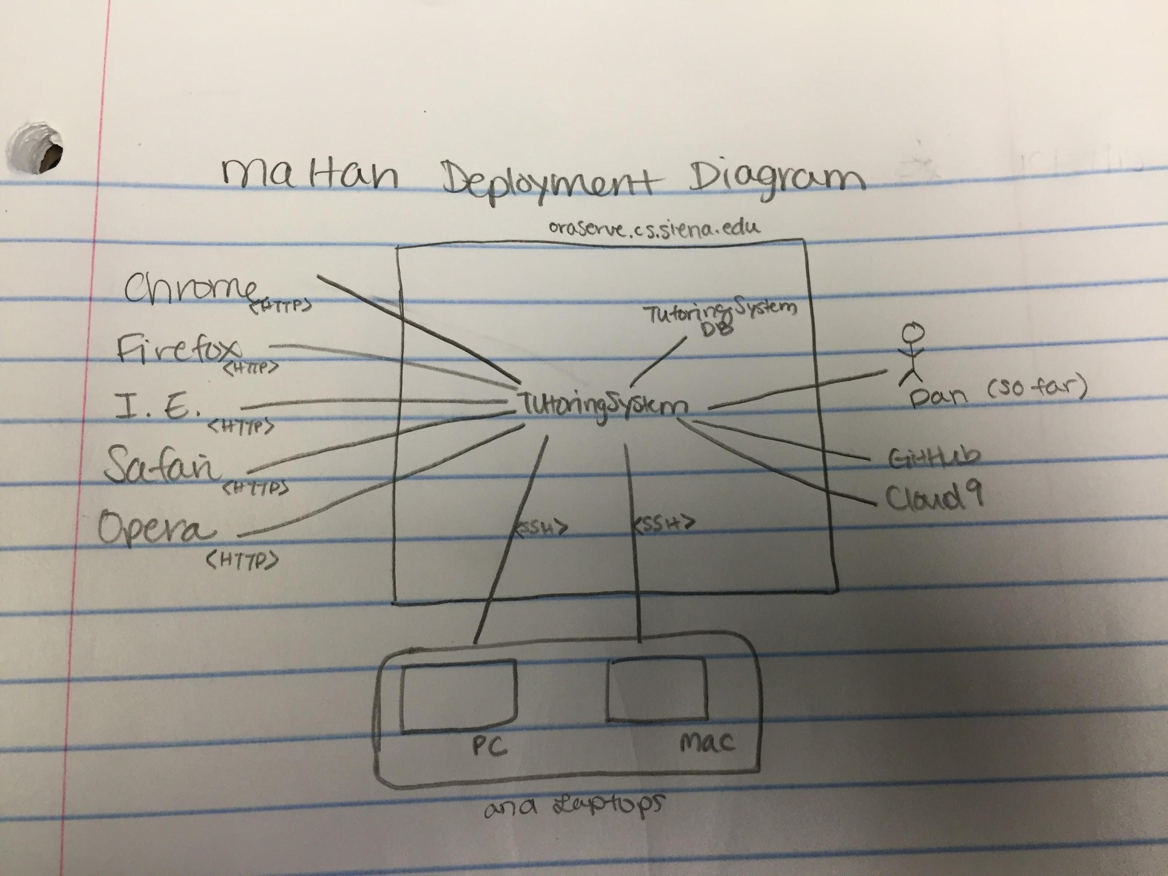
Deployment Diagram

Slide 4
Sprint 1: User Stories and Acceptance Criteria
As an admin
I want to be able to login
So that I can use the site
As an admin,
I want to be able to see what i have added
So that i can process this information
When I enter the correct credentials of an Admin account to the login form, I can sign in to the system as an Admin.
If I enter the incorrect credentials of an Admin account to the login form, the system alerts me that I have entered either a wrong username or password.
If I am logged in as Admin, I can see a list of Admins and Tutors that are stored on the database.
The list of Admins and Tutors displayed should contain the following fields: ”Username”, “Password”, “Email”, “First”, “Last”, “Added By”.

Slide 5
Sprint 1: User Stories and Acceptance Criteria
As an admin
I want to be able to create more admins
So that others can login as admins
As admin
I want to be able to add tutors
So that admins can see a list of tutors
If I am logged in as Admin/Tutor, I can create new Admin.
I can create new Admins/Tutors by entering the following information: “First Name”, “Last Name”, “Username”, “Password” and “Email Address”.

Slide 6
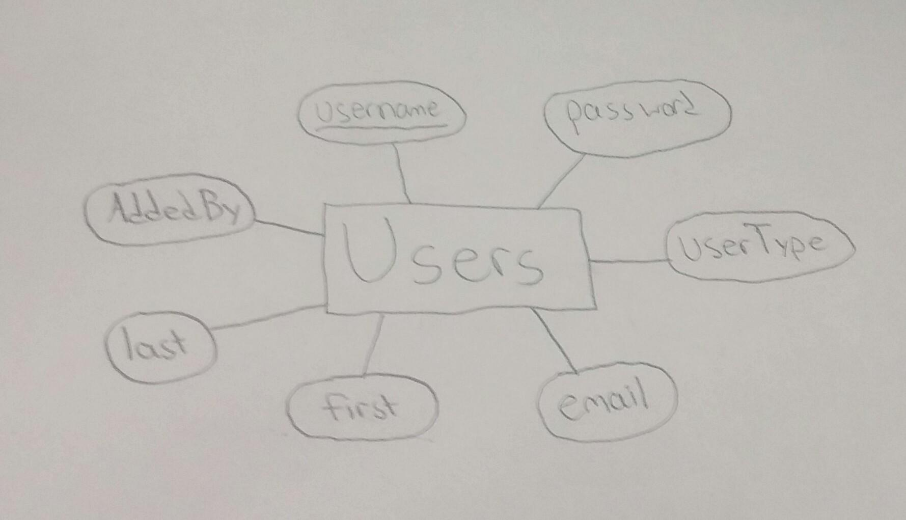
Sprint 1: ER Diagram -

Slide 7
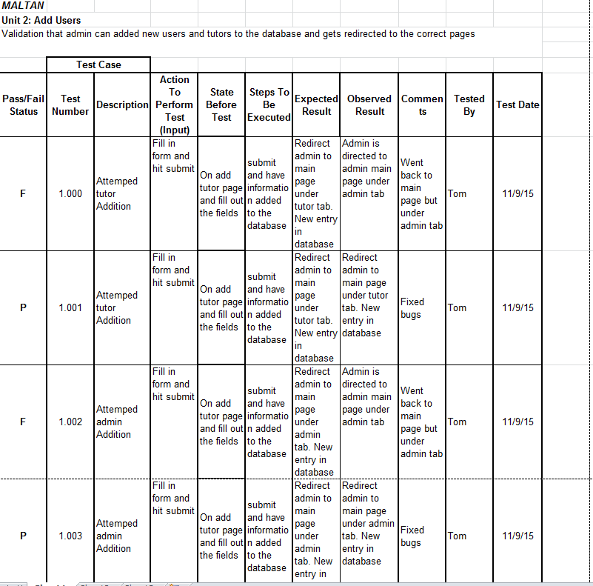
Sprint 1: Unit Test Cases

Slide 8
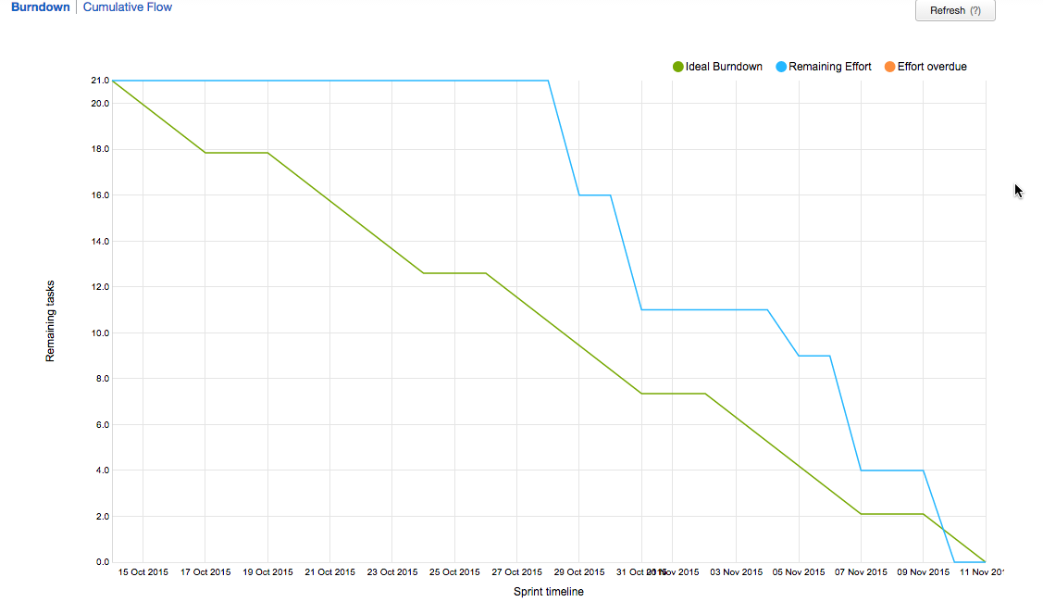
Burndown

Slide 9
Sprint 1: Velocity Measurement
Our velocity for Sprint 1 was 21 points
We completed all of our points assigned
We finished a few days early, too
Therefore, we will be able to assign more points in the following sprints
09.17.XX
10.20.XX
1101.XX

Slide 10
Demo
http://oraserv.cs.siena.edu/~perm_maltan/

Slide 11
Criteria from Product Owner
Our client is not here with us today.
Client’s Criteria
Keep it simple
Similar to Google and Blackboard
Easy to use

Slide 12
Thank you!
Maltan

