Slide 1
Computer Science Alumni Connection Through Interactive Open Networking System (CS-ACTIONS)
Software Plan by MAKER Technologies

Slide 2
Agenda
Introduction
Problem Definition
System Justification
System Goals
System Constraints
Resources
Model
Timeline

Slide 3
Introduction
Our Clients
Dr. Eric Breimer
Professor James Matthews
Marissa Bianchi – Team Leader
Ryan Clancy – Lead Developer
Andrew Reynolds – Webmaster
Kaitlyn Boomhower – Developer & Co-Webmaster
Eduardo Luiz Cabral Da Silva – Database Administrator

Slide 4
Agenda
Introduction
Problem Definition
System Justification
System Goals
System Constraints
Resources
Model
Timeline

Slide 5
Problem Definition
Web Application with Interactive Map
Alumni Profiles -> Employment, Advice, Home town
Automated processes for recruiting & screening
Application available on Siena CS Web Site

Slide 6
Agenda
Introduction
Problem Definition
System Justification
System Goals
System Constraints
Resources
Model
Timeline

Slide 7
System Justification
Shows high school students different paths in Computer Science
Gives current CS majors an idea of what positions are out there, or what companies Siena graduates work for
Could possibly contact CS alumni for internship opportunities

Slide 8
Agenda
Introduction
Problem Definition
System Justification
System Goals
System Constraints
Resources
Model
Timeline

Slide 9
System Goals
Reach the maximum number of Alumni possible
Easy to use & visually appealing
Accessible by:
Siena seniors in CS
high school students
Future: Use by other departments

Slide 10
Agenda
Introduction
Problem Definition
System Justification
System Goals
System Constraints
Resources
Model
Timeline

Slide 11
System Constraints
Compatibility with the most up to date releases of web browsers
Language regulation screening process
Ensure all user information is stored securely

Slide 12
Agenda
Introduction
Problem Definition
System Justification
System Goals
System Constraints
Resources
Model
Timeline

Slide 13
Resources
Team Members
Clients: Dr. Breimer and Professor Matthews
Programming Languages: Java, HTML, CSS, PHP, SQL and JavaScript
Computers: Mac and PC in Software Engineering Lab

Slide 14
Agenda
Introduction
Problem Definition
System Justification
System Goals
System Constraints
Resources
Model
Timeline

Slide 15
Development Model
Software Plan
Requirements Specification
Development and Testing
Preliminary Design
Detailed Design
Acceptance Test

Slide 16
Agenda
Introduction
Problem Definition
System Justification
System Goals
System Constraints
Resources
Model
Timeline

Slide 17
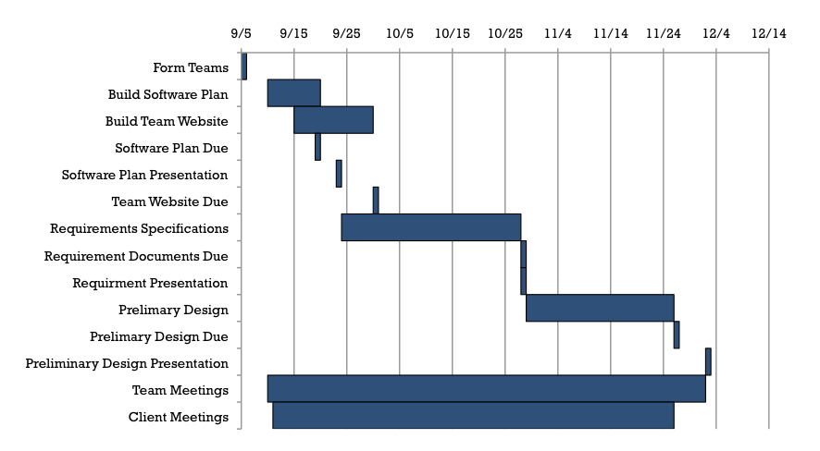
Timeline

Slide 18
Thank you!
Questions or Comments?

