Slide 1
C.S.-A.C.T.I.O.N.S.
Requirements Specification
By MAKER Technologies
October 30, 2014

Slide 2
Agenda
Introduction
Product Overview
Project Progression
Use Case Narratives
UML Use Case Diagram
Data Flow Diagrams
Functional Requirements
Non-Functional Requirements
Prototypes
What’s Next?
2

Slide 3
Introduction
Marissa Bianchi - Team Lead
Ryan Clancy - Lead Developer
Kaitlyn Boomhower - Co-Developer, Co-Webmaster
& Document Analyst
Eduardo Silva - Database Administrator
Andrew Reynolds - Webmaster
3

Slide 4
Agenda
Introduction
Product Overview
Project Progression
Use Case Narratives
UML Use Case Diagram
Data Flow Diagrams
Functional Requirements
Non-Functional Requirements
Prototypes
What’s Next?
4

Slide 5
Product Overview
An easy to use web application that keeps track of Siena College Computer Science Alumni.
All users can view and interact with the map
Administrators control everything
Goals:
Allow current Siena CS students & prospective students to see what career paths Siena CS Alumni have taken
Keep Siena College Computer Science Alumni connected to each other!
5

Slide 6
Agenda
Introduction
Product Overview
Project Progression
Use Case Narratives
UML Use Case Diagram
Data Flow Diagrams
Functional Requirements
Non-Functional Requirements
Prototypes
What’s Next?
6

Slide 7
Project Progression
Software Plan
Requirements Specification
Development and Testing
Preliminary Design
Detailed Design
Acceptance Test
7

Slide 8
Agenda
Introduction
Product Overview
Project Progression
Use Case Narratives
UML Use Case Diagram
Data Flow Diagrams
Functional Requirements
Non-Functional Requirements
Prototypes
What’s Next?
8

Slide 9
Use Case Narratives
Student
Interact with map
Click on pins and view public Alumni profiles
Send the alumnus a request for contact
9

Slide 10
Use Case Narratives
Alumni
Register on the system
Login to C.S.-A.C.T.I.O.N.S.
Forgot password
Edit profile
Change password
Disable certain content from being shown (i.e. contact information)
Hide profile
View map and click on pins to view any other Alumni profiles
Request for contact to other alumni
10

Slide 11
Use Case Narratives
Administrator
Login
View all of the content generated from the alumni survey
Approve or deny pending alumni profiles
Delete, create, or edit the content on any of the alumni profiles
Send a message to all alumni with an account on the system
Interact with the map in the same way as the alumni and students.
11

Slide 12
Agenda
Introduction
Product Overview
Project Progression
Use Case Narratives
UML Use Case Diagram
Data Flow Diagrams
Functional Requirements
Non-Functional Requirements
Prototypes
What’s Next?
12

Slide 13
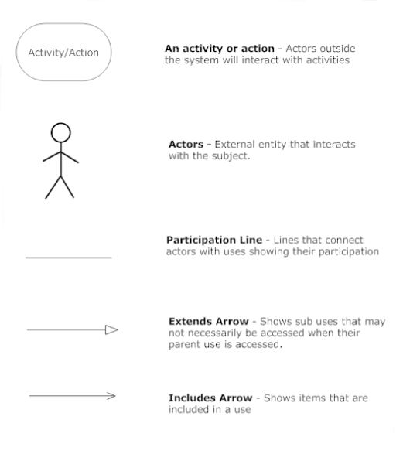
UML Use Case Diagram Legend
13

Slide 14
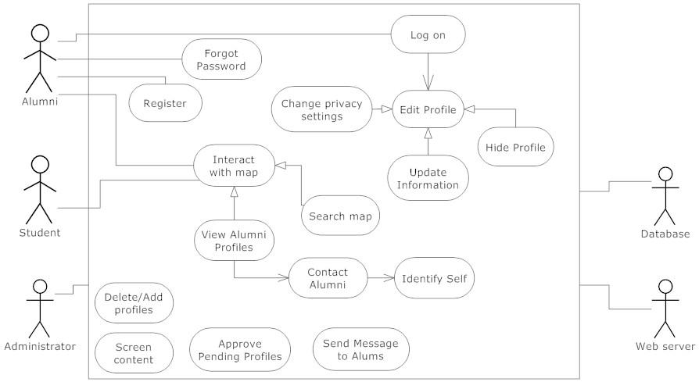
UML Use Case Diagram
14

Slide 15
Agenda
Introduction
Product Overview
Project Progression
Use Case Narratives
UML Use Case Diagram
Data Flow Diagrams
Functional Requirements
Non-Functional Requirements
Prototypes
What’s Next?
15

Slide 16
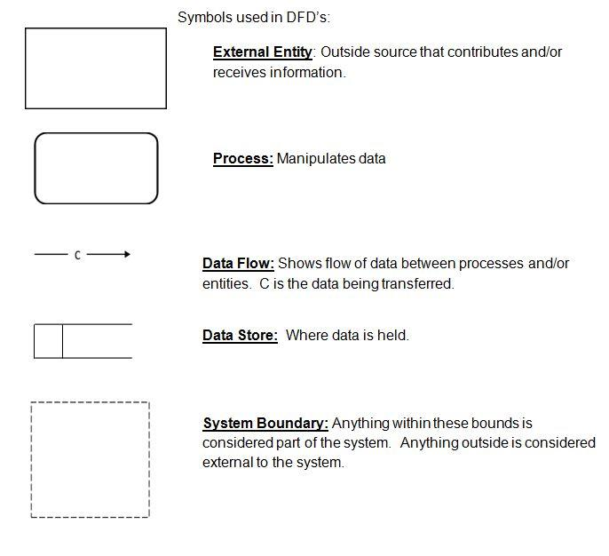
Data Flow Diagram Legend
16

Slide 17
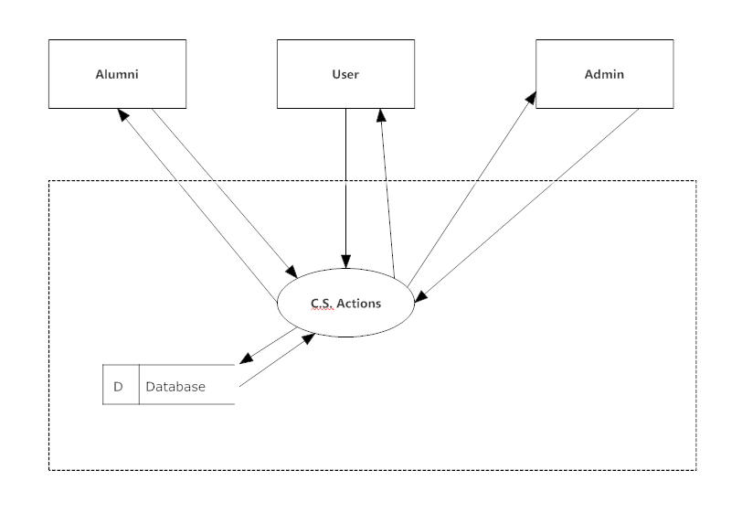
Context Diagram
C.S.-A.C.T.I.O.N.S.
16.5

Slide 18
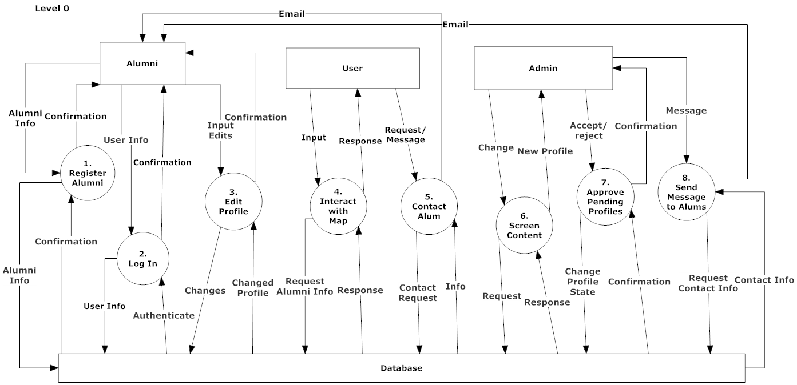
Level 0 Diagram
17

Slide 19
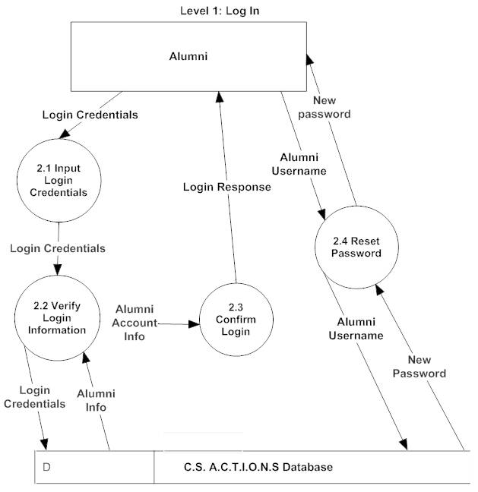
18

Slide 20
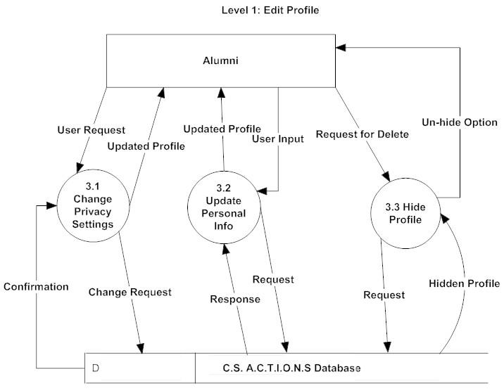
19

Slide 21
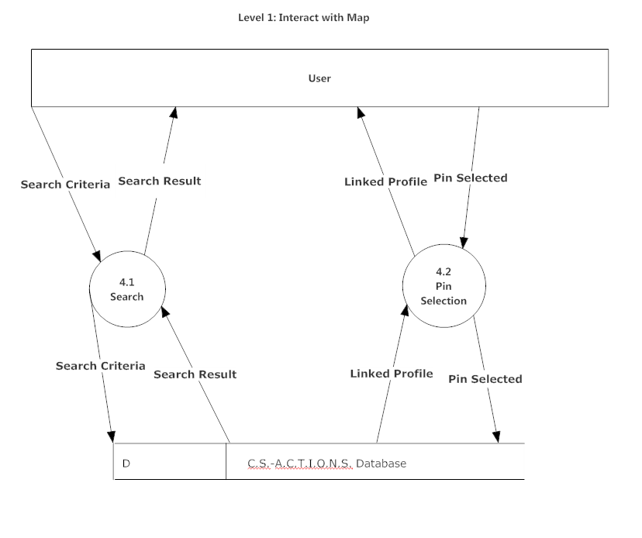
C.S.-A.C.T.I.O.N.S. Database
20

Slide 22
21

Slide 23
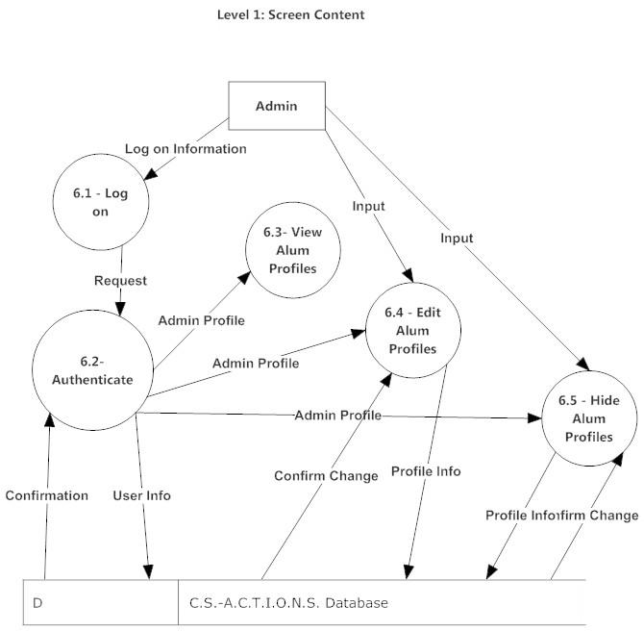
22

Slide 24
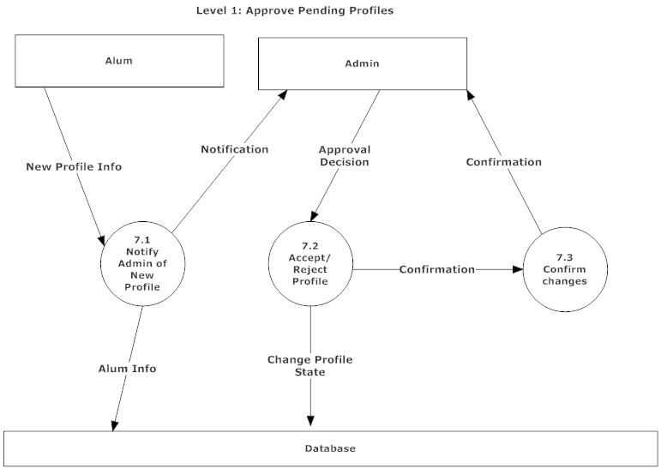
23

Slide 25
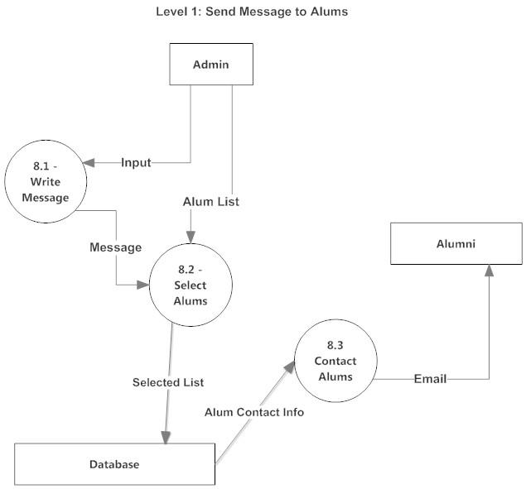
24

Slide 26
Agenda
Introduction
Product Overview
Project Progression
Use Case Narratives
UML Use Case Diagram
Data Flow Diagrams
Functional Requirements
Non-Functional Requirements
Prototypes
What’s Next?
25

Slide 27
Functional Requirements
Alumni:
Will be able to set up an account on C.S.-A.C.T.I.O.N.S.
Will be able to log into C.S.-A.C.T.I.O.N.S.
Will be able to change password
Will interact with map using pins representing locations of alumni
Will be able to view other Alumni profiles
Will be able to edit/make changes to own profile
Will be able to change privacy settings
Will be able to log out of C.S.-A.C.T.I.O.N.S.
26

Slide 28
Functional Requirements
Student:
Will interact with map using pins representing hometowns of alumni
Will be able to view Alumni profiles
Will be able to contact Alumni
27

Slide 29
Functional Requirements
Administrator:
Will be able to log into C.S.-A.C.T.I.O.N.S.
Will interact with map using pins representing hometowns of alumni
Will be able to view Alumni profiles
Will be able to send message to all Alumni
Will be able to edit/make changes to any information in an alumni profile
Will be able to approve/deny pending profiles
Will be able to log out of C.S.-A.C.T.I.O.N.S.
28

Slide 30
Agenda
Introduction
Product Overview
Project Progression
Use Case Narratives
UML Use Case Diagram
Data Flow Diagrams
Functional Requirements
Non-Functional Requirements
Prototypes
What’s Next?
29

Slide 31
Non-Functional Requirements
C.S.-A.C.T.I.O.N.S will:
Be user friendly
Run efficiently
Be easy to access
Have compatibility on multiple browsers
Be stable
30

Slide 32
Agenda
Introduction
Product Overview
Project Progression
Use Case Narratives
UML Use Case Diagram
Data Flow Diagrams
Functional Requirements
Non-Functional Requirements
Prototypes
What’s Next?
31

Slide 33
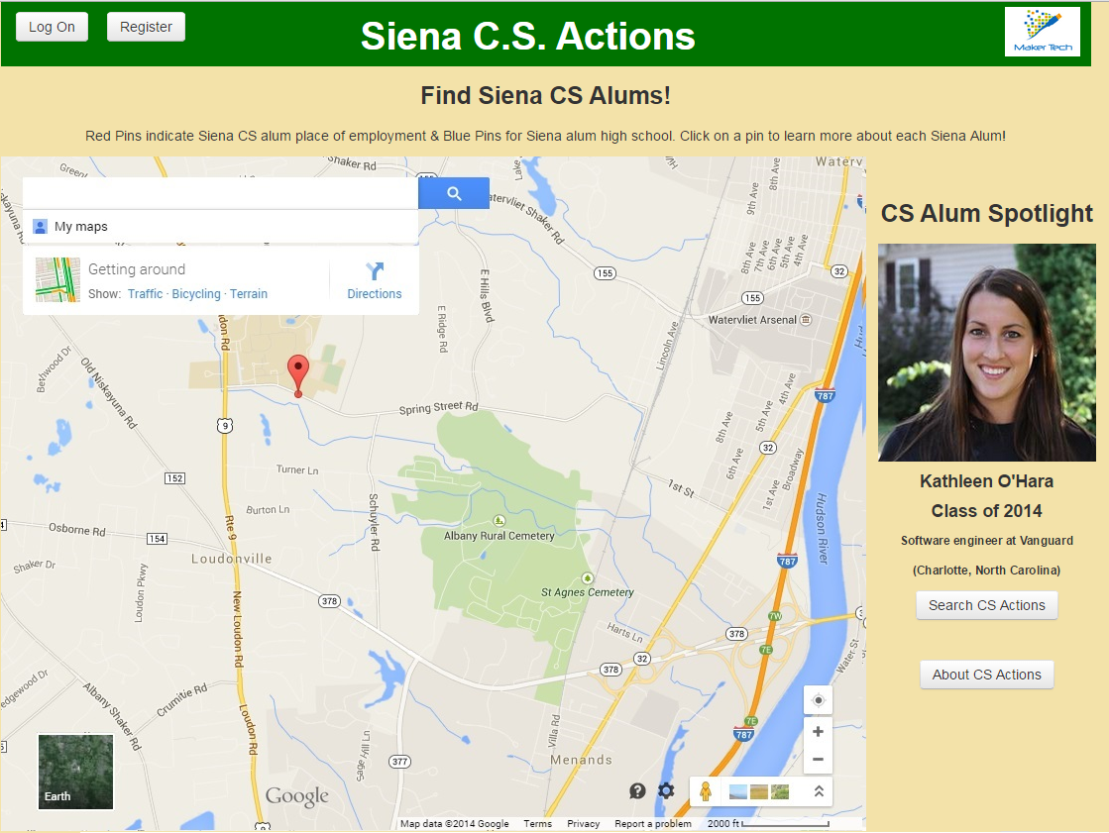
Initial Prototype
32

Slide 34
Agenda
Introduction
Product Overview
Project Progression
Use Case Narratives
UML Use Case Diagram
Data Flow Diagrams
Functional Requirements
Non-Functional Requirements
Prototypes
What’s Next?
33

Slide 35
What’s Next?
Software Plan
Requirements Specification
Development and Testing
Preliminary Design
Detailed Design
Acceptance Test
34

Slide 36
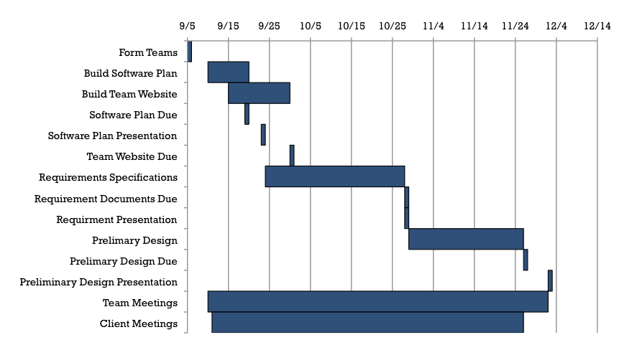
What’s Next?
35

Slide 37
Thank You!!
Questions or Comments?
36

