Slide 1
C.S.-A.C.T.I.O.N.S
Preliminary Design
by MAKER Technologies

Slide 2
Introduction
Marissa Bianchi – Team Leader
Ryan Clancy – Lead Developer
Andrew Reynolds – Webmaster
Kaitlyn Boomhower – Developer & Co-Webmaster
Eduardo Luiz Cabral Da Silva – Database Administrator

Slide 3
Agenda
Product Overview
Project Progression
User Case Narratives
Use Case Diagram
Deployment Diagram
Website Map
Activity Diagram
Data Flow Diagrams
Requirements Inventory
Data Dictionary
Testing Plan
Development Environment & Production Environment
Prototypes
What’s Next

Slide 4
Product Overview
An easy to use web application that keeps track of Siena College Computer Science Alumni.
All users can view and interact with the map
Administrators control everything
Goals:
Allow current Siena CS students & prospective students to see what career paths Siena CS Alumni have taken
Keep Siena College Computer Science Alumni connected to each other!

Slide 5
Project Progression
Software Plan
Requirements Specification
Development and Testing
Preliminary Design
Detailed Design
Acceptance Test

Slide 6
Use Case Narratives
User
Interact with map
Click on pins and view public Alumni profiles
Send the alumnus a request for contact

Slide 7
Use Case Narratives
Alumni
Register on the system
Login
Reset Password if forgotten
Edit profile
Change password
Disable certain content from being shown (i.e. contact information)
Hide profile
View map and click on pins to view any other Alumni profiles
Request to contact other alums

Slide 8
Use Case Narratives
Administrator
Login
Approve or deny pending alumni profiles
Delete, create, or edit the content on any of the alumni profiles
Send a message to all alumni with an account on the system
Interact with the map in the same way as the alumni and students.

Slide 9
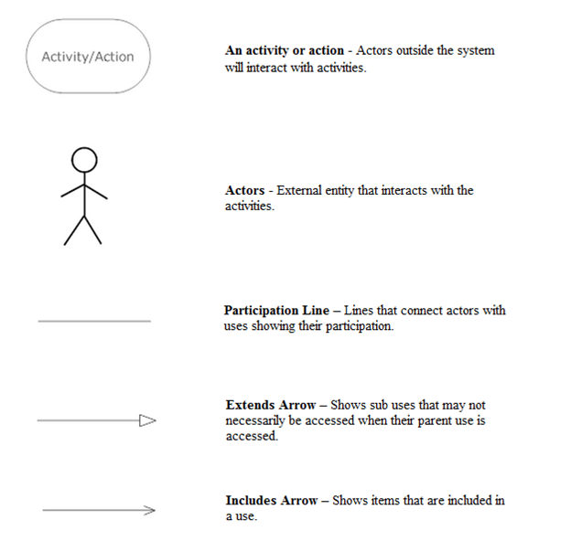
Use Case Diagram Legend

Slide 10
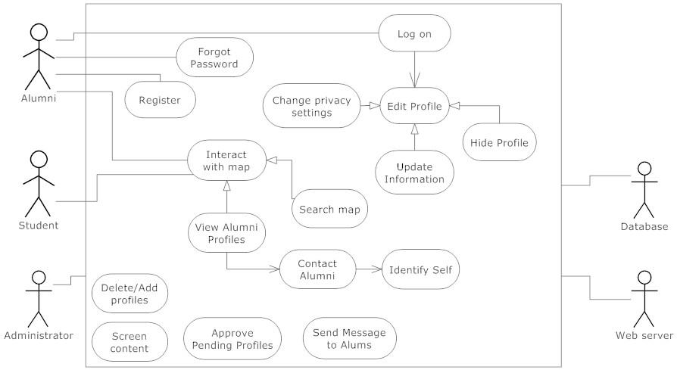
Use Case Diagram

Slide 11
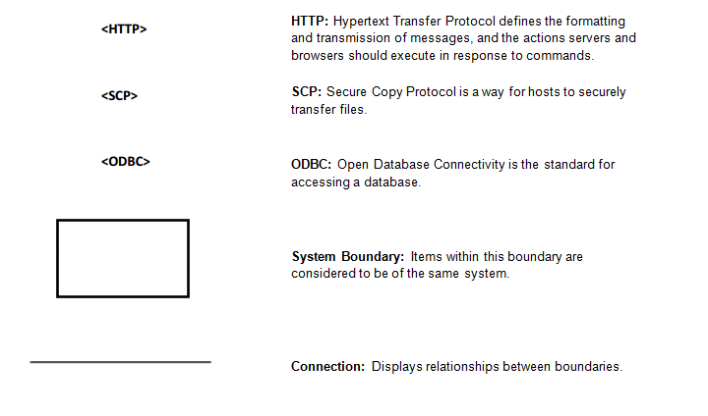
Deployment Diagram Legend

Slide 12
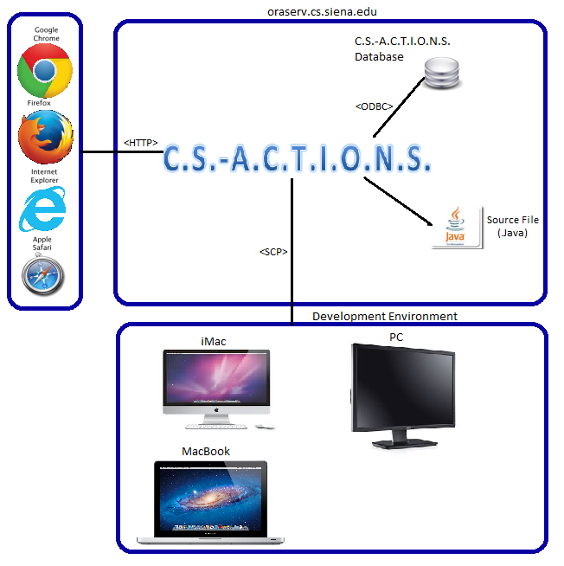
Deployment Diagram

Slide 13
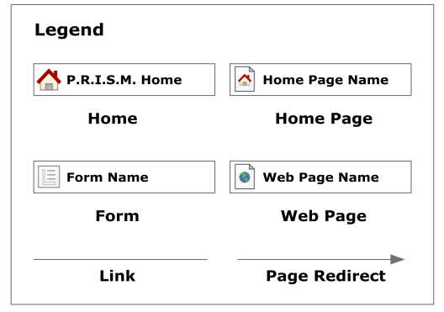
Website Map Legend
C.S.-A.C.T.I.O.N.S

Slide 14
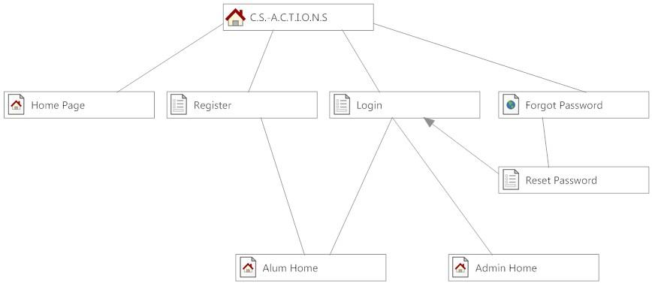
Website Maps

Slide 15
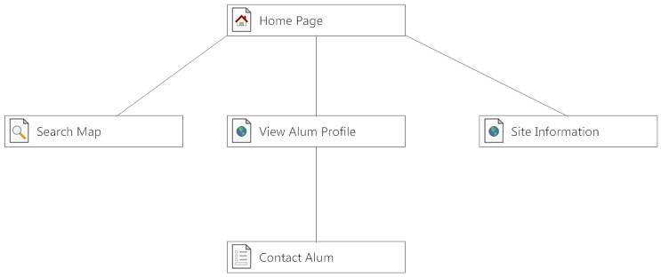
Website Map: Home Page

Slide 16
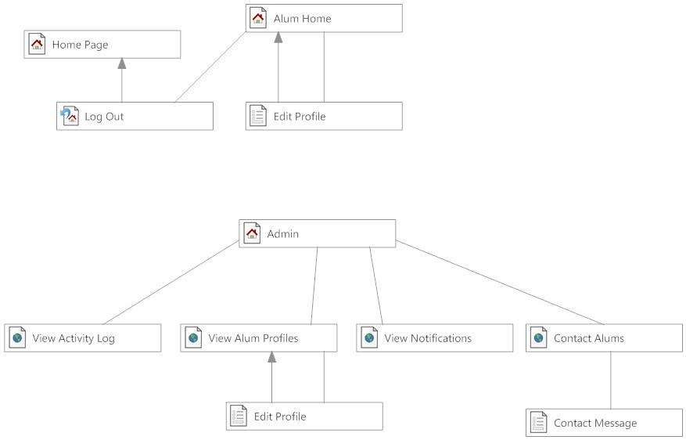
Website Map: Admin Home

Slide 17
Website Map: Alum Home

Slide 18
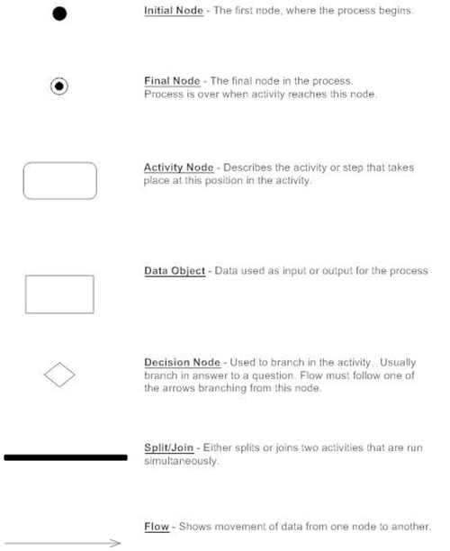
Activity Diagram Legend

Slide 19
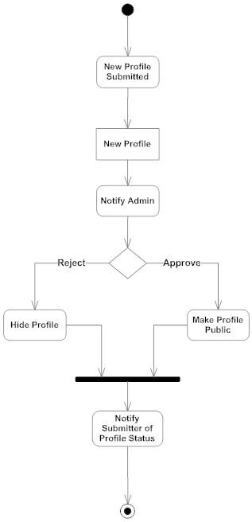
Approve Pending Profiles

Slide 20
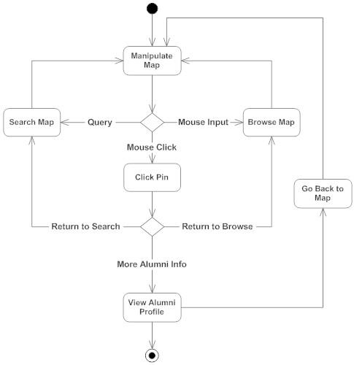
Interact With Map

Slide 21
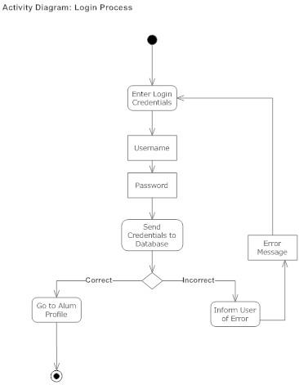
Login

Slide 22
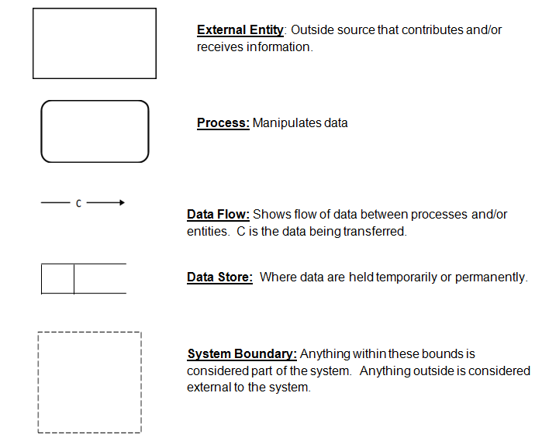
Data Flow Diagram Legend

Slide 23
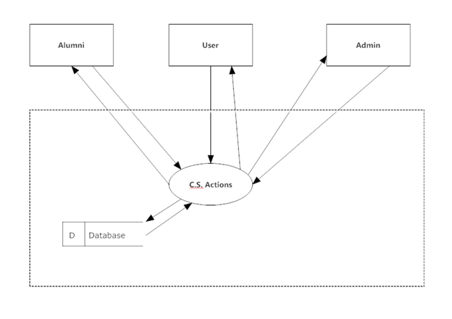
Context Diagram

Slide 24
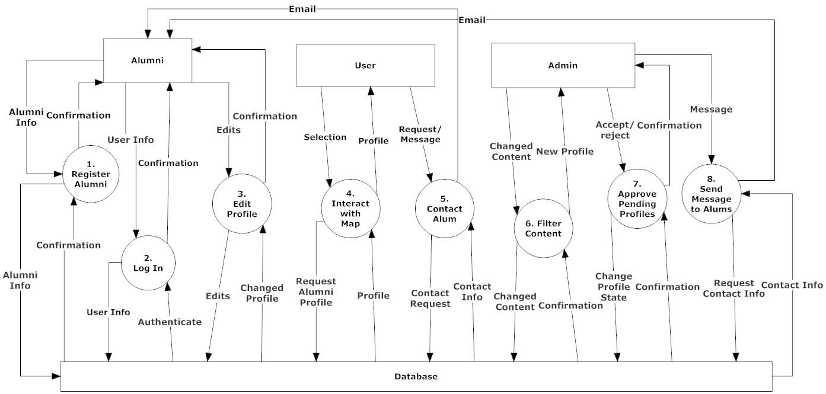
Level 0 Diagram

Slide 25
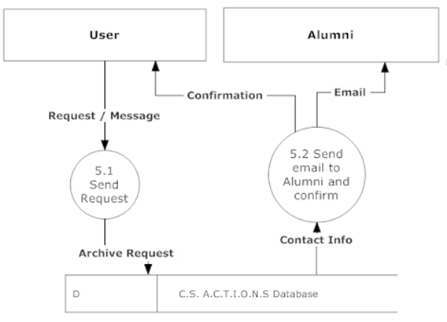
Level 1: Contact Alumni

Slide 26
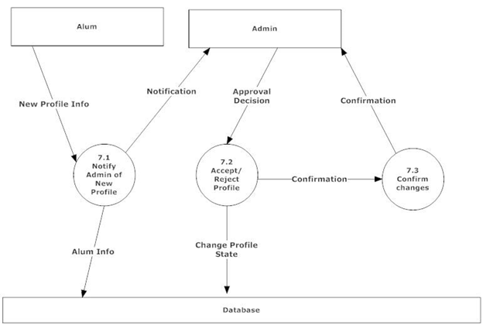
Level 1: Approve Pending Profiles

Slide 27
Functional Requirements: Alumni
Set up an account on C.S.-A.C.T.I.O.N.S.
Log on
Change password
Interact with map using pins representing locations of alumni
View other Alumni profiles
Edit/make changes to own profile
Change privacy settings
Log out

Slide 28
Functional Requirements: User
● Interact with map using pins
● View Alumni profiles
● Contact Alumni

Slide 29
Functional Requirements: Admin
Log in
Interact with map using pins
View Alumni profiles
Send message to all Alumni
Edit/make changes to any information in an alumni profile
Approve/deny pending profiles
Log out

Slide 30
Non-Functional Requirements
● User friendly
● Run efficiently
● Easy to access
● Fully functional on multiple browsers
● Stable

Slide 31
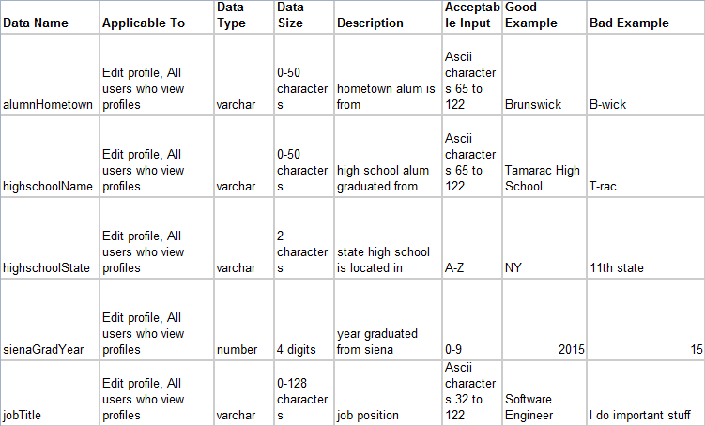
Data Dictionary

Slide 32
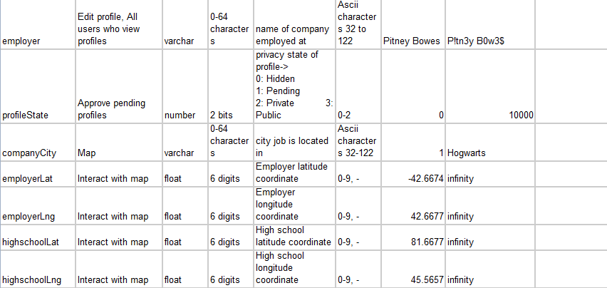

Slide 33
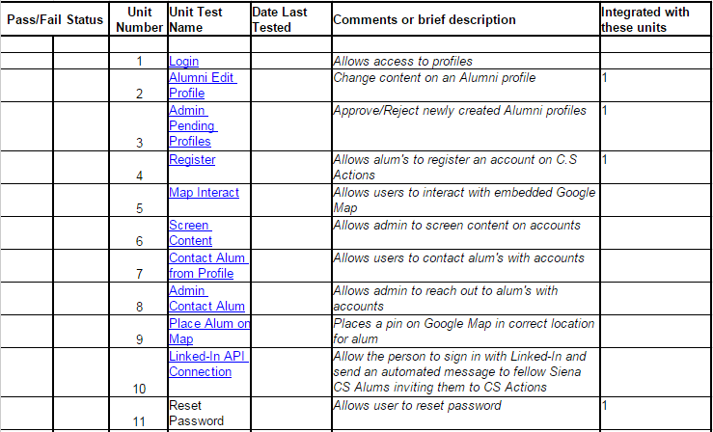
Unit Tests

Slide 34
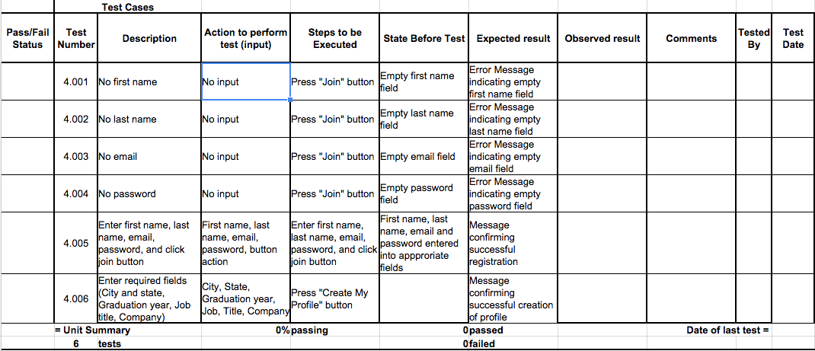
Unit Tests: Register Alumni

Slide 35
Unit Tests: Contact Alumni

Slide 36
Prototypes

Slide 37
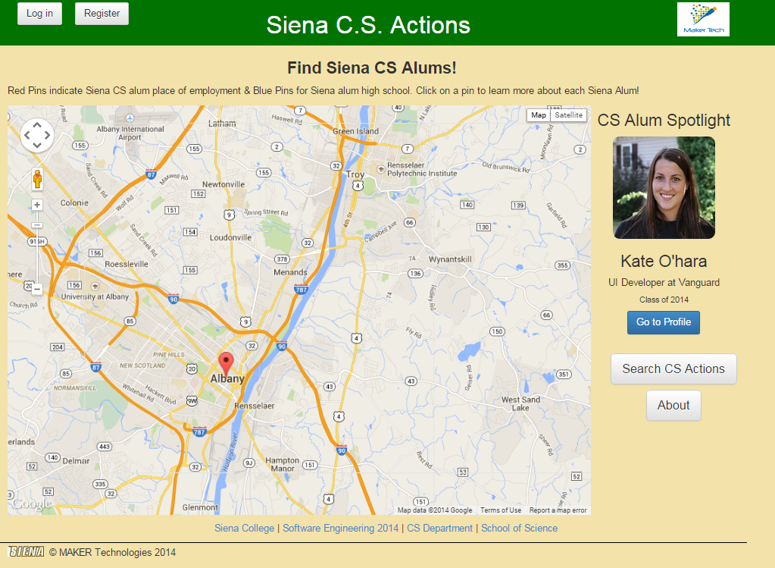

Slide 38
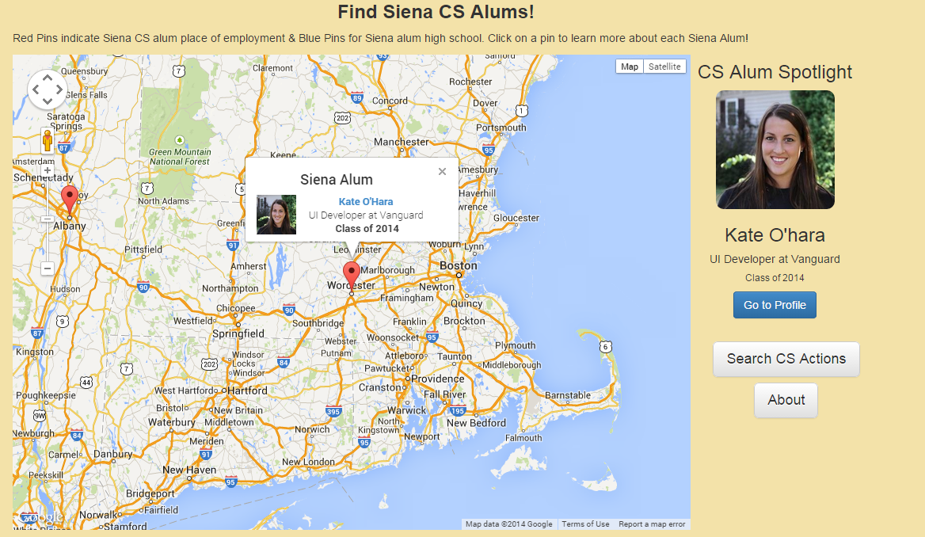

Slide 39
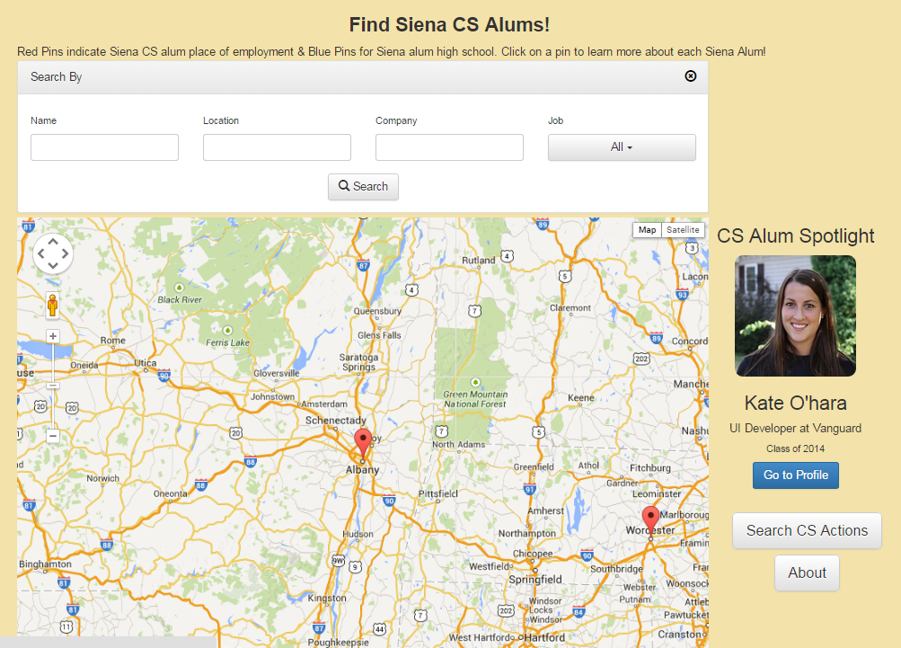

Slide 40
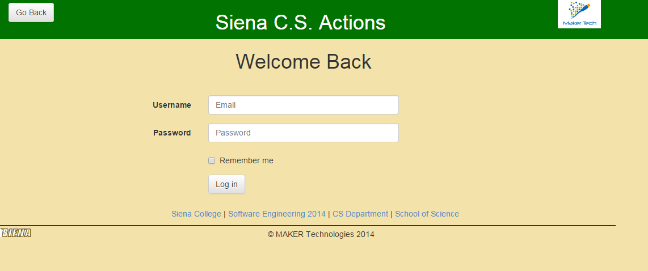

Slide 41
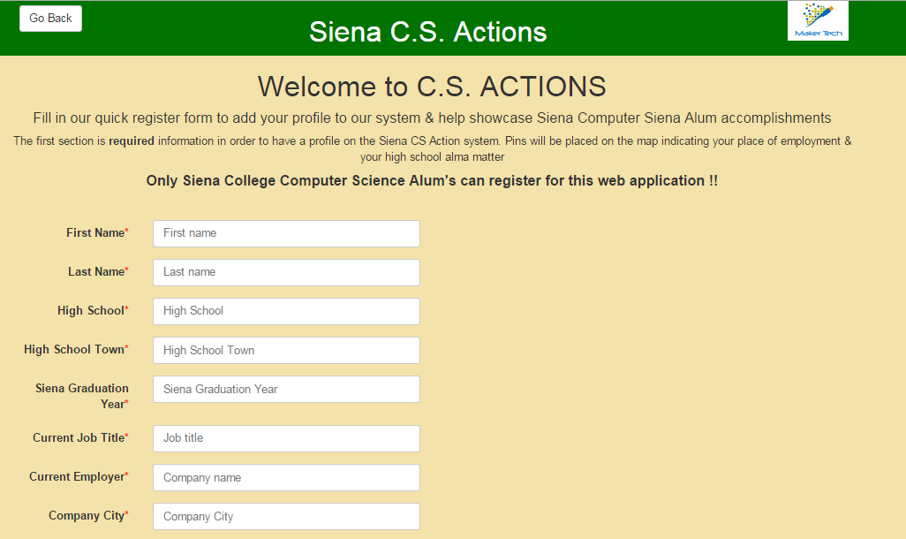

Slide 42
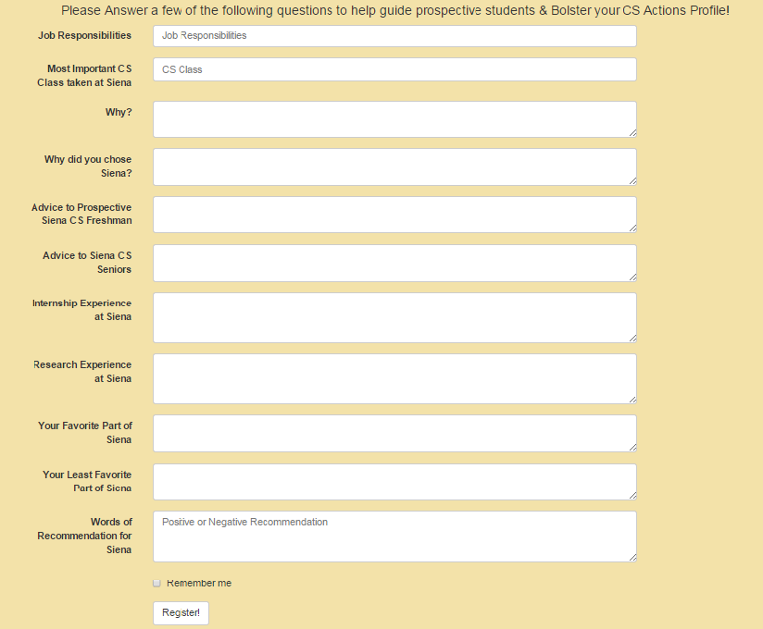

Slide 43
What’s Next?
Software Plan
Requirements Specification
Development and Testing
Preliminary Design
Detailed Design
Acceptance Test

