Slide 1
FSH Technologies
Software Plan
September 23, 2011

Slide 2
Today’s Agenda
Team Introductions
Problem Definition and System Justification
Goals and Constraints
Development Technologies
Project Timeline

Slide 3
FSH Technologies
Matt Kemmer
Team Leader
Mike Tanski
Webmaster
Matt Brancato
Systems Administrator
Jackie Boylan
Librarian
Serena Moore
Sub-Group Leader
Nydia Negron
Head Researcher

Slide 4
Today’s Agenda
Team Introductions
Problem Definition and System Justification
Goals and Constraints
Development Technologies
Project Timeline

Slide 5
The Problem
There is no easy way to create an Implicit Association Test (IAT)
Difficult to distribute an IAT and collect data online
There are no interfaces available for creating and publishing IAT’s online
Researchers need to be focused on choosing correct stimuli objects for the test rather than creating the test itself

Slide 6
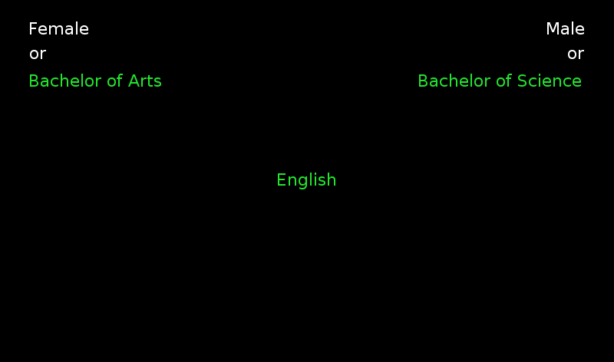
Implicit Association Tests

Slide 7
System Justification
A computer administered test will lead to the most accurate research
The most important aspect of an IAT is the results
Accurate Reaction Time
More Variables
Better Research Reports

Slide 8
Today’s Agenda
Team Introductions
Problem Definition and System Justification
Goals and Constraints
Development Technologies
Project Timeline

Slide 9
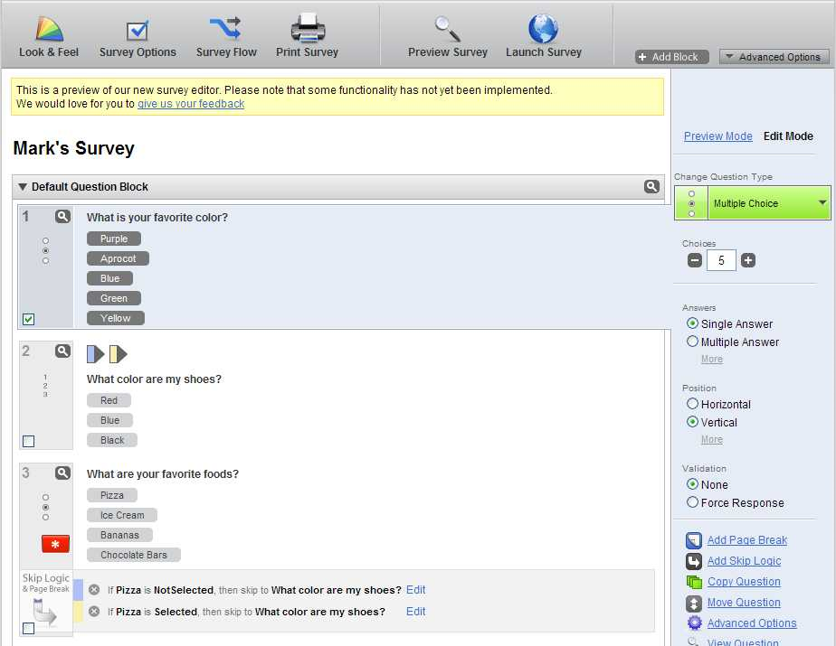
Our Goals
Create an online environment that provides users with templates to create, administer and collect data on IAT’s online
Similar to Qualtrics and SurveyMonkey

Slide 10
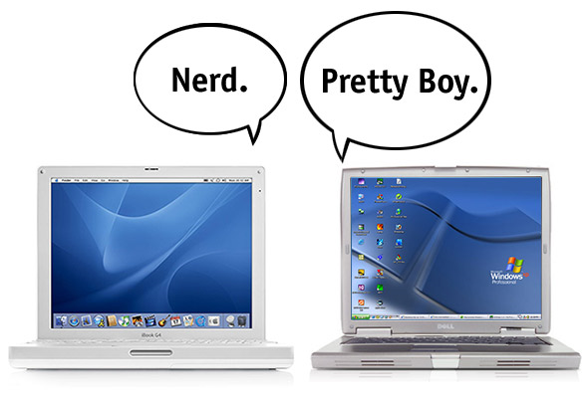
Project Constraints
Must be web-based
Written in common web programming languages (JavaScript, PhP)
Supported on as many devices and operating systems as possible
No flash, PC or Mac specific detailing

Slide 11
Today’s Agenda
Team Introductions
Problem Definition and System Justification
Goals and Constraints
Development Technologies
Project Timeline

Slide 12
Development Technologies
Development hardware:
Windows and Mac computers in the Software Engineering lab
Team members personal computers
Development languages:
HTML and CSS
JavaScript
PhP
MySQL
Development software:
Adobe Creative Suite (Dreamweaver, Fireworks, Photoshop)
Microsoft Office Suite
Firefox, Chrome, Safari and Internet Explorer
MySQL Server and Microsoft Access

Slide 13
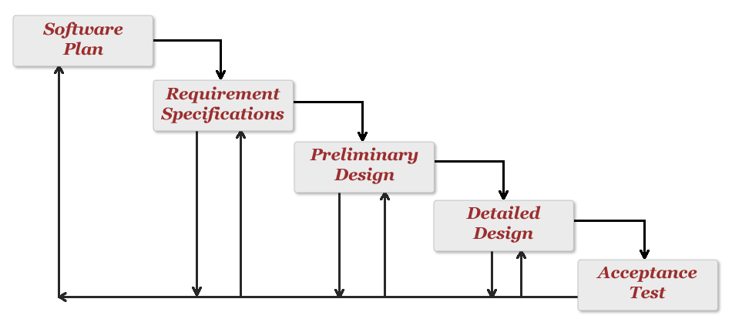
Development Model
Our development model will follow a close resemblance to the traditional ‘Waterfall’ model.

Slide 14
Today’s Agenda
Team Introductions
Problem Definition and System Justification
Goals and Constraints
Development Technologies
Project Timeline

Slide 15
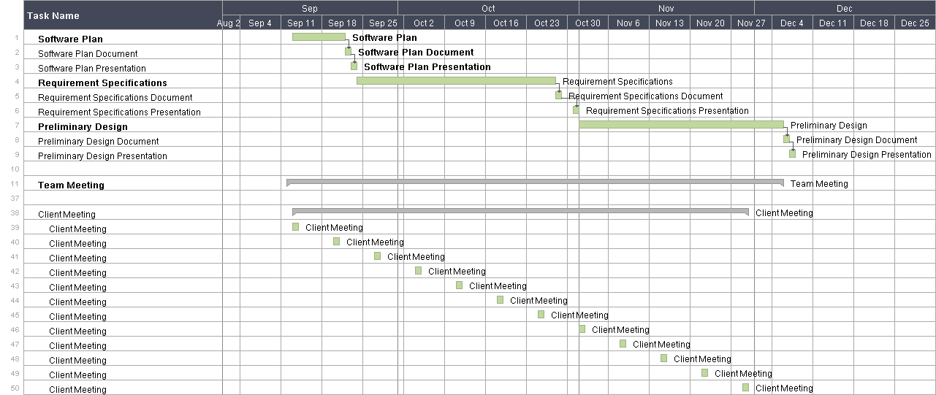
Project Timeline

Slide 16
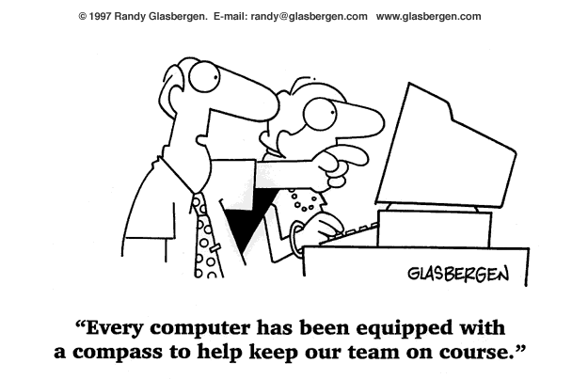
Timeline Deliverable Dates
Software Plan – September 22, 2011
Requirement Specifications – October 28, 2011
Preliminary Design – December 6, 2011

Slide 17
Thank You!
Questions?

