Slide 1
FSH Technologies
Requirements Specification
October 31, 2011

Slide 2
Today’s Agenda
Team Introductions
Problem Definition
Project Progression
User Case Narratives
Use Case Diagram
Data Flow Diagrams
Requirements Inventory
Future Work and Conclusion

Slide 3
FSH Technologies
Matt Kemmer
Team Leader
Mike Tanski
Webmaster
Matt Brancato
Systems Administrator
Jackie Boylan
Librarian
Serena Moore
Sub-Group Leader
Nydia Negron
Head Researcher

Slide 4
Today’s Agenda
Team Introductions
Problem Definition
Project Progression
User Case Narratives
Use Case Diagram
Data Flow Diagrams
Requirements Inventory
Future Work and Conclusion

Slide 5
The Problem
There is no easy way to create an Implicit Association Test (IAT)
Difficult to distribute an IAT and collect data online
There are no interfaces available for creating and publishing IAT’s online
Researchers need to be focused on choosing correct stimuli objects for the test rather than creating the test itself

Slide 6
Implicit Association Tests

Slide 7
Today’s Agenda
Team Introductions
Problem Definition
Project Progression
User Case Narratives
Use Case Diagram
Data Flow Diagrams
Requirements Inventory
Future Work and Conclusion

Slide 8
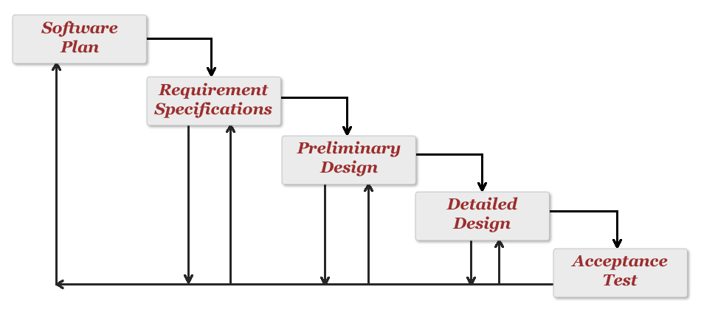
Project Progression

Slide 9
Today’s Agenda
Team Introductions
Problem Definition
Project Progression
User Case Narratives
Use Case Diagram
Data Flow Diagrams
Requirements Inventory
Future Work and Conclusion

Slide 10
User Case Narratives
Fabricating IAT Luminating, Existing, Thinking (F.I.L.E.T.)
Administrator and Participant
How each user interacts with F.I.L.E.T.
Description of user goals

Slide 11
User Case Narratives
Administrator
Authentication via username and password
Create new IATs
Create new surveys associated with each IAT
Edit and maintain existing IATs and surveys
Publish survey/IAT to the web

Slide 12
User Case Narratives
Participant
Access IAT instructions
Take published survey and IAT
See results (if applicable)

Slide 13
Today’s Agenda
Team Introductions
Problem Definition
Project Progression
User Case Narratives
Use Case Diagram
Data Flow Diagrams
Requirements Inventory
Future Work and Conclusion

Slide 14
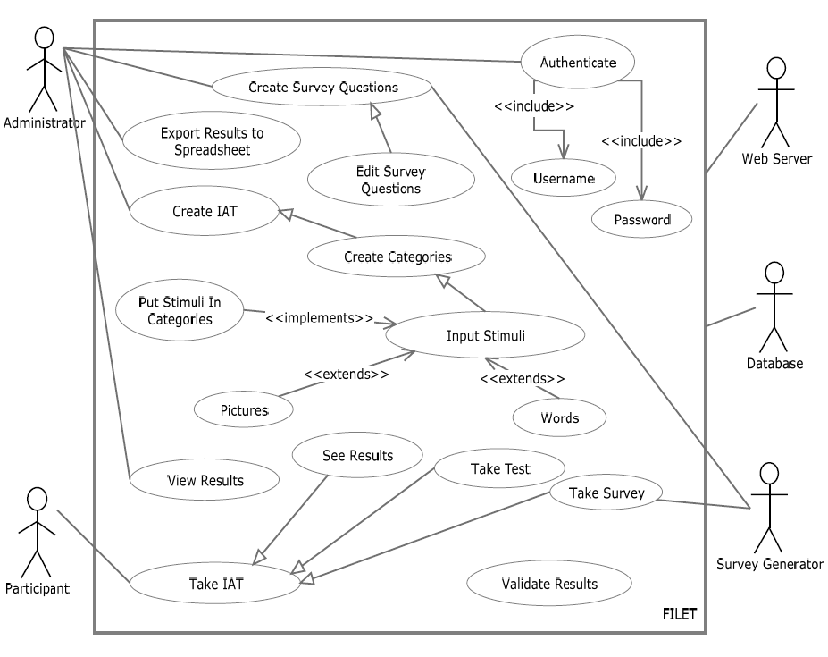
UML Use Case Diagram

Slide 15
Today’s Agenda
Team Introductions
Problem Definition
Project Progression
User Case Narratives
Use Case Diagram
Data Flow Diagrams
Requirements Inventory
Future Work and Conclusion

Slide 16
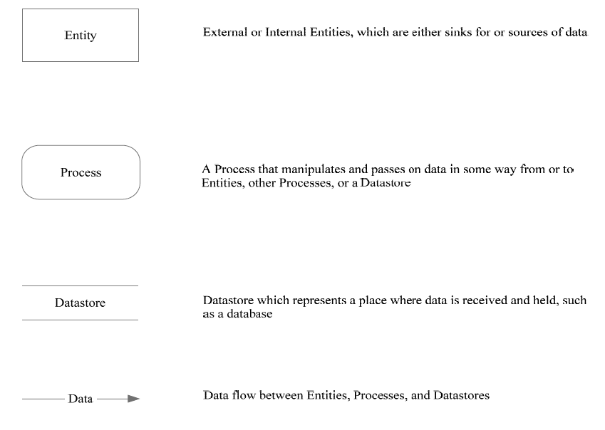
Data Flow Diagrams - Legend

Slide 17
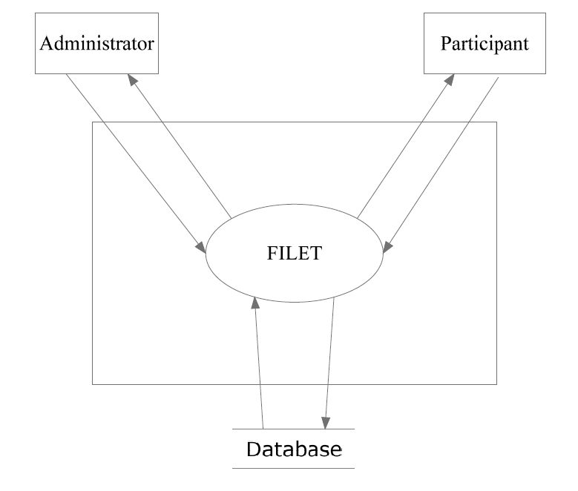
F.I.L.E.T. Context Diagram

Slide 18
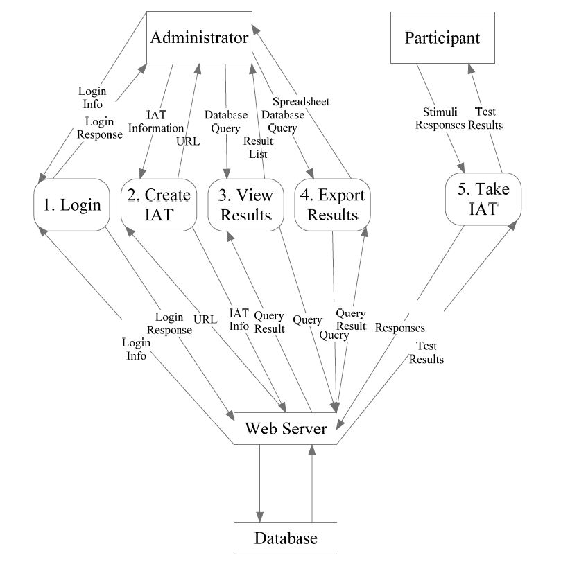
F.I.L.E.T. Level 0 Diagram

Slide 19
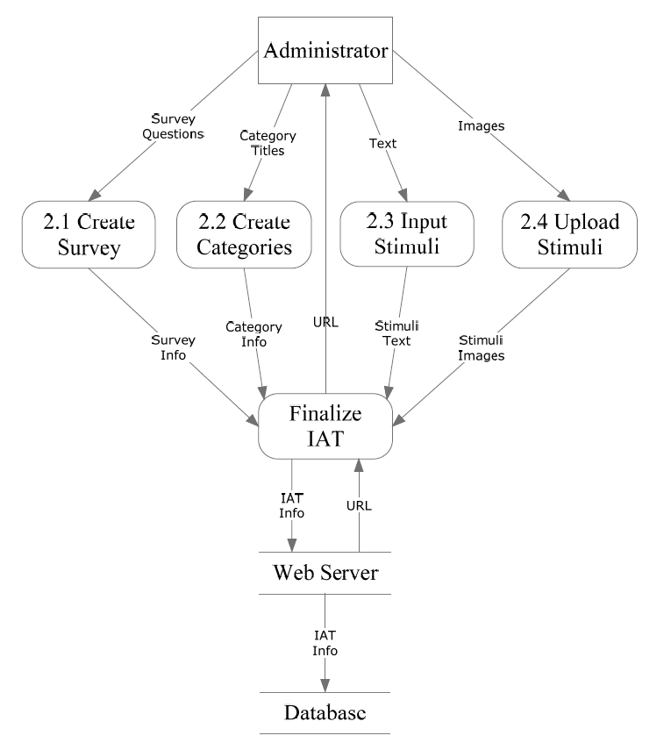
F.I.L.E.T. Level 1: Create IAT

Slide 20
Today’s Agenda
Team Introductions
Problem Definition
Project Progression
User Case Narratives
Use Case Diagram
Data Flow Diagrams
Requirements Inventory
Future Work and Conclusion

Slide 21
Functional Requirements Inventory
F.I.L.E.T.
Web based
Compatible with all popular web browsers
Authentication system

Slide 22
Functional Requirements Inventory
Participant
Able to follow link to survey/IAT
Able to answer survey questions (omitting optional questions)
Able to take IAT (categorizing stimuli objects)
Able to view results (if applicable)

Slide 23
Functional Requirements Inventory
Administrator
Able to authenticate
Able to create surveys and IATs
Able to view and edit surveys and IATs
Able to publish surveys and IATs to the web via hyperlink
Able to export results to a spreadsheet

Slide 24
Today’s Agenda
Team Introductions
Problem Definition
Project Progression
User Case Narratives
Use Case Diagram
Data Flow Diagrams
Requirements Inventory
Future Work and Conclusion

Slide 25
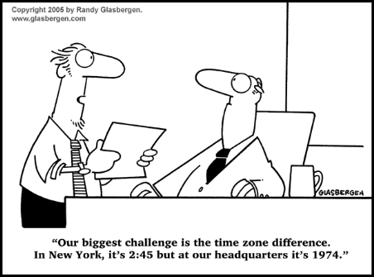
Future Deliverable Dates
Software Plan – September 22, 2011
Requirement Specifications – October 28, 2011
Preliminary Design – December 6, 2011

Slide 26
Thank You!

