Slide 1

FSH Technologies
Preliminary Design: F.I.L.E.T.
December 9, 2011

Slide 2
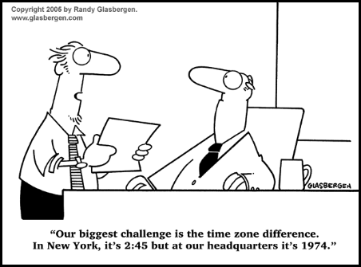
Today’s Agenda
Team Introductions
Problem Definition
Project Progression
User Case Narratives
UML Diagrams
Structure Diagrams
Data Flow Diagrams
Requirements Inventory
Testing
Data Dictionary
Prototype Screens
Future Work and Conclusion

Slide 3
FSH Technologies
Matt Kemmer
Team Leader
Mike Tanski
Webmaster
Matt Brancato
Systems Administrator
Jackie Boylan
Librarian
Serena Moore
Sub-Group Leader
Nydia Negron
Head Researcher

Slide 4
Today’s Agenda
Team Introductions
Problem Definition
Project Progression
User Case Narratives
UML Diagrams
Structure Diagrams
Data Flow Diagrams
Requirements Inventory
Testing
Data Dictionary
Prototype Screens
Future Work and Conclusion

Slide 5
The Problem
There is no easy way to create an Implicit Association Test (IAT)
Difficult to distribute an IAT and collect data online
There are no interfaces available for creating and publishing IAT’s online
Researchers need to be focused on choosing correct stimuli objects for the test rather than creating the test itself

Slide 6


Implicit Association Tests

Slide 7
Today’s Agenda
Team Introductions
Problem Definition
Project Progression
User Case Narratives
UML Diagrams
Structure Diagrams
Data Flow Diagrams
Requirements Inventory
Testing
Data Dictionary
Prototype Screens
Future Work and Conclusion

Slide 8
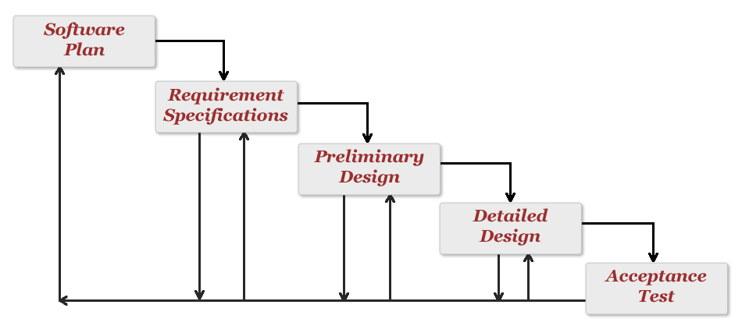
Project Progression
Development and Testing

Slide 9
Today’s Agenda
Team Introductions
Problem Definition
Project Progression
User Case Narratives
UML Diagrams
Structure Diagrams
Data Flow Diagrams
Requirements Inventory
Testing
Data Dictionary
Prototype Screens
Future Work and Conclusion

Slide 10

User Case Narratives
Functional IAT to Learn Everyone’s Thoughts (F.I.L.E.T.)
  Administrator and Participant
  How each user interacts with F.I.L.E.T.
  Description of user goals

Slide 11
User Case Narratives
Administrator
  Authentication via username and password
  Create new IATs
  Create new surveys associated with each IAT
  Publish survey/IAT to the web
  View and organize resulting data

Slide 12
User Case Narratives
Participant
  Access IAT instructions
  Take published survey and IAT
  See results (if applicable)

Slide 13
Today’s Agenda
Team Introductions
Problem Definition
Project Progression
User Case Narratives
UML Diagrams
Structure Diagrams
Data Flow Diagrams
Requirements Inventory
Testing
Data Dictionary
Prototype Screens
Future Work and Conclusion

Slide 14
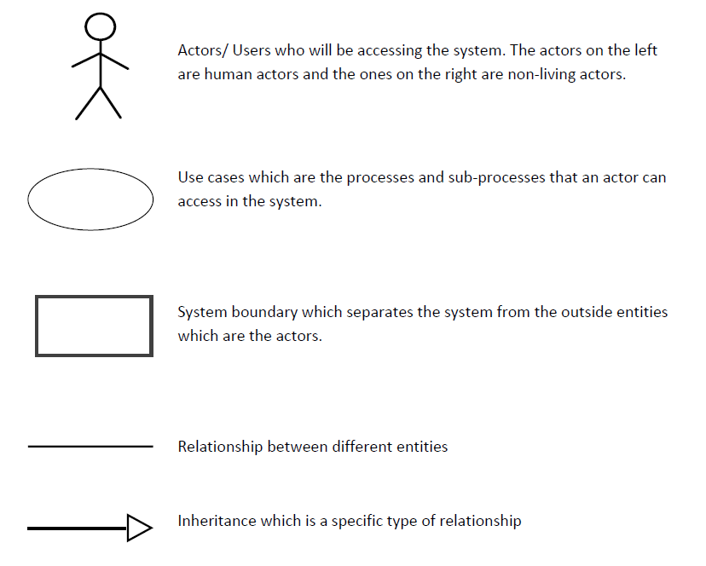
UML Diagram Legend

Slide 15
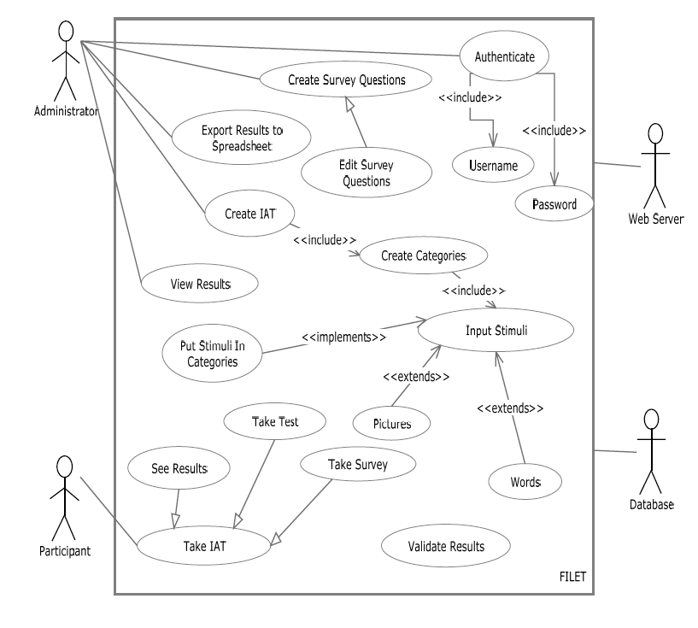
UML Use Case Diagram

Slide 16
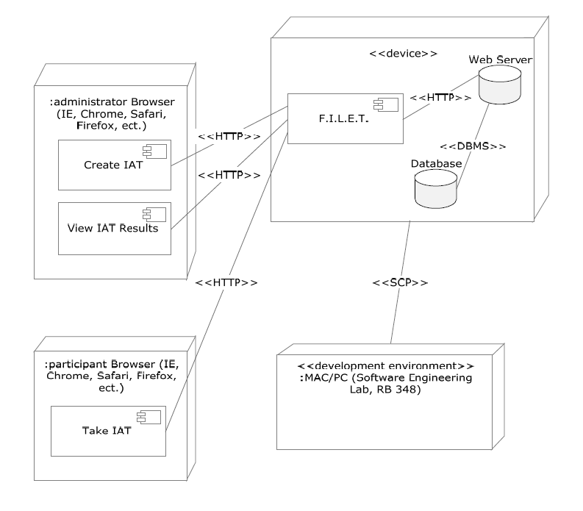
UML Deployment Diagram

Slide 17
Today’s Agenda
Team Introductions
Problem Definition
Project Progression
User Case Narratives
UML Diagrams
Structure Diagrams
Data Flow Diagrams
Requirements Inventory
Testing
Data Dictionary
Prototype Screens
Future Work and Conclusion

Slide 18
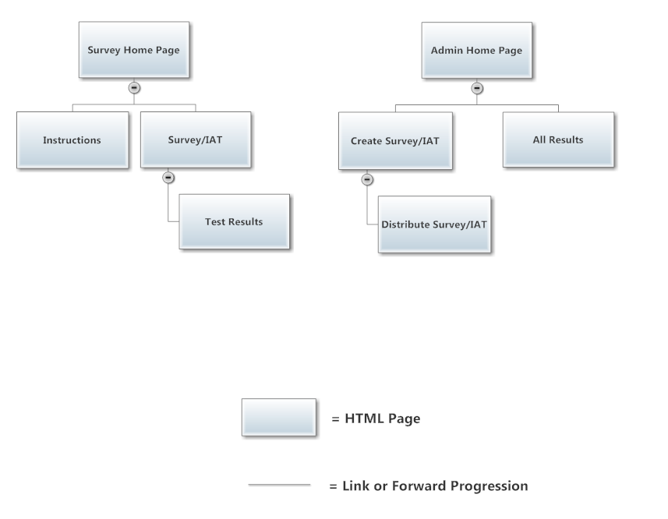
Structure Diagram: Website Map

Slide 19
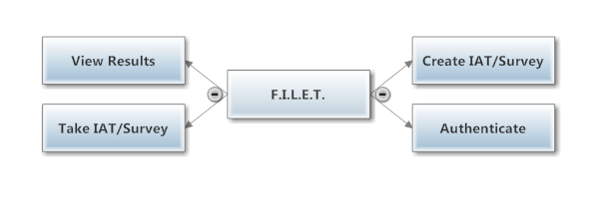
Structure Diagram: F.I.L.E.T.

Slide 20
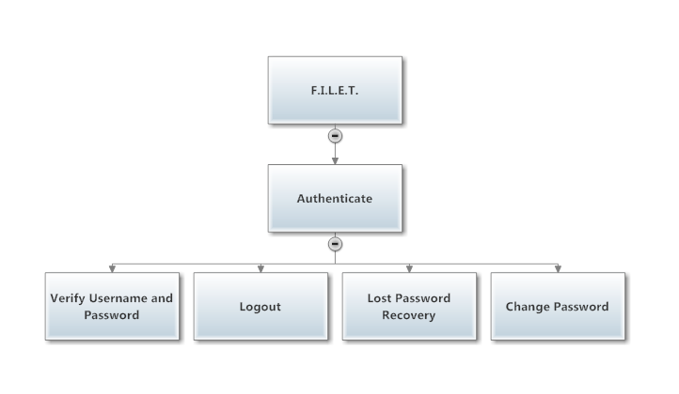
Structure Diagram: Authenticate

Slide 21
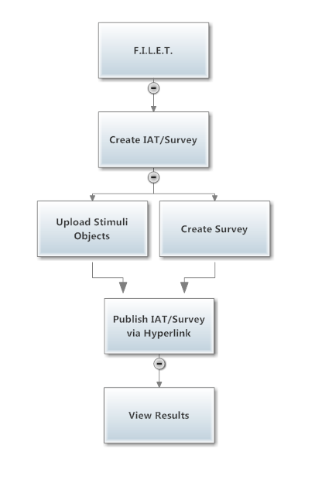
Structure Diagram: Create IAT

Slide 22
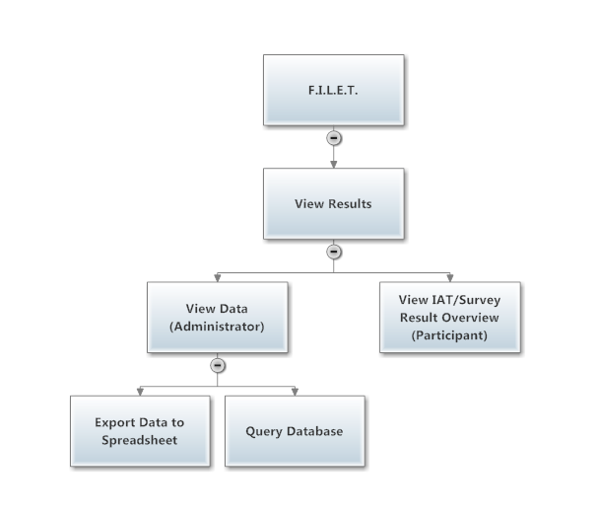
Structure Diagram: View Results

Slide 23
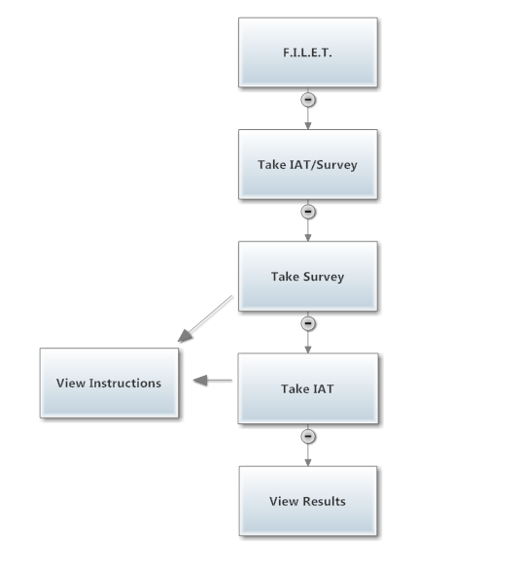
Structure Diagram: Take IAT

Slide 24
Today’s Agenda
Team Introductions
Problem Definition
Project Progression
User Case Narratives
UML Diagrams
Structure Diagrams
Data Flow Diagrams
Requirements Inventory
Testing
Data Dictionary
Prototype Screens
Future Work and Conclusion

Slide 25
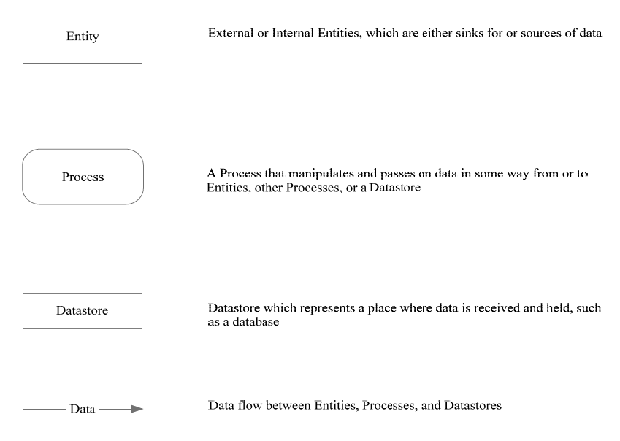
Data Flow Diagrams - Legend

Slide 26
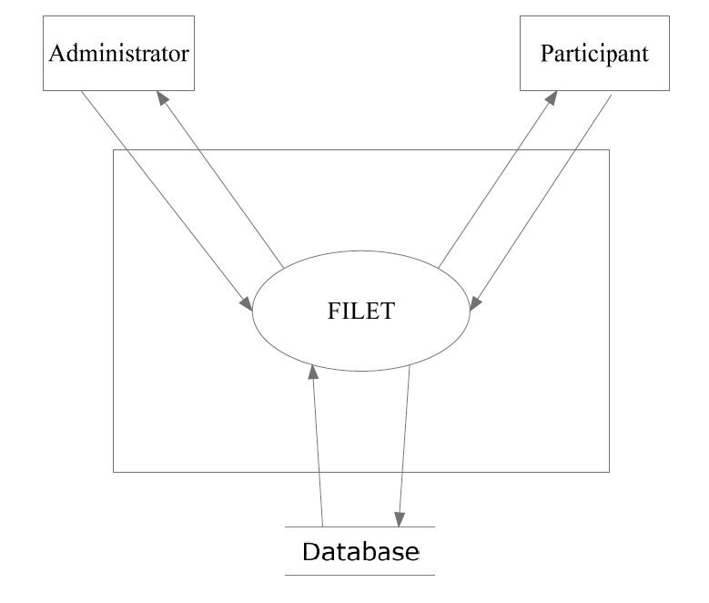
F.I.L.E.T. - Context Diagram

Slide 27
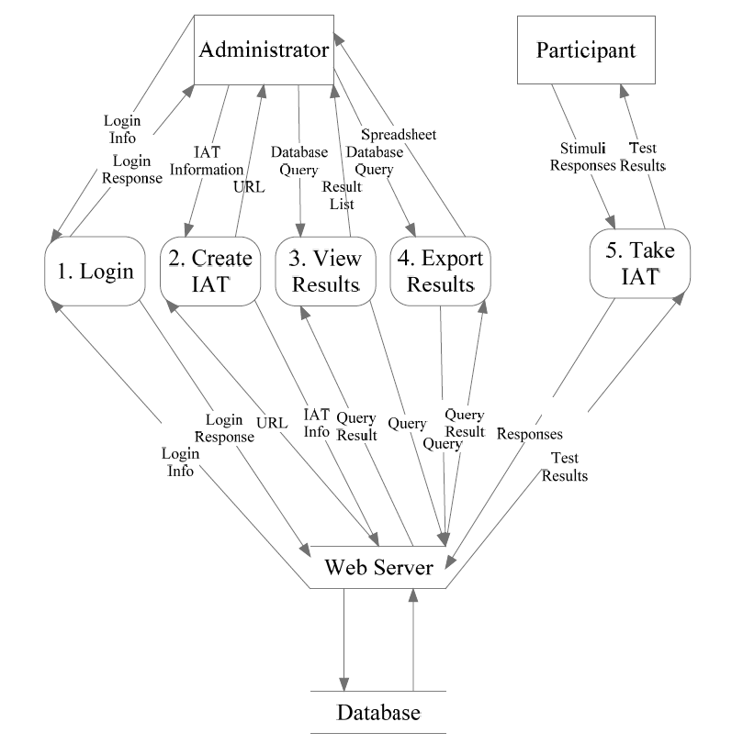
F.I.L.E.T. - Level 0 Diagram

Slide 28
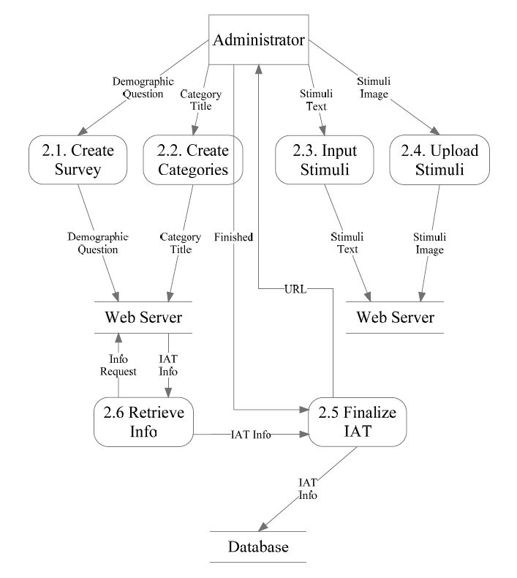
Level 1: Process 2 – Create IAT

Slide 29
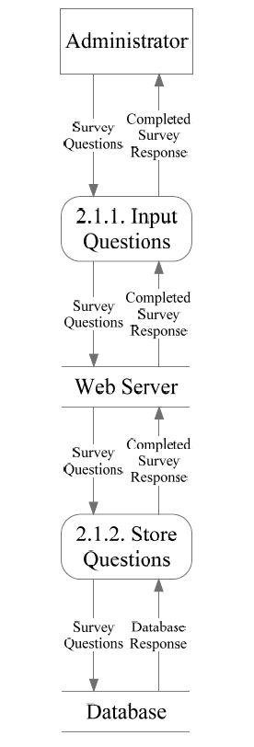
Level 2: Process 2.1 – Create Survey

Slide 30
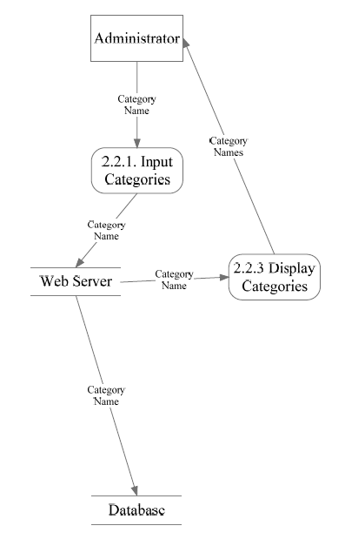
Level 2: Process 2.2 – Create Categories

Slide 31
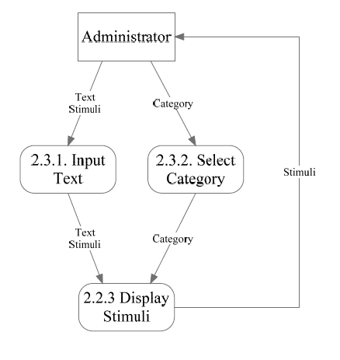
Level 2: Process 2.3 – Input Stimuli

Slide 32
Level 2: Process 2.4 – Upload Stimuli

Slide 33
Today’s Agenda
Team Introductions
Problem Definition
Project Progression
User Case Narratives
UML Diagrams
Structure Diagrams
Data Flow Diagrams
Requirements Inventory
Testing
Data Dictionary
Prototype Screens
Future Work and Conclusion

Slide 34
Functional Requirements Inventory
F.I.L.E.T.
  Web based
  Compatible with all popular web browsers
  Authentication system

Slide 35
Functional Requirements Inventory
Participant
  Able to follow link to survey/IAT
  Able to answer survey questions (omitting optional questions)
  Able to take IAT (categorizing stimuli objects)
  Able to view results (if applicable)

Slide 36
Functional Requirements Inventory
Administrator
  Able to authenticate
  Able to create surveys and IATs
  Able to publish surveys and IATs to the web via hyperlink
  Able to export results to a spreadsheet

Slide 37
Today’s Agenda
Team Introductions
Problem Definition
Project Progression
User Case Narratives
UML Diagrams
Structure Diagrams
Data Flow Diagrams
Requirements Inventory
Testing
Data Dictionary
Prototype Screens
Future Work and Conclusion

Slide 38
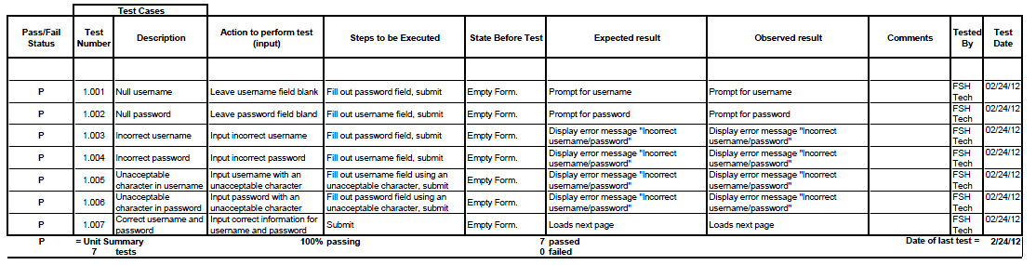
Testing: Authenticate

Slide 39
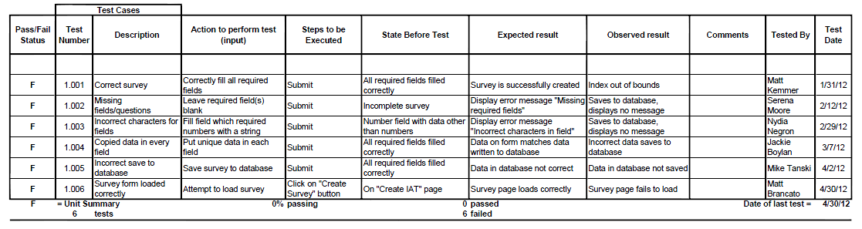
Testing: Take Survey

Slide 40
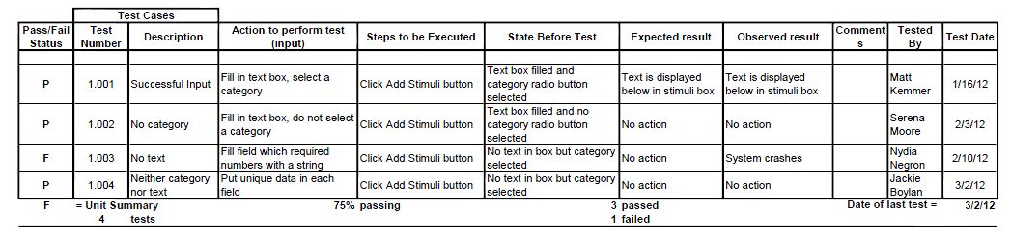
Testing: Input Stimuli

Slide 41
Today’s Agenda
Team Introductions
Problem Definition
Project Progression
User Case Narratives
UML Diagrams
Structure Diagrams
Data Flow Diagrams
Requirements Inventory
Testing
Data Dictionary
Prototype Screens
Future Work and Conclusion

Slide 42
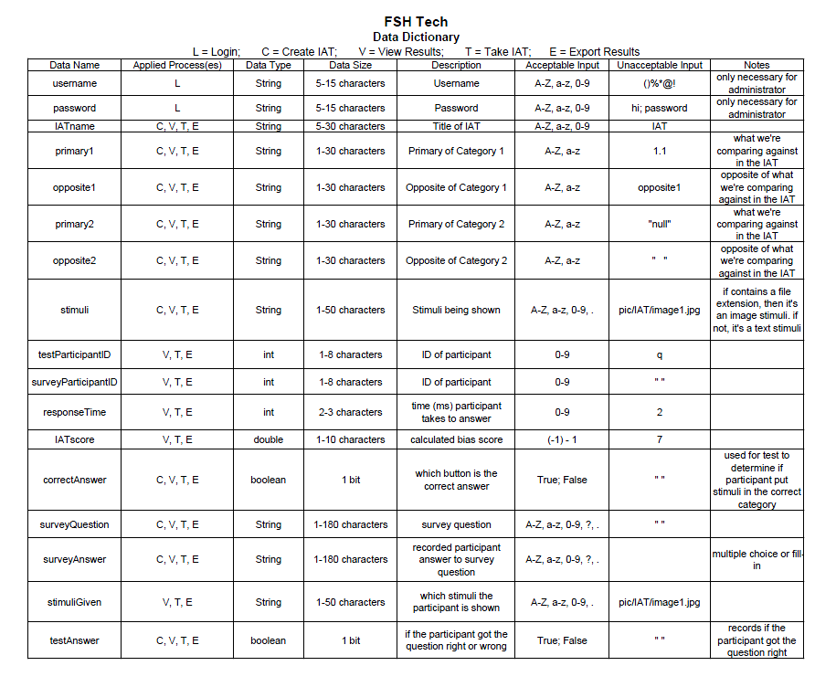
Data Dictionary

Slide 43
Today’s Agenda
Team Introductions
Problem Definition
Project Progression
User Case Narratives
UML Diagrams
Structure Diagrams
Data Flow Diagrams
Requirements Inventory
Testing
Data Dictionary
Prototype Screens
Future Work and Conclusion

Slide 44
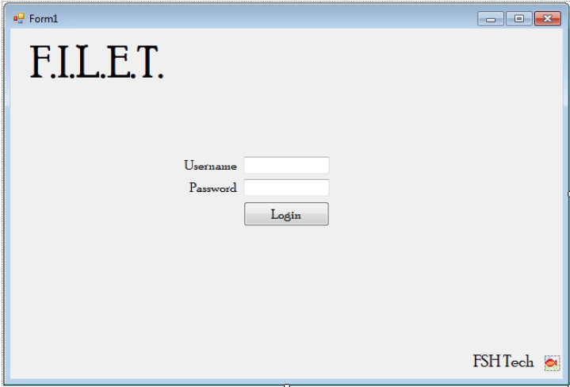
Prototype: Authenticate

Slide 45
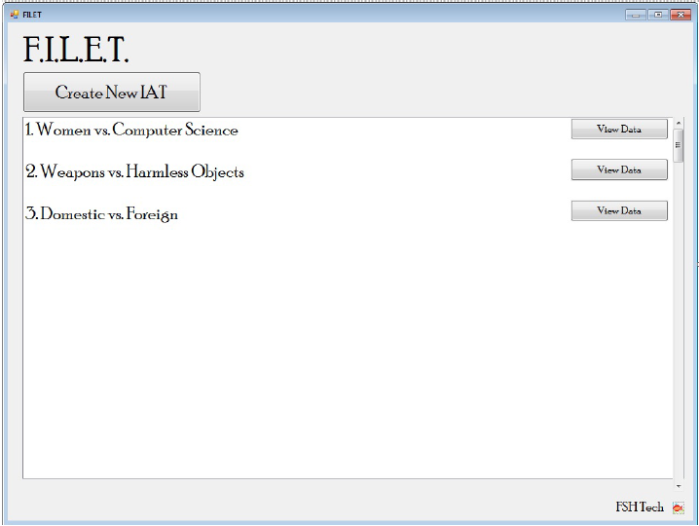
Prototype: Home

Slide 46
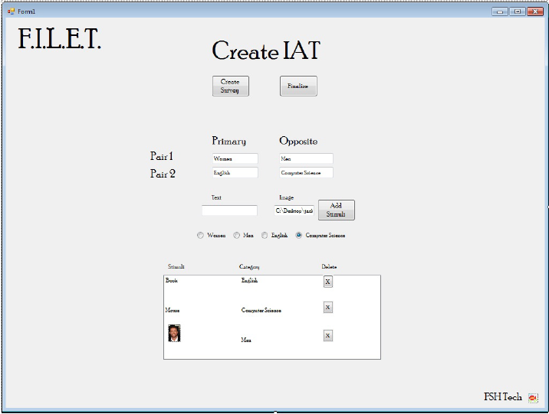
Prototype: Create IAT

Slide 47
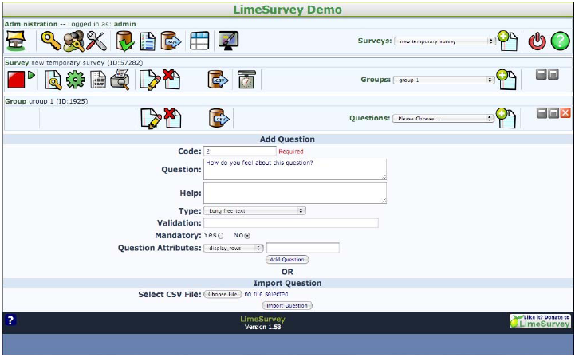
Prototype: Create Survey

Slide 48
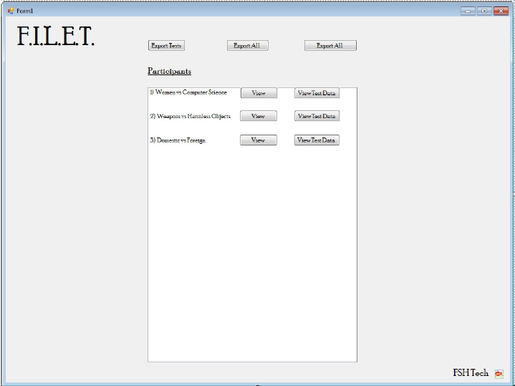
Prototype: View Data

Slide 49
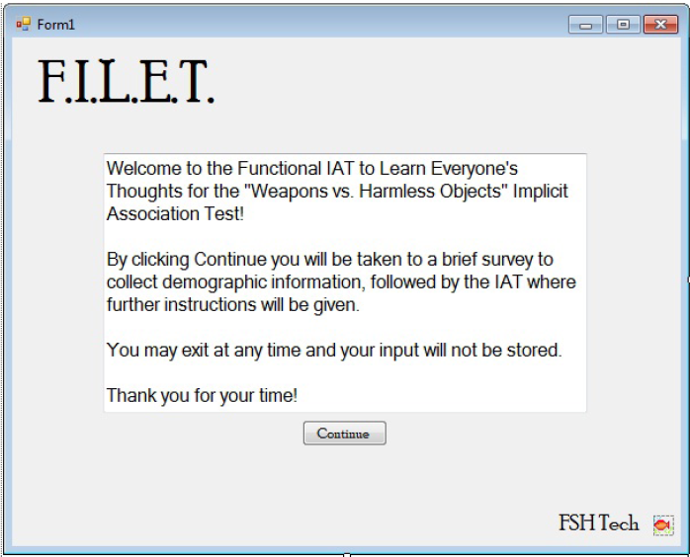
Prototype: Take IAT/Survey

Slide 50
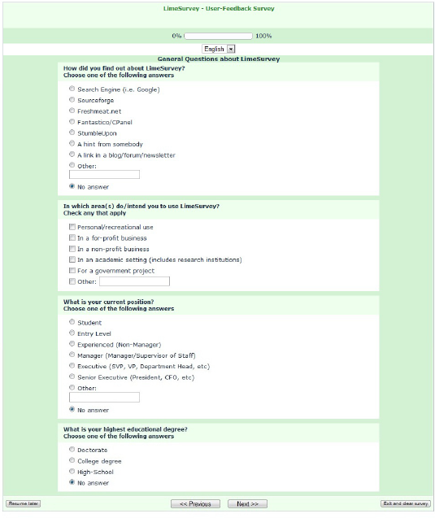
Prototype: Take Survey

Slide 51
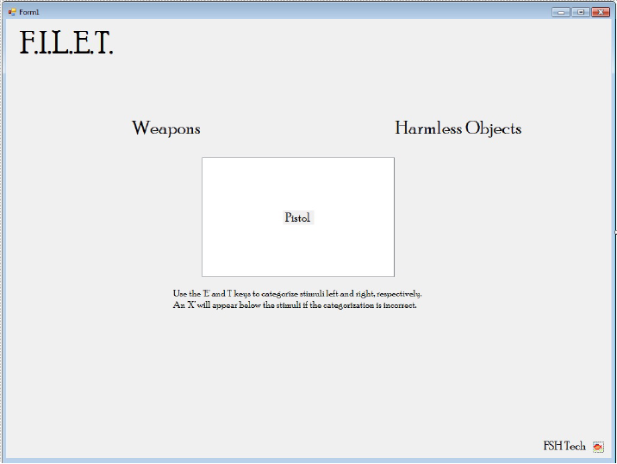
Prototype: Take IAT

Slide 52
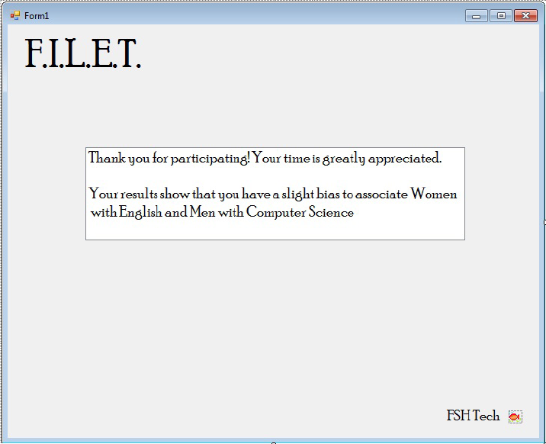
Prototype: View Results

Slide 53
Today’s Agenda
Team Introductions
Problem Definition
Project Progression
User Case Narratives
UML Diagrams
Structure Diagrams
Data Flow Diagrams
Requirements Inventory
Testing
Data Dictionary
Prototype Screens
Future Work and Conclusion

Slide 54
Future Deliverable Dates
Detailed Design – February 28, 2012
Acceptance Test – April 25, 2012
Academic Celebration – April 27, 2012

Slide 55
Thank You!

