Slide 1
FSH Technologies
Detailed Design: F.I.L.E.T.
March 1, 2012

Slide 2
Today’s Agenda
Team Introductions
Problem Definition
Project Progression
Data Dictionary
Entity – Relationship Diagram
Schema
Unit Test
Integration and Acceptance Test
Development Environment
Prototype Screens
Future Work and Conclusion

Slide 3
FSH Technologies
Jackie Boylan
Team Leader
Mike Tanski
Webmaster
Matt Brancato
Systems Administrator
Matt Kemmer
Database Administrator
Serena Moore
Sub-Group Leader
Nydia Negron
Librarian

Slide 4
Today’s Agenda
Team Introductions
Problem Definition
Project Progression
Data Dictionary
Entity – Relationship Diagram
Schema
Unit Test
Integration and Acceptance Test
Development Environment
Prototype Screens
Future Work and Conclusion

Slide 5
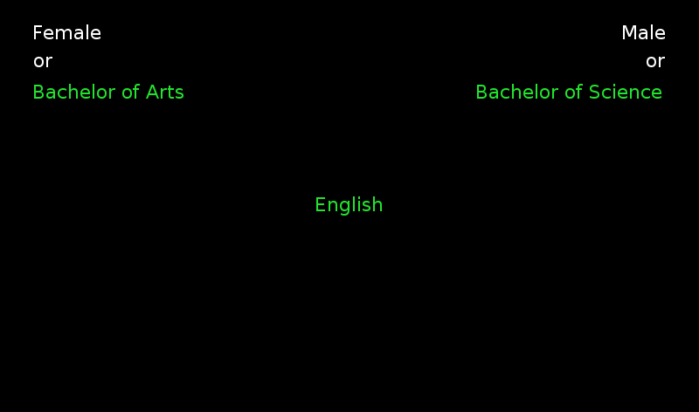
Implicit Association Tests

Slide 6
The Problem
There is no easy way to create an Implicit Association Test (IAT)
Difficult to distribute an IAT and collect data online
There are no interfaces available for creating and publishing IAT’s online
Researchers need to be focused on choosing correct stimuli objects for the test rather than creating the test itself

Slide 7
Today’s Agenda
Team Introductions
Problem Definition
Project Progression
Data Dictionary
Entity – Relationship Diagram
Schema
Unit Test
Integration and Acceptance Test
Development Environment
Prototype Screens
Future Work and Conclusion

Slide 8
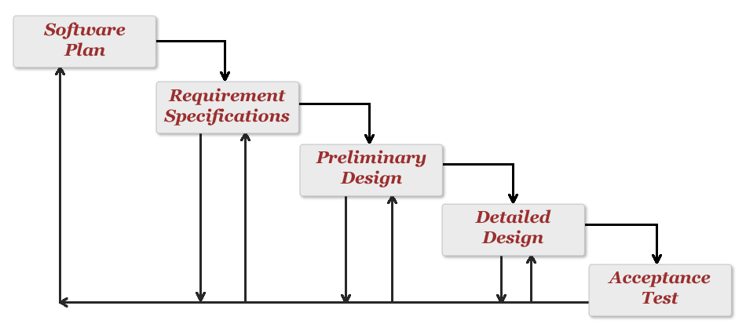
Project Progression
Development and Testing

Slide 9
Today’s Agenda
Team Introductions
Problem Definition
Project Progression
Data Dictionary
Entity – Relationship Diagram
Schema
Unit Tests
Integration and Acceptance Test
Development Environment
Prototype Screens
Future Work and Conclusion

Slide 10
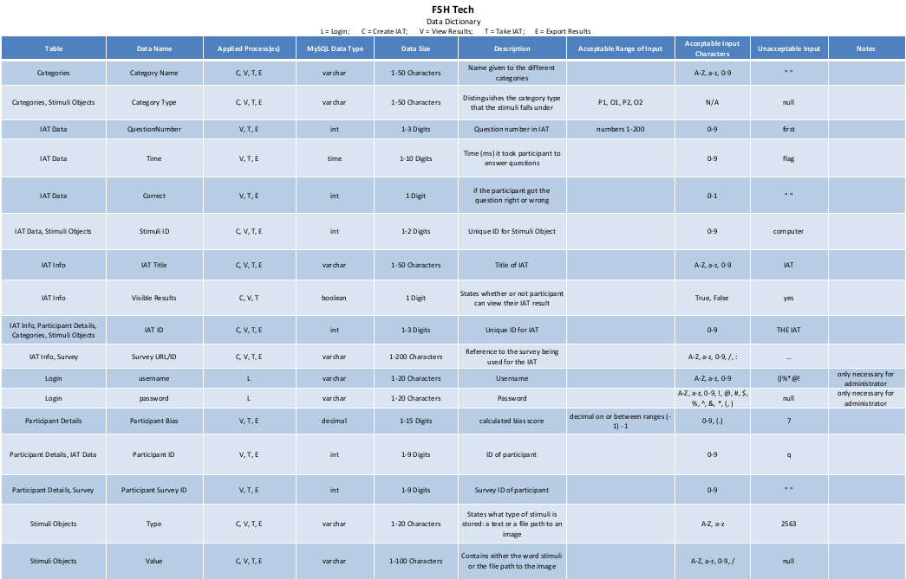

Slide 11
Today’s Agenda
Team Introductions
Problem Definition
Project Progression
Data Dictionary
Entity – Relationship Diagram
Schema
Unit Tests
Integration and Acceptance Test
Development Environment
Prototype Screens
Future Work and Conclusion

Slide 12
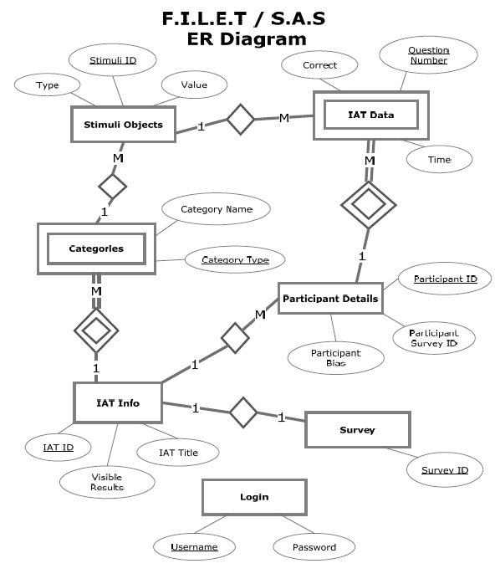
Entity-Relationship Diagram

Slide 13
Today’s Agenda
Team Introductions
Problem Definition
Project Progression
Data Dictionary
Entity – Relationship Diagram
Schema
Unit Tests
Integration and Acceptance Test
Development Environment
Prototype Screens
Future Work and Conclusion

Slide 14
Relational Schema

Slide 15
Today’s Agenda
Team Introductions
Problem Definition
Project Progression
Data Dictionary
Entity – Relationship Diagram
Schema
Unit Tests
Integration and Acceptance Test
Development Environment
Prototype Screens
Future Work and Conclusion

Slide 16
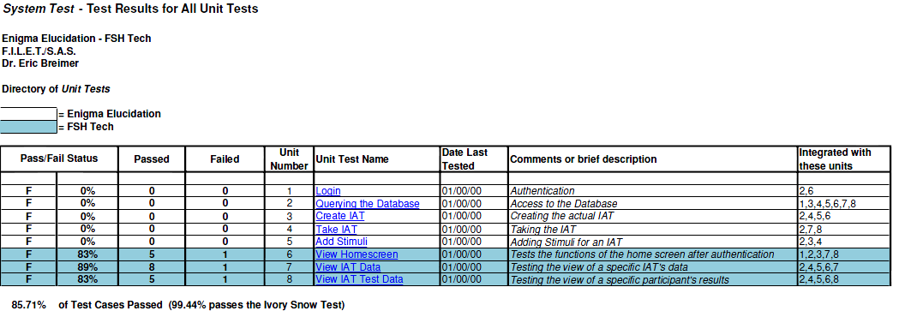
Unit Testing - Directory

Slide 17
Unit Testing – View Home Screen

Slide 18
Unit Testing – View IAT Data

Slide 19
Unit Testing – View IAT Test Data

Slide 20
Today’s Agenda
Team Introductions
Problem Definition
Project Progression
Data Dictionary
Entity – Relationship Diagram
Schema
Unit Tests
Integration and Acceptance Test
Development Environment
Prototype Screens
Future Work and Conclusion

Slide 21
Integration Test
Combination of SAS and FILET
Testing success
Advantages

Slide 22
Acceptance Test
Criteria determined by:
Functional Requirements
Non-Functional Requirements
F.I.L.E.T. will be tested on:
Windows and Mac operating systems
Four major web browsers (IE, Safari, Firefox & Chrome)

Slide 23
Today’s Agenda
Team Introductions
Problem Definition
Project Progression
Data Dictionary
Entity – Relationship Diagram
Schema
Unit Tests
Integration and Acceptance Test
Development Environment
Prototype Screens
Future Work and Conclusion

Slide 24
Development Environment
Server:
Web Server: Apache version 2.2.21
PHP version 5.2.17
MySQL 5.1.58-community log
Additional computer specifications can be found in our document

Slide 25
Today’s Agenda
Team Introductions
Problem Definition
Project Progression
Data Dictionary
Entity – Relationship Diagram
Schema
Unit Tests
Integration and Acceptance Test
Development Environment
Prototype Screens
Future Work and Conclusion

Slide 26
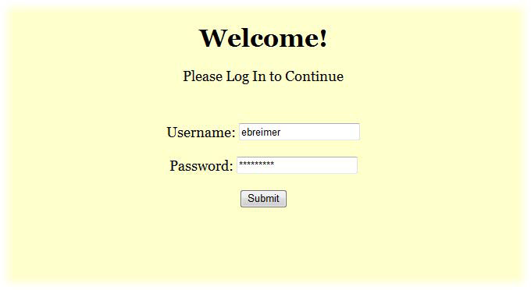
Prototype: Welcome Screen

Slide 27
Prototype: Home Screen

Slide 28
Prototype: View IAT Data

Slide 29
Prototype: View IAT Survey Data

Slide 30
Prototype: View IAT Test Data

Slide 31
Today’s Agenda
Team Introductions
Problem Definition
Project Progression
Data Dictionary
Entity – Relationship Diagram
Schema
Unit Tests
Integration and Acceptance Test
Development Environment
Prototype Screens
Future Work and Conclusion

Slide 32
Future Work
Development and Testing
Acceptance Test
March 1st – April 25th

Slide 33
Thank You!

