Slide 1

FSH Technologies
Acceptance Test: F.I.L.E.T.
April 26th, 2012

Slide 2
Today’s Agenda
Welcome & Team Introductions
Problem Definition
Project Progression
Functional & Non-Functional Requirements
Data Dictionary & ER Diagram
Scoring Algorithm
Testing
Demo
Deliverables
Future Work, Conclusion & Questions

Slide 3
Welcome
Our Client:
Dr. Eric Breimer
Associate Professor of Computer Science
Siena College
Our Professor:
Dr. Timoth Lederman
Professor of Computer Science
Siena College

Slide 4
FSH Technologies
Jackie Boylan
Team Leader
Mike Tanski
Webmaster
Matt Brancato
Systems Administrator
Matt Kemmer
Database Administrator
Serena Moore
Sub-Group Leader
Nydia Negron
Librarian

Slide 5
Today’s Agenda
Welcome & Team Introductions
Problem Definition
Project Progression
Functional & Non-Functional Requirements
Data Dictionary & ER Diagram
Scoring Algorithm
Testing
Demo
Deliverables
Future Work, Conclusion & Questions

Slide 6

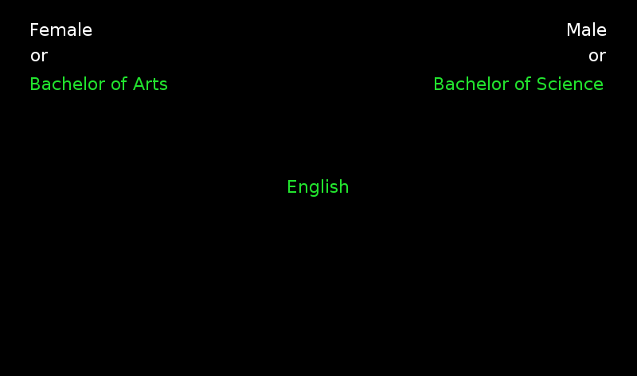
Implicit Association Tests

Slide 7
The Problem
There is no easy way to create an Implicit Association Test (IAT)
Difficult to distribute an IAT and collect data online
There are no interfaces available for creating and publishing IAT’s online
Researchers need to be focused on choosing correct stimuli objects for the test rather than creating the test itself

Slide 8
Today’s Agenda
Welcome & Team Introductions
Problem Definition
Project Progression
Functional & Non-Functional Requirements
Data Dictionary & ER Diagram
Scoring Algorithm
Testing
Demo
Deliverables
Future Work, Conclusion & Questions

Slide 9
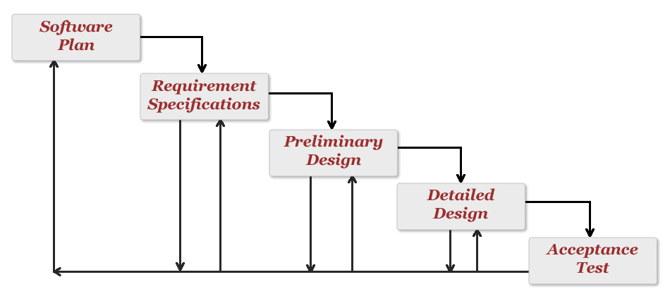
Project Progression
Development and Testing

Slide 10
Today’s Agenda
Welcome & Team Introductions
Problem Definition
Project Progression
Functional & Non-Functional Requirements
Data Dictionary & ER Diagram
Scoring Algorithm
Testing
Demo
Deliverables
Future Work, Conclusion & Questions

Slide 11
Functional Requirements
Administrator will be able to authenticate
  Will be able to enter username and password
Administrator will be able to view IAT results
  Will be able to view survey results
  Will be able to view test data
Administrator will be able to export IAT results to a spreadsheet
  Will be able to export only survey data
  Will be able to export all data
  Will be able to export only statistical association results

Slide 12
Non-Functional Requirements
The system will be maintainable.
The system will be stable.
The system will be operational on several different browsers.
The system will be easy to use.
They system will be visually appealing.

Slide 13
Today’s Agenda
Welcome & Team Introductions
Problem Definition
Project Progression
Functional & Non-Functional Requirements
Data Dictionary & ER Diagram
Scoring Algorithm
Testing
Demo
Deliverables
Future Work, Conclusion & Questions

Slide 14
Entity-Relationship Diagram
Visually describes database
Shows relationship between different entities
  Tables
Weak Entities depend on other Entities to exist

Slide 15
Entity-Relationship Diagram Key

Slide 16
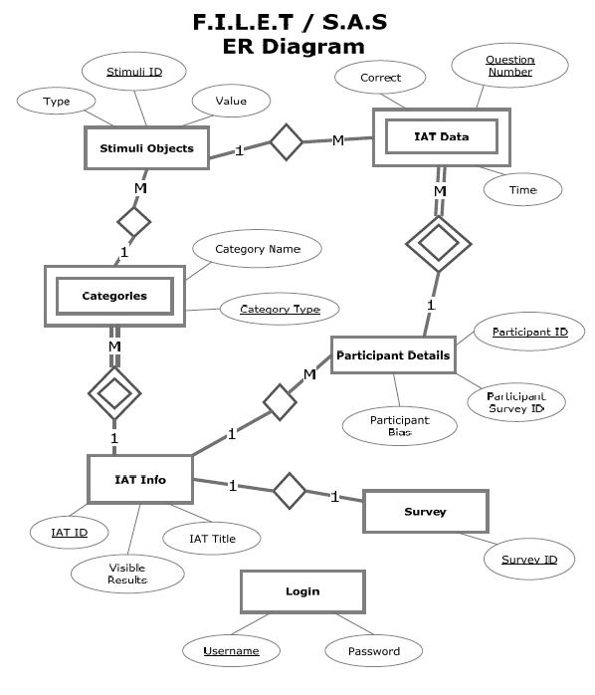
Entity-Relationship Diagram

Slide 17
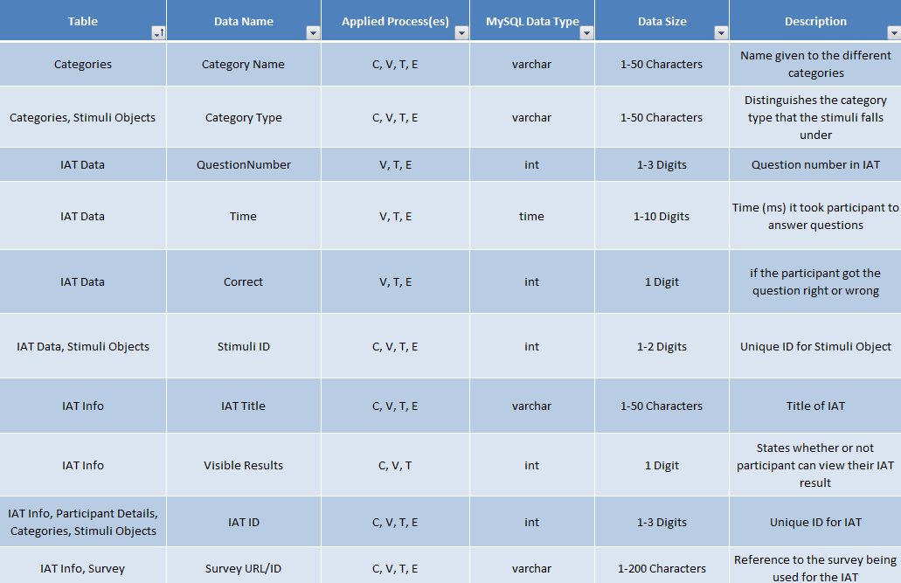
Segment of Data Dictionary

Slide 18
Today’s Agenda
Welcome & Team Introductions
Problem Definition
Project Progression
Functional & Non-Functional Requirements
Data Dictionary & ER Diagram
Scoring Algorithm
Testing
Demo
Deliverables
Future Work, Conclusion & Questions

Slide 19
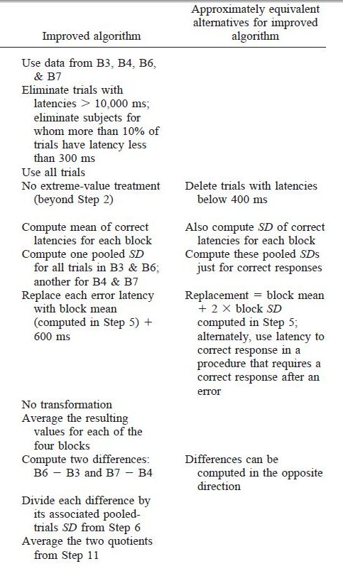
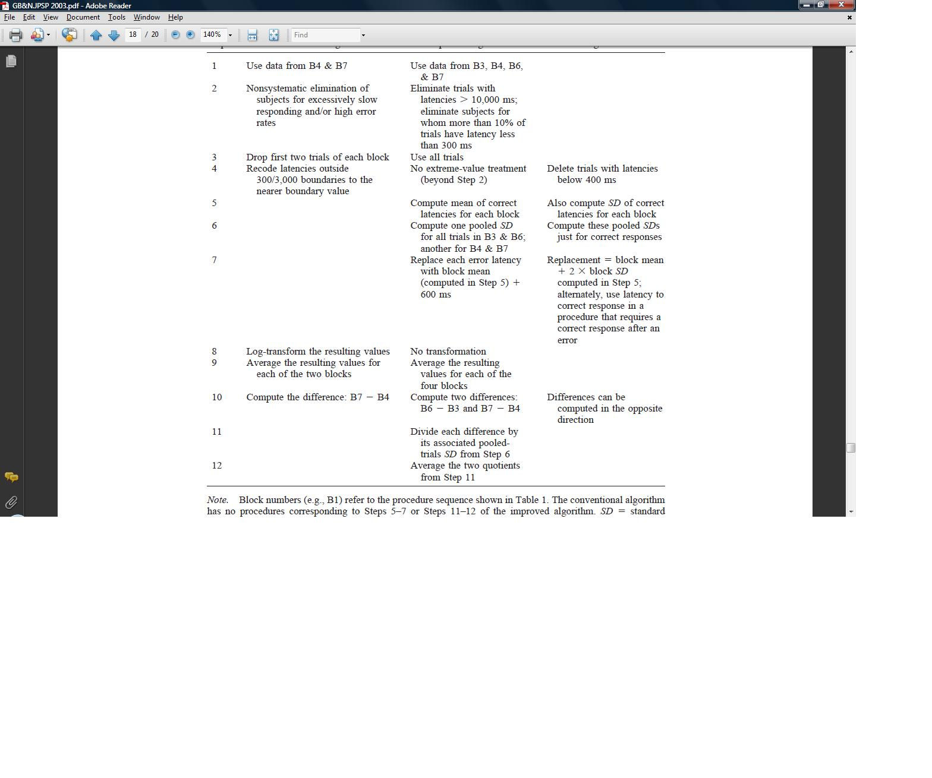
Scoring Algorithm
Understanding and Using the Implicit Association Test: I. An Improved Scoring Algorithm
Greenwald, Banaji, Nosek
for the combined trials of Blocks 3&6 and Blocks 4&7

Slide 20
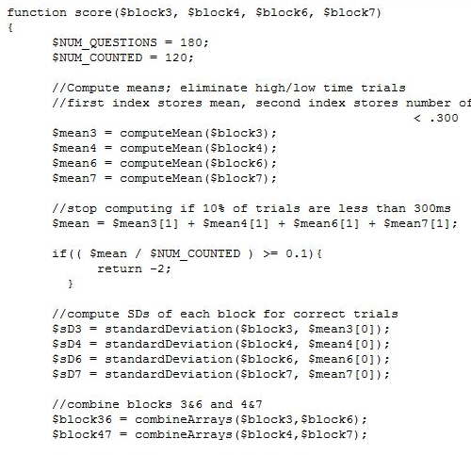
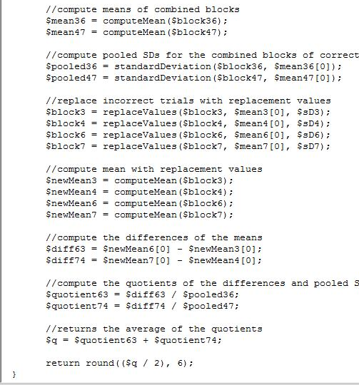
Algorithm Implementation
1
6
2,3,4
7
9
5
10
11
12

Slide 21
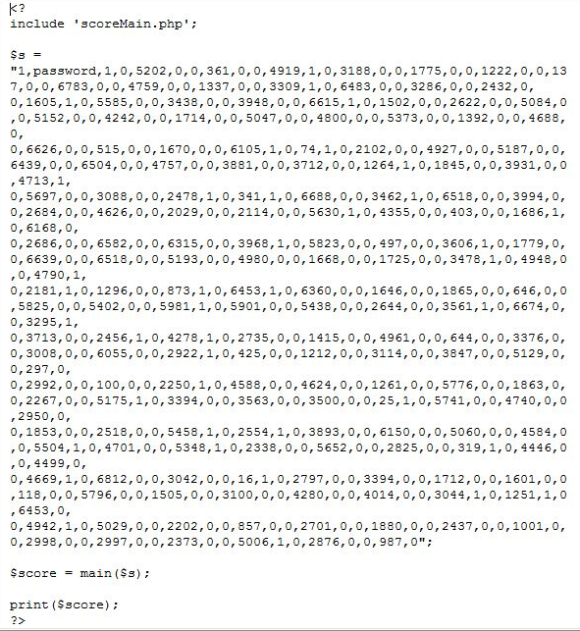
Score Example
IAT Score Test

Slide 22
Today’s Agenda
Welcome & Team Introductions
Problem Definition
Project Progression
Functional & Non-Functional Requirements
Data Dictionary & ER Diagram
Scoring Algorithm
Testing
Demo
Deliverables
Future Work, Conclusion & Questions

Slide 23
Test Plan
Log our test results together with Enigma Elucidations
Test units individually and then the system as a whole
Use to guarantee that all functional requirements have been met
Includes Unit Tests, Integration Tests, and Acceptance Tests

Slide 24
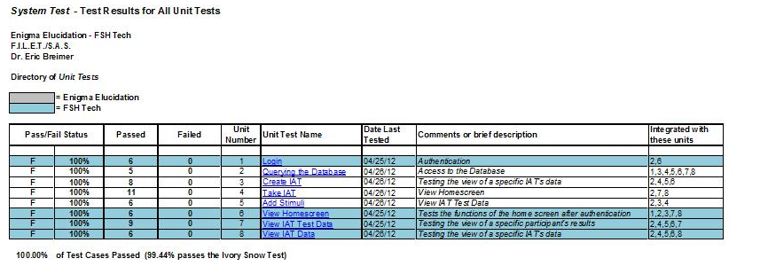
Unit Testing - Directory

Slide 25
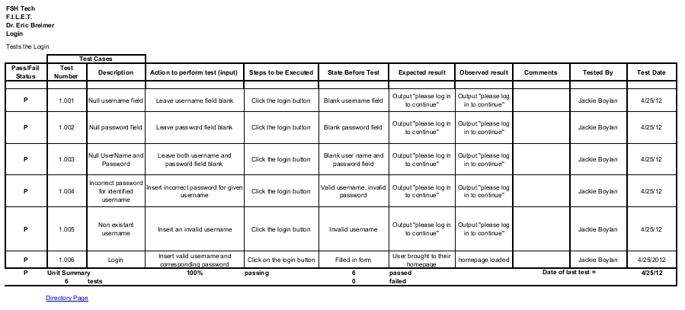
Unit Testing - Login

Slide 26
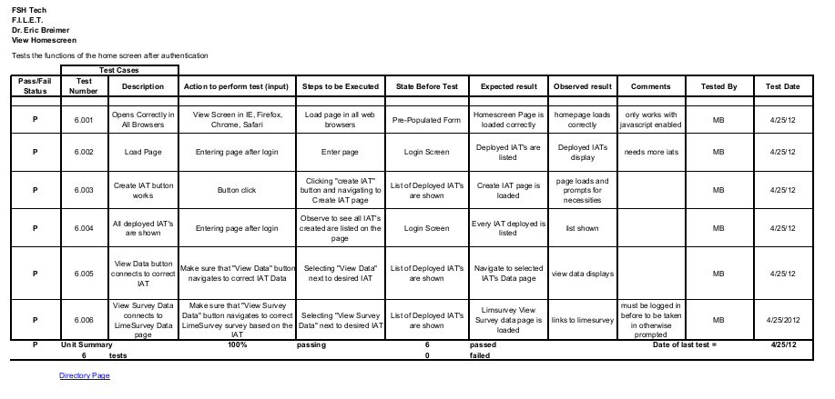
Unit Testing – View Home Screen

Slide 27
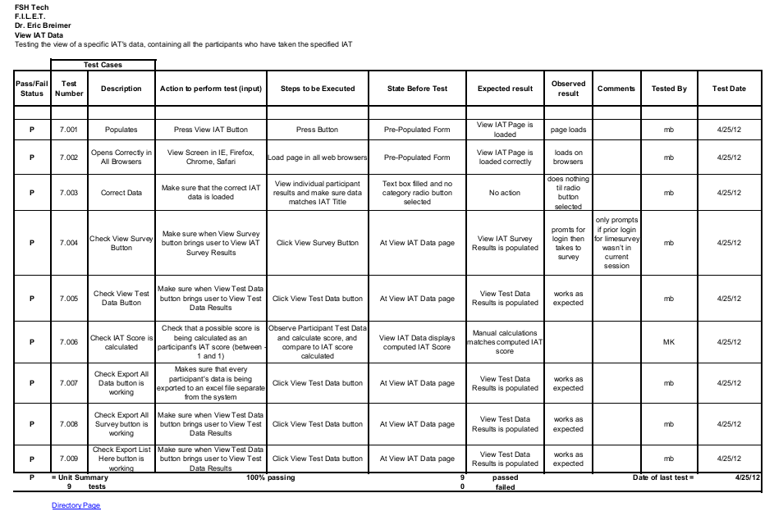
Unit Testing – View IAT Data

Slide 28
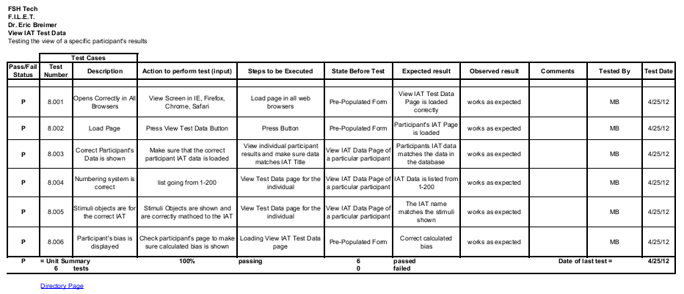
Unit Testing – View IAT Test Data

Slide 29
Integration Test
Combination of SAS and FILET
  Testing success
  Advantages

Slide 30
Acceptance Test
Ensure that all Functional and Non-Functional Requirements have been met
Ensure that system passes both Unit Tests and Integration Tests

Slide 31
Today’s Agenda
Welcome & Team Introductions
Problem Definition
Project Progression
Functional & Non-Functional Requirements
Data Dictionary & ER Diagram
Scoring Algorithm
Testing
Demo
Deliverables
Future Work, Conclusion & Questions

Slide 32
Demo
Demo of F.I.L.E.T.

Slide 33
Today’s Agenda
Welcome & Team Introductions
Problem Definition
Project Progression
Functional & Non-Functional Requirements
Data Dictionary & ER Diagram
Testing
Scoring Algorithm
Demo
Deliverables
Future Work, Conclusion & Questions

Slide 34
Deliverables
A DVD of the following
  Acceptance Test Documents and Presentation
  Source code for FILET
  Team Website Files
  Team Song
    Lyrics
    Audio recording
    Video

Slide 35
Today’s Agenda
Welcome & Team Introductions
Problem Definition
Project Progression
Functional & Non-Functional Requirements
Data Dictionary & ER Diagram
Testing
Scoring Algorithm
Demo
Deliverables
Future Work, Conclusion & Questions

Slide 36
Future Work
Academic Celebration – April 27th
Software Engineering Party – April 30th
Computer Science End-Of-Year Party – May 1st
Graduation Party for Faculty and Family – May 12th
Commencement – May 13th

Slide 37
Thank You!
Questions?

