Slide 1
Requirements Specification: Smart Scheduling
Client: Dr. Robert Yoder

Slide 2
Welcome
Dr. Robert Yoder (client)
Head of the Computer Science Department at Siena College
Dr. Timoth Lederman
Our Professor

Slide 3
Agenda
Software Engineering Team
Restatement of Problem
Project Progression
User Case Narratives and Use Case Diagram
Data Flow Diagrams
Requirements Inventory
Prototype Screens
What’s Next
Questions

Slide 4
Empire Unlimited
Thomas Mottola – Team Leader
Jason Czajkowski – Lead Systems Administrator
Meghan Servello – Organizational Information Manager
Brian Maxwell – Lead Software Developer
Jonathan Smith – Information Analysis Manager
Collin Lefeber - Webmaster

Slide 5
Agenda
Software Engineering Team
Restatement of Problem
Project Progression
User Case Narratives and Use Case Diagram
Data Flow Diagrams
Requirements Inventory
Prototype Screens
What’s Next
Questions

Slide 6
The Problem
Scheduling classrooms, labs, courses, and professors.
Currently scheduling is done in a cumbersome fashion.
Lack of a self-checking system.
There are constraints set by Siena College.
Schedules can be difficult to read.

Slide 7
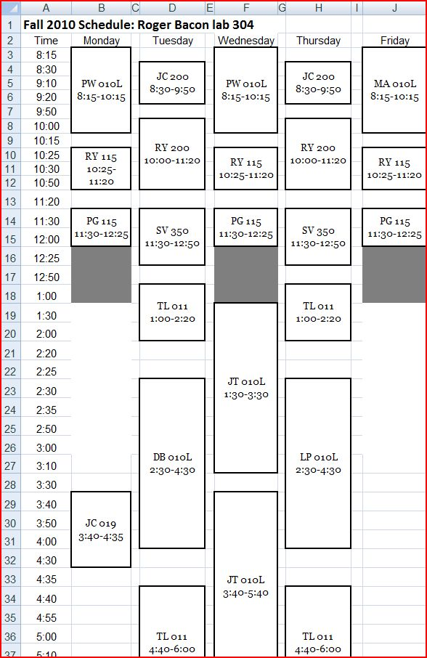
Examples

Slide 8
Agenda
Software Engineering Team
Restatement of Problem
Project Progression
User Case Narratives and Use Case Diagram
Data Flow Diagrams
Requirements Inventory
Prototype Screens
What’s Next
Questions

Slide 9
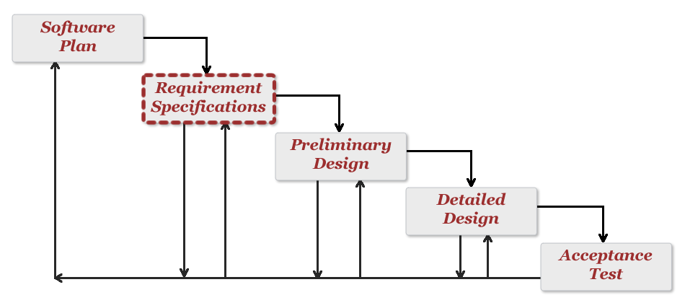
Project Progression

Slide 10
Agenda
Software Engineering Team
Restatement of Problem
Project Progression
User Case Narratives and Use Case Diagram
Data Flow Diagrams
Requirements Inventory
Prototype Screens
What’s Next
Questions

Slide 11
User Case Narratives
What’s Provided:
Description of how each user interacts with the system.
Description of a specific users goal when interacting with the system.

Slide 12
User Case Narratives – Course Coordinator
Log in via username / password
Assign classrooms, courses, and faculty
Class Modification
Access to previous schedules
View reports

Slide 13
User Case Narratives - Faculty
Log in via username / password
View schedules
View reports
Apply Filters
Add office hours unique to the faculty member

Slide 14
User Case Narratives – General User
View schedules
View reports
Apply Filters

Slide 15
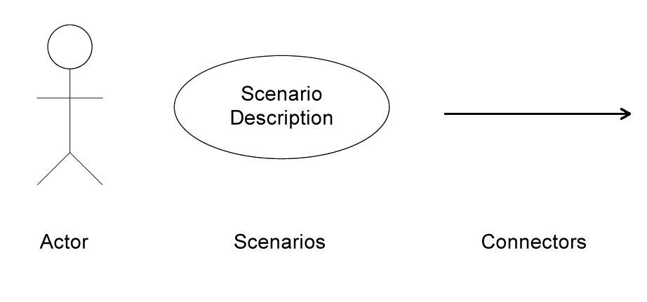
UML Diagram - Legend

Slide 16
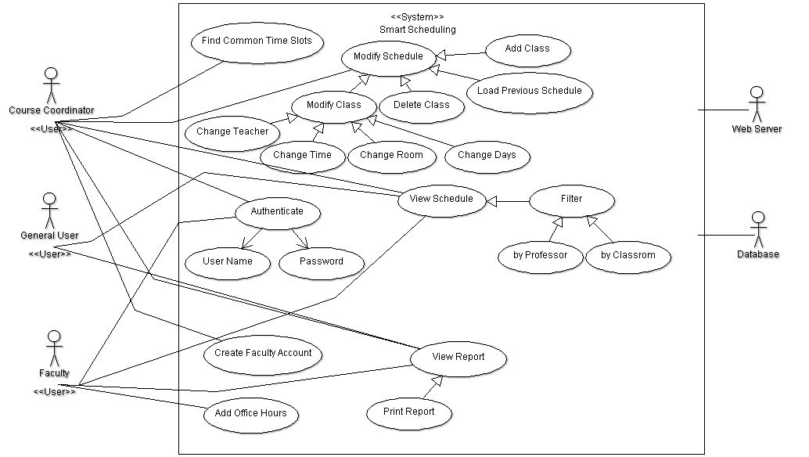
UML Diagram – Use Case Diagram

Slide 17
Agenda
Software Engineering Team
Restatement of Problem
Project Progression
User Case Narratives and Use Case Diagram
Data Flow Diagrams
Requirements Inventory
Prototype Screens
What’s Next
Questions

Slide 18
Data Flow Diagram - Overview
Provide representation of data flow
Provide representation of data manipulation
“Top Down” view of the system

Slide 19
Data Flow Diagram - Legend
Entities/Sources/Sinks
Processes
Stores
The Flows

Slide 20
Data Flow Diagram – Context

Slide 21
Data Flow Diagram – Level 0

Slide 22
Data Flow Diagram – Level 1

Slide 23
Data Flow Diagram – Level 1

Slide 24
Data Flow Diagram – Level 1

Slide 25
Agenda
Software Engineering Team
Restatement of Problem
Project Progression
User Case Narratives and Use Case Diagram
Data Flow Diagrams
Requirements Inventory
Prototype Screens
What’s Next
Questions

Slide 26
Functional Requirements Inventory
Web based
Able to run on all popular web browsers
Login system to differentiate between users
Reports will be easily viewable

Slide 27
F. R. I. – Course Coordinator
Find common time slots in schedule
Modify the schedule
Add new classes
Create faculty accounts
View the schedule (filtering available)

Slide 28
F. R. I. – Faculty
Add office hours specific to the faculty member
View and print room reports
View the schedule (filtering available)

Slide 29
F. R. I. – General User
View and print room reports
View the current schedule (filtering available)

Slide 30
Agenda
Software Engineering Team
Restatement of Problem
Project Progression
User Case Narratives and Use Case Diagram
Data Flow Diagrams
Requirements Inventory
Prototype Screens
What’s Next
Questions

Slide 31
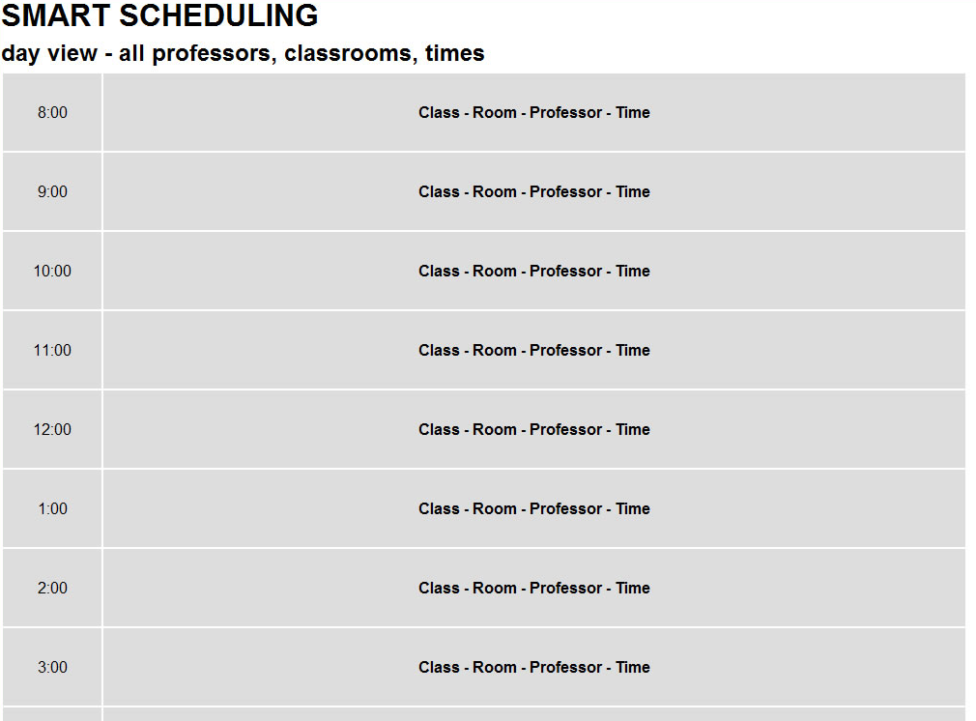
Prototype – Single Day

Slide 32
Prototype – Week View

Slide 33
Prototype – Week View

Slide 34
Agenda
Software Engineering Team
Restatement of Problem
Project Progression
User Case Narratives and Use Case Diagram
Data Flow Diagrams
Requirements Inventory
Prototype Screens
What’s Next
Questions

Slide 35
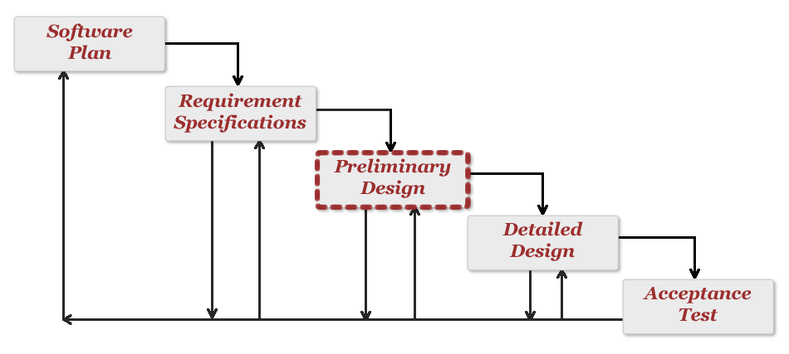
What’s Next
Preliminary Design
Tentatively Nov. 2 – Dec. 8

Slide 36
The End
Thank you.
Questions or Comments?

