Slide 1
Preliminary Design: Smart Scheduling
Client: Dr. Robert Yoder

Slide 2
Welcome
Dr. Robert Yoder (client)
Head of the Computer Science Department at Siena College
Dr. Timoth Lederman
Our Professor

Slide 3
Agenda
Software Engineering Team
Restatement of Problem
Project Progression
User Case Narratives
UML Diagram
Framework Map
Data Flow Diagrams
Requirements Inventory
Testing
Data Dictionary
Prototype Screens
What’s Next
Questions

Slide 4
Empire Unlimited
Thomas Mottola – Team Leader
Jason Czajkowski – Lead Systems Administrator
Meghan Servello – Organizational Information Manager
Brian Maxwell – Lead Software Developer
Jonathan Smith – Information Analysis Manager
Collin Lefeber - Webmaster

Slide 5
Agenda
Software Engineering Team
Restatement of Problem
Project Progression
User Case Narratives
UML Diagram
Framework Map
Data Flow Diagrams
Requirements Inventory
Testing
Data Dictionary
Prototype Screens
What’s Next
Questions

Slide 6
The Problem
Scheduling classrooms, labs, courses, and professors.
Currently scheduling is done in a cumbersome fashion.
Lack of a self-checking system.
There are constraints set by Siena College.
Schedules can be difficult to read.

Slide 7
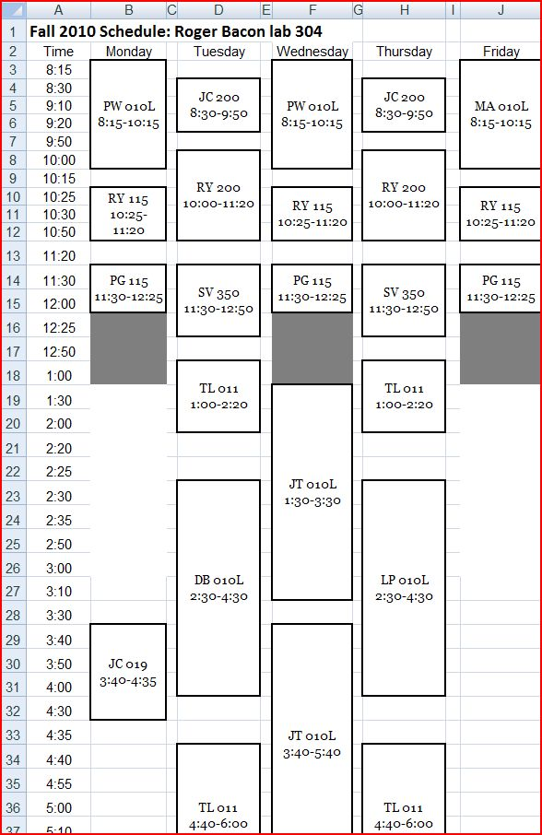
Examples

Slide 8
Agenda
Software Engineering Team
Restatement of Problem
Project Progression
User Case Narratives
UML Diagram
Framework Map
Data Flow Diagrams
Requirements Inventory
Testing
Data Dictionary
Prototype Screens
What’s Next
Questions

Slide 9
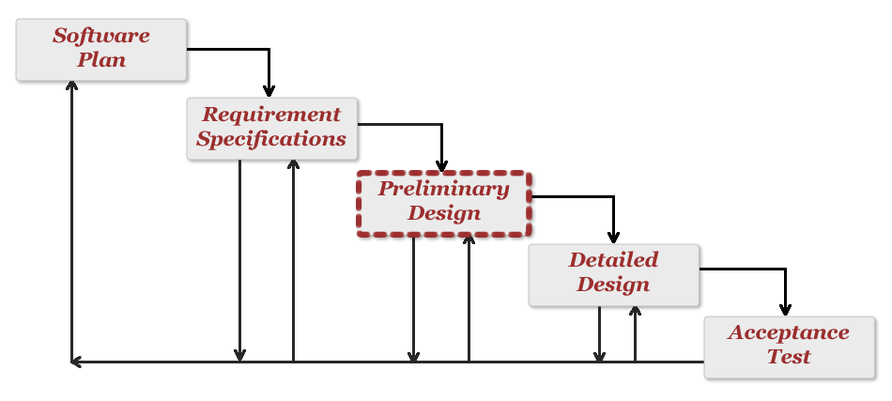
Project Progression

Slide 10
Agenda
Software Engineering Team
Restatement of Problem
Project Progression
User Case Narratives
UML Diagram
Framework Map
Data Flow Diagrams
Requirements Inventory
Testing
Data Dictionary
Prototype Screens
What’s Next
Questions

Slide 11
User Case Narratives
What’s Provided:
Description of how each user interacts with the system.
Description of a specific users goal when interacting with the system.

Slide 12
User Case Narratives – Course Coordinator
Log in via username / password
Assign classrooms, courses, and faculty
Class Modification
Access to previous schedules
View reports

Slide 13
User Case Narratives - Faculty
Log in via username / password
View schedules
View reports
Apply Filters
Add office hours unique to the faculty member

Slide 14
User Case Narratives – General User
View schedules
View reports
Apply Filters

Slide 15
Agenda
Software Engineering Team
Restatement of Problem
Project Progression
User Case Narratives
UML Diagram
Framework Map
Data Flow Diagrams
Requirements Inventory
Testing
Data Dictionary
Prototype Screens
What’s Next
Questions

Slide 16
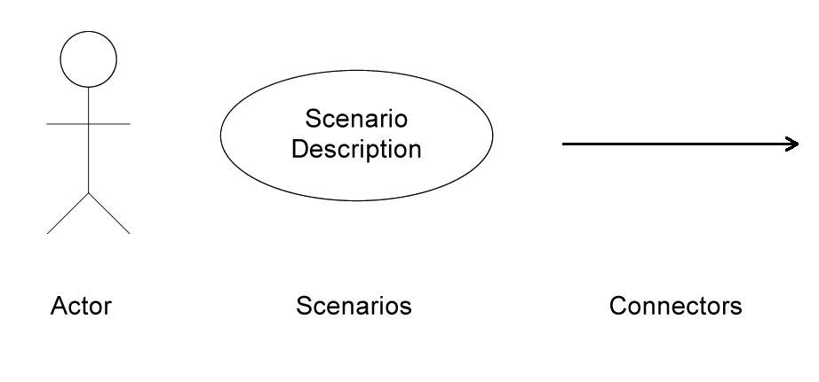
UML Diagram - Legend

Slide 17
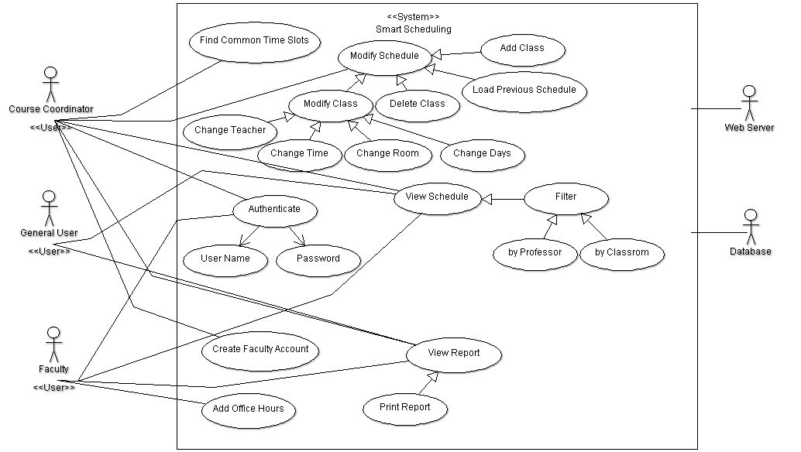
UML Diagram – Use Case Diagram
Agenda

Slide 18
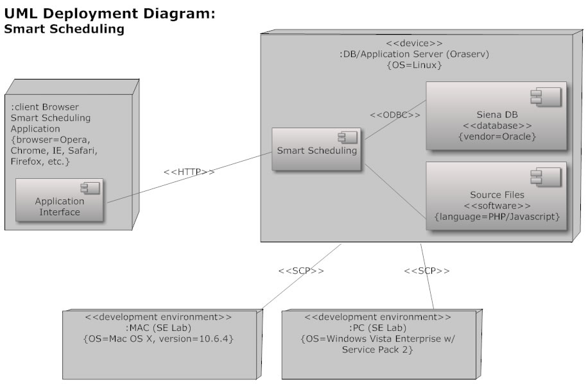
UML Deployment Diagram

Slide 19
Agenda
Software Engineering Team
Restatement of Problem
Project Progression
User Case Narratives
UML Diagram
Framework Map
Data Flow Diagrams
Requirements Inventory
Testing
Data Dictionary
Prototype Screens
What’s Next
Questions

Slide 20
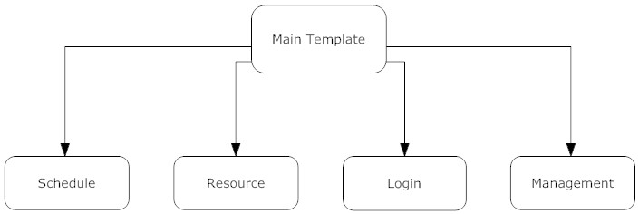
Framework Map

Slide 21
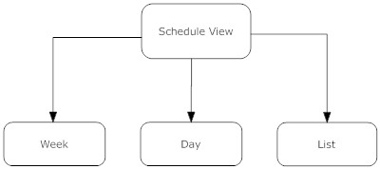
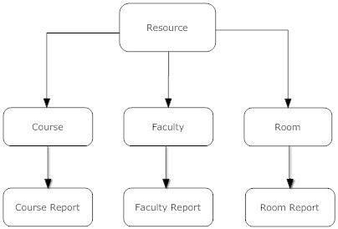
Framework Map

Slide 22
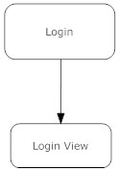
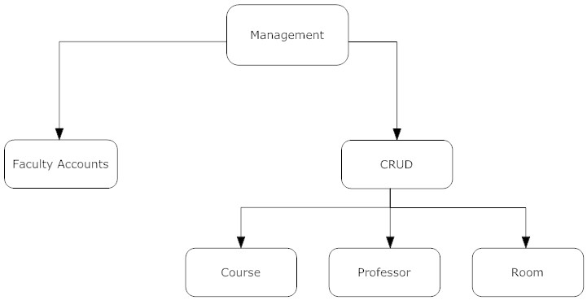
Framework Map

Slide 23
Agenda
Software Engineering Team
Restatement of Problem
Project Progression
User Case Narratives
UML Diagram
Framework Map
Data Flow Diagrams
Requirements Inventory
Testing
Data Dictionary
Prototype Screens
What’s Next
Questions

Slide 24
Data Flow Diagram - Overview
Provide representation of data flow
Provide representation of data manipulation
“Top Down” view of the system

Slide 25
Data Flow Diagram - Legend
Entities/Sources/Sinks
Processes
Stores
The Flows

Slide 26
Data Flow Diagram – Context

Slide 27
Data Flow Diagram – Level 0

Slide 28
Data Flow Diagram – Level 1

Slide 29
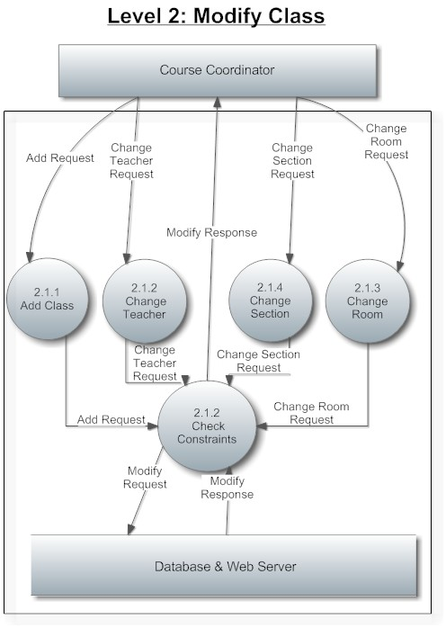
Data Flow Diagram – Level 2

Slide 30
Agenda
Software Engineering Team
Restatement of Problem
Project Progression
User Case Narratives
UML Diagram
Framework Map
Data Flow Diagrams
Requirements Inventory
Testing
Data Dictionary
Prototype Screens
What’s Next
Questions

Slide 31
Functional Requirements Inventory
Web based
Able to run on all popular web browsers
Login system to differentiate between users
Reports will be easily viewable

Slide 32
F. R. I. – Course Coordinator
Find common time slots in schedule
Modify the schedule
Add new classes
Create faculty accounts
View the schedule (filtering available)

Slide 33
F. R. I. – Faculty
Add office hours specific to the faculty member
View and print room reports
View the schedule (filtering available)

Slide 34
F. R. I. – General User
View and print room reports
View the current schedule (filtering available)

Slide 35
Non-Functional Requirements
The system will be…
easily maintained
stable
viewable on multiple browsers
efficient
user friendly and easy to use

Slide 36
Agenda
Software Engineering Team
Restatement of Problem
Project Progression
User Case Narratives
UML Diagram
Framework Map
Data Flow Diagrams
Requirements Inventory
Testing
Data Dictionary
Prototype Screens
What’s Next
Questions

Slide 37
Testing
Units:
Add Faculty member
Authenticate
Update Class

Slide 38
Testing
Acceptance Criteria : Determined by F.R.I.
Testing Environment
Testing Process:
Unit
Module
As a whole

Slide 39
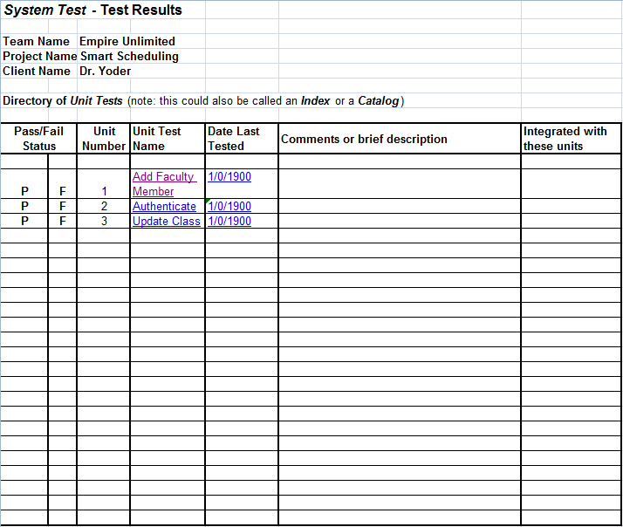
Testing

Slide 40
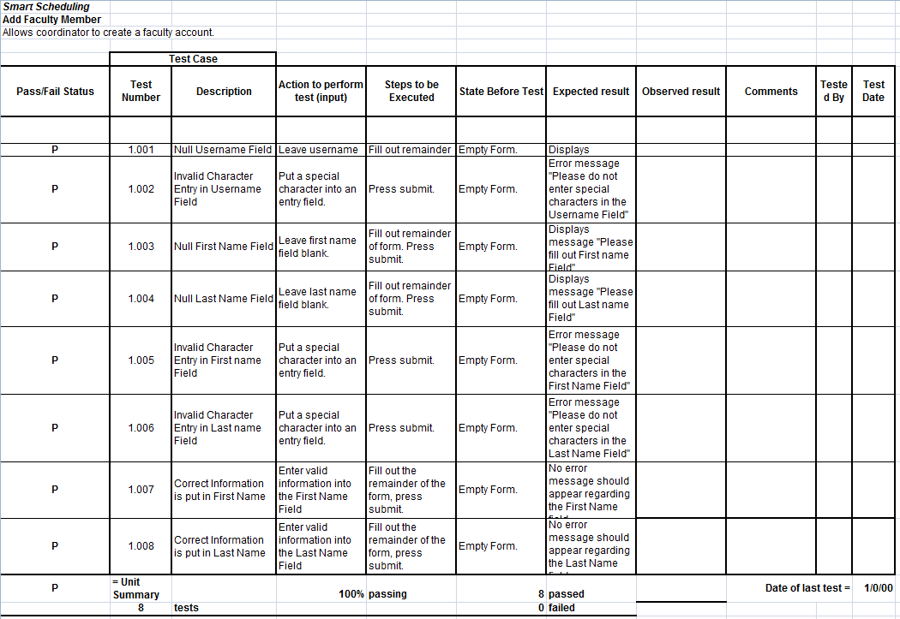
Testing

Slide 41
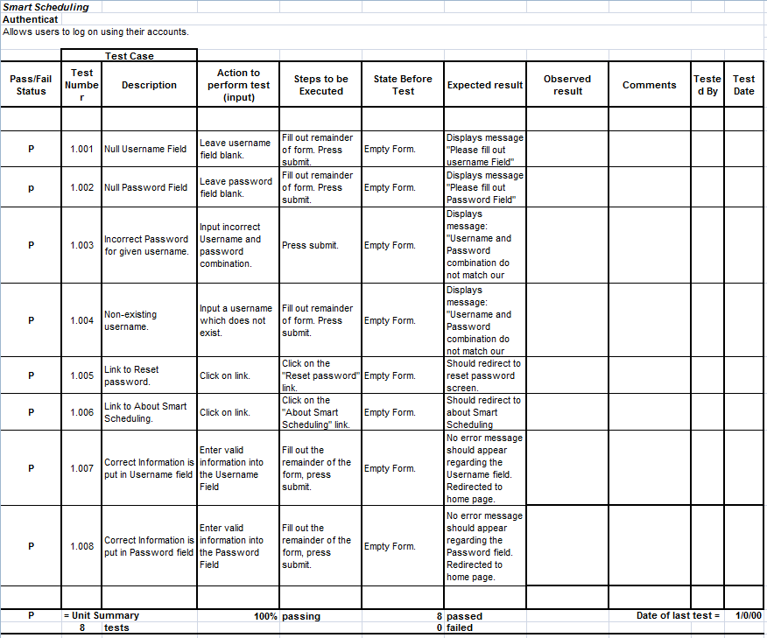
Testing

Slide 42
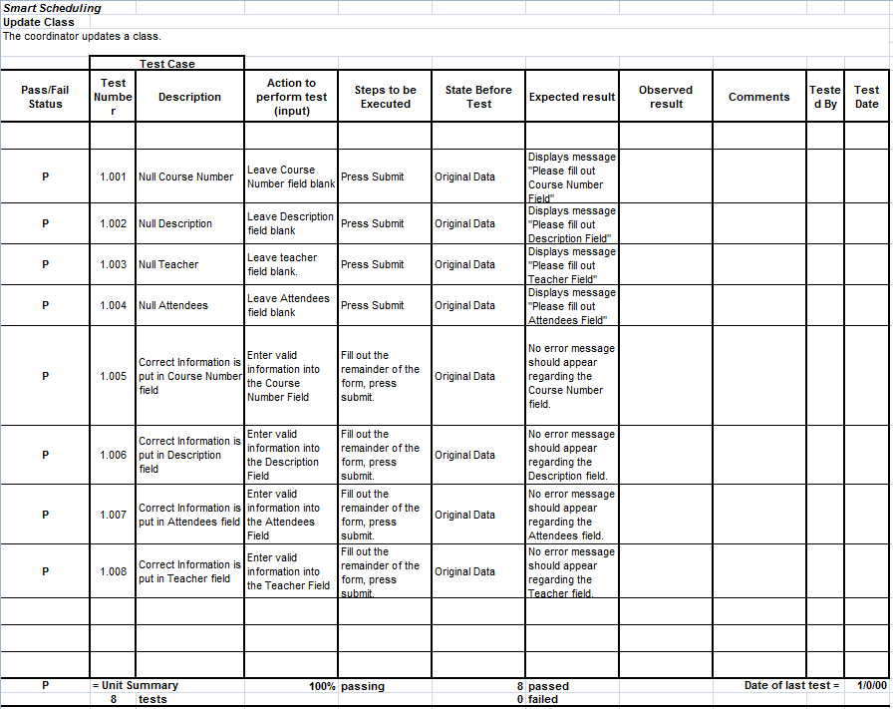
Testing

Slide 43
Agenda
Software Engineering Team
Restatement of Problem
Project Progression
User Case Narratives
UML Diagram
Framework Map
Data Flow Diagrams
Requirements Inventory
Testing
Data Dictionary
Prototype Screens
What’s Next
Questions

Slide 44
Data Dictionary
KEY:
Data Name
Applicable To
Data Type
Data Size
Description
Acceptable Input
Correct Example of Input
Notes
Notes:
Data Name: The name of the data entity being stored, whether it be in a database or not.
Applicable To: The screens that this data entity will be used for.
Data Type: The type of data for a data entity
Data Size: The size of the data in terms of it's data type.
Description: A description of what data this entity is storing.
Acceptable Input: What must be inputted by a user in order for the system to accept the data.
Correct Example of Input: An example of data that would be accepted by the system.
Notes: Additional information regarding the data.

Slide 45
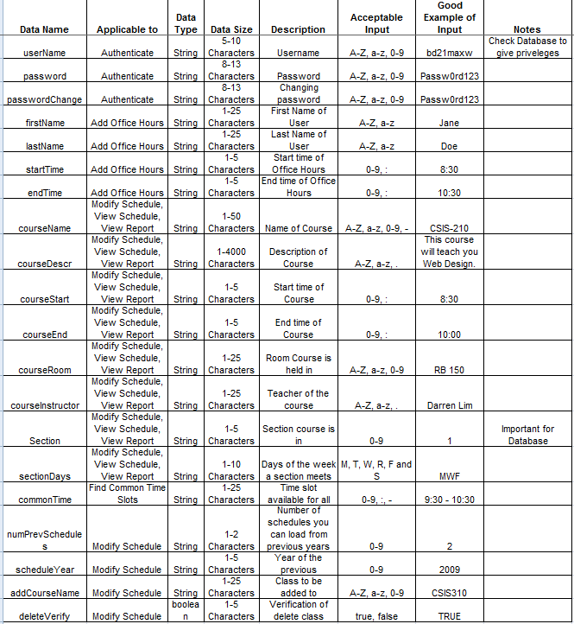
Data Dictionary

Slide 46
Agenda
Software Engineering Team
Restatement of Problem
Project Progression
User Case Narratives
UML Diagram
Framework Map
Data Flow Diagrams
Requirements Inventory
Testing
Data Dictionary
Prototype Screens
What’s Next
Questions

Slide 47
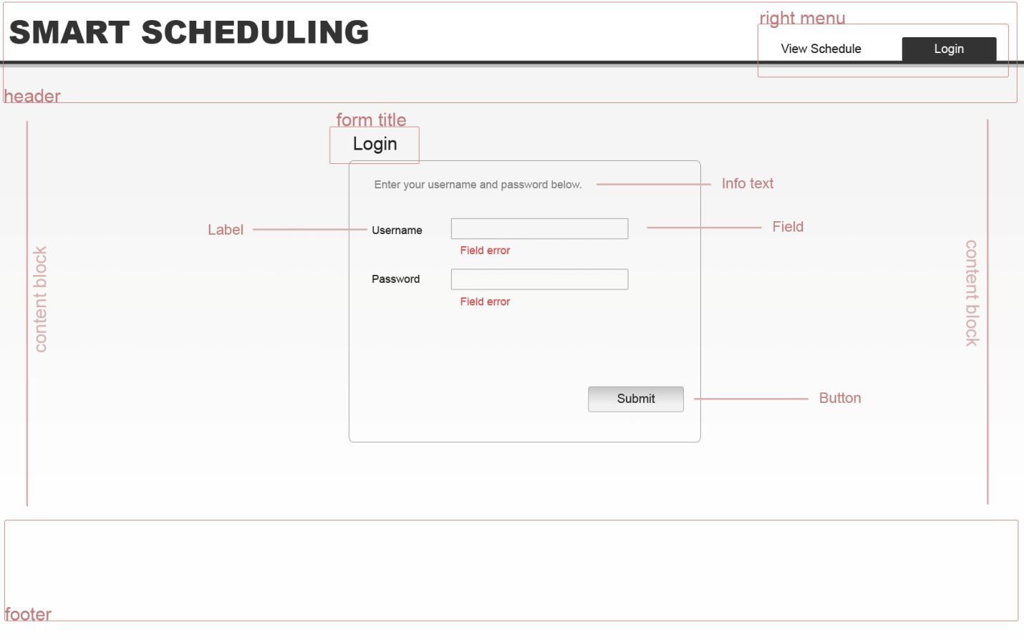
Prototype – Login View

Slide 48
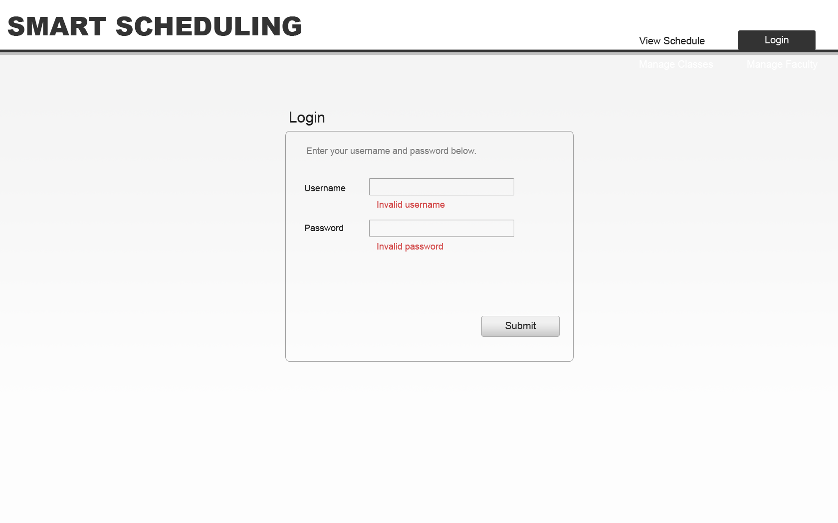
Prototype – Login View with Errors

Slide 49
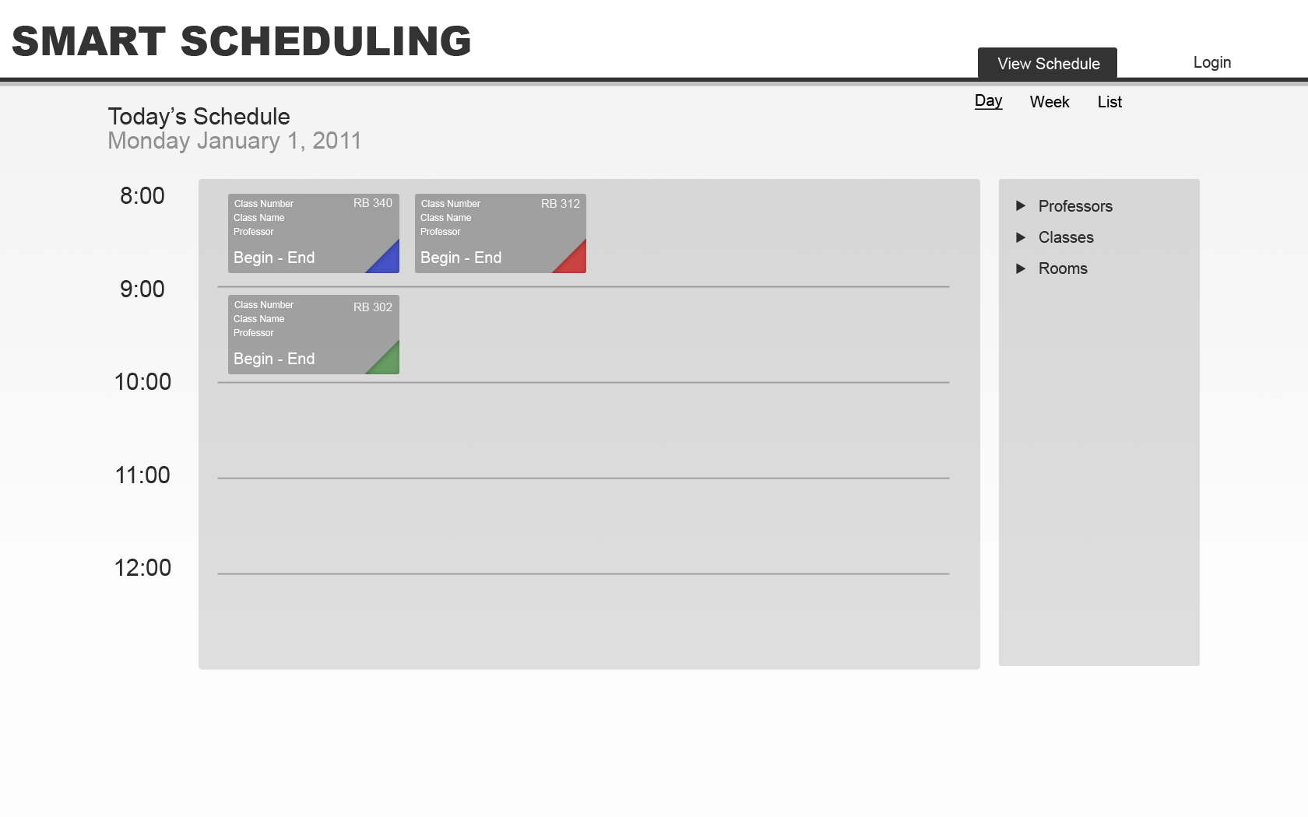
Prototype – Schedule Day View

Slide 50
Prototype – Schedule Day View with filter

Slide 51
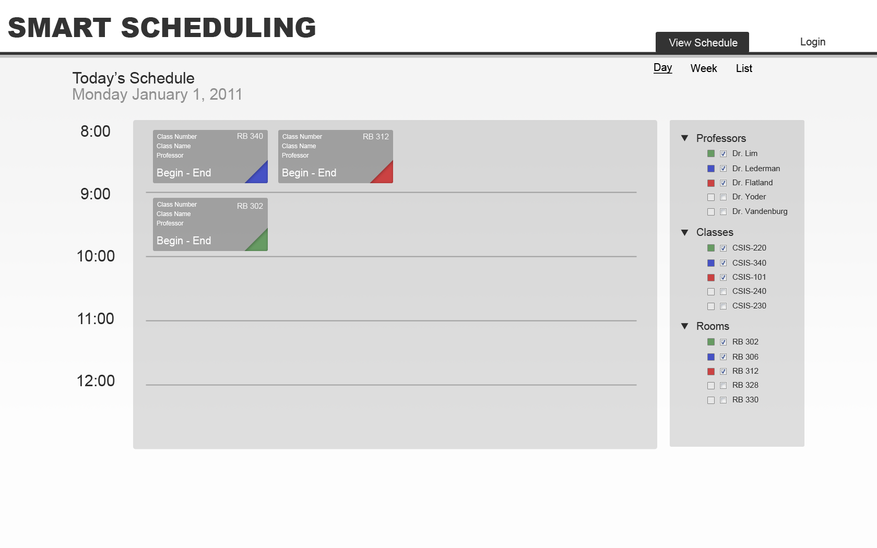
Prototype – Schedule Day View with all filters

Slide 52
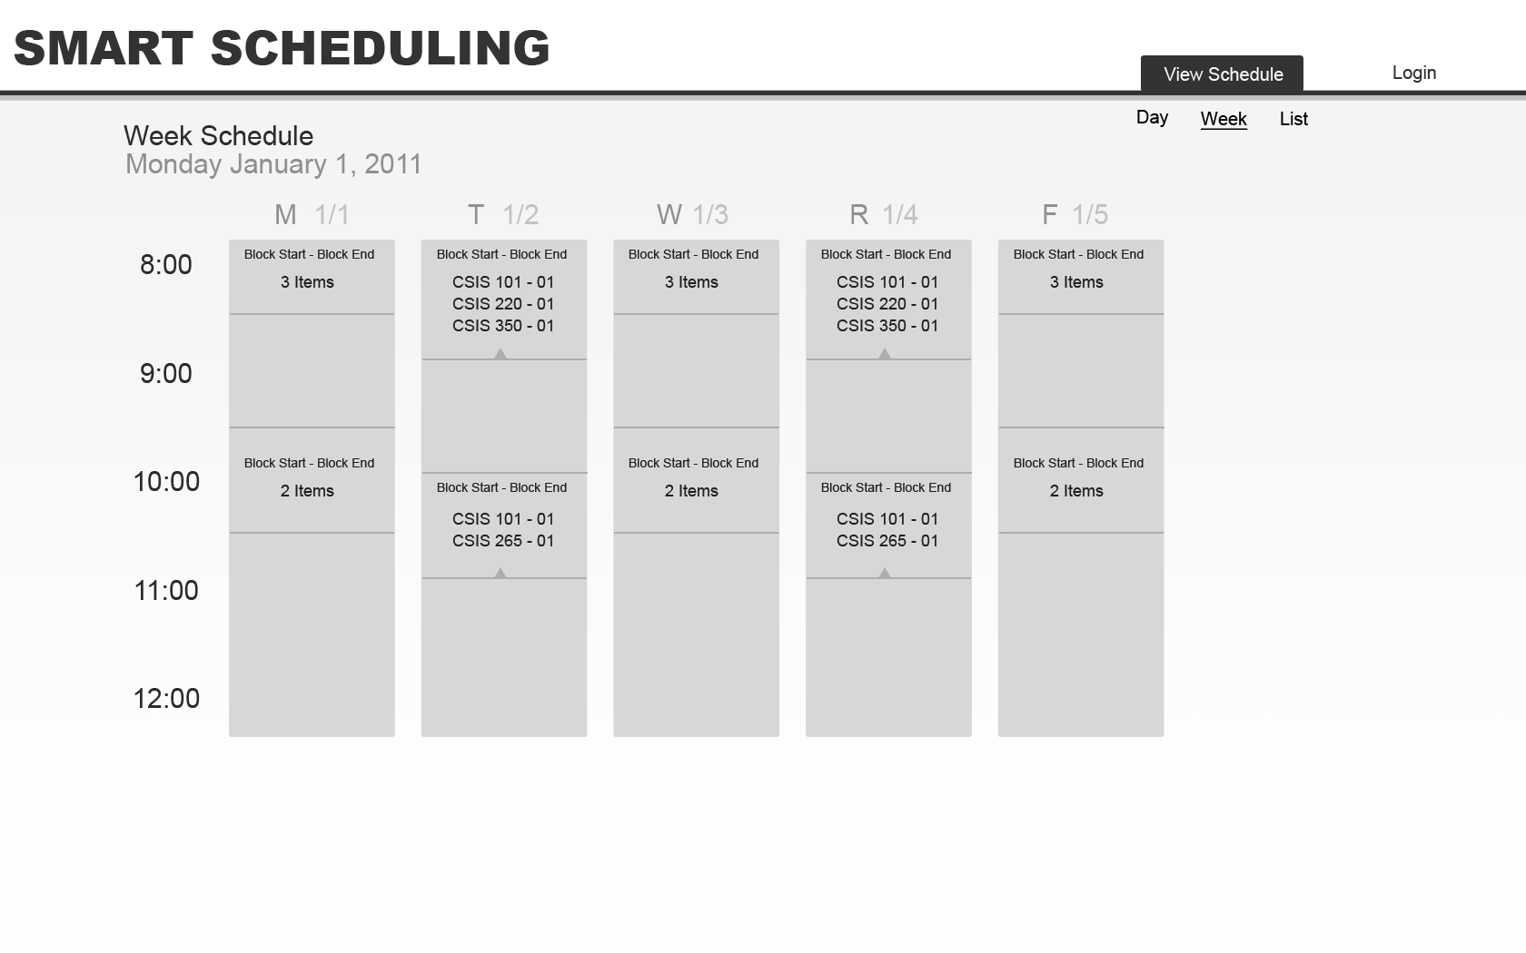
Prototype – Schedule Week View

Slide 53
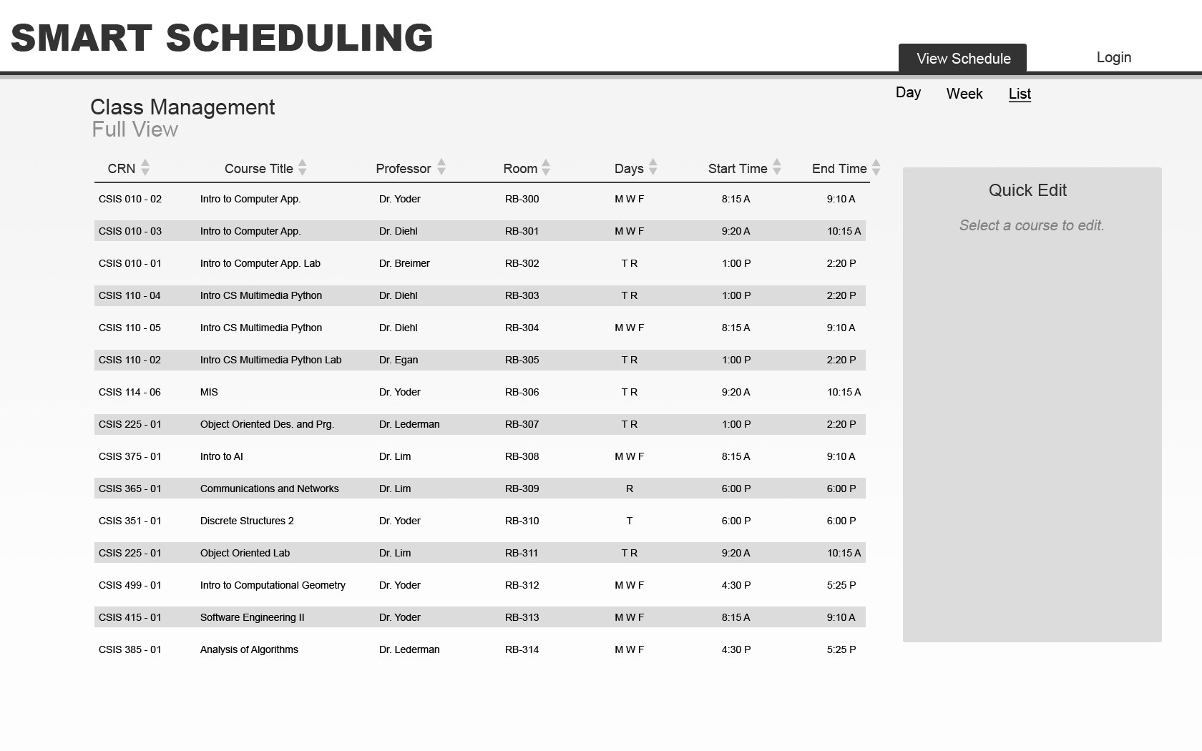
Prototype – Schedule List View

Slide 54
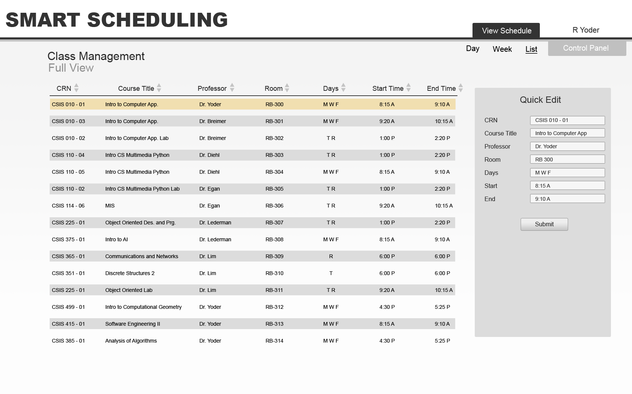
Prototype – Schedule List View with quick editing

Slide 55
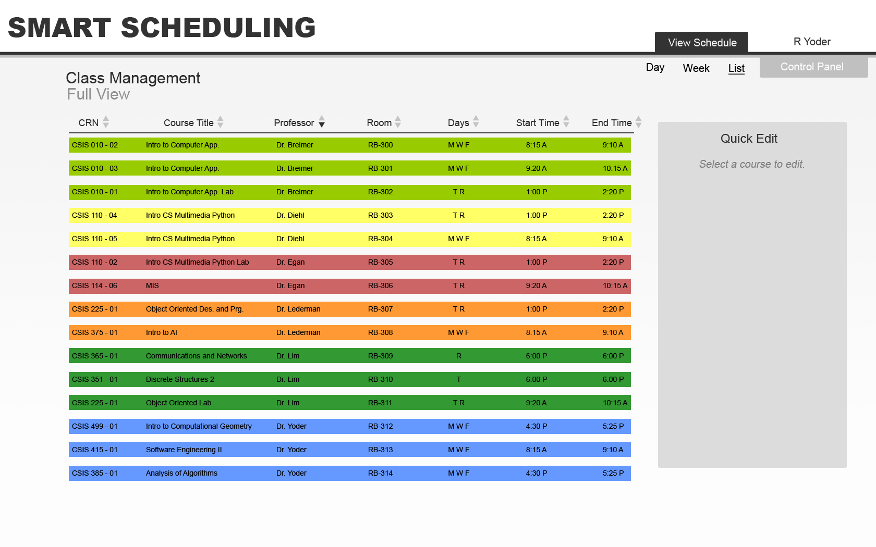
Prototype – Schedule List View sorting example

Slide 56
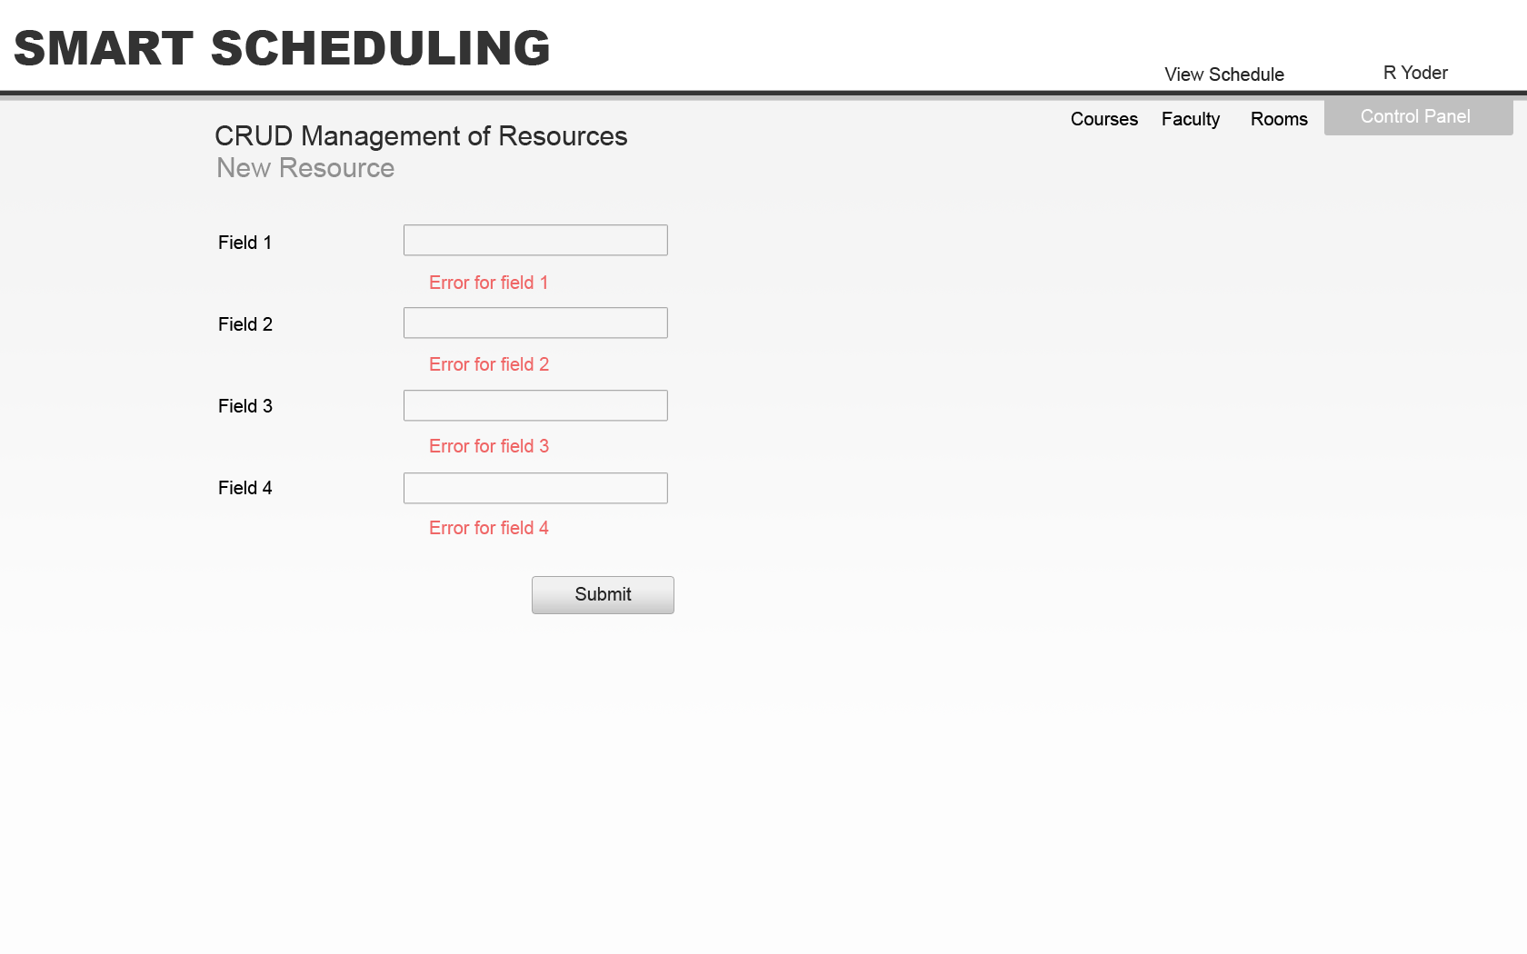
Prototype – Resource CRUD View

Slide 57
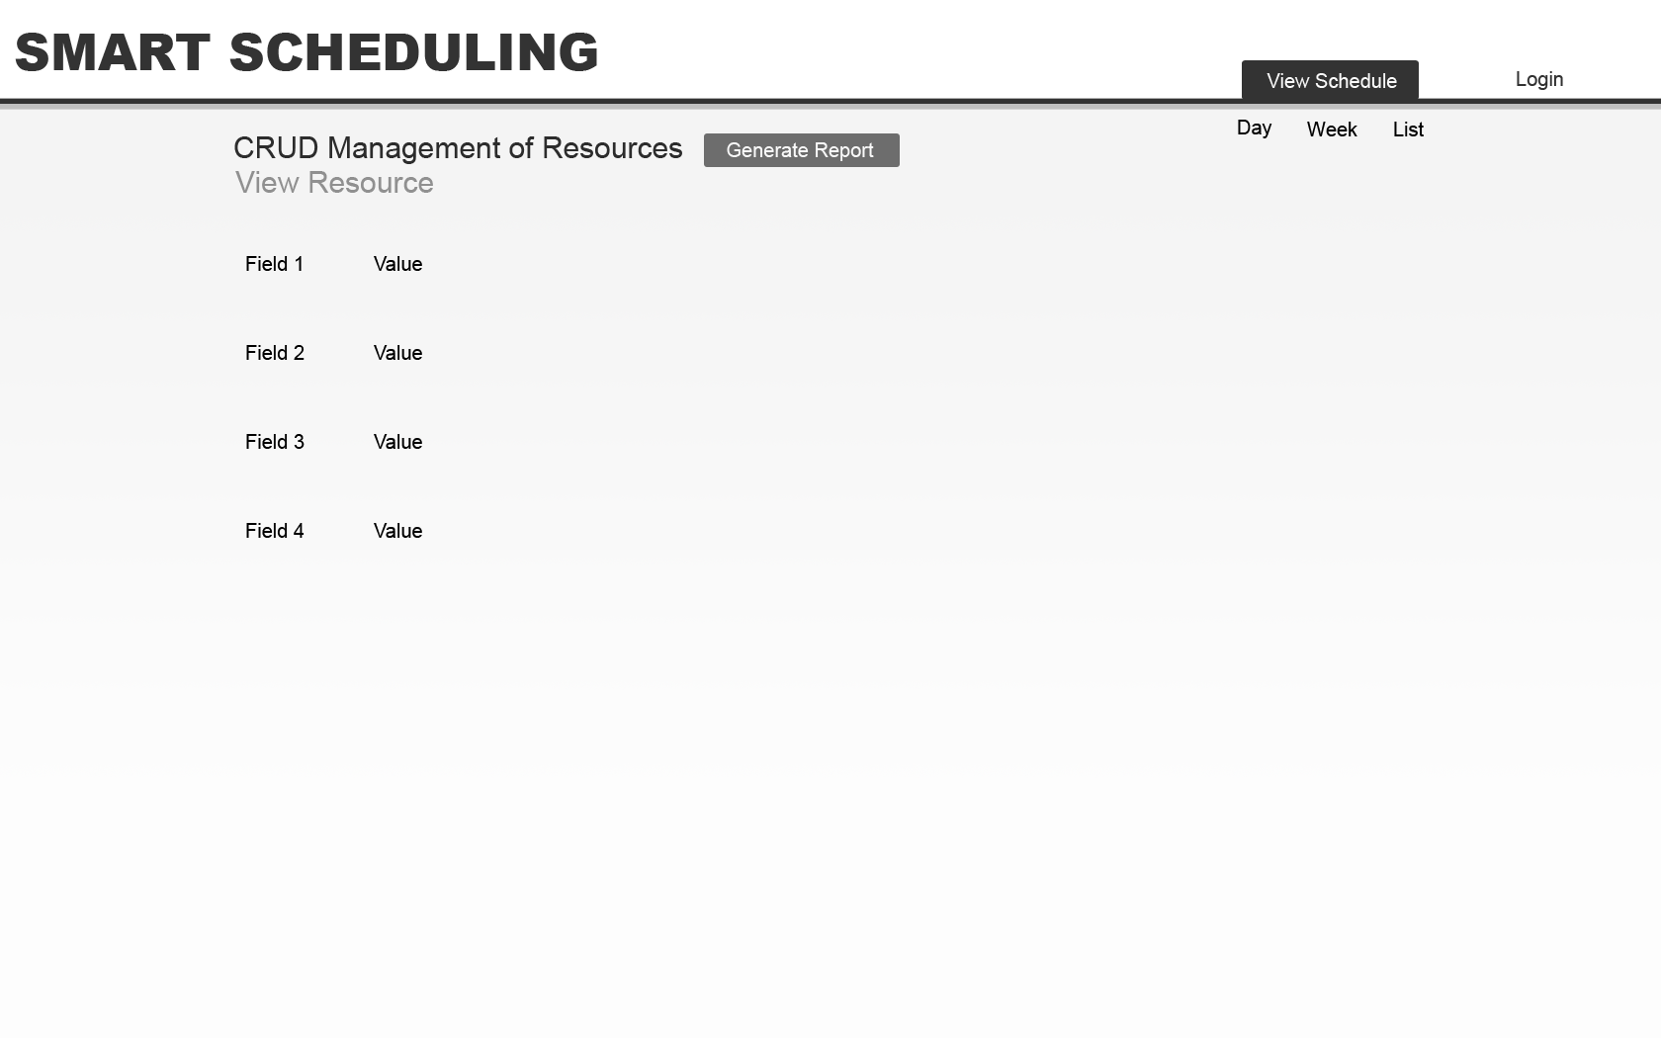
Prototype – View Resource CRUD View

Slide 58
Agenda
Software Engineering Team
Restatement of Problem
Project Progression
User Case Narratives
UML Diagram
Framework Map
Data Flow Diagrams
Requirements Inventory
Testing
Data Dictionary
Prototype Screens
What’s Next
Questions

Slide 59
What’s Next

Slide 60
The End
Thank you.
Questions or Comments?

