Slide 1
Acceptance Test: Smart Scheduling
Client: Dr. Robert Yoder

Slide 2
Welcome
Dr. Robert Yoder (client)
Head of the Computer Science Department at Siena College
Dr. Timoth Lederman
Our Professor

Slide 3
Agenda
Software Engineering Team
Restatement of Problem
Functional Requirements
Non-Functional Requirements
Testing Overview
Demonstration
Deliverables
Project Progression
What’s Next
Questions

Slide 4
Empire Unlimited
Meghan Servello – Team Leader
Jason Czajkowski – Systems Analyst
Thomas Mottola – Head Programmer
Brian Maxwell – Project Manager
Jonathan Smith – Support and Quality Manager
Collin Lefeber – Web Developer

Slide 5
Agenda
Software Engineering Team
Restatement of Problem
Functional Requirements
Non-Functional Requirements
Testing Overview
Demonstration
Deliverables
Project Progression
What’s Next
Questions

Slide 6
The Problem
Scheduling classrooms, labs, courses, and professors.
Currently scheduling is done in a cumbersome fashion.
Lack of a self-checking system.
There are constraints set by Siena College.
Schedules can be difficult to read.

Slide 7
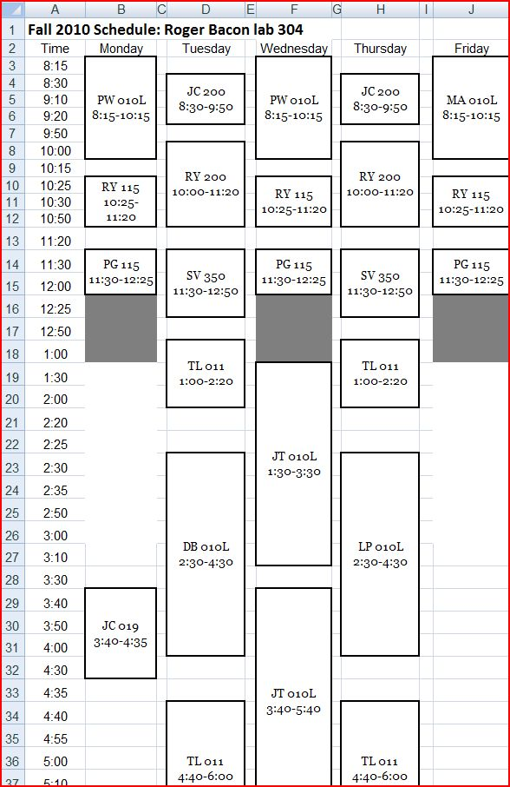
Examples

Slide 8
Agenda
Software Engineering Team
Restatement of Problem
Functional Requirements
Non-Functional Requirements
Testing Overview
Demonstration
Deliverables
Project Progression
What’s Next
Questions

Slide 9
Functional Requirements – Course Coordinator
Find common time slots to schedule departmental meetings or new classes.
Modify the schedule.
Delete previous schedules.
Delete classes.
Modify classes.
Add new classes.
Create a faculty account, where faculty will be able to access the system.
Securely log into the system using a registered username and password.
View the current schedule.
Filter the schedule by professor(s).
Filter the schedule by classroom(s).
View and print room reports.

Slide 10
Functional Requirements - Faculty
Securely log into the system using a registered username and password.
to view the current schedule.
Filter the schedule by professor(s).
Filter the schedule by classroom(s).
View and print room reports.
Add office hours or other meetings, where they will be available in order to meet with students or fellow teachers.

Slide 11
Functional Requirements – General User
View and print room reports.
View the current schedule.
Filter the schedule by professor(s).
Filter the schedule by classroom(s).

Slide 12
Agenda
Software Engineering Team
Restatement of Problem
Functional Requirements
Non-Functional Requirements
Testing Overview
Demonstration
Deliverables
Project Progression
What’s Next
Questions

Slide 13
Non-Functional Requirements
The system will be easily maintained.
Viewable on multiple browsers.
User friendly and easy to use.

Slide 14
Agenda
Software Engineering Team
Restatement of Problem
Functional Requirements
Non-Functional Requirements
Testing Overview
Demonstration
Deliverables
Project Progression
What’s Next
Questions

Slide 15
Testing
Unit Tests
Integration Testing
System Test

Slide 16
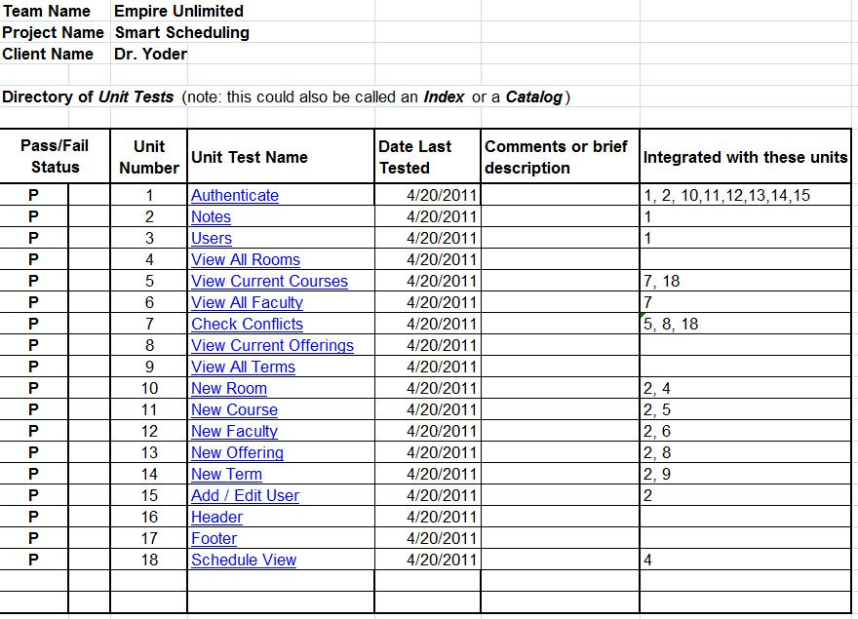
Unit Tests

Slide 17
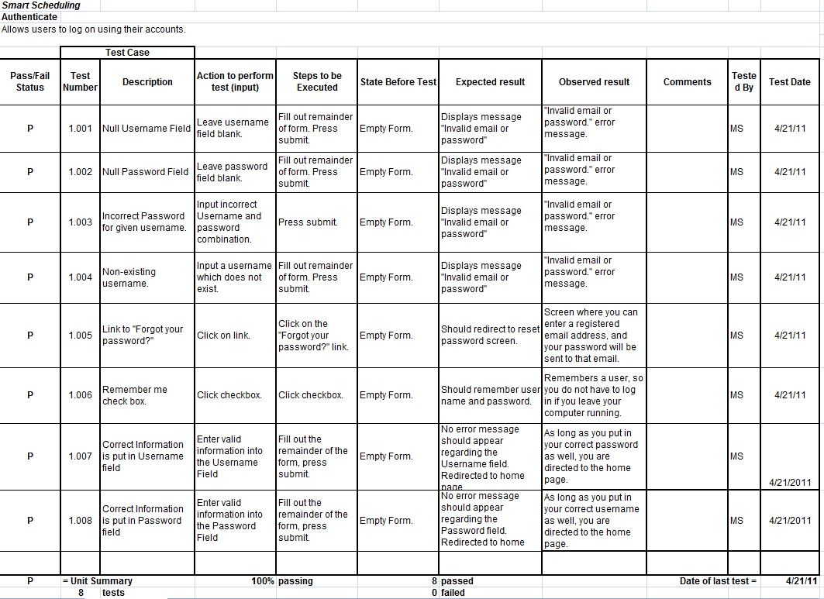
Unit Test - Authenticate

Slide 18
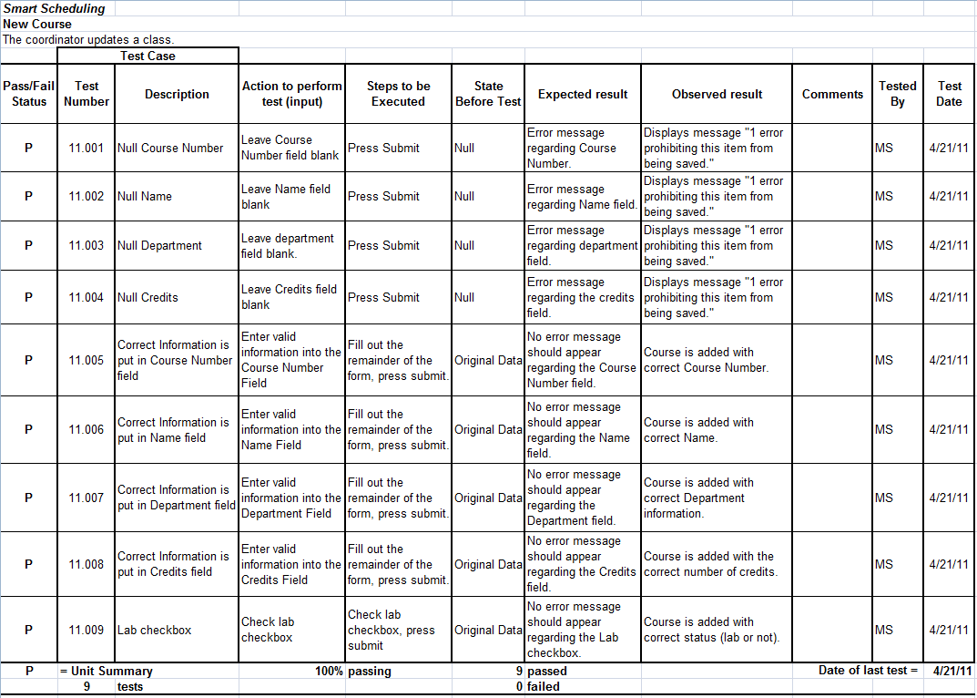
Unit Tests – New Course

Slide 19
Agenda
Software Engineering Team
Restatement of Problem
Functional Requirements
Non-Functional Requirements
Testing Overview
Demonstration
Deliverables
Project Progression
What’s Next
Questions

Slide 20
Demonstration
The moment you have been waiting for…

Slide 21
Agenda
Software Engineering Team
Restatement of Problem
Functional Requirements
Non-Functional Requirements
Testing Overview
Demonstration
Deliverables
Project Progression
What’s Next
Questions

Slide 22
Deliverables
All the following will be delivered in CD-ROM format at the Software Engineering end of year party:
All the files associated with Smart Scheduling.
All the files associated with the team website.
The lyrics to our team song; a copy of a sound/music file for our team song; and, an audio/video recording of our team song

Slide 23
Agenda
Software Engineering Team
Restatement of Problem
Functional Requirements
Non-Functional Requirements
Testing Overview
Demonstration
Deliverables
Project Progression
What’s Next
Questions

Slide 24
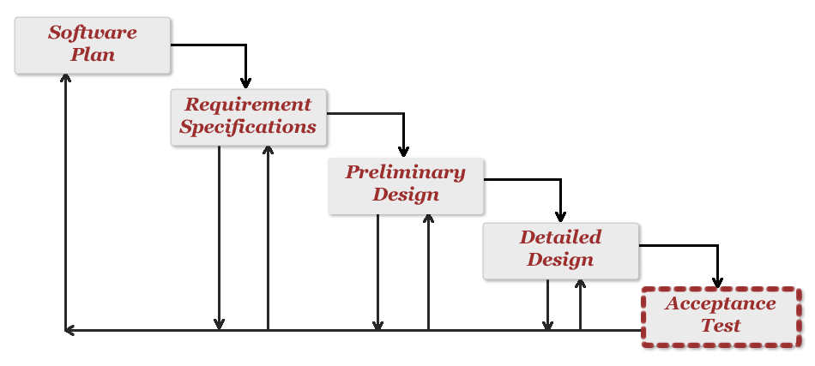
Project Progression

Slide 25
Agenda
Software Engineering Team
Restatement of Problem
Functional Requirements
Non-Functional Requirements
Testing Overview
Demonstration
Deliverables
Project Progression
What’s Next
Questions

Slide 26
What’s Next
Academic Celebration – April 29th
Software Engineering Party – May 2nd
Computer Science End-Of-Year Party – May 3rd
Commencement – May 15th

Slide 27
Agenda
Software Engineering Team
Restatement of Problem
Functional Requirements
Non-Functional Requirements
Testing Overview
Demonstration
Deliverables
Project Progression
What’s Next
Questions

Slide 28
The End
Thank you.
Questions or Comments?

