Slide 1
Elite
Sprint 2

Slide 2
Project Overview
Create an application to help users practice deductive reasoning
Utilize an instructor/student structure like blackboard
Allow instructors to create proof problems and quizzes
Allow students to take quizzes and practice proofs
Incorporate statistics tracking within the database

Slide 3
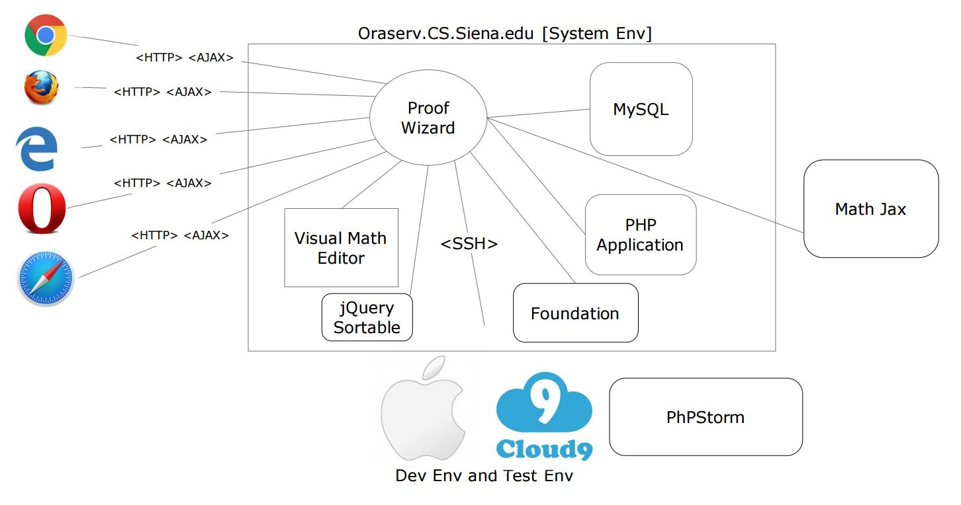

Slide 4
Create Quiz

Slide 5
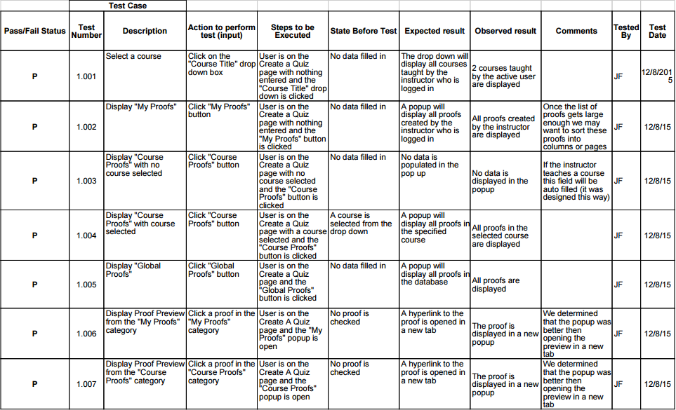

Slide 6
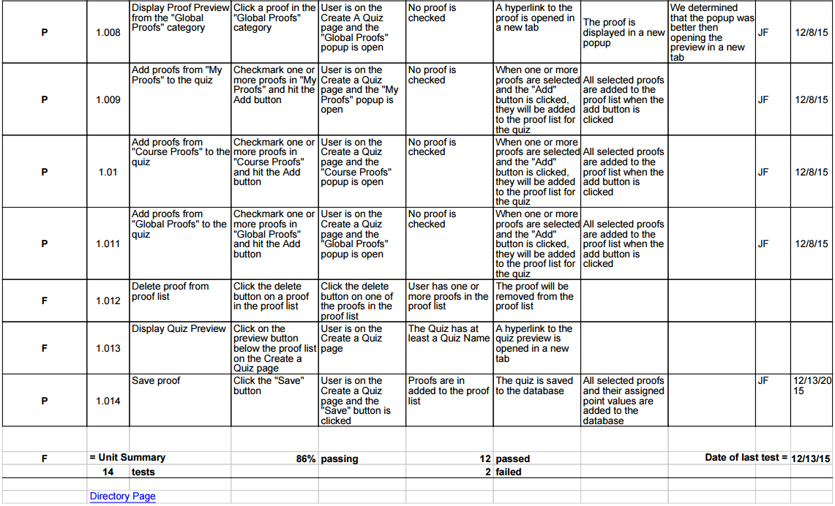

Slide 7
Switch User Type

Slide 8
Unit Test Cases
 | Test Case
Pass/Fail Status | Test Number | Description | Action to perform test (input) | Steps to be Executed | State Before Test | Expected result | Observed result | Comments | Tested By | Test Date
P | 1.001 | Generate Links | Look at switch user type area**TBD | User is on current my account page, | User has multiple user types. Links should be generated for the user types that the user has, that the user is not logged in as | Links for all user types | Links for all user types |  | Kirby and Dan | 23-Nov
P | 1.002 | Switch user type | Click one of the switch user links | Log in as a user that has multiple data types. Click the switch user link | User is logged in with multiple user types. | The dashboard for the new user type is displayed | The dashboard for the new user type is displayed. |  | Kirby and Dan | 23-Nov
P | = Unit Summary |  | 100% | passing | 2 | passed |  | Date of last test = |  | 11/23/15
 | 2 | tests |  |  | 0 | failed

Slide 9
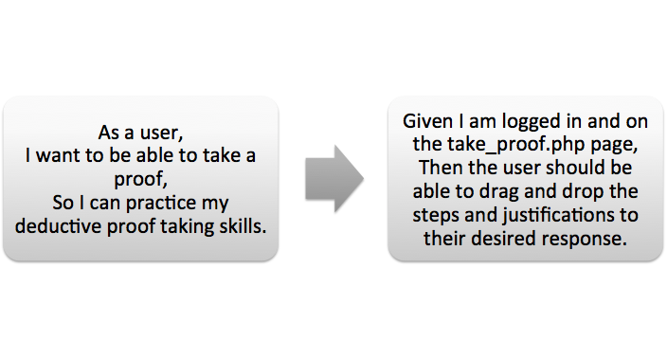
Take Proof

Slide 10
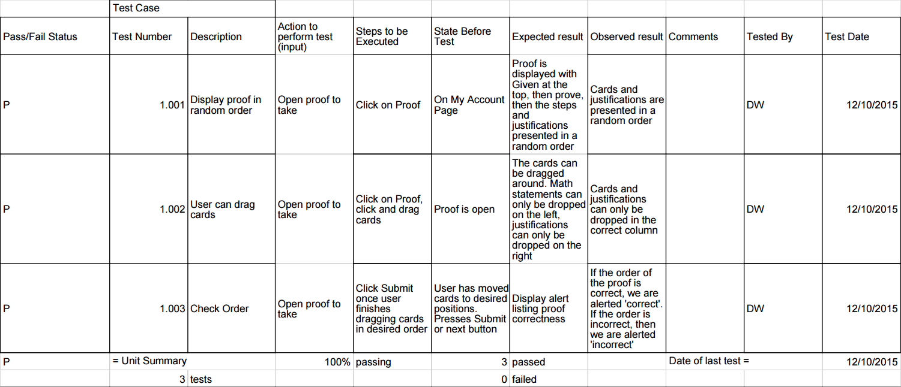

Slide 11
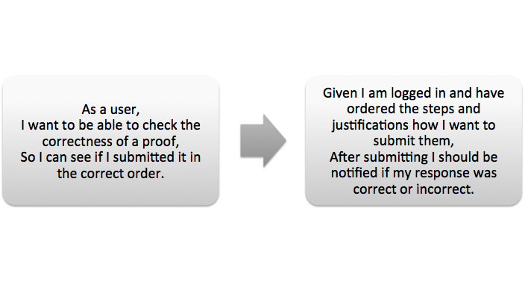
Check Correctness of Proof

Slide 12
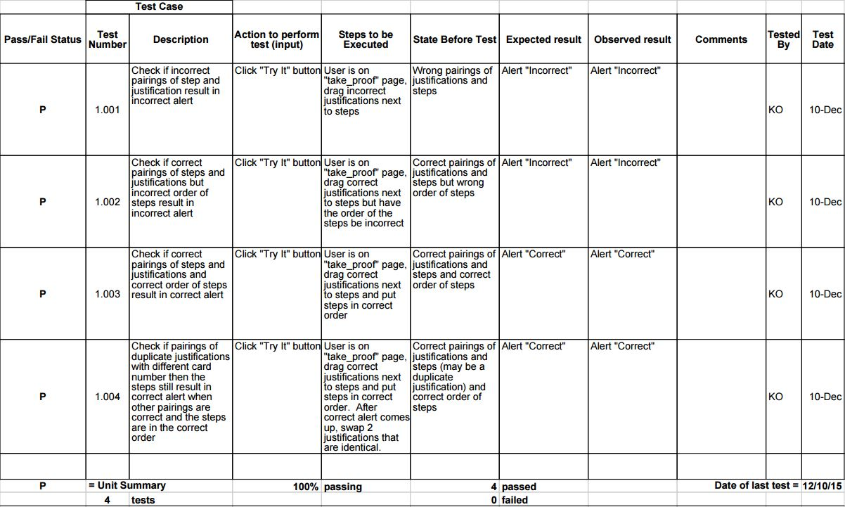

Slide 13
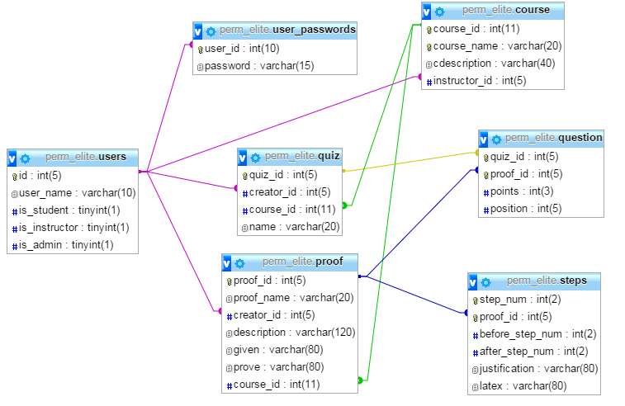
Database Design

Slide 14
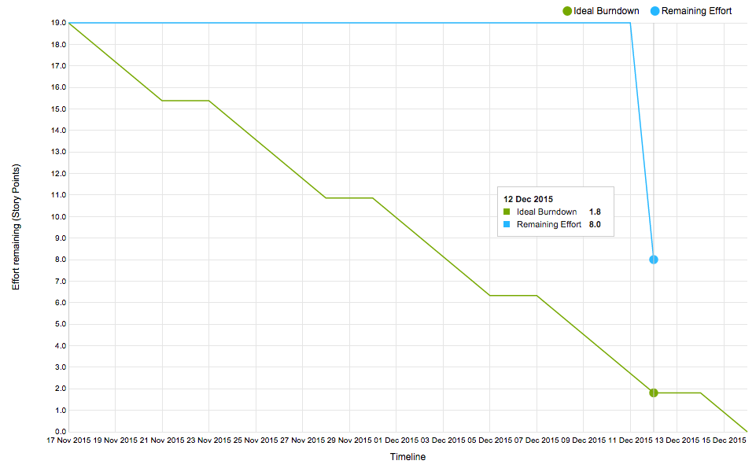

Slide 15
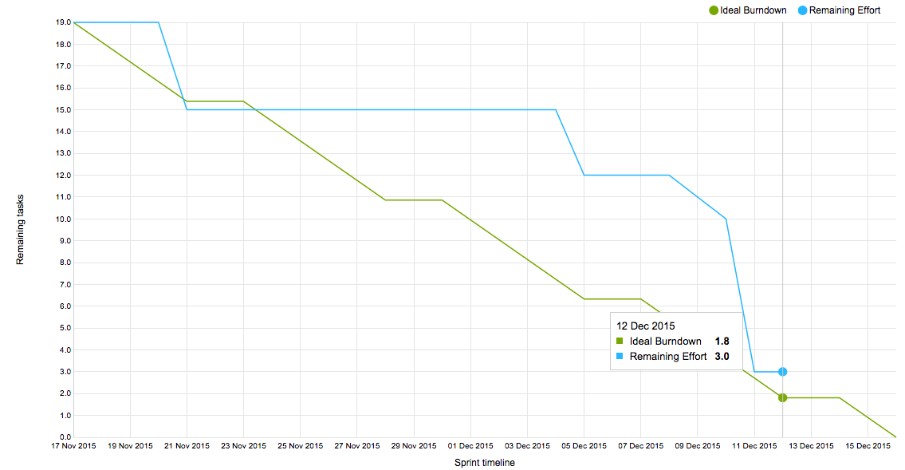
Velocity:
Sprint 2:
16 tasks completed
11 Story Points (one story not completed)
Average:
12 Story Points

Slide 16
DEMO

Slide 17
Reflection and Retrospective
Actions made for Sprint 2 | Actions to make for Sprint 3
Make test cases first Conduct a more effective planning meeting Try to get tasks verified more frequently | Be sure to manually verify stories so they show up on YouTrack burndown chart Thoroughly think of all tasks before starting sprint Have formal stand up meetings more frequently

