Slide 1
Elite

Slide 2
What Are We Trying to Accomplish?
Create an application to help users practice deductive reasoning
Utilize an instructor/student structure like blackboard
Incorporate statistics tracking within the database
Notes:
Joe
At a high level we are creating an application to help students understand deductive reasoning
Instructors create course content and assign that content in any manner they desire (quiz, homework, exam, etx.). The students must then complete this content for a grade. The instructor can also override grades just like in blackboard.
The instructor can go back and look at statistics on a per proof basis and understand what parts of proofs students are having issues with. This information can then be used by the instructor to help his/her students better understand the mistakes they are making in the deductive process.

Slide 3
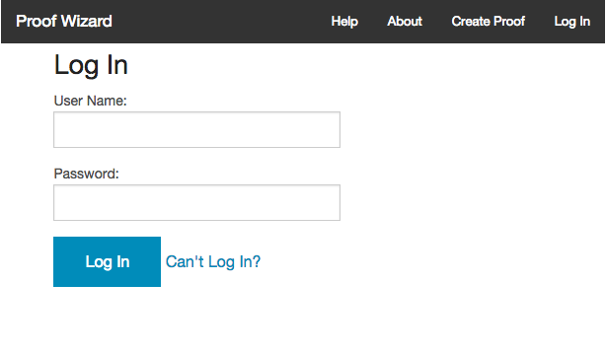
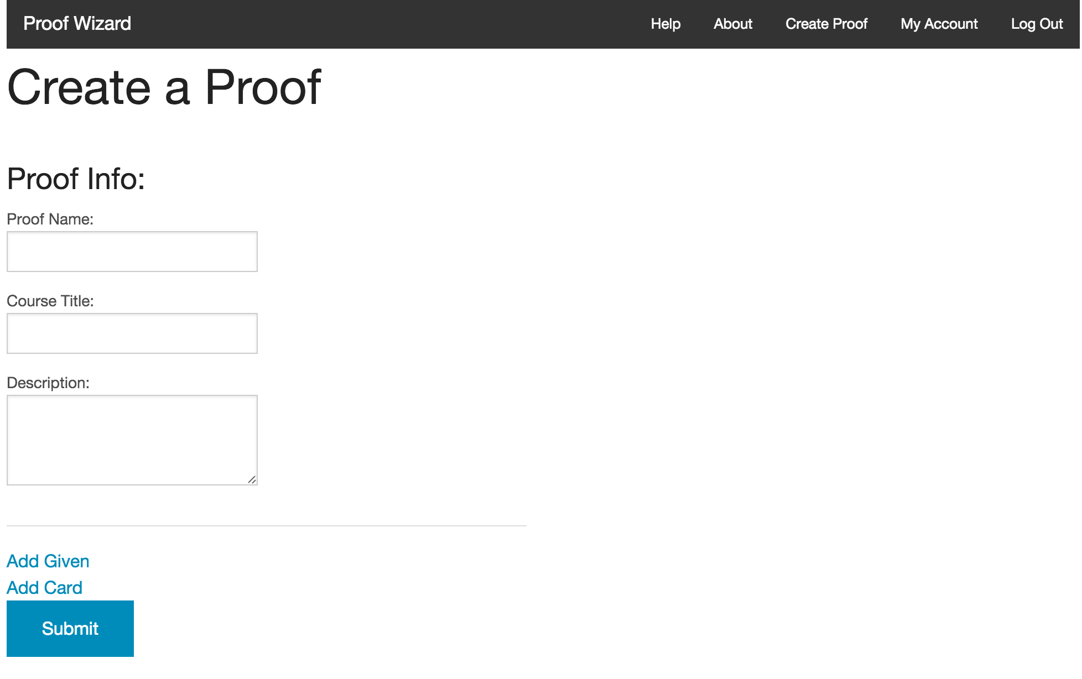
Completed User Stories
As a User, I want to login so I can see my Student/Instructor interface.
As an Instructor, I want to set up a proof so I can assess my students.
Notes:
Dan
Story 1 Acceptance Criteria:
Students can log on, and then select a course from a list. Logging on consists of a username and password combination. This is assigned to them at some point, and persists throughout their student lifetime. Students should be able to recover from forgetting username/password, as well as managing their account.
Story 2 Acceptance Criteria:
Given that the server is up and the login works and the application works
When the instructor makes a proof
a set of card pairs are produced (proof statement / justification), extra cards (optional), and a grading rubric.
Then students need to be able to do the proof
ensure students can do proof
ensure students can submit proof

Slide 4
In Progress User Stories
As an Instructor, I want to be able to create quizzes out of predetermined questions so my students can take them.
As an Instructor, I want to be able to assign a quiz to my students so they can take them
Notes:
Story 3 Acceptance Criteria:
Given that an instructor is logged in
and that there are questions in the database
Then the instructor should be able to select from the questions to create a quiz
The system will have questions stored in various locations (local/global), from which an instructor can select for insertion into a quiz. For the quiz, point values must be determined before actual deployment. The quiz will have a due date/time. It will automatically grade all quiz proofs, according to each rubric. The instructor can then adjust scores and place notes for each proof.
Story 4 Acceptance Criteria:
Given that I’m logged in as an instructor,
and that I have a course with students in it
and that I have created a quiz
Then I should be able to assign the quiz to the course
and students will get a notification to take the quiz

Slide 5
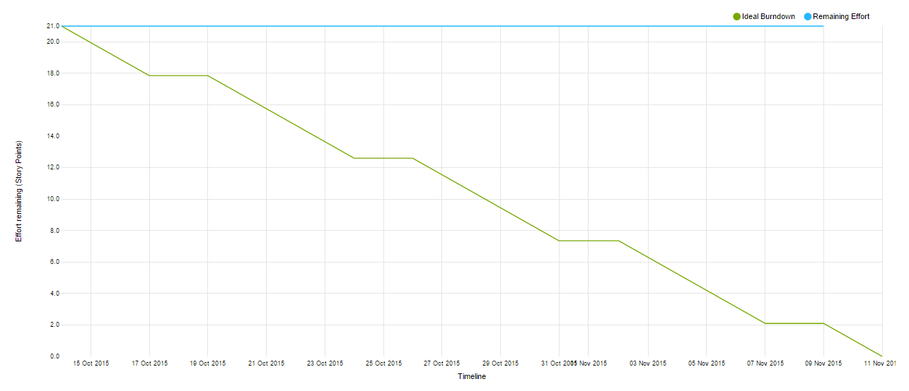
Sprint Burndown
Notes:
Filipe
Current sprint burndown as of 11/8 and waiting on Dr. Lim to verify the first two stories and that will bring remaining points to 8

Slide 6
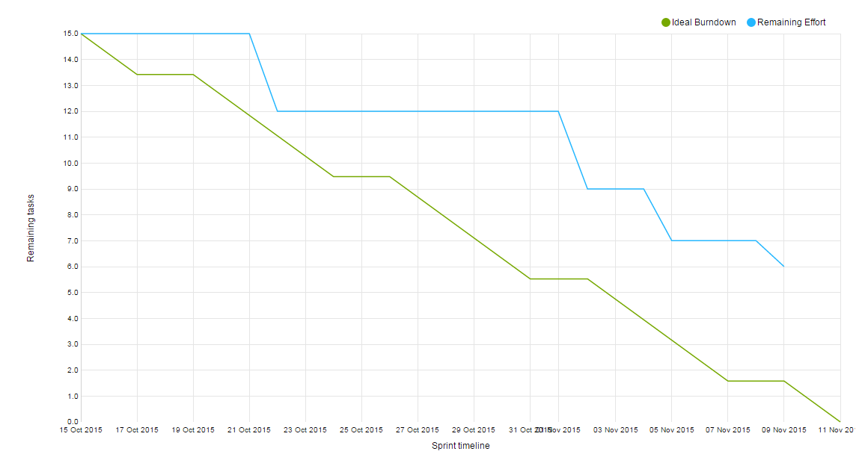
Velocity
Total Tasks 15 (21 points)
Completed tasks 9 (13 points)
Notes:
Filipe
Assuming Dr. Lim verifies both the Login and Create Proof stories, we will have an estimated velocity of 13 ( 5 + 8 ).

Slide 7
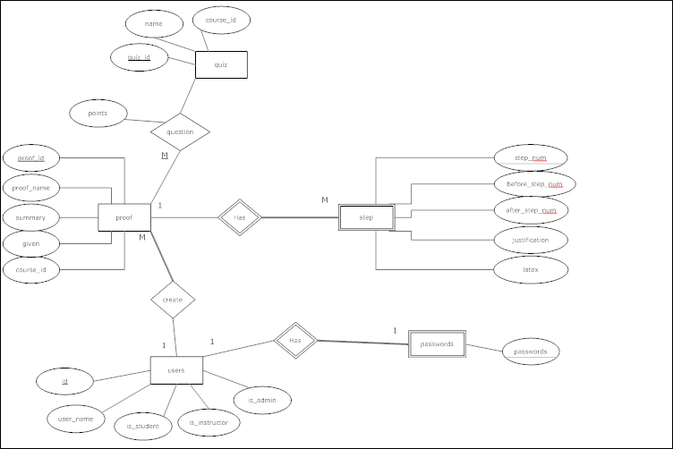
ER Diagram
Notes:
Andy

Slide 8
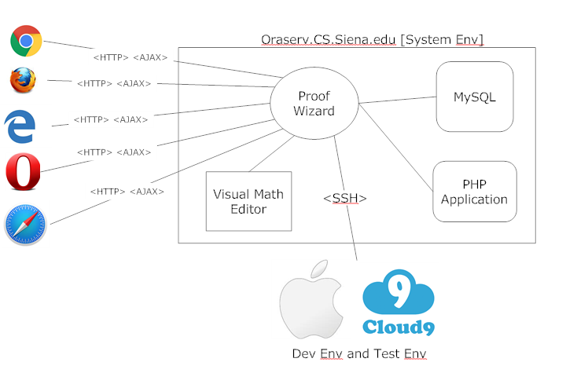
Deployment Diagram
Notes:
Andy

Slide 9
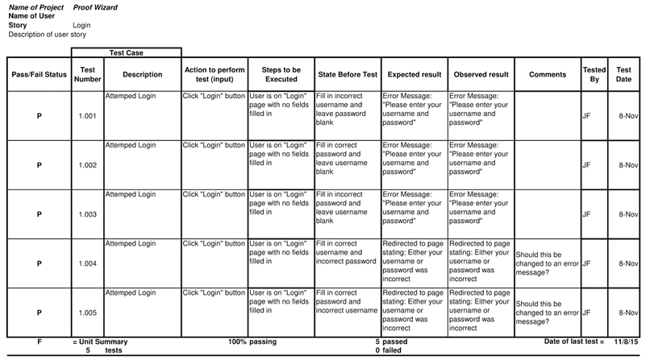
Test Cases
Notes:
Kirby

Slide 10
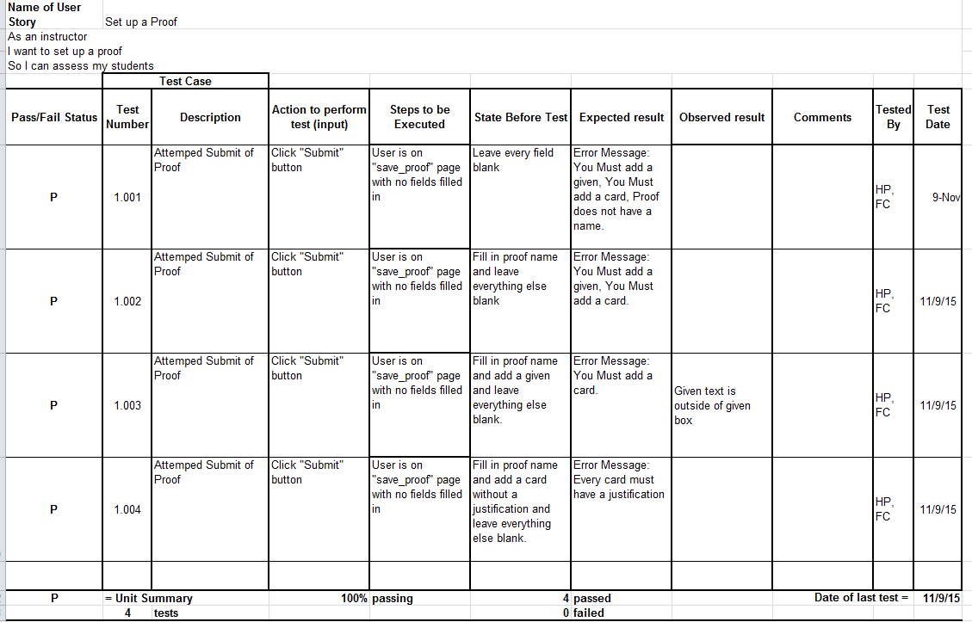
Test Cases
Notes:
Kirby

