Slide 1
Chevrolet Advance-Design Series Paint Visualizer
Preliminary Design
Y
O
S
Your Dream, Our Solution

Slide 2
Agenda
Introduction
Problem Overview
Project Progression
User Case Narratives
UML Use Case Diagram
UML Deployment Diagram
Website Map
UML Activity Diagrams
Data Flow Diagrams
Requirements Inventory
Data Dictionary
Testing
Development Environment
Prototype Screens
What’s Next?

Slide 3
Team introduction
Troy Valle – Team Leader
Frank Schroeder – Project Manager
Kerrie Daley – Technical Processor
Grady McBride – Database Manager
Matt Mainello – Webmaster

Slide 4
Agenda
Introduction
Problem Overview
Project Progression
User Case Narratives
UML Use Case Diagram
UML Deployment Diagram
Website Map
UML Activity Diagrams
Data Flow Diagrams
Requirements Inventory
Data Dictionary
Testing
Development Environment
Prototype Screens
What’s Next?

Slide 5
Problem Overview
Dr. Timoth Lederman is a General Motors Truck enthusiast. Several years ago, he found a web application on the Internet that allowed him to custom design trucks. Unfortunately, the website is no longer in existence. Dr. Lederman has expressed his want for a new web application that will allow users to custom design 1947-1955 Chevrolet trucks. This project will be called Chevrolet Advance-Design Series Paint Visualizer (CADS Paint Visualizer).

Slide 6
Agenda
Introduction
Problem Overview
Project Progression
User Case Narratives
UML Use Case Diagram
UML Deployment Diagram
Website Map
UML Activity Diagrams
Data Flow Diagrams
Requirements Inventory
Data Dictionary
Testing
Development Environment
Prototype Screens
What’s Next?

Slide 7
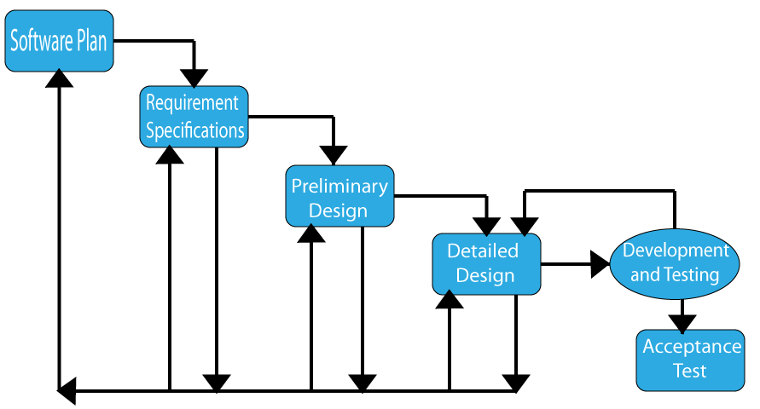
Project Progression

Slide 8
Agenda
Introduction
Problem Overview
Project Progression
User Case Narratives
UML Use Case Diagram
UML Deployment Diagram
Website Map
UML Activity Diagrams
Data Flow Diagrams
Requirements Inventory
Data Dictionary
Testing
Development Environment
Prototype Screens
What’s Next?

Slide 9
TWO DIFFERENT USERS
CUSTOMIZER
RESTORER
CASUAL USER

Slide 10
General Use of CADS Paint Visualizer
Select model by year
Change color
Change view
Save truck

Slide 11
What’s the Difference?

Slide 12
Agenda
Introduction
Problem Overview
Project Progression
User Case Narratives
UML Use Case Diagram
UML Deployment Diagram
Website Map
UML Activity Diagrams
Data Flow Diagrams
Requirements Inventory
Data Dictionary
Testing
Development Environment
Prototype Screens
What’s Next?

Slide 13
UML Use Case Legend
13
Actor: An entity that interacts with the
system externally. This can be either a
human or non-human user.
System Boundary: A boundary between
internal and external components.
Actor A interacts with all of the systems
Use Cases
A
Use Case: A component within the system
that actors may interact with.
B
Actor A interacts with Use Case B
A
Actor B interacts with all Use Cases that
Actor A is able to interact with.
A
B
A
B
Use Case A includes Use Case B
A
B
Use Case B is a more specific type of Use Case A

Slide 14
Cads Uml use case diagram
Fender
<<extends>>
Change Color
<<extends>>
Grill
<<extends>>
<<extends>>
Pinstripe
Upper
<<extends>>
<<extends>>
on Wheels
Body
<<extends>>
<<extends>>
Pinstripe
Lower
Rims
on Body
Body
Bumper
MySQL
DBMS
User
Change View
Save Truck
<<extends>>
<<extends>>
<<includes>>
Apache
Front View
Input Unique
Webserver
Webhosting
Restorer
Customizer
Side View
Name
Pad
Select Make
and Model
<<includes>>
<<extends>>
Year
<<includes>>
<<extends>>
Cab Style
Body Style
Window
Style

Slide 15
Agenda
Introduction
Problem Overview
Project Progression
User Case Narratives
UML Use Case Diagram
UML Deployment Diagram
Website Map
UML Activity Diagrams
Data Flow Diagrams
Requirements Inventory
Data Dictionary
Testing
Development Environment
Prototype Screens
What’s Next?

Slide 16






UML Deployment Diagram
www.cadspv.com
<HTTP>
CADS
CADS Database
<HTTP>
<
ODBC
>
<HTTP>
<HTTP>
<
SCP
>
<
SCP
>
SEA3
SEB3

Slide 17
Agenda
Introduction
Problem Overview
Project Progression
User Case Narratives
UML Use Case Diagram
UML Deployment Diagram
Website Map
UML Activity Diagrams
Data Flow Diagrams
Requirements Inventory
Data Dictionary
Testing
Development Environment
Prototype Screens
What’s Next?

Slide 18
Website Map

Slide 19
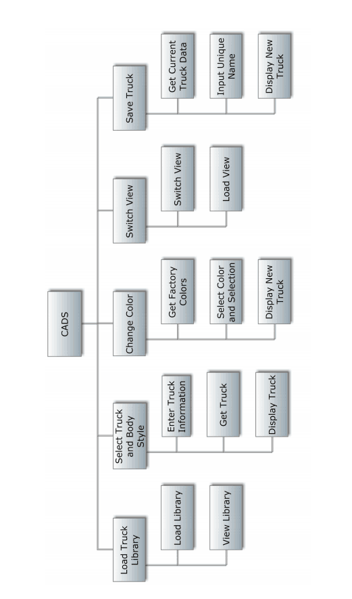
Structure Diagram

Slide 20
Agenda
Introduction
Problem Overview
Project Progression
User Case Narratives
UML Use Case Diagram
UML Deployment Diagram
Website Map
UML Activity Diagrams
Data Flow Diagrams
Requirements Inventory
Data Dictionary
Testing
Development Environment
Prototype Screens
What’s Next?

Slide 21
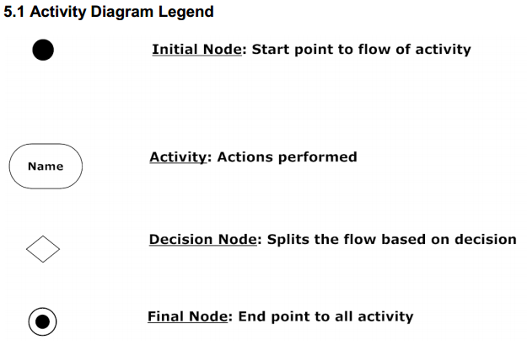
UML Activity Diagram Legend

Slide 22
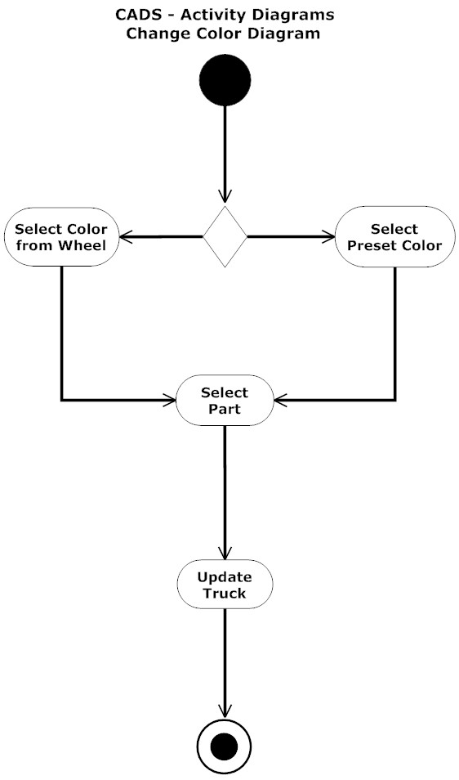

Slide 23
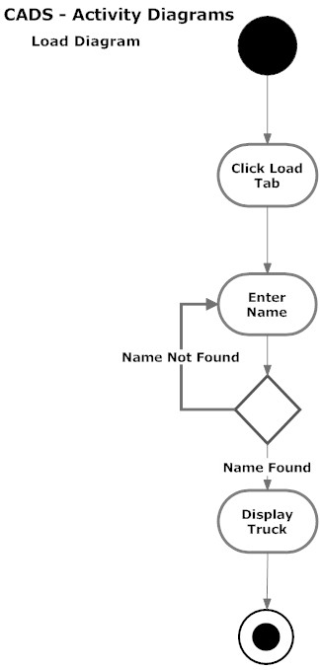

Slide 25
Agenda
Introduction
Problem Overview
Project Progression
User Case Narratives
UML Use Case Diagram
UML Deployment Diagram
Website Map
UML Activity Diagrams
Data Flow Diagrams
Requirements Inventory
Data Dictionary
Testing
Development Environment
Prototype Screens
What’s Next?

Slide 27
Context diagram
27
GMC
Truck
Customizer
GMC
Truck
Restorer
CADS
CADS MySQL Database

Slide 28
28
Level 0 Diagram
CADS MySQL Database
Truck Data
Truck Data
Available Views
Request
Truck
Save
Information
Factory Colors
View Request
Response
Truck
Truck
2. Select
Data
Request
Color Request
Truck and
Body Style
4. Switch
View
5. Save Truck
3. Change
Truck
Color
Image
Type of
1. Load Truck
View Type
Truck
Save Response
Library
New View
Truck
Selected Color
Information
Library
Truck with
Request
new color.
Library
GM Truck
Response
Customizer
/Restorer

Slide 29
29
Level 1 Select Truck
CADS MySQL Database
Truck
Truck
Image
Information
2.2 Get
Truck
Truck
Image
Truck
Information
2.3 Display
2.1 Enter
Truck
Truck
Information
Truck
Truck
Image
Information
User

Slide 30
Level 2 Select Truck-2.1 Enter Truck Information

Slide 31
Agenda
Introduction
Problem Overview
Project Progression
User Case Narratives
UML Use Case Diagram
UML Deployment Diagram
Website Map
UML Activity Diagrams
Data Flow Diagrams
Requirements Inventory
Data Dictionary
Testing
Development Environment
Prototype Screens
What’s Next?

Slide 32
Functional Requirements Inventory
32
1947 Pickup Truck- The 1947 model will include:
A split flat windshield
No vent window
An air scoop window on the cowl
Curved bedsides
Bumper dip
1947 Cab Over Engine- The 1947 model will include:
A split flat windshield
No vent window
An air scoop on the cowl
Flat bed
1948 Pickup Truck-
A split flat windshield
No vent window
An air scoop window on the cowl
Curved bedsides
1948 Cab Over Engine-
A split flat windshield
No vent window
An air scoop on the cowl
Flat bed

Slide 33
1949 Pickup Truck-
A split flat windshield
No vent window
An air scoop window
on the cowl
Curved bedsides
1949 Cab Over Engine-
A split flat windshield
No vent window
An scoop vent on the cowl
Flat bed
1950 Pickup Truck-
A split flat windshield
No vent window
An air scoop on the cowl
Curved bedsides
1950 Cab Over Engine-
A split flat windshield
No vent window
An air scoop on the cowl
Flat bed
1951 Pickup Truck-
A split flat windshield
Vent window
No air scoop on the cowl
Curved bedsides
1951 Cab Over Engine-
A split flat windshield
Vent window
No air scoop on the cowl
Flat bed
1952 Pickup Truck-
A split flat windshield
Vent window
No air scoop on the cowl
Curved bedsides
1952 Cab Over Engine-
A split flat windshield
Vent window
No air scoop on the cowl
Flat bed
1954 Pickup Truck-
A single-curved windshield
Vent Window
No air scoop on the cowl
Flat top on bedsides
Dip in the bumper
1954 Cab Over Engine-
A single-curved windshield
Vent Window
No air scoop on the cowl
Flat bed
Dip in the bumper
1955 Pickup Truck-
A single-curved windshield
Vent window
No air scoop on the cowl
Flat top on bedsides
Dip in the bumper
1953 Pickup Truck-
A split flat windshield
Vent window
No air scoop on the cowl
Curved bedsides
1953 Cab Over Engine-
A split flat windshield
Vent window
No air scoop on the cowl
Flat bed
1955 Cab Over Engine-
A single-curved windshield
Vent window
No air scoop on the cowl
Flat bed
Dip in the bumper

Slide 34
Truck Matrix
Color Matrix

Slide 35
Agenda
Introduction
Problem Overview
Project Progression
User Case Narratives
UML Use Case Diagram
UML Deployment Diagram
Website Map
UML Activity Diagrams
Data Flow Diagrams
Requirements Inventory
Data Dictionary
Testing
Development Environment
Prototype Screens
What’s Next?

Slide 36
Logical Data dictionary
Key
Data Name: The name of the data entity being stored, whether it be in a database or not.
Applicable to: The screens that this data entity will apply to.
Data Type: The type of data for a data entity.
Data Size: The size of the data in terms of it's data type.
Description: A description of what data this entity is storing.
Acceptable Input: What must be inputted by a user in order for the system to accept the data.
Good Example of Input: An example of data that would be accepted by the system.
Notes: Additional important information about the data.

Slide 37
Data Name | Applicable to | Data Type | Data Size | Description | Acceptable Input | Good Example of Input | Notes
truckName | Save Truck, Load Library | Char | 1-20 Characters | The name used to save the truck for future use (editing or viewing) | ASCII Chars from Decimal 32 to Decimal 126 inclusive, allowed | TRuck233 | Must be unique and can not be null.
color | Change Color | Char | 3-30 Characters | The name used for each factory color. | ASCII Chars from Decimal 32 to Decimal 126 inclusive, allowed | Red | Must be unique and can not be null.
redValue | Change Color, Save Truck | Byte | 3 digit number | The value that will represent how much red will be used in a certain color. | Any integer ranging from 0 to 255 | 120 | It doesn't have to be unique. It can not be null.
greenValue | Change Color, Save Truck | Byte | 3 digit number | The value that will represent how much green will be used in a certain color. | Any integer ranging from 0 to 255 | 120 | It doesn't have to be unique. It can not be null.
blueValue | Change Color, Save Truck | Byte | 3 digit number | The value that will represent how much blue will be used in a certain color. | Any integer ranging from 0 to 255 | 120 | It doesn't have to be unique. It can not be null.
partName | Change Color, Save Truck | Char | 3-15 Characters | A specific part that is on each truck. Each truck will have all of the same parts but we will need to store which part has which color for when we save the truck | ASCII Chars from Decimal 32 to Decimal 126 inclusive, allowed | Fender | It doesn't have to be unique. It can not be null.

Slide 38
Data Name | Applicable to | Data Type | Data Size | Description | Acceptable Input | Good Example of Input | Notes
Year | Change Color, Save Truck, Change View, Select Year | Int | 4 digit number | Year of the truck | Any integer ranging from 1947-1955 | 1948 | It doesn't have to be unique. It can not be null.
cabStyle | Save Truck, Change View, Change Year | Char | 1-15 Characters | Cab Style of the truck. Different years may have different selections of CAB styles | ASCII Chars from Decimal 32 to Decimal 126 inclusive, allowed | Crew Cab | It doesn't have to be unique. It can not be null.
windowStyle | Save Truck, Change View, Change Year | Char | 1-15 Characters | Window Style of the truck. Different years may have different selections of Window styles | ASCII Chars from Decimal 32 to Decimal 126 inclusive, allowed | Traditional | It doesn't have to be unique. It can not be null.

Slide 39
Agenda
Introduction
Problem Overview
Project Progression
User Case Narratives
UML Use Case Diagram
UML Deployment Diagram
Website Map
UML Activity Diagrams
Data Flow Diagrams
Requirements Inventory
Data Dictionary
Testing
Development Environment
Prototype Screens
What’s Next?

Slide 40
Unit Tests

Slide 41
Agenda
Introduction
Problem Overview
Project Progression
User Case Narratives
UML Use Case Diagram
UML Deployment Diagram
Website Map
UML Activity Diagrams
Data Flow Diagrams
Requirements Inventory
Data Dictionary
Testing
Development Environment
Prototype Screens
What’s Next?

Slide 42
Development Environment
Software Engineering Lab’s Window’s Computer:
Model: Dell OptiPlex 760
Operating System: Windows Vista Enterprise
Processor: Intel Core 2 Duo 2.93 GHz
RAM: 4GB
HDD: 300GB
Software Engineering Lab’s Macintosh Computer
Model: iMac 5.1
Operating System: Mac OS X
Processor: Intel Core i5 2.5 GHz
RAM: 4GB (1333 MHz DDR3)
Graphics: AMD Radeon HD 6750M 512MB
HDD: 500GB
Software
Adobe Dreamweaver, Google Chrome, Internet Explorer, Mozilla Firefox, MySQL, Notepad ++
YDOS will also be using personal laptops throughout the development of CADS Paint Visualizer.

Slide 43
Agenda
Introduction
Problem Overview
Project Progression
User Case Narratives
UML Use Case Diagram
UML Deployment Diagram
Website Map
UML Activity Diagrams
Data Flow Diagrams
Requirements Inventory
Data Dictionary
Testing
Development Environment
Prototype Screens
What’s Next?

Slide 44
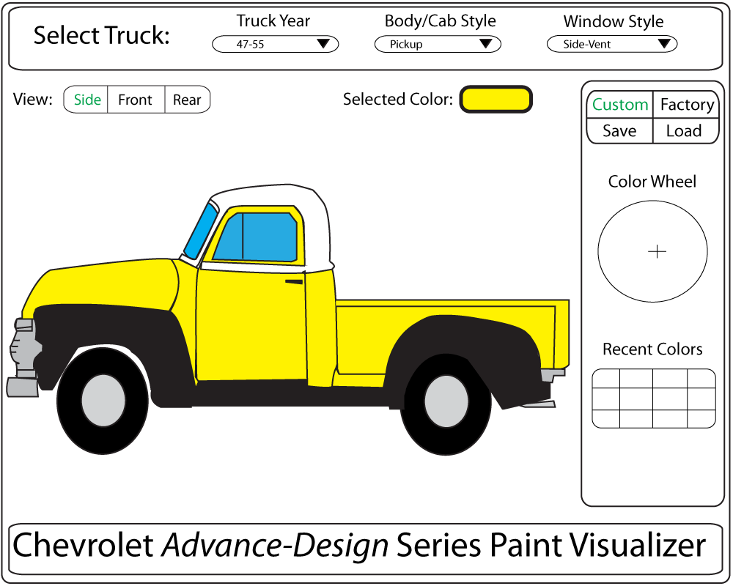

Slide 45
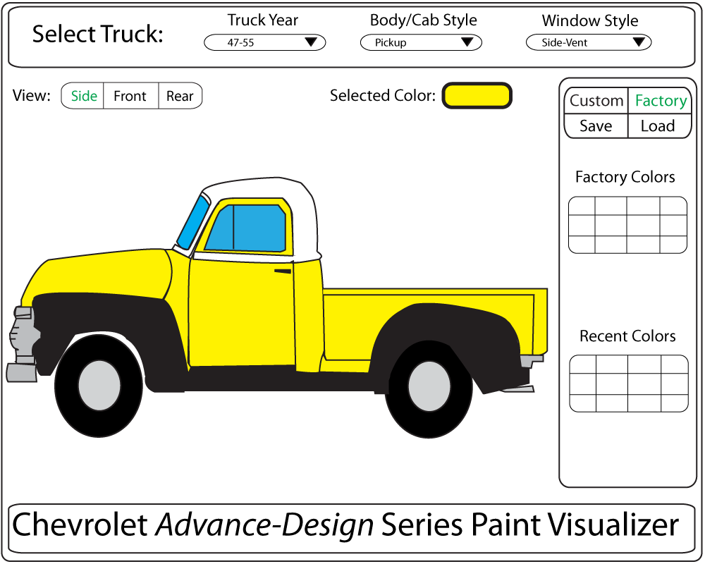

Slide 46
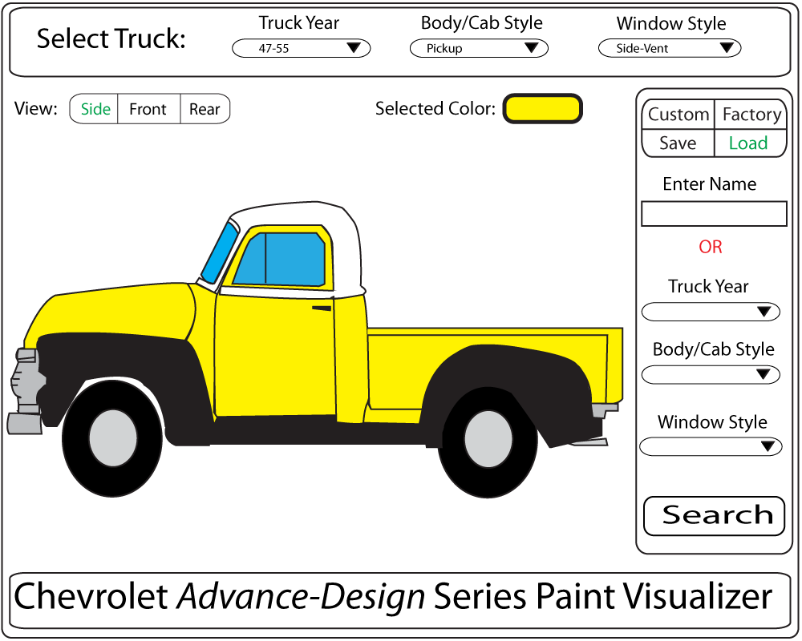

Slide 47
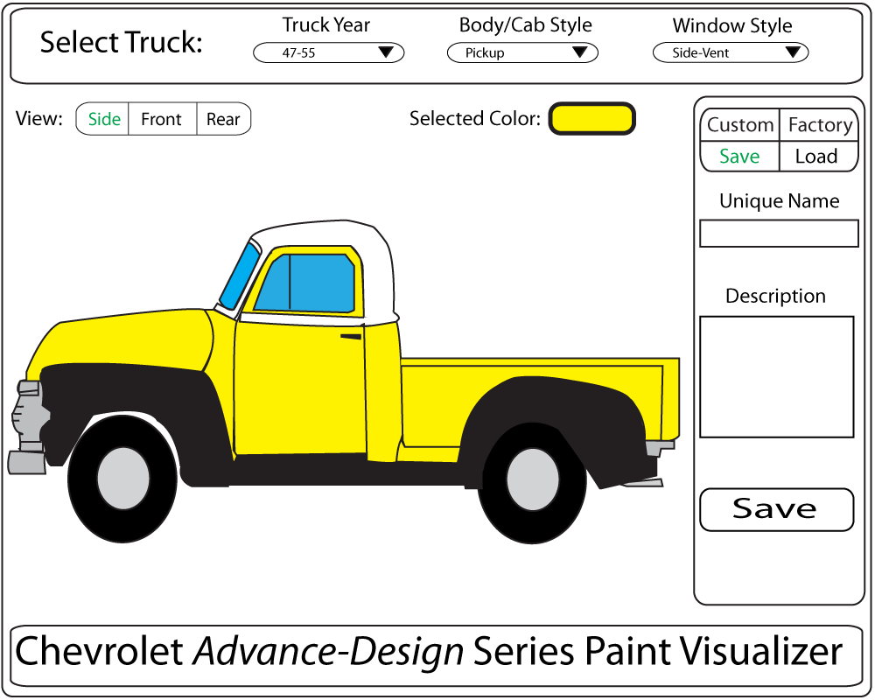

Slide 48
Agenda
Introduction
Problem Overview
Project Progression
User Case Narratives
UML Use Case Diagram
UML Deployment Diagram
Website Map
UML Activity Diagrams
Data Flow Diagrams
Requirements Inventory
Data Dictionary
Testing
Development Environment
Prototype Screens
What’s Next?

Slide 49
49
What is Next?
  Detailed Design – March 2014
  Acceptance Test– April 2014

Slide 50
QUESTIONS?

