Slide 1
presents
Project United
Software Plan

Slide 2
Welcome
Client: Dr. Timoth Lederman
Guest: Dr. Darren Lim
Guest: Dr. Meg Fryling
2
Software Plan

Slide 3
Agenda
Introduction
Problem Definition
System Justification
System Goals
System Constraints
Resources
Model
Timeline
Software Plan

Slide 4
Introduction
Zachary Witter
Team Leader
Dustin Clark
Webmaster
Josh Tomazewski
Database Administrator
Devin Hurley
Lead Developer
Chan Tran
Data Scientist
Software Plan

Slide 5
Agenda
Introduction
Problem Definition
System Justification
System Goals
System Constraints
Resources
Model
Timeline
Software Plan

Slide 6
Problem Definition
Difficult to find other forum members
Current system is time consuming
Forum members can not add their own data
Intuitive implementation needed
Software Plan

Slide 7
Agenda
Introduction
Problem Definition
System Justification
System Goals
System Constraints
Resources
Model
Timeline
Software Plan

Slide 8
System Justification
Members enter data
Members easily arrange meetings
Simplified way to obtain directions
Peace-of-mind to traveling members
Software Plan

Slide 9
Agenda
Introduction
Problem Definition
System Justification
System Goals
System Constraints
Resources
Model
Timeline
Software Plan

Slide 10
System Goals
Simple & Easy
Viewing Map
Inputting data
Directions
Low Maintenance
Software Plan

Slide 11
Agenda
Introduction
Problem Definition
System Justification
System Goals
System Constraints
Resources
Model
Timeline
Software Plan

Slide 12
System Constraints
Compatibility
Different Browsers
Different versions
Resolution Size
Administrator Monitoring of User Data
MySQL
Software Plan

Slide 13
Agenda
Introduction
Problem Definition
System Justification
System Goals
System Constraints
Resources
Model
Timeline
Software Plan

Slide 14
Resources
Hardware
Languages
Software
Software Plan

Slide 15
Agenda
Introduction
Problem Definition
System Justification
System Goals
System Constraints
Resources
Model
Timeline
Software Plan

Slide 16
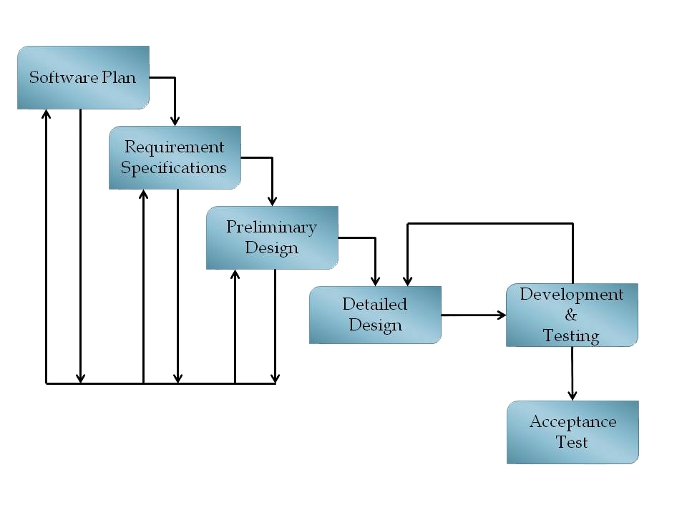
Model
Software Plan

Slide 17
Agenda
Introduction
Problem Definition
System Justification
System Goals
System Constraints
Resources
Model
Timeline
Software Plan

Slide 18
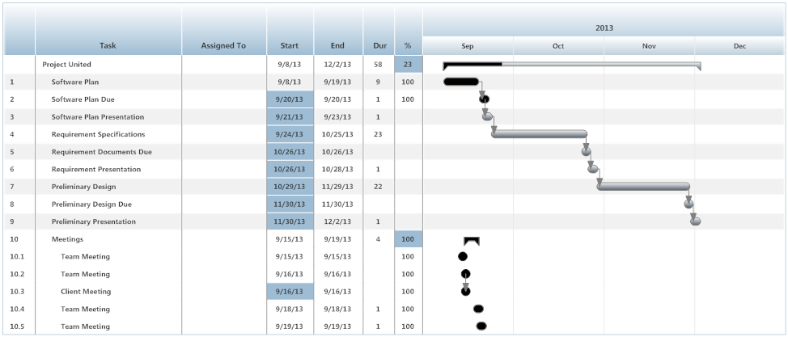
Timeline
Software Plan

Slide 19
Thank You
Software Plan

