Slide 1
Requirements
Specification
October 30th 2013

Slide 2
Welcome
Client: Dr. Timoth Lederman
Guest: Dr. Darren Lim
Guest: Dr. Meg Fryling

Slide 3
Agenda
Introduction
Problem Definition
Current Status
Functional Requirements / Use Case Narratives
UML Use Case Diagram
Data Flow Diagrams
Prototypes used for discovery
What is next for our project
Questions

Slide 4
Introduction
Zachary Witter
Team Leader
Dustin Clark
Webmaster
Josh Tomaszewski
Database Administrator
Devin Hurley
Lead Developer
Chan Tran
Data Scientist

Slide 5
Agenda
Introduction
Problem Definition
Current Status
Functional Requirements / Use Case Narratives
UML Use Case Diagram
Data Flow Diagrams
Prototypes used for discovery
What is next for our project
Questions

Slide 6
Problem Definition
Difficult to find other forum members
Current system is time consuming
Forum members can not add their own data
Intuitive implementation needed

Slide 7
Agenda
Introduction
Problem Definition
Current Status
Functional Requirements / Use Case Narratives
UML Use Case Diagram
Data Flow Diagrams
Prototypes used for discovery
What is next for our project
Questions

Slide 8
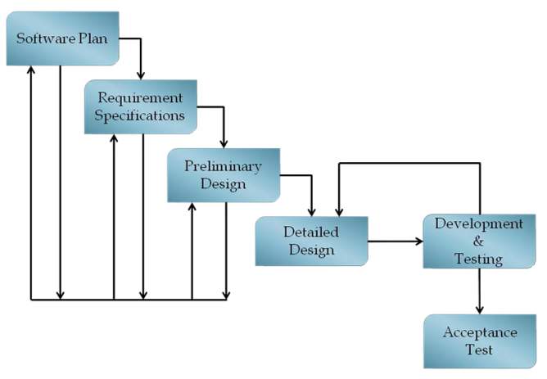
Current Status

Slide 9
Agenda
Introduction
Problem Definition
Current Status
Functional Requirements / Use Case Narratives
UML Use Case Diagram
Data Flow Diagrams
Prototypes used for discovery
What is next for our project
Questions

Slide 10
Functional Requirements
General Requirements
Map with pins
Slide out panel with tabs
Functional Requirements and Narratives for oldGMCtrucks Mapper’s four users

Slide 11
Non-oldGMCtrucks Member
Random User
Narrative
Functional requirements
Will see blank map
Will have the ability to sign up for an account on oldGMCtrucks forum.

Slide 12
oldGMCtrucks Forum Member
Narrative
Functional requirements
Access the site through the oldGMCtrucks forum.
View a map with user information on the map.
Request an account on the oldGMCtrucks Mapper site.

Slide 13
oldGMCtrucks Mapper Member
Narrative
Functional requirements
Ability to log in.
Ability to update information in their profile.
Can derive directions to an event or to another member’s location.
Can create/edit events

Slide 14
System Administrator
Narrative
Functional requirements
Extends oldGMCtrucks Mapper Member.
Can modify any member’s data.
Can create user accounts.

Slide 15
Agenda
Introduction
Problem Definition
Current Status
Functional Requirements / Use Case Narratives
UML Use Case Diagram
Data Flow Diagrams
Prototypes used for discovery
What is next for our project
Questions

Slide 16
UML Use Case Legend
Actor

Slide 17
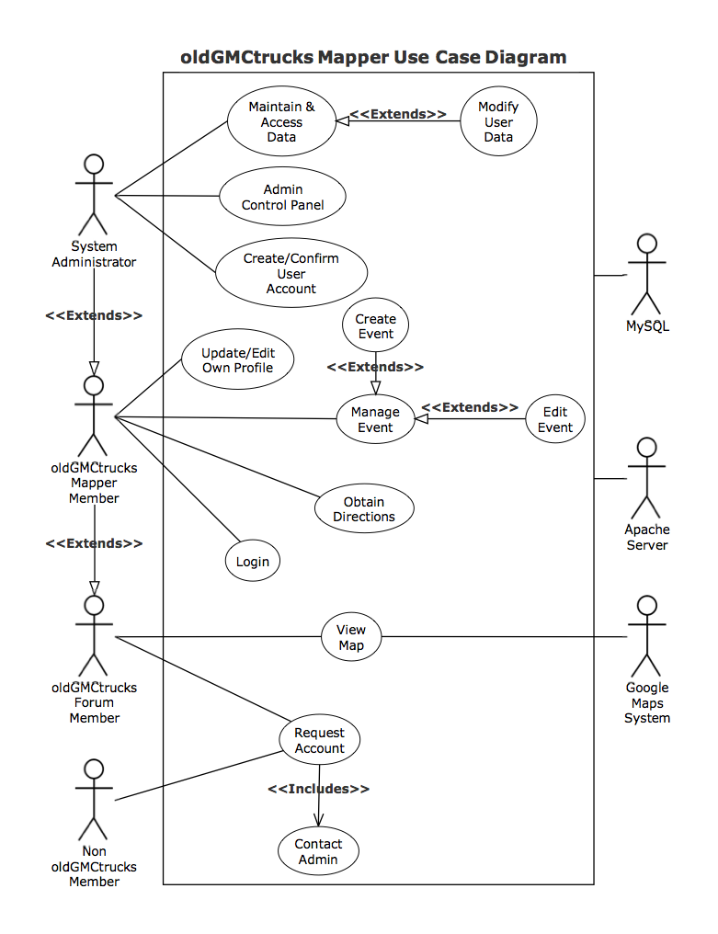
oldGMCtrucks Mapper
UML
Use
Case
Diagram

Slide 18
Agenda
Introduction
Problem Definition
Current Status
Functional Requirements / Use Case Narratives
UML Use Case Diagram
Data Flow Diagrams
Prototypes used for discovery
What is next for our project
Questions

Slide 19
Data Flow Diagram Legend

Slide 20
Context Diagram

Slide 21
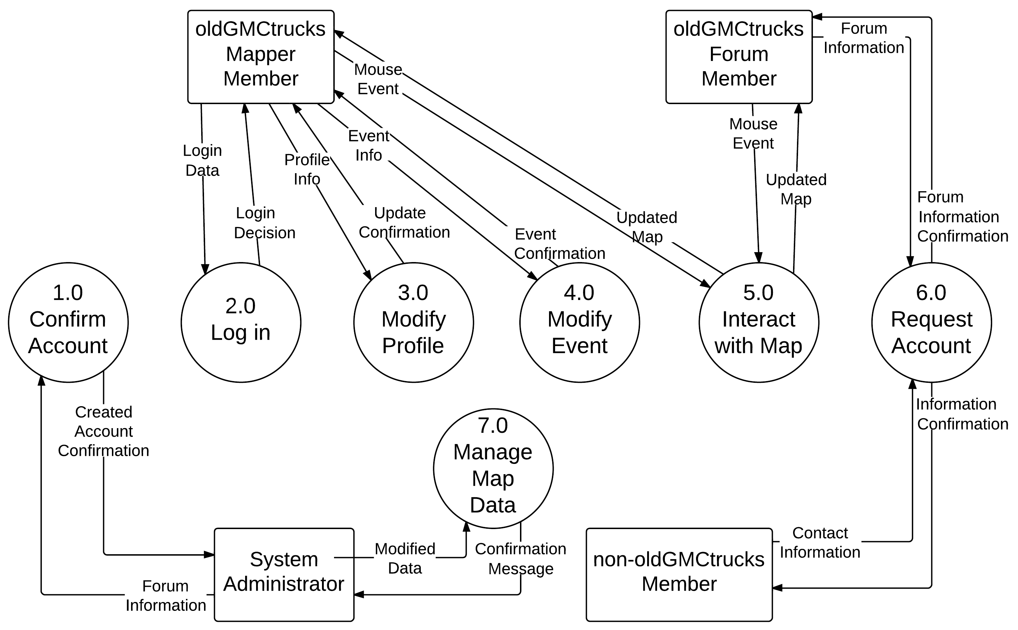
Level 0 Diagram

Slide 22
Level 1 Confirm Account

Slide 23
Agenda
Introduction
Problem Definition
Current Status
Functional Requirements / Use Case Narratives
UML Use Case Diagram
Data Flow Diagrams
Prototypes used for discovery
What is next for our project
Questions

Slide 24
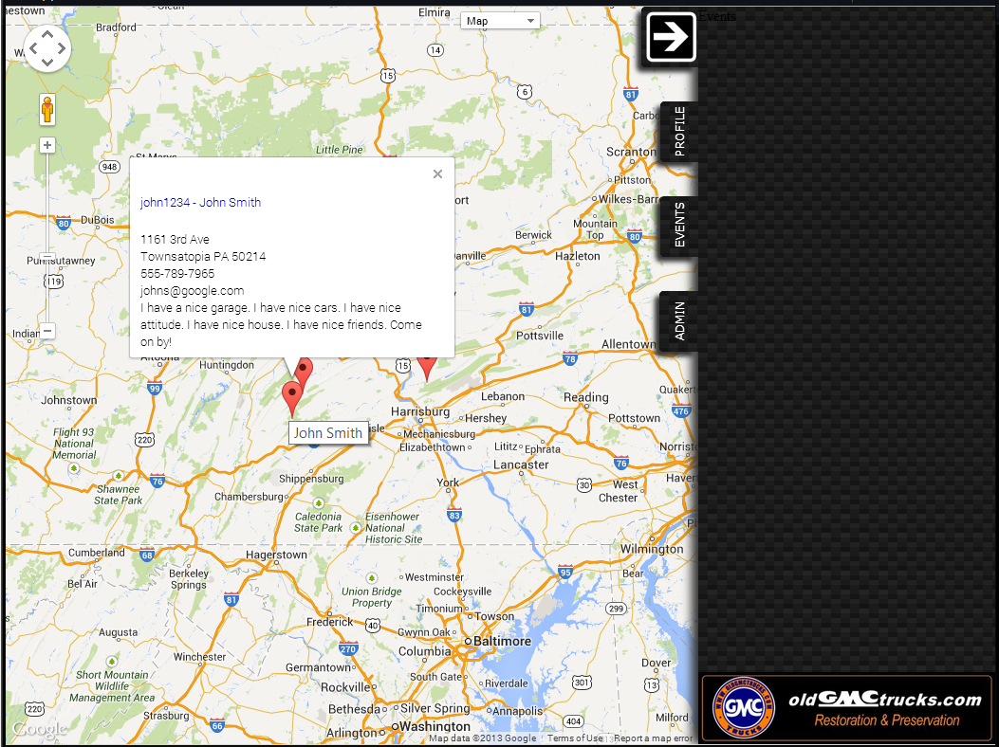
Prototype used for Discovery

Slide 25
Agenda
Introduction
Problem Definition
Current Status
Functional Requirements / Use Case Narratives
UML Use Case Diagram
Data Flow Diagrams
Prototypes used for discovery
What is next for our project
Questions

Slide 26
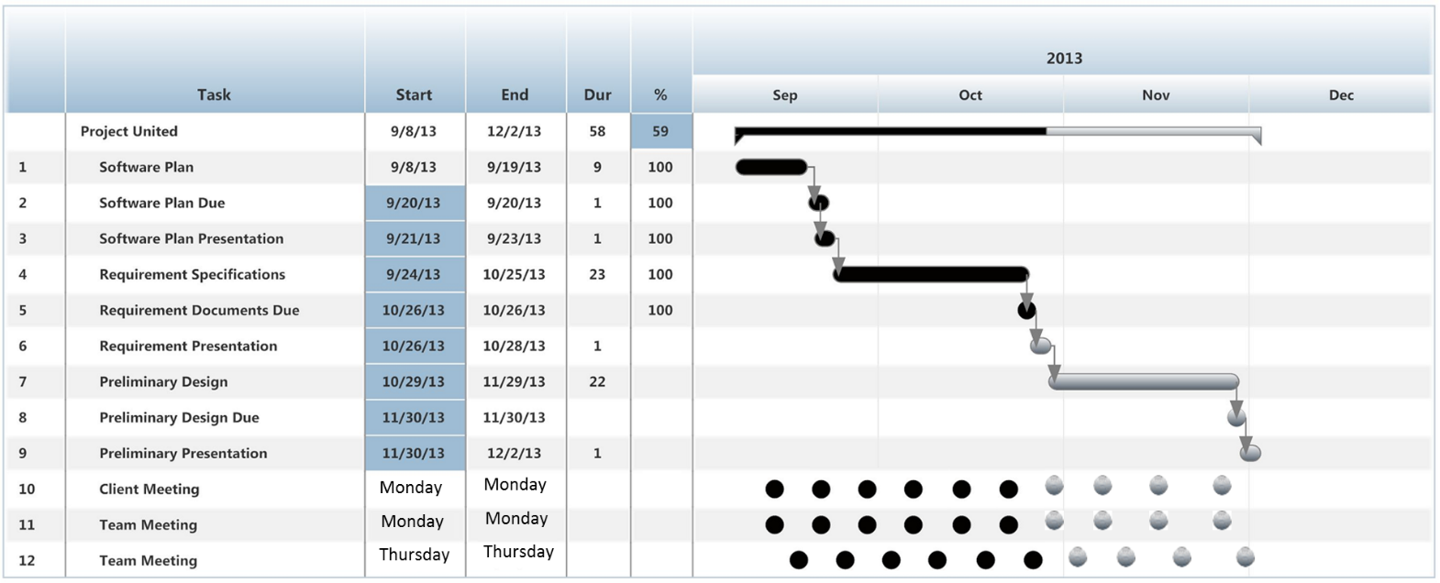
What is Next?
oldGMCtrucks Mapper

Slide 27
Acknowledgements
Dr. Timoth Lederman
Dr. Darren Lim
Dr. Meg Fryling
Software Engineering Class

