Slide 1

Preliminary
Design
December 2nd 2013

Slide 2
Welcome
Client: Dr. Timoth Lederman
Guest: Dr. Darren Lim
Guest: Dr. Meg Fryling

Slide 3
Agenda
Introduction/ Problem Definition
User Case Narratives/ Requirements Inventory
Testing
Data Design
UML User Case Diagrams
Website Map / Data Flow Diagrams
Development Environment
Prototypes
What is next for our project

Slide 4
Introduction
Zachary Witter
Team Leader
Dustin Clark
Webmaster
Josh Tomaszewski
Database Administrator
Devin Hurley
Lead Developer
Chan Tran
Data Scientist

Slide 5
Problem Definition
Difficult to find other forum members
Current system is time consuming
Forum members can not add their own data
Intuitive implementation needed

Slide 6
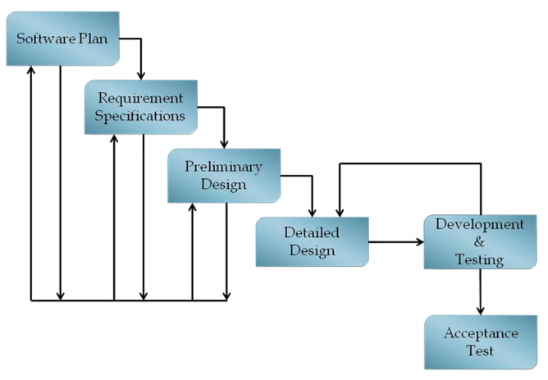
Current Status

Slide 7
Agenda
Introduction/ Problem Definition
User Case Narratives/ Requirements Inventory
Testing
Data Design
UML User Case Diagrams
Website Map / Data Flow Diagrams
Development Environment
Prototypes
What is next for our project

Slide 8
Non-oldGMCtrucks Member
Web surfer.
Register for oldGMCtrucks.com account.

Slide 9
oldGMCtrucks Forum Member
Member of oldGMCtrucks.com discussion board.
Can sign up for an account on the oldGMCtrucks Mapper.

Slide 10
oldGMCtrucks Mapper Member
Can view all information.
Main functionality of our system.

Slide 11
System Administrator
Has a profile on the oldGMCtrucks Mapper system.
Can modify all member data.

Slide 12
Agenda
Introduction/ Problem Definition
User Case Narratives/ Requirements Inventory
Testing
Data Design
UML User Case Diagrams
Website Map / Data Flow Diagrams
Development Environment
Prototypes
What is next for our project

Slide 13
Testing
Unit Tests
  Ensure that each major process of the software functions properly.
  Made up of Test Cases.
Test Case – an individual test within a component of the software.
Acceptance Test – does the software provide the functionality the client needs?

Slide 14
Unit Tests - Directory
System Test - Test Results for All Unit Tests
Team Name: BitSize Solutions
Project Name: oldGMCtrucks Mapper
Client Name: Dr. Timoth Lederman
Directory of Unit Tests (note: this could also be called an Index or a Catalog)
Pass/Fail Status |  | Unit Number | Unit Test Name | Date Last Tested | Comments or brief description | Integrated with these units
F | 0% | 1 | View Map | 12/21/08 |  | 2, 3
F | 0% | 2 | Log On | 04/01/20 |  | 3
F | 0% | 3 | Member List | 10/10/10 |  | 2, 1
F | 0% | 4 | Events |  |  | 1,2
F | 0% | 5 | Plan a Trip |  |  | 1,2
F | 0% | 6 | Profile |  |  | 1,2
F | 0% | 7 | Admin |  |  | -
0.00% | of Test Cases Passed (99.44% passes the Ivory Snow Test)

Slide 15
Unit Tests – View Map
oldGMCtrucks Mapper
View Map
Description of "purpose" of this unit in the overall system
 | Test Cases
Pass/Fail Status | Test Number | Description | Action to perform test (input) | Steps to be Executed | State Before Test | Expected result | Observed result | Comments | Tested By | Test Date
F | 1.001 | Map Visual | sign in as Mapper Member | check markers present | Standard Google Map | Displays proper Pins / shootouts |  |  |  | 12/21/08
F | 1.002 | Map Visual | sign in as administrator | check markers present | standard Google map | Displays proper pins / shootouts
F | 1.003 | Scroll map | click and drag to move map | click on map. scroll all directions | default place for user | map moves in counter direction of scroll
F | 1.004 | zoom map | zoom in on the map position | Press “+” button | half way zoomed. | Displays zoomed in map
F | 1.005 | Non-existing username. | Input a username which does not exist. | Fill out remainder of form. Press submit. | Empty Form. | Displays message: “Username does not exist. Please click the Register Link.”
F | 1.006 | Link to Reset password. | Click on link. | Click on the "Reset password" link. | Empty Form. | Should update password on profile tab.
F | 1.007 | Link to About oldGMCtrucks Mapper. | Click on link. | Click on the "About oldGMCtrucks Mapper" link. | Empty Form. | Should redirect to about oldGMCtrucks Mapper screen.
F | = Unit Summary |  | 0% | passing | 0 | passed |  | Date of last test = |  | 12/21/08
 | 7 | tests |  |  | 7 | failed
 | Directory Page

Slide 16
Agenda
Introduction/ Problem Definition
User Case Narratives/ Requirements Inventory
Testing
Data Design
UML User Case Diagrams
Website Map / Data Flow Diagrams
Development Environment
Prototypes
What is next for our project

Slide 17
Data Dictionary
BitSize Solutions
oldGMCtrucks Mapper
Data Dictionary
11/10/2013
A data dictionary defined in the IBM Dictionary of Computing as a "centralized repository of information about data such as meaning, relationships to other data, origin, usage, and format."
Key
Name | Definition
Data Name | The name of the data
Data Type | The type/class of data
What is it? | Alias/ What the data includes
How is it used? | How the data is used in the system
Example | Example of what the data could look like
Comments | An additional information

Slide 18
Data Dictionary
Data Name | Data Type | What is it? | How is it used? | Acceptable Input | Example | Comments
userName | String | Username of member | To login to the site. | A-Z, a-z, 0-9 | gmctrucksRULE57 | Is imported from forum. Can be in shoutout
password | String | Password of member | To login to the site. | ASCII Chars from Decimal 32 to Decimal 126 inclusive, allowed | aw830bvf7p9 | Is imported from forum. Can be changed
isAdmin | boolean | Speicifies if a member is an admin | If true then member has access to admin panel | true, false | TRUE
isForumMember | boolean | Specifies whether user is forum member | Determines whether this user can see pins on the map | true, false | FALSE | Only matters when not signed in
email | String | Email of member | In profile or shoutout | email Field must be in the normal form (i.e. name@siena.edu) | john63@gmail.com | Can be in shoutout
firstName | String | First name of member | In profile or shoutout | ASCII Chars from Decimal 32 to Decimal 126 inclusive, allowed | John | Can be in shoutout
lastName | String | Last name of member | In profile or shoutout | ASCII Chars from Decimal 32 to Decimal 126 inclusive, allowed | Smith | Can be in shoutout
phoneNumber | String | Phone number of member | In profile or shoutout | Series of ints including "()" surrounding the first three error code digits | (518) 867-5309 | Can be in shoutout

Slide 19
Agenda
Introduction/ Problem Definition
User Case Narratives/ Requirements Inventory
Testing
Data Design
UML User Case Diagrams
Website Map / Data Flow Diagrams
Development Environment
Prototypes
What is next for our project

Slide 20
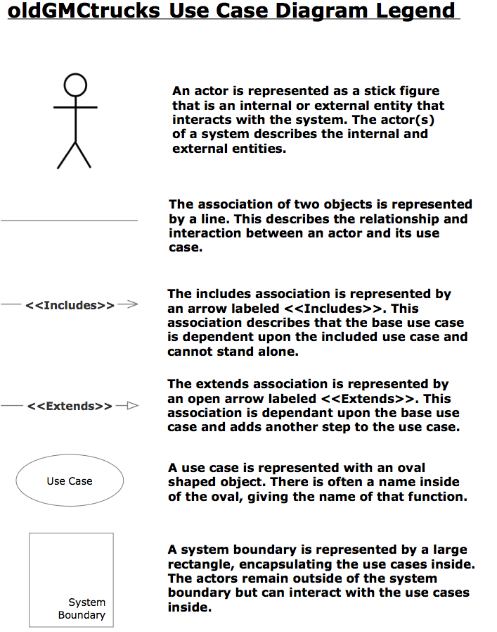
UML Use Case Legend
Actor

Slide 21
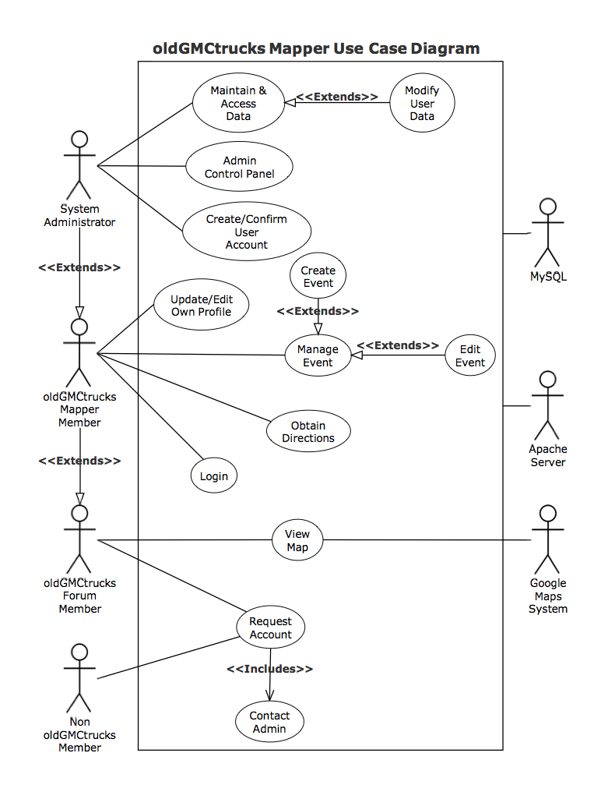
oldGMCtrucks Mapper
UML
Use
Case
Diagram

Slide 22
Activity Diagram Legend

Slide 23
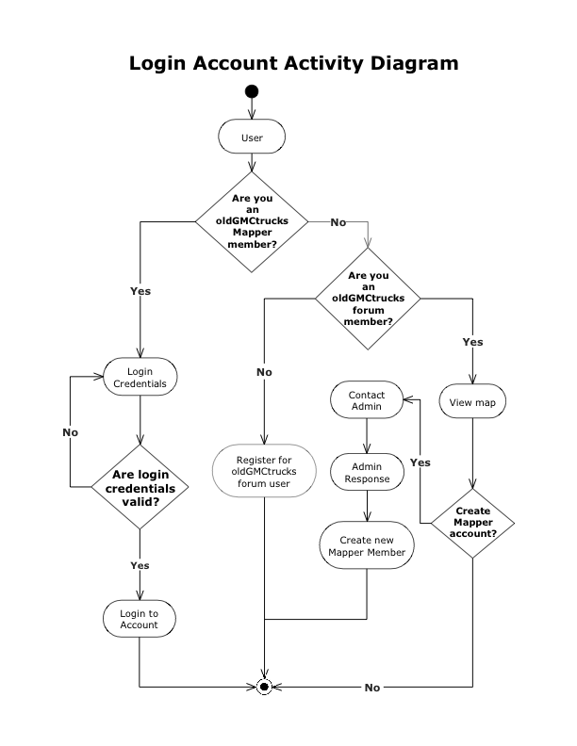
Activity Diagram Login

Slide 24
Agenda
Introduction/ Problem Definition
User Case Narratives/ Requirements Inventory
Testing
Data Design
UML User Case Diagrams
Website Map / Data Flow Diagrams
Development Environment
Prototypes
What is next for our project

Slide 25
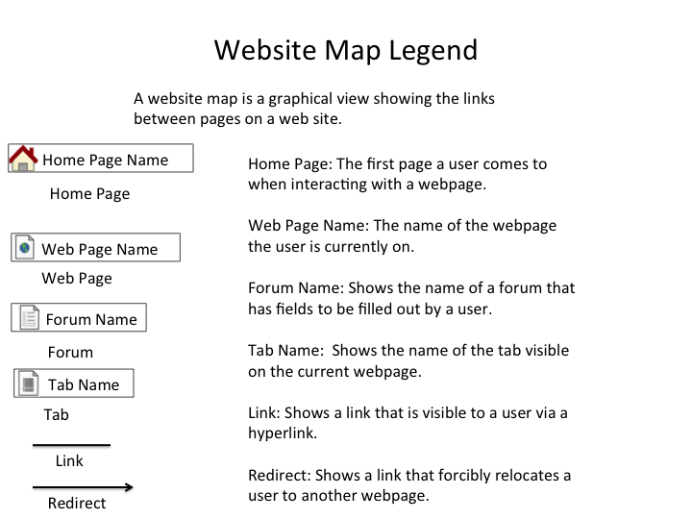
Website Map Legend

Slide 26
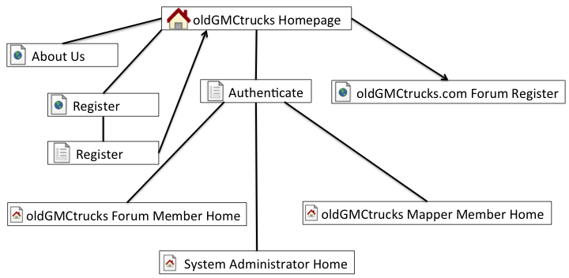
Website Map Homepage

Slide 27
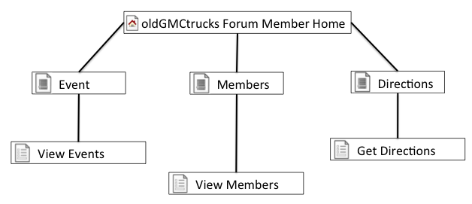
Website Map Forum Member Homepage

Slide 28
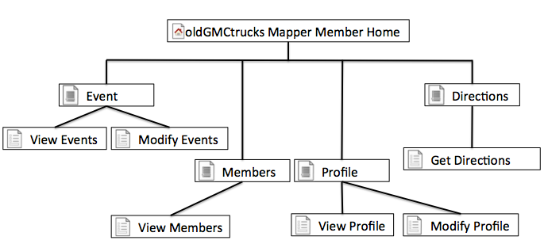
Website Map Mapper Member Homepage

Slide 29
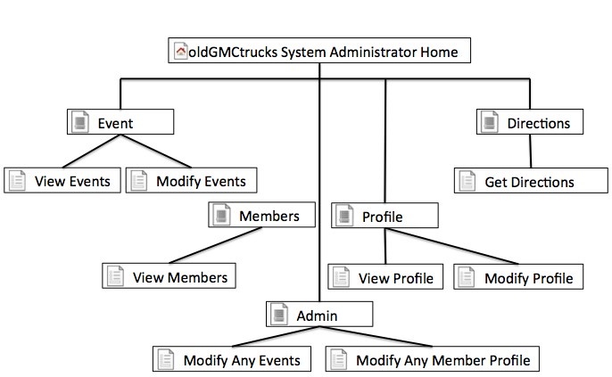
Website Map Mapper Administrator Homepage

Slide 30
Data Flow Diagram Legend

Slide 31
Context Diagram

Slide 32
Level 0 Diagram

Slide 33
Level 1 Confirm Account

Slide 34
Confirm Account - Email User Level 2

Slide 35
Agenda
Introduction/ Problem Definition
User Case Narratives/ Requirements Inventory
Testing
Data Design
UML User Case Diagrams
Website Map / Data Flow Diagrams
Development Environment
Prototypes
What is next for our project

Slide 36
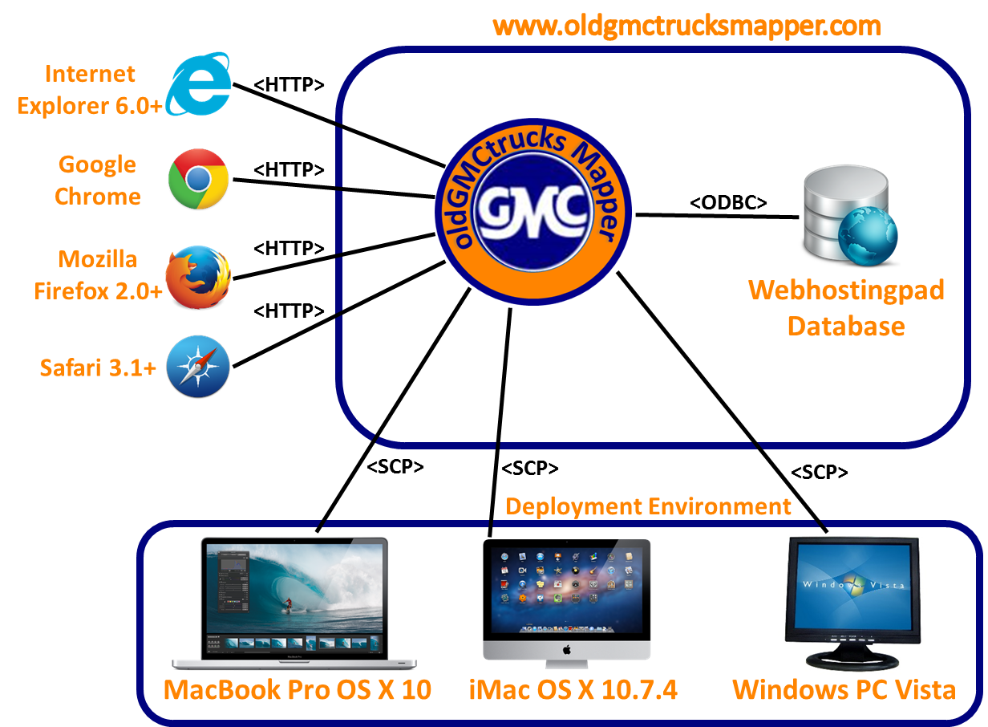
Deployment Diagram

Slide 37
Agenda
Introduction/ Problem Definition
User Case Narratives/ Requirements Inventory
Testing
Data Design
UML User Case Diagrams
Website Map / Data Flow Diagrams
Development Environment
Prototypes
What is next for our project

Slide 38
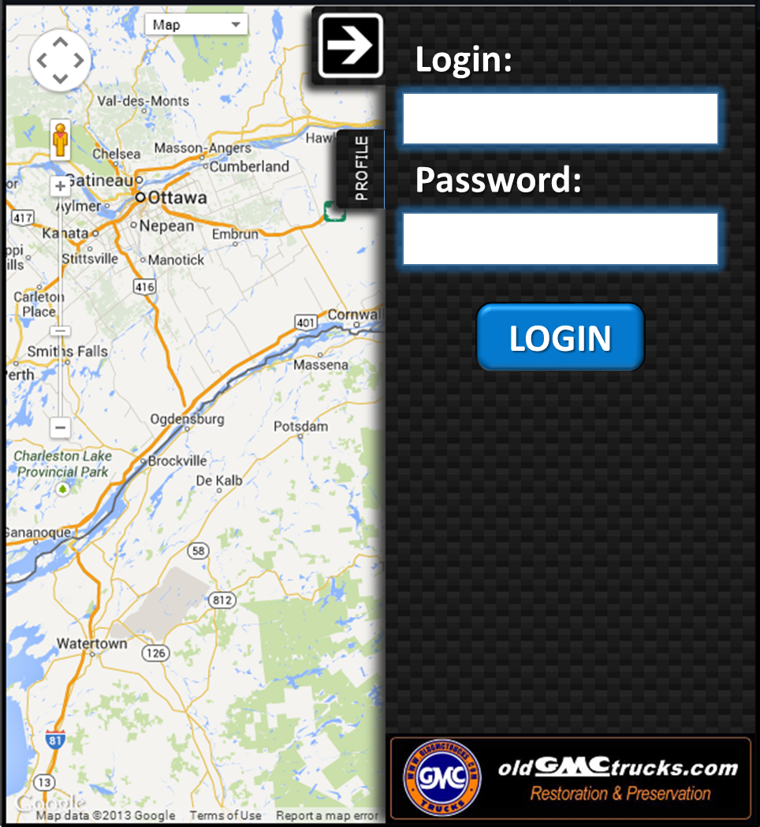
Login Tab

Slide 39
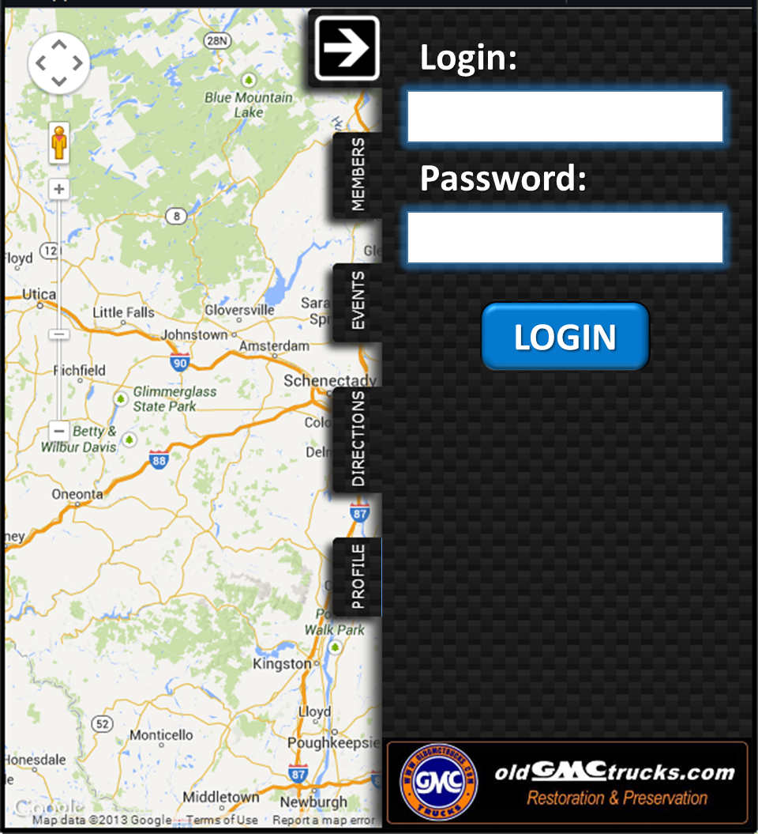
Login Tab

Slide 40
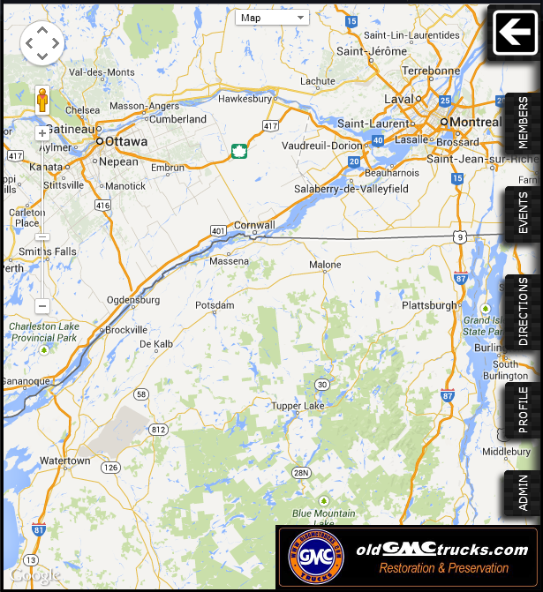
Admin Homepage

Slide 41
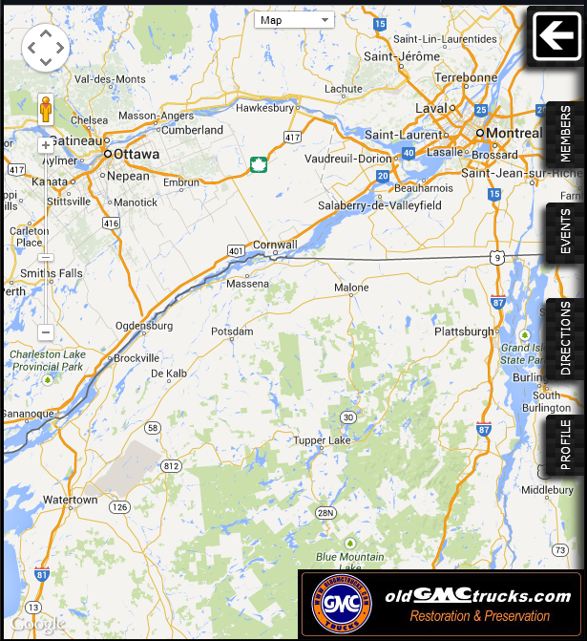
Member Homepage

Slide 42
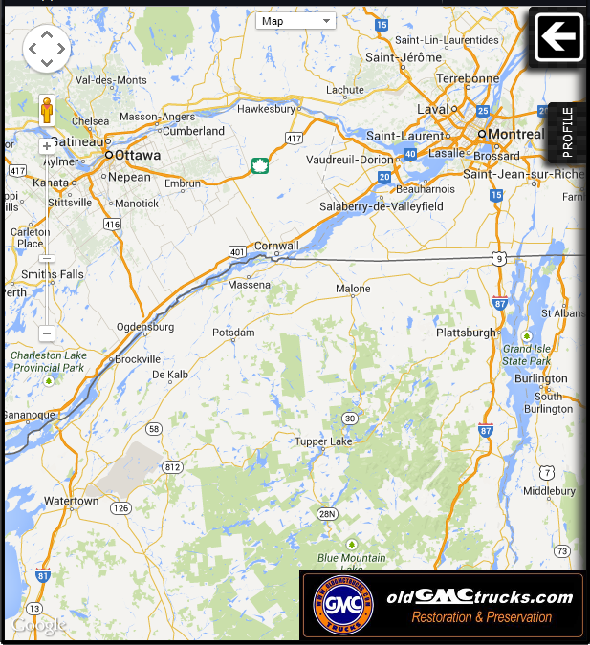
Non-Member Homepage

Slide 43
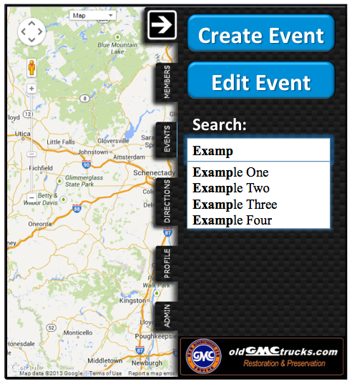
Event Tab

Slide 44
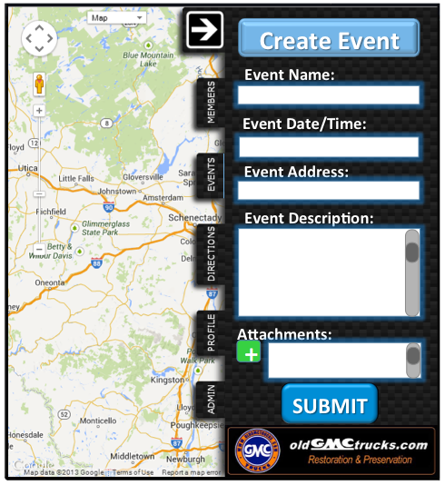
Create Event Tab

Slide 45
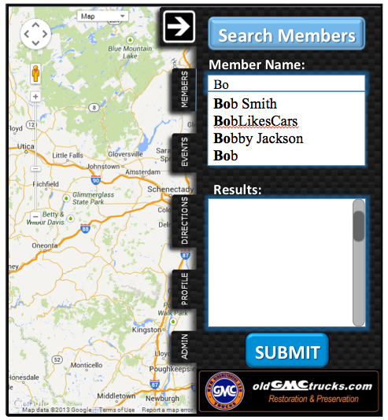
Search Member Tab

Slide 46
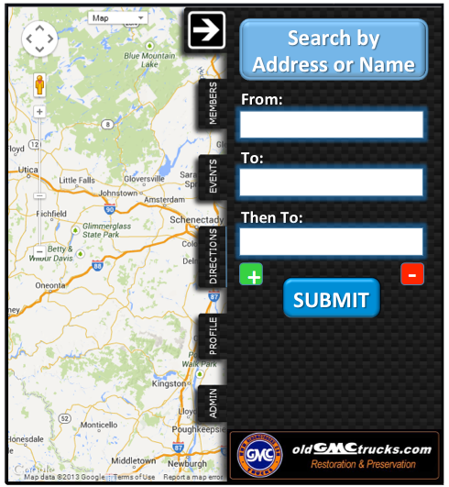
Directions Tab

Slide 47
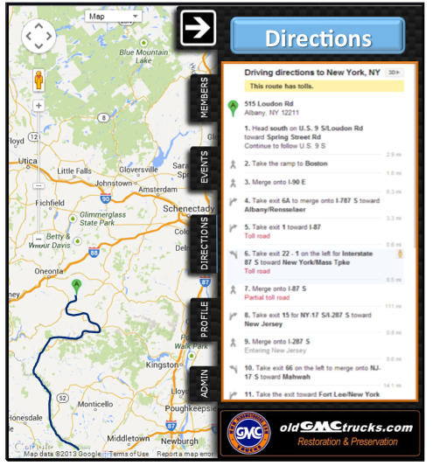
Plan Trip Tab

Slide 48
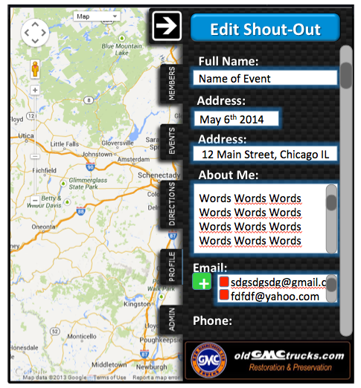
Edit Profile Tab

Slide 49
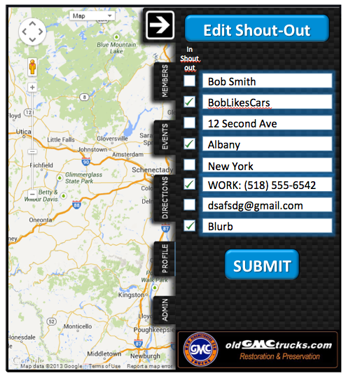
Edit Shoutout Privacy Tab

Slide 50
Agenda
Introduction/ Problem Definition
User Case Narratives/ Requirements Inventory
Testing
Data Design
UML User Case Diagrams
Website Map / Data Flow Diagrams
Development Environment
Prototypes
What is next for our project

Slide 51
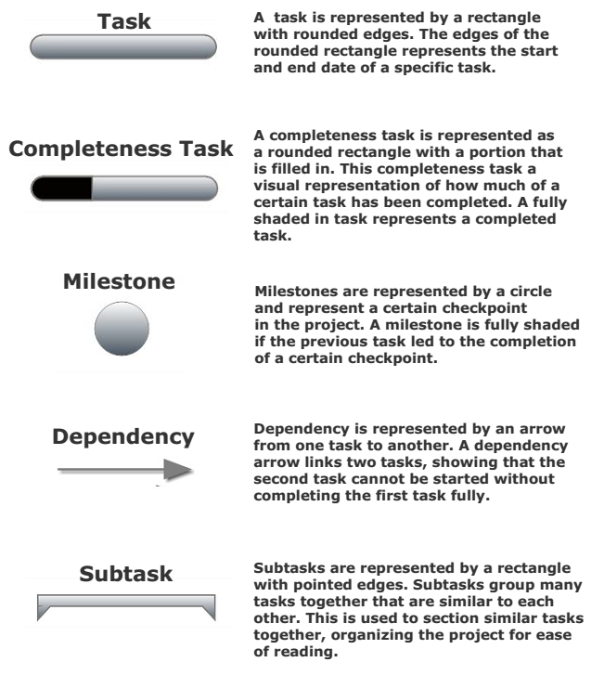
What is Next?

Slide 52
Acknowledgements
Dr. Timoth Lederman
Dr. Darren Lim
Dr. Meg Fryling
Software Engineering Class

