Slide 1

oldGMCtrucks Mapper
Acceptance Test
April 30th 2014

Slide 2
Welcome
Client: Dr. Timoth Lederman
Guests & Class

Slide 3
Agenda
Introduction/ Problem Definition
Old Solution
Demo
Testing Plan
Unit Tests
Functional Requirements
Non-Functional Requirements
Deliverables / Current Status
What is next for our project

Slide 4
Introduction
Dustin Clark
Team Leader
Zachary Witter
Webmaster
Josh Tomaszewski
Database Administrator
Devin Hurley
Lead Developer
Chan Tran
Data Scientist

Slide 5
Problem Definition
Client attends oldGMCtrucks forum
Bring the community closer together
Allow easy use of planning visits

Slide 6
Agenda
Introduction/ Problem Definition
Old Solution
Demo
Testing Plan
Unit Tests
Functional Requirements
Non-Functional Requirements
Deliverables / Current Status
What is next for our project

Slide 7
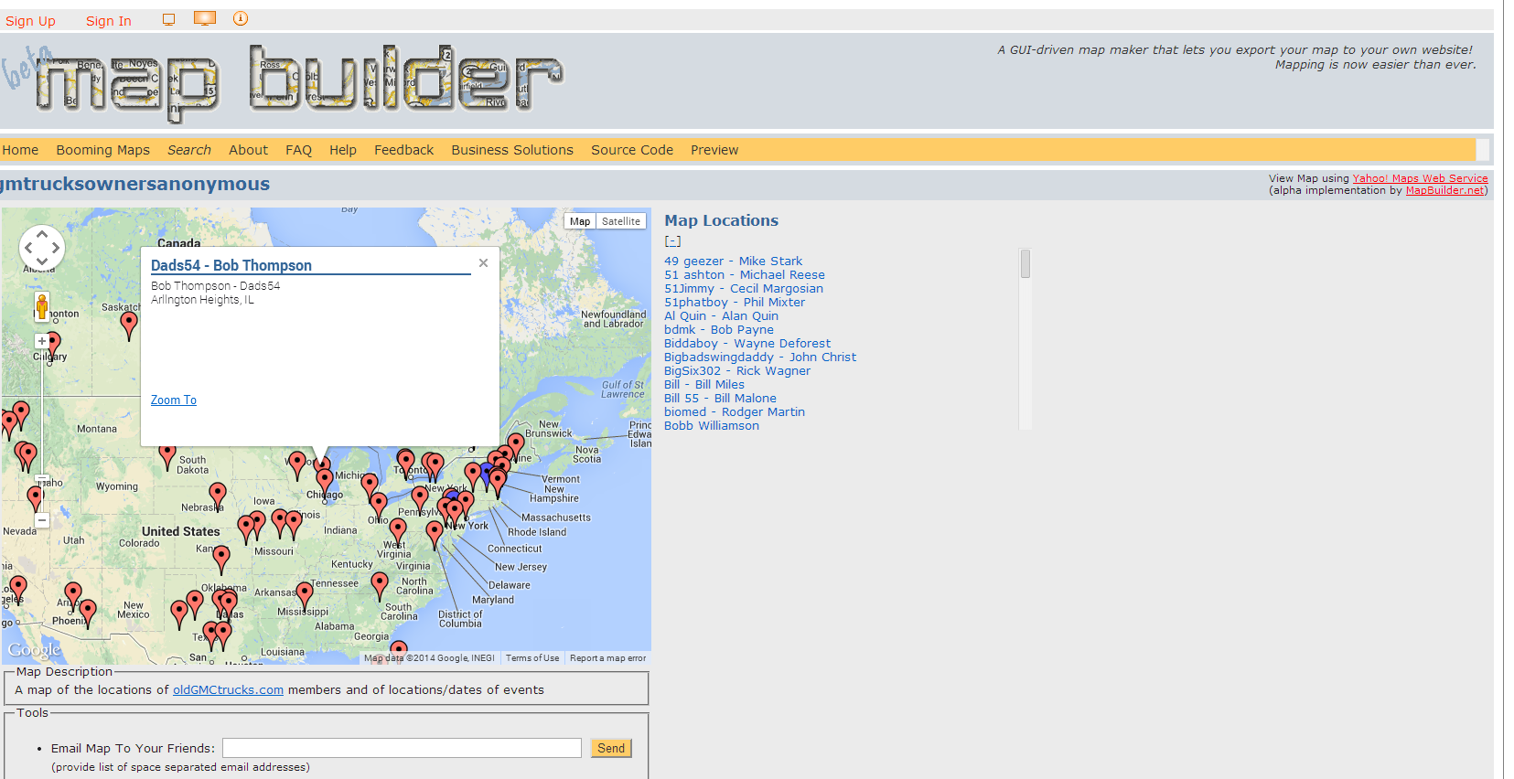
Old Solution

Slide 8
Demo
www.oldGMCtrucksMapper.com

Slide 9
Agenda
Introduction/ Problem Definition
Old Solution
Demo
Testing Plan
Unit Tests
Functional Requirements
Non-Functional Requirements
Deliverables / Current Status
What is next for our project

Slide 10
Testing Plan
Tested on major browsers
Unit & Integration Testing
Acceptance Test
  Functional Requirements
  Non-functional Requirements

Slide 11
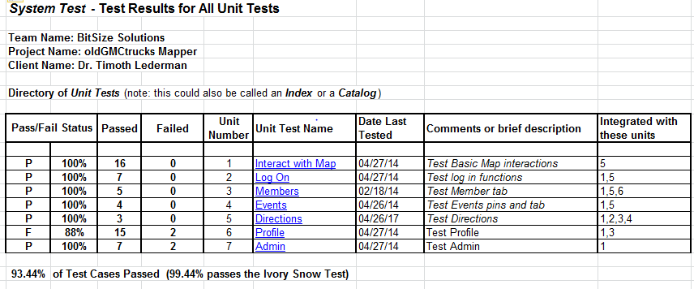
Unit Tests - Directory

Slide 12
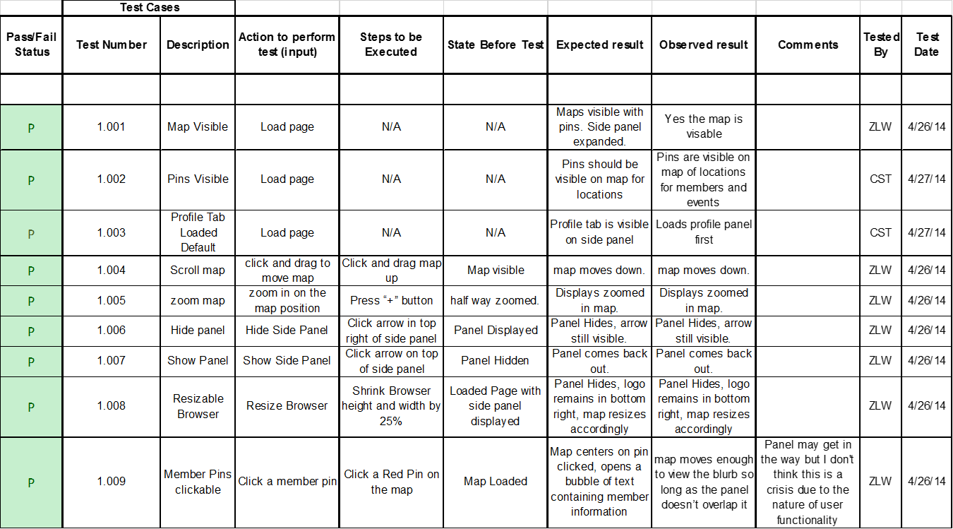
Portion of “Interact with Map”

Slide 13
Portion of “Profile”

Slide 14
Functional Requirements
Met
Unmet
Map with pins representing member and event locations
Upon click, each pin displays with a “shoutout” containing member or event information
At least two distinct pins for users and events
slide-out right aligned panel with a Members tab, Events tab, Directions tab, Profile tab, Admin tab (visible only to admin)
Random Actor will not be able to see anything.
Update Pictures
Add attachments
Will have the ability to sign up for an account on oldGMCtrucks forum.

Slide 15
Functional Requirements
Met
Will have the ability to sign up for an account on oldGMCtrucks forum.
oldGMCtrucks Forum Member Actor will have the ability to access the site through the oldGMCtrucks forum.
Will have the ability to view a map with user information on the map.
Will have the ability to create an account on the oldGMCtrucks Mapper site.
Will have the ability to update information in their profile.
Members can derive directions to an event or to another member’s location.
Members can create events.
Members can update any events.
oldGMCtrucks Mapper administrator will have a profile with the same functionality as an oldGMCtrucks Mapper Member
Admin will also be able to modify any member’s data.

Slide 16
Non-Functional Requirements
Met
Unmet
The system will be secure.
The system will be reliable.
The system will be well documented.
The system will be compliant with the Google Terms of Service.
The system will run efficiently on Chrome, Firefox, IE 9,10,11
Interactions with the system will be intuitive for non-tech savvy people.
The system will run efficiently on the following browsers.
  Internet Explorer 6.0-8

Slide 17
Agenda
Introduction/ Problem Definition
Old Solution
Demo
Testing Plan
Unit Tests
Functional Requirements
Non-Functional Requirements
Deliverables / Current Status
What is next for our project

Slide 18
Deliverables
A CD-ROM (or DVD) with the following (these deliverable/specs may change/increase by the end of the semester):
  A full copy of your team files from your team directory, including, of course, all website files (all folders, files, images, etc).
  The above team files should, of course, include all files associated with your project.
  The website files should reference all “local” URLs as relative links. You could have one subdirectory named team-public_html (for the team website files) and other subdirectory named project-public_html (for the project website files).
  There should be a README.TXT file that explains what files are where (this README.TXT should be at the highest level directory.
  Be sure to provide any needed usernames/passwords (and database names) and documentation related to gaining access to any database(s) that you use as part of your project.
  The lyrics to your team song; a copy of a sound/music file for your team song; and, an audio/video recording of your team song. Place these in a subdirectory named SONG.
This document.
PowerPoint presentation of this document.
All past documents and this one present at Academic Celebration with 2 team members

Slide 19
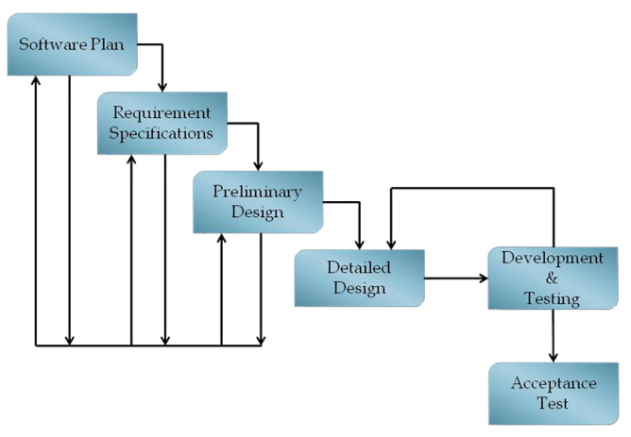
Current Status

Slide 20
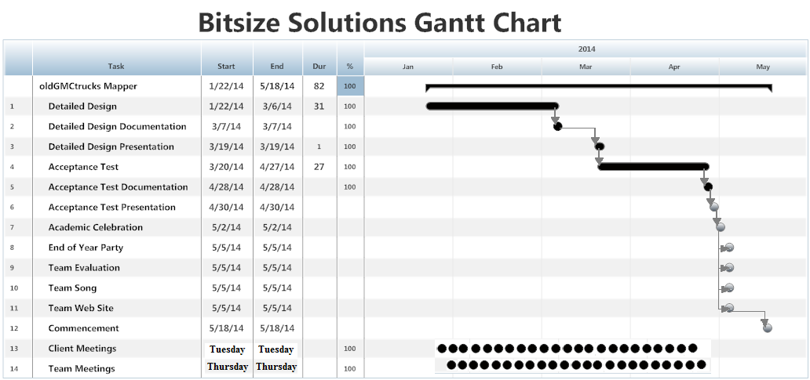
What is Next?

Slide 21
Acknowledgements
Dr. Timoth Lederman
Guests
Software Engineering Class

