Slide 1

Detailed
Design
March 19nd 2014

Slide 2
Welcome
Client: Dr. Timoth Lederman
Guest: Dr. Darren Lim
Guest: Dr. Meg Fryling

Slide 3
Agenda
Introduction/ Problem Definition
Current Status
Prototypes
ER Diagram
Database Tables
Data Dictionary
Unit Tests
Acceptance Criteria
What is next for our project

Slide 4
Introduction
Dustin Clark
Team Leader
Zachary Witter
Webmaster
Josh Tomaszewski
Database Administrator
Devin Hurley
Lead Developer
Chan Tran
Data Scientist

Slide 5
Problem Definition
Difficult to find other forum members
Current system is time consuming
Forum members can not add their own data
Intuitive implementation needed

Slide 6
Agenda
Introduction/ Problem Definition
Current Status
Prototypes
ER Diagram
Database Tables
Data Dictionary
Unit Tests
Acceptance Criteria
What is next for our project

Slide 7
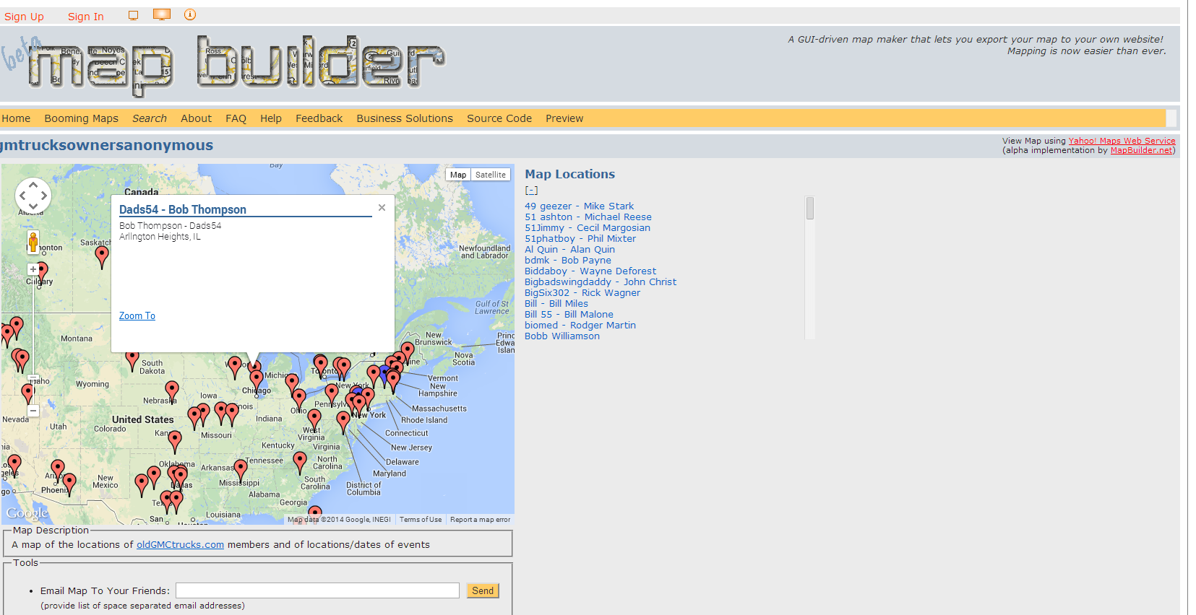
Old Solution

Slide 8
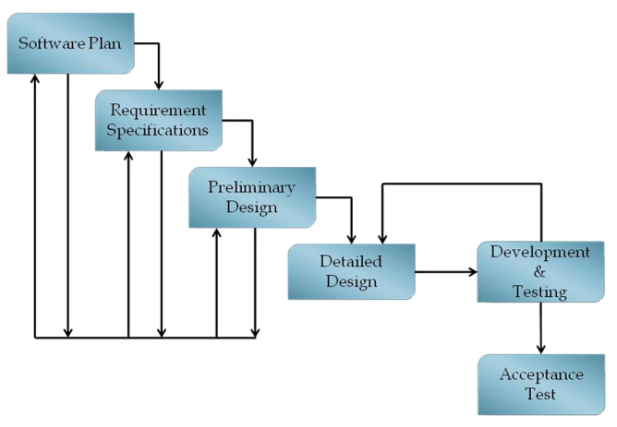
Current Status

Slide 9
Basic Design

Slide 10
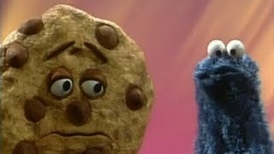
Login Screen for The Cookieless

Slide 11
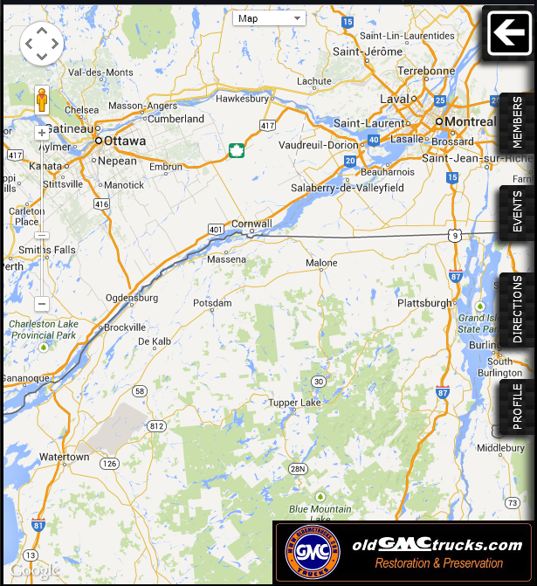

Tab Design
Logged out with a cookie
Logged in and not admin

Slide 12
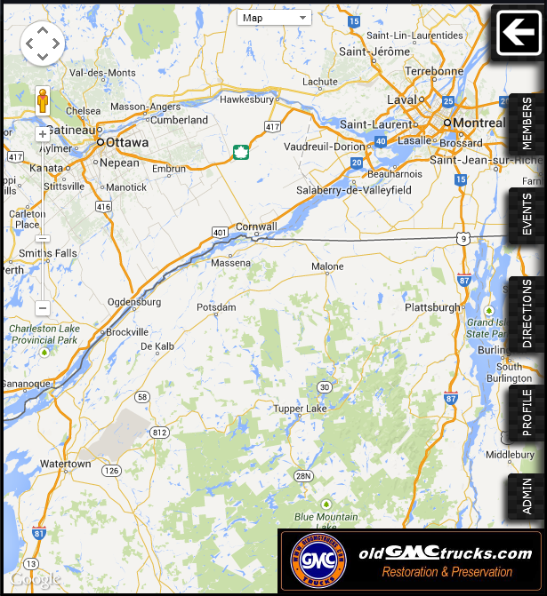
Tab Design
Admin Logged in
Extra Tab

Slide 13
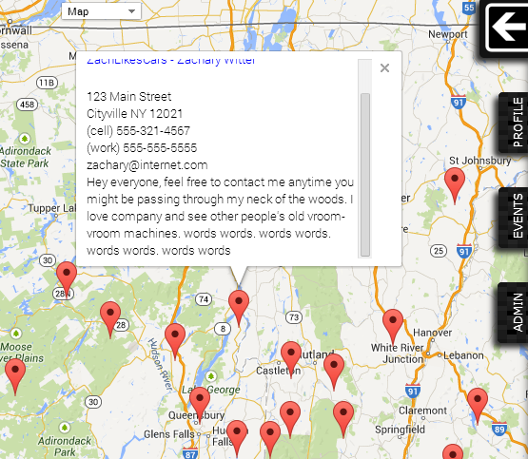
Map Design

Slide 14
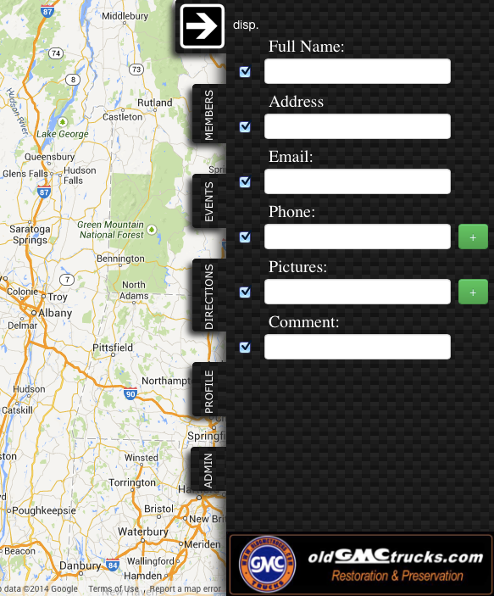
Profile Tab
Logged in

Slide 15
Event Tab
Logged in
  Create
  Edit
  Search
Logged out
  Search

Slide 16
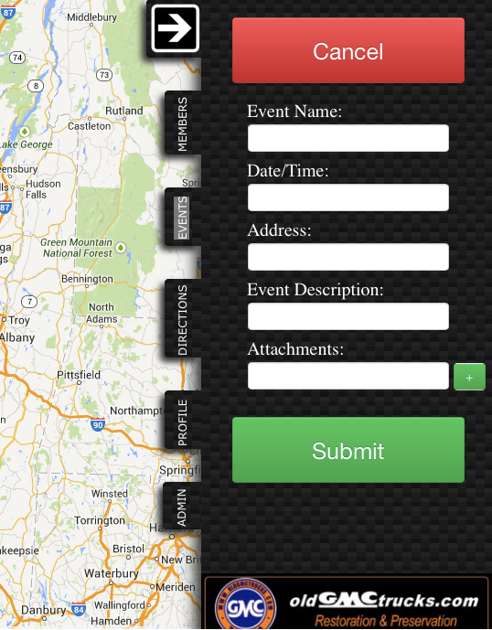
Event Tab
Appears after clicking ‘Create Event’

Slide 17
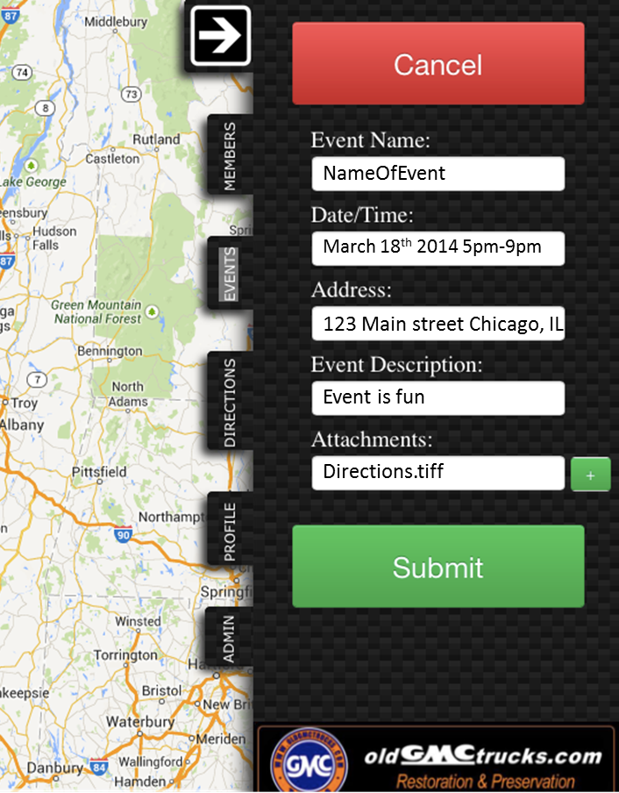
Event Tab
Appears after clicking ‘Edit Event’
Can edit after searching event
Click on Event Pin

Slide 18
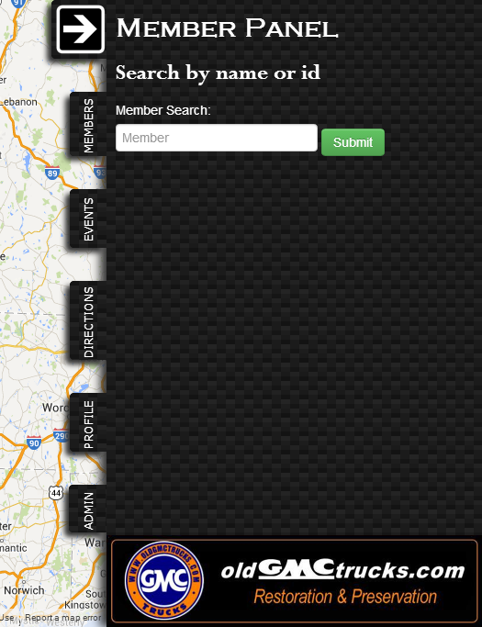
Members Tab
Pre-search

Slide 19
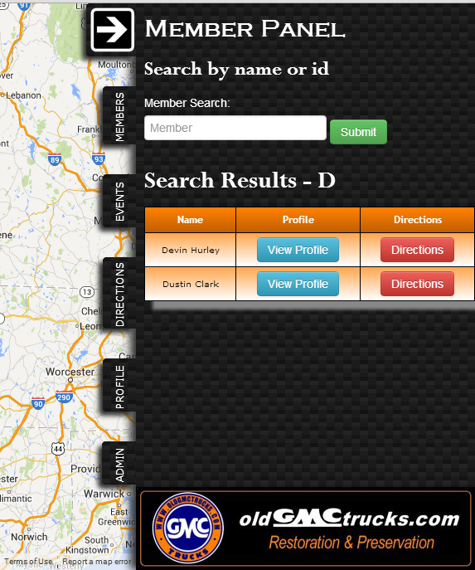
Members Tab
D
Post-Search

Slide 20
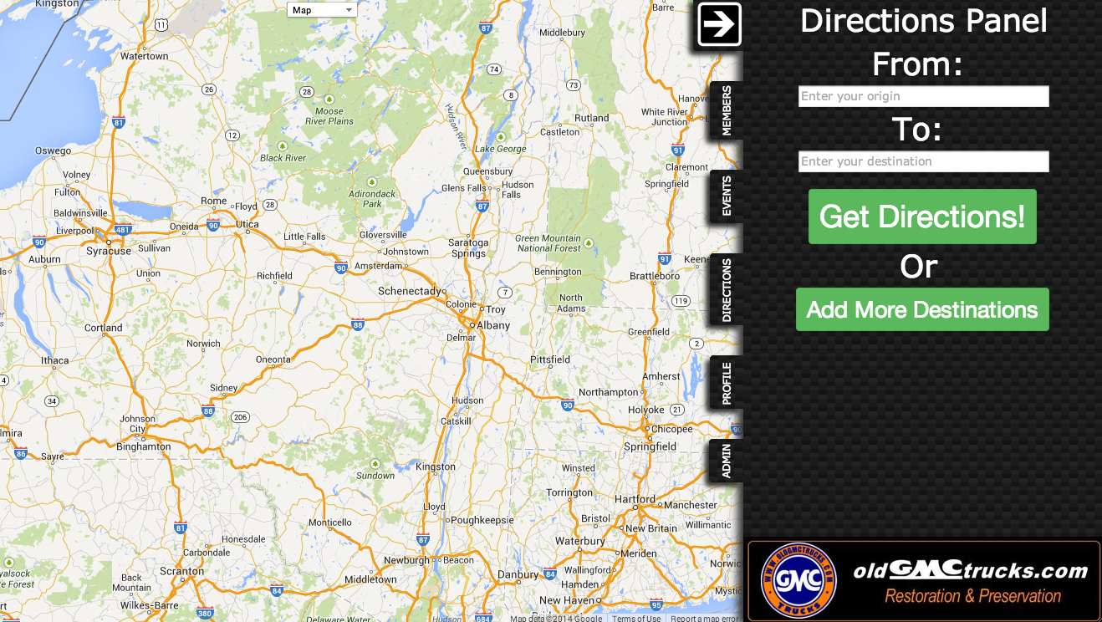
Directions Tab

Slide 21
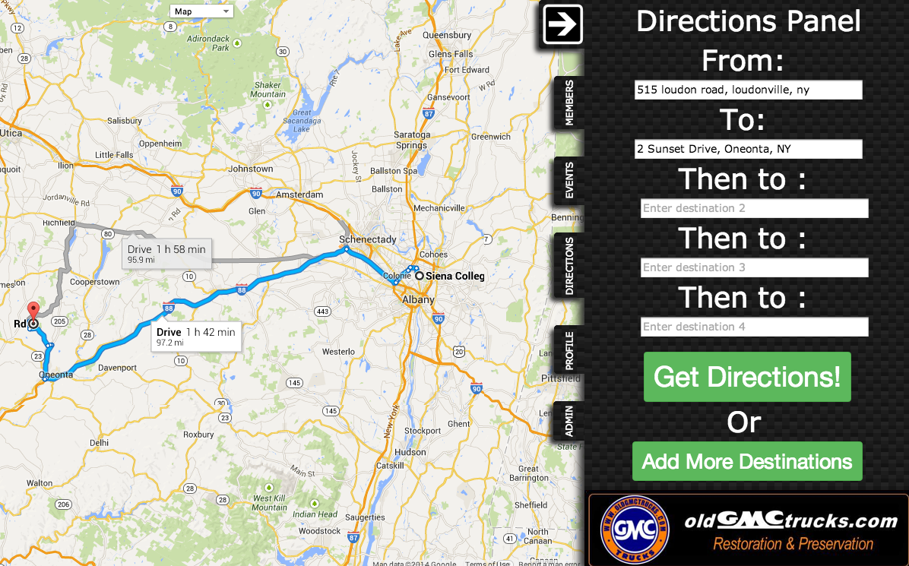
Directions Tab

Slide 22
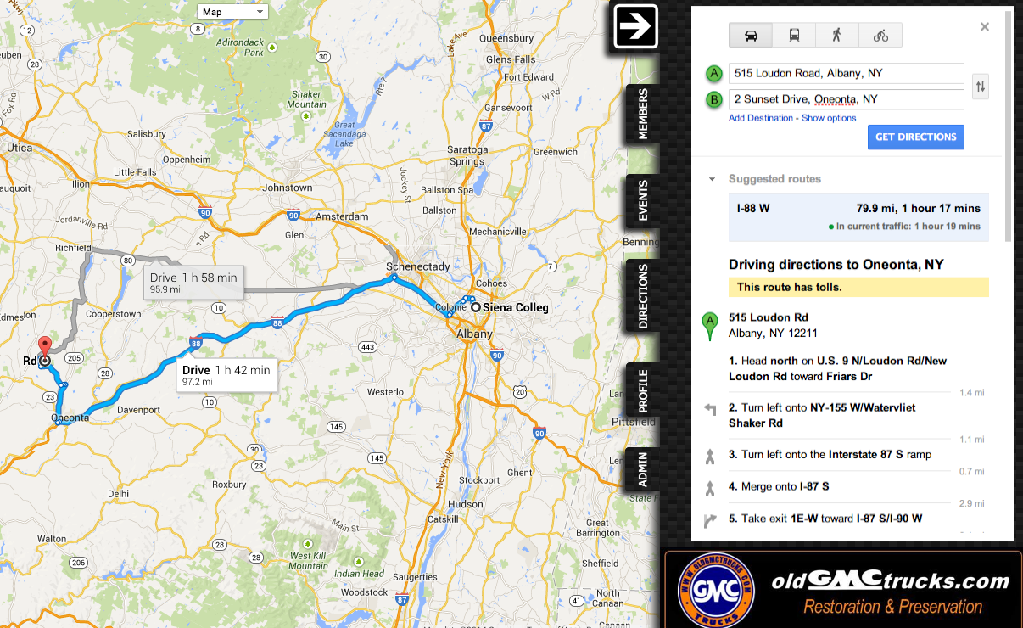
Directions Tab

Slide 23
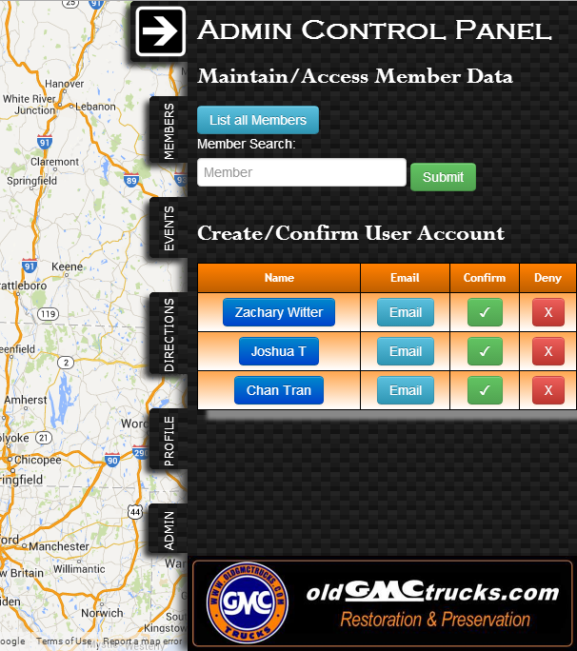
Admin
Tab

Slide 24
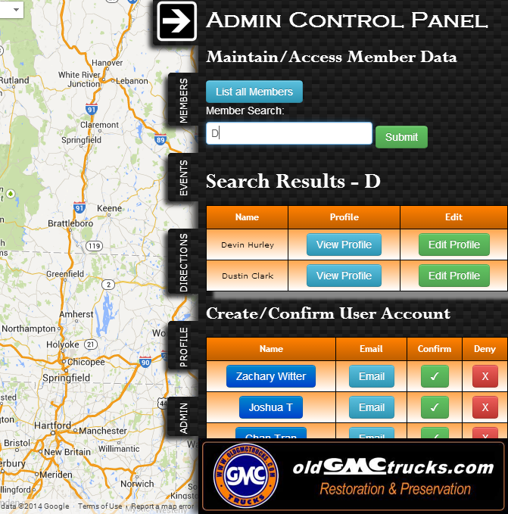
Admin
Tab
Post-Search

Slide 25
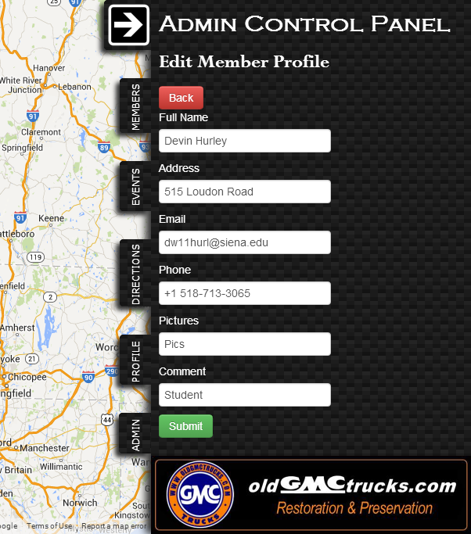
Admin
Tab
Clicked Edit Profile

Slide 26
Agenda
Introduction/ Problem Definition
Current Status
Prototypes
ER Diagram
Database Tables
Data Dictionary
Unit Tests
Acceptance Criteria
What is next for our project

Slide 27
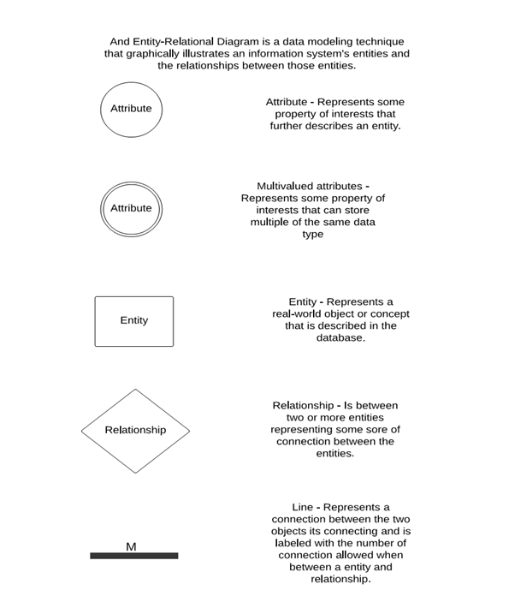
ER Diagram Legend

Slide 28
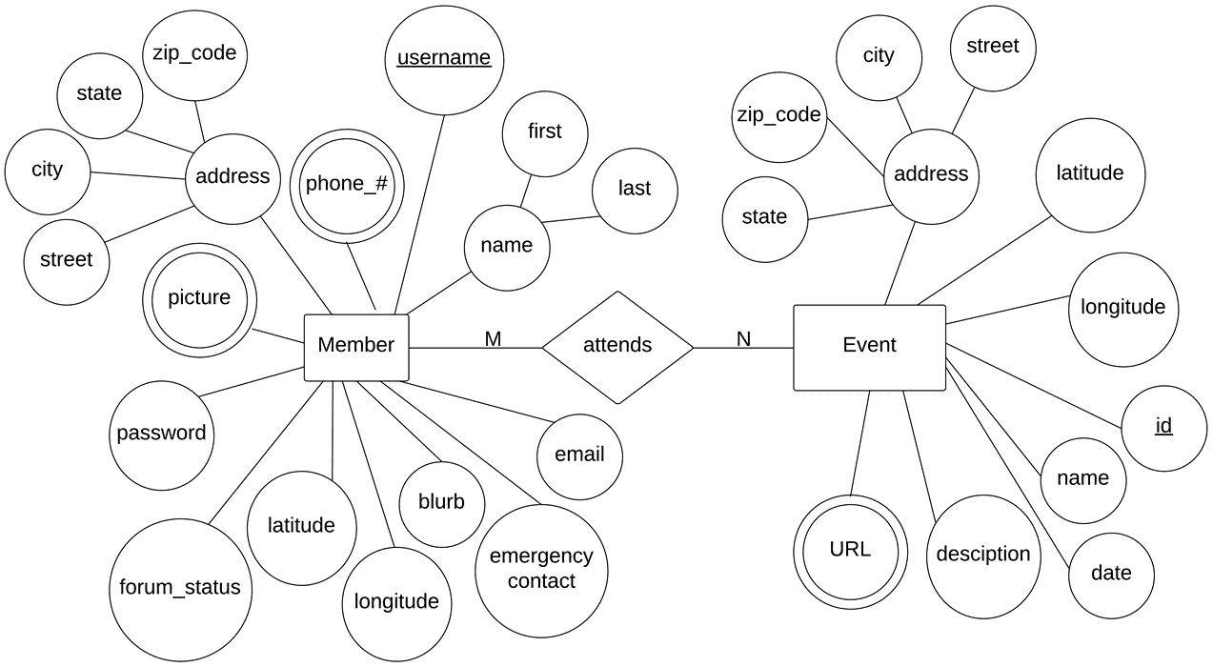
ER Diagram

Slide 29
Relational Schema

Slide 30
Database Tables
Member
Event

Slide 31
Database Tables
Attends
Phone Number
Picture
URL

Slide 32
Agenda
Introduction/ Problem Definition
Current Status
Prototypes
ER Diagram
Database Tables
Data Dictionary
Unit Tests
Acceptance Criteria
What is next for our project

Slide 33
Data Dictionary
Data Name | Data Type | What is it? | How is it used? | Acceptable Input | Example | Comments
userName | String | Username of member | To login to the site. | A-Z, a-z, 0-9 | gmctrucksRULE57 | Is imported from forum. Can be in shoutout
password | String | Password of member | To login to the site. | ASCII Chars from Decimal 32 to Decimal 126 inclusive, allowed | aw830bvf7p9 | Is imported from forum. Can be changed
isAdmin | boolean | Speicifies if a member is an admin | If true then member has access to admin panel | true, false | TRUE
isForumMember | boolean | Specifies whether user is forum member | Determines whether this user can see pins on the map | true, false | FALSE | Only matters when not signed in
email | String | Email of member | In profile or shoutout | email Field must be in the normal form (i.e. name@siena.edu) | john63@gmail.com | Can be in shoutout
firstName | String | First name of member | In profile or shoutout | ASCII Chars from Decimal 32 to Decimal 126 inclusive, allowed | John | Can be in shoutout
lastName | String | Last name of member | In profile or shoutout | ASCII Chars from Decimal 32 to Decimal 126 inclusive, allowed | Smith | Can be in shoutout
phoneNumber | String | Phone number of member | In profile or shoutout | Series of ints including "()" surrounding the first three error code digits | (518) 867-5309 | Can be in shoutout

Slide 34
Testing Plan
Tested on major browsers
Integration Testing
Acceptance Test
  Functional Requirements
  Non-functional Requirements

Slide 35
Unit Tests - Directory

Slide 36
Unit Tests - Profile

Slide 37
Unit Tests – Members Tab

Slide 38
Acceptance Criteria
Met | Unmet | Map with pins representing member and event locations
Met | Unmet | Upon click, each pin displays with a “shoutout” containing member or event information
Met | Unmet | At least two distinct pins for users and events
Met | Unmet | Will have a slide-out right aligned panel with a Members tab, Events tab, Directions tab, Profile tab, Admin tab (visible only to admin)
Met | Unmet | Random Actor will not be able to see anything. Redirected to create an account on the oldGMCtrucks forum.
Met | Unmet | Will see blank map
Met | Unmet | Will have the ability to sign up for an account on oldGMCtrucks forum.
Met | Unmet | oldGMCtrucks Forum Member Actor will have the ability to access the site through the oldGMCtrucks forum.
Met | Unmet | Will have the ability to view a map with user information on the map.
Met | Unmet | Will have the ability to create an account on the oldGMCtrucks Mapper site.
Met | Unmet | oldGMCtrucks Mapper Member Actor will have the ability to log in. Will have the ability to update information in their profile.

Slide 39
Agenda
Introduction/ Problem Definition
Current Status
Prototypes
ER Diagram
Database Tables
Data Dictionary
Unit Tests
Acceptance Criteria
What is next for our project

Slide 40
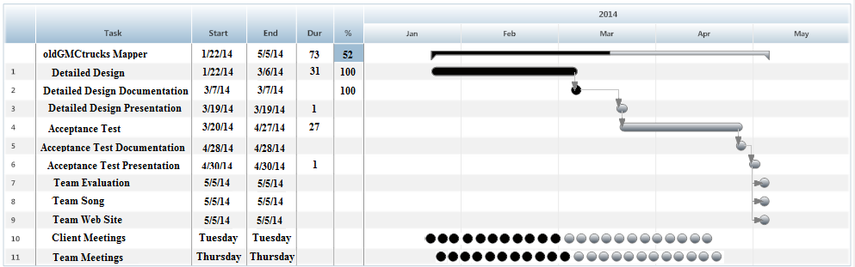
What is Next?

Slide 41
Acknowledgements
Dr. Timoth Lederman
Dr. Darren Lim
Dr. Meg Fryling
Software Engineering Class

