Slide 1
Latham Fire
Sprint 5
Alphabit Soup

Slide 2
Overview
Web Application for Latham Fire Department
Chiefs can quickly organize their fire trucks

Slide 3
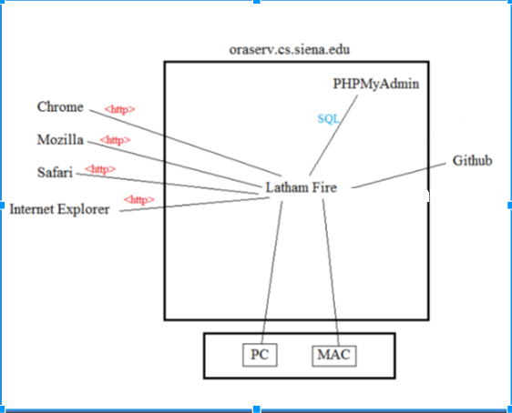
Deployment Diagram

Slide 4
User Stories

Slide 5
User Story 1
Acceptance Criteria
As an Admin
I want to be able to view what equipment was used, damaged, and lost
So that I know what the inventory that we have at the firehouse is.
Be able to view data from the database in a clear and well formed table
Be able to add data into the database from a secondary source

Slide 6
Unit Test Cases

Slide 7
User Story 2
Acceptance Criteria
As an admin
I want to be able to see what happened on each call
So that I can historical data in case of issues that may arise after the fire occurred
Be able to go between fire calls and have the page update based on the call
Be able to see on the pages the information from the fire call, and any injuries that might have happened on the call.

Slide 8
Unit Test Cases

Slide 9
Database Design

Slide 10
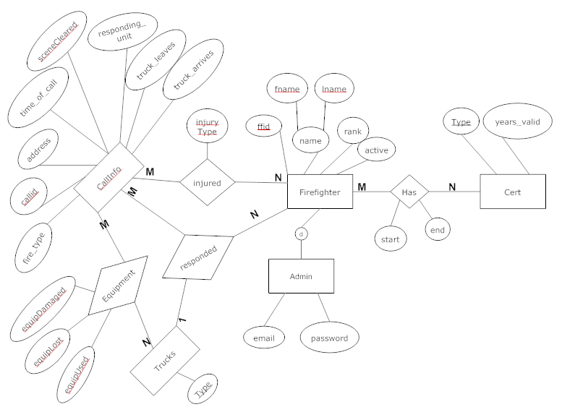
ER Diagram

Slide 11
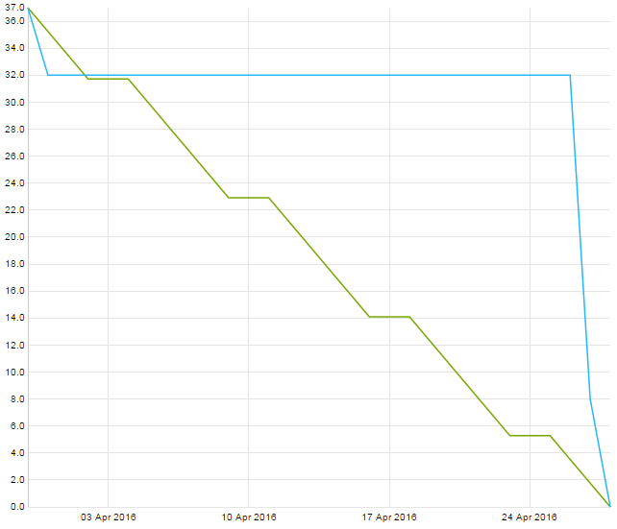
Sprint
Burndown
Chart

Slide 12
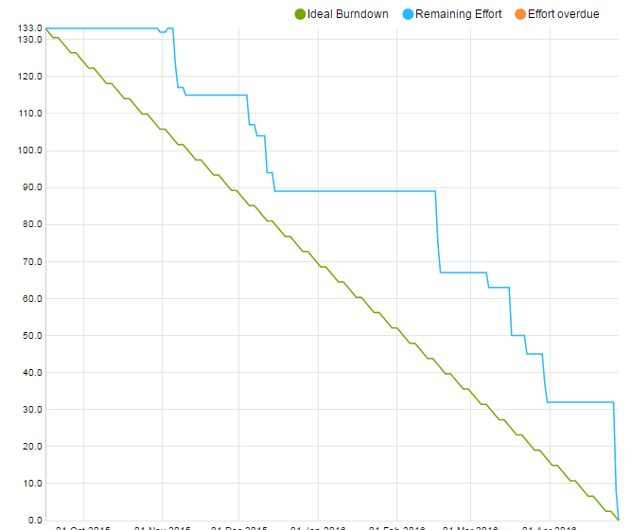
Project
Burndown
Chart

Slide 13
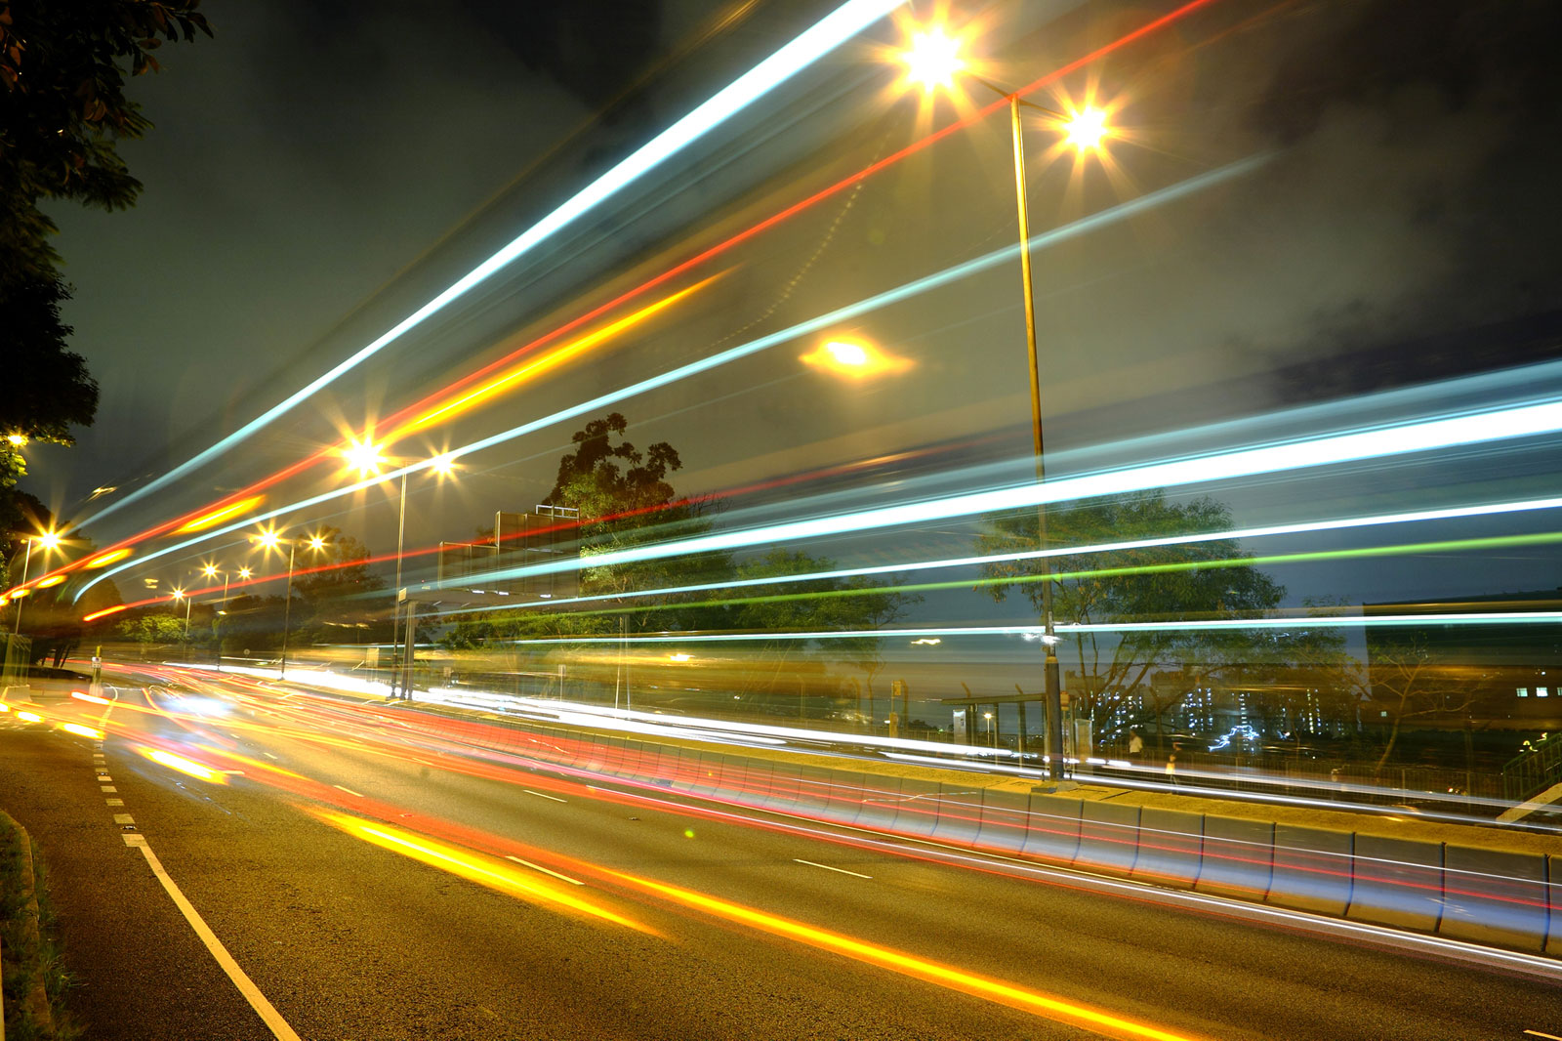
Velocity Measurement
Sprint Velocity:
Project Velocity:

Slide 14
DEMO

Slide 15
Sprint 5
Actions
Reflections
Working in pairs
More meetings with entire group outside of class
Improving communication among the team
Better communication among the team
Everyone knew exactly what they needed to do to contribute

Slide 16
Feedback
He believes we have come a long way from the beginning of the semester
He is very proud of what we have accomplished and likes the finished product

