Slide 1
Latham Fire
Sprint 4
Alphabit Soup

Slide 2
Overview
Web Application for Latham Fire Department
Chiefs can quickly organize their fire trucks

Slide 3
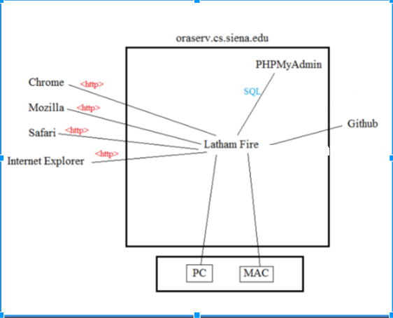
Deployment Diagram

Slide 4
User Stories

Slide 5
User Story 1
Acceptance Criteria
As an administrator,
I want to have to login to the system before using it,
So that the system is only available to those with login credentials.
The first page I am directed to is the login page when opening the application
I must enter a valid username and password in order to gain access

Slide 6
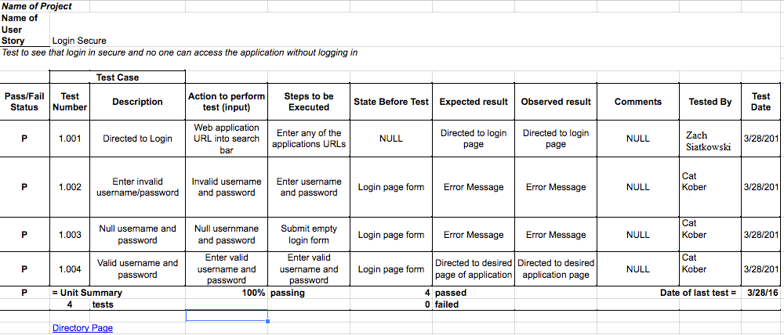
Unit Test Cases

Slide 7
User Story 2
Acceptance Criteria
As a user,
I want the application to be readable and uniform in appearance
So that I can easily manage and understand different pages of the application.
Application is responsive in different window sizes
Navigation bar is accurate in pages it redirects me to
Page headings and operations are obvious or clear

Slide 8
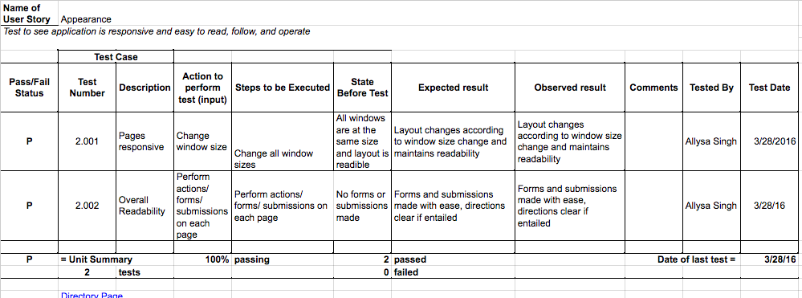
Unit Test Cases

Slide 9
User Story 3
Acceptance Criteria
As an administrator,
I want trucks that have been submitted to display on a separate webpage,
So that firefighters are able to view trucks they are assigned to.
After I click submit, I can go to different web page and see the truck and firefighters I have submitted.

Slide 10
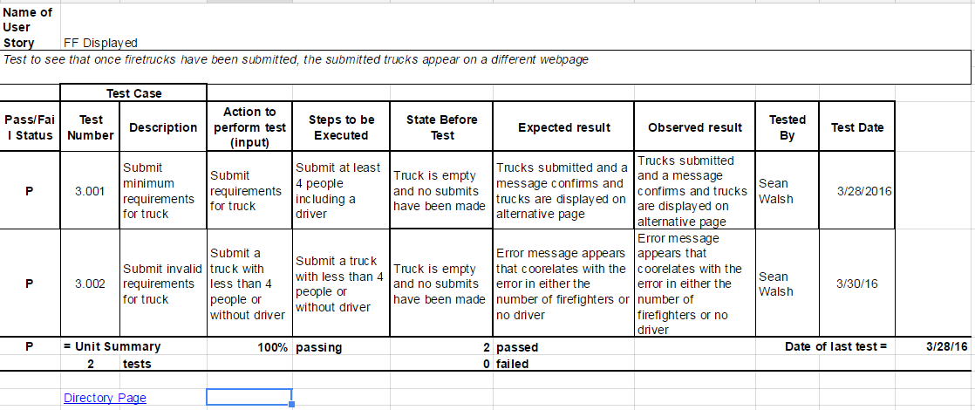
Unit Test Cases

Slide 11
Database Design

Slide 12
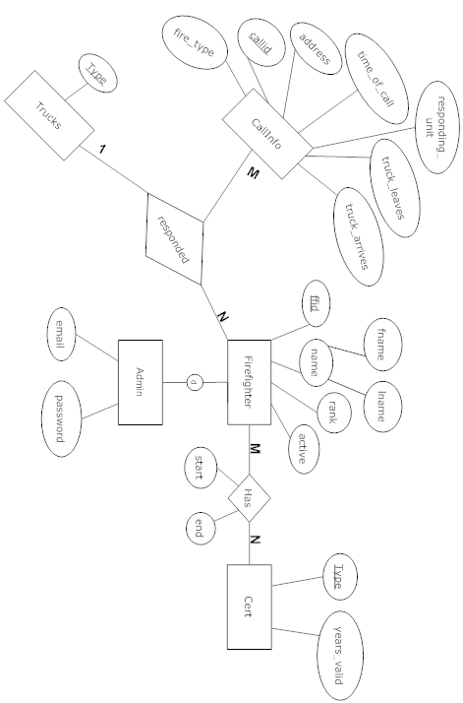
ER Diagram

Slide 13
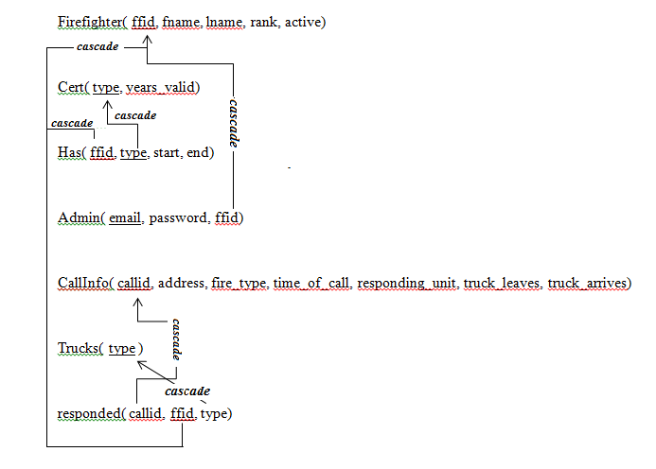
Relational Schema

Slide 14
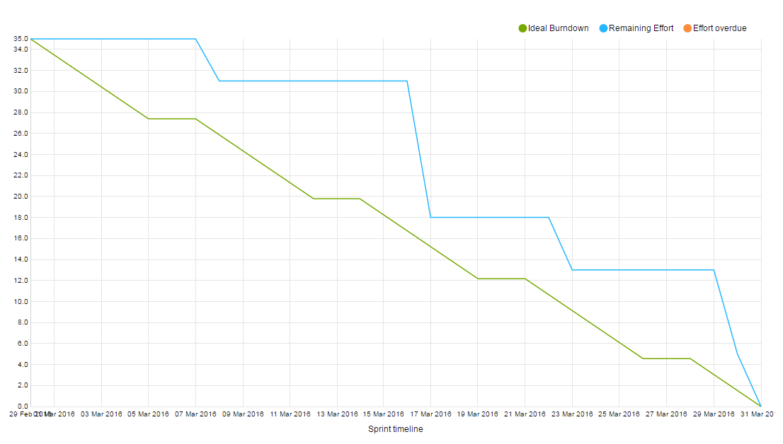
Sprint Burndown Chart

Slide 15
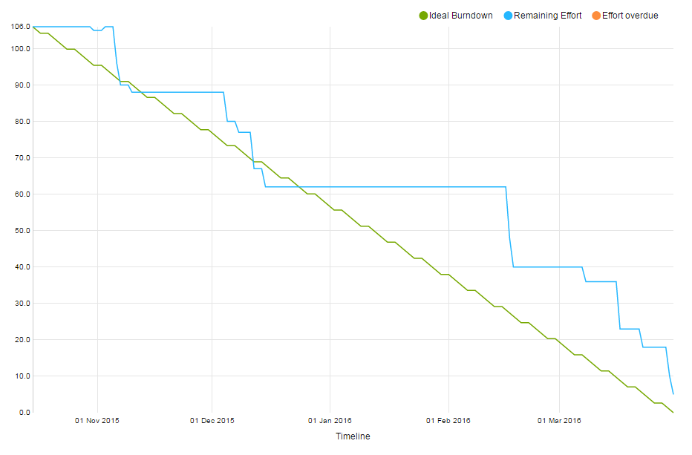
Project Burndown Chart

Slide 16
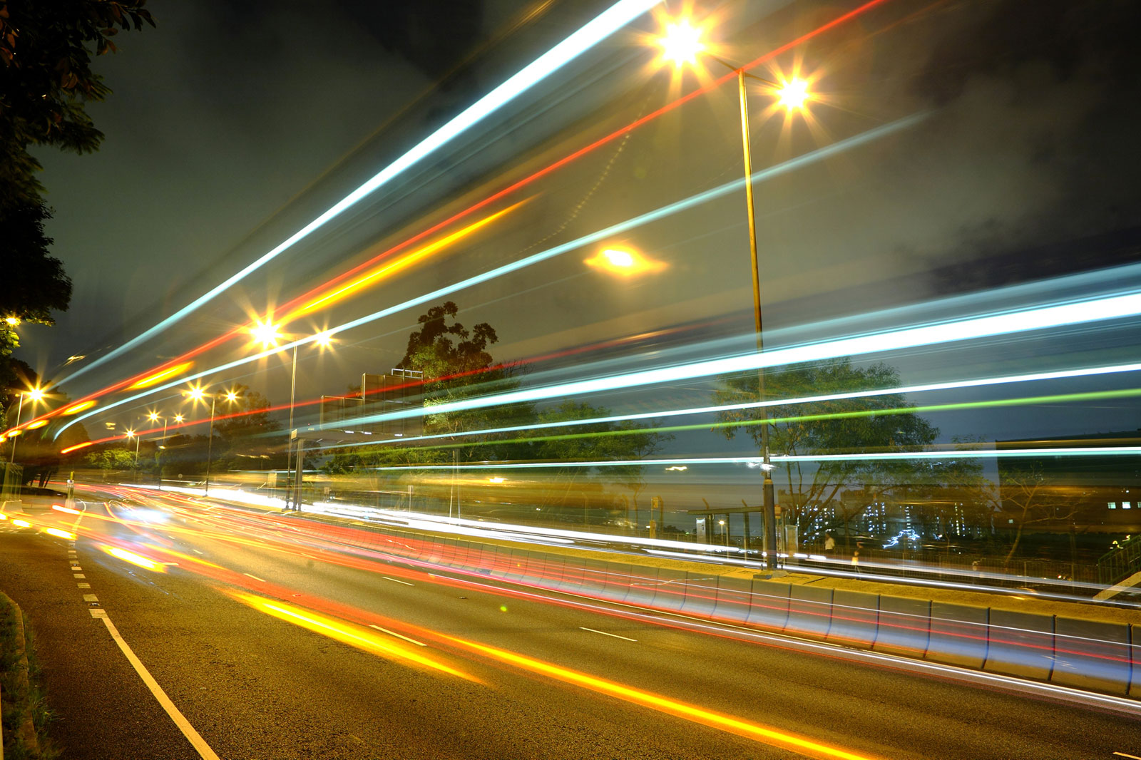
Velocity Measurement
Sprint Velocity: 35
Project Velocity: 26.5

Slide 17
DEMO

Slide 18
Sprint 4
Actions
Reflections
More SCRUM Meetings
Push code as is it’s completed, not waiting until the end of sprint
Improving communication among the team
Bugs are managed more efficiently pushing code as it’s completed
Tasks were being completed earlier, work was getting done faster

Slide 19
Sprint 5 Actions
Hold more thorough sprint retrospective
Meet more as a team this last sprint to fill in any holes or minor changes
Push ourselves on our final sprint

Slide 20
Feedback
Little fixes to make here and there
We’ve gotten far in the project
Doing a good job

