Slide 1
Latham Fire
Sprint 3
Alphabit Soup

Slide 2
Overview
Web Application for Latham Fire Department
Chiefs can quickly organize their fire trucks

Slide 3
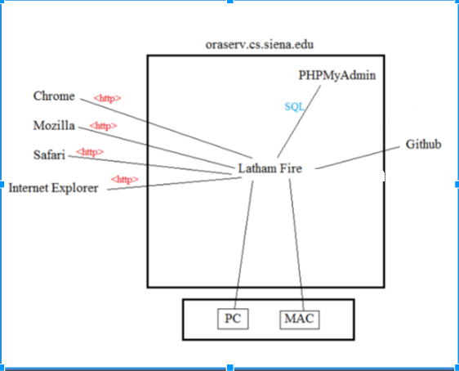
Deployment Diagram

Slide 4
User Stories

Slide 5
User Story 1
Acceptance Criteria
As a admin,
I want to be able to sort firefighters by their current presence,
So that I can load trucks with only firefighters that are available at that moment.
I can choose from a list of all firefighters.
I can select a checkbox for which fire fighters should present.
I can select a checkbox for which firefighters are no longer present.

Slide 6
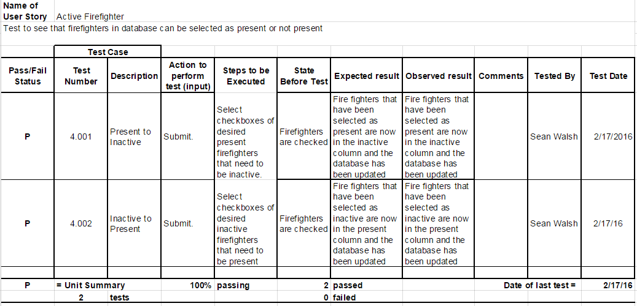
Active Firefighters Unit Test Cases

Slide 7
User Story 2
Acceptance Criteria
As an administrator,
I want to be able to view a live update of call information on screen,
so that I can respond to the call with the necessary trucks and firefighters.
Be able to input data such as
fire address
type of fire
time of call
responding unit
time truck leaves fire station
Time truck arrives at fire station, into the database
From this data have the information from the call shown on the website when loading the trucks

Slide 8
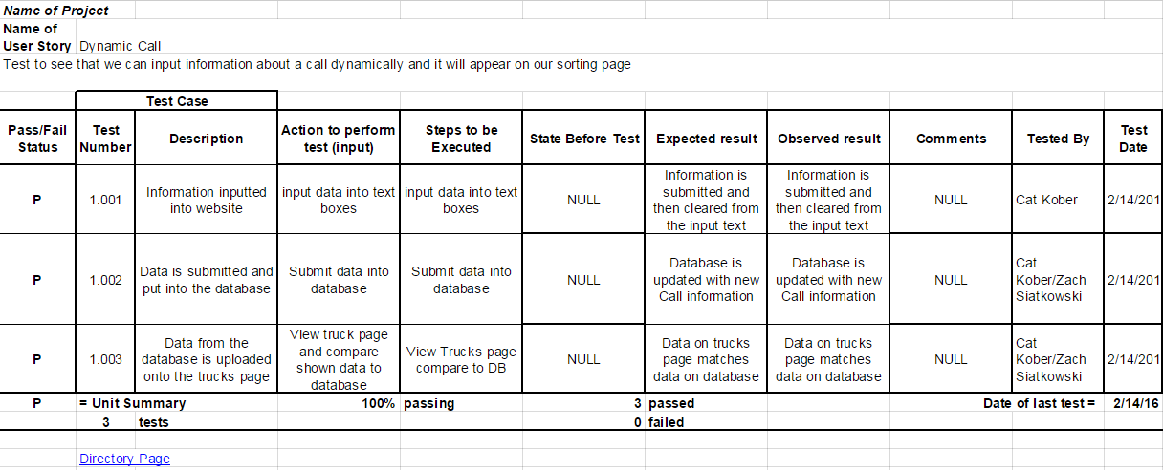
Dynamic Call Information Unit Test Cases

Slide 9
User Story 3
Acceptance Criteria
As an administrator,
I want to double check the truck has a driver and at least 4 firemen before submitting,
so that I don't accidentally send out a truck that's insufficient in the firefighters it requires.
I receive a notification on which trucks don’t have at least 4 FFs when I submit the trucks.
I receive a notification on which trucks don’t have a driver.
I receive a notification when all trucks meet all requirements.

Slide 10
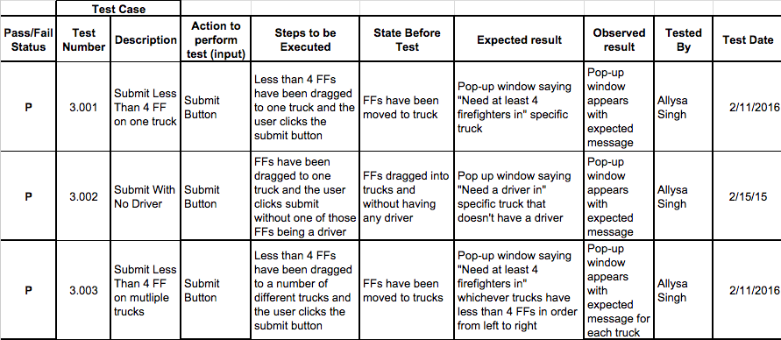
Firefighter Check Unit Test Cases

Slide 11
Firefighter Check Unit Test Cases

Slide 12
User Story 4
Acceptance Criteria
As an Admin,
I want to have a CMS,
So that I can edit the database when logged in.
I can edit/ update a firefighter.
The changes I make to the database will be permanent.
Notes:
This was a user story from our backlog last sprint

Slide 13
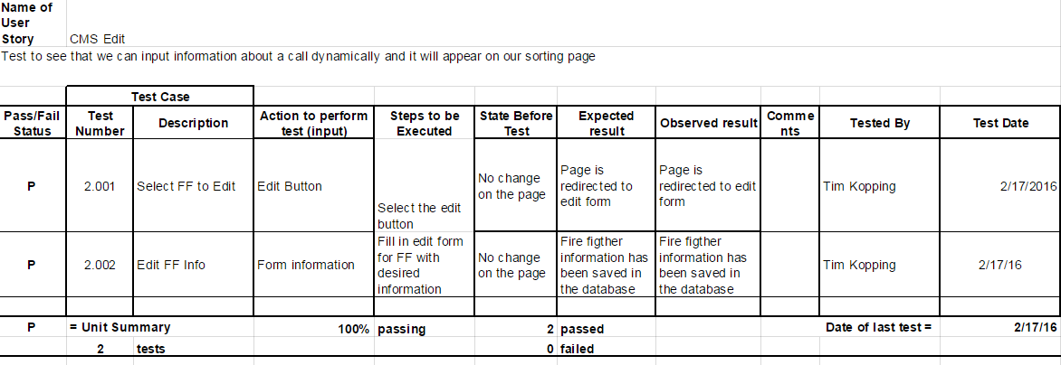
CMS Edit Test Cases

Slide 14
Database Design

Slide 15
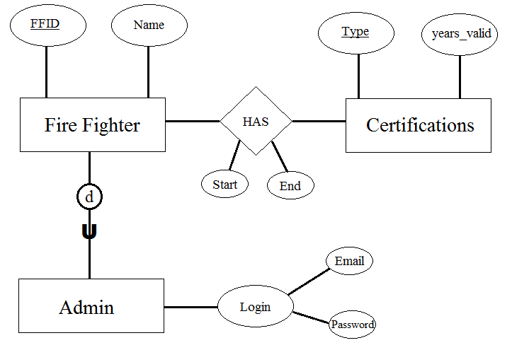
ER Diagram

Slide 16
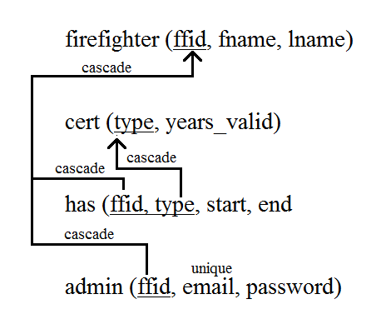
Relational Schema

Slide 17
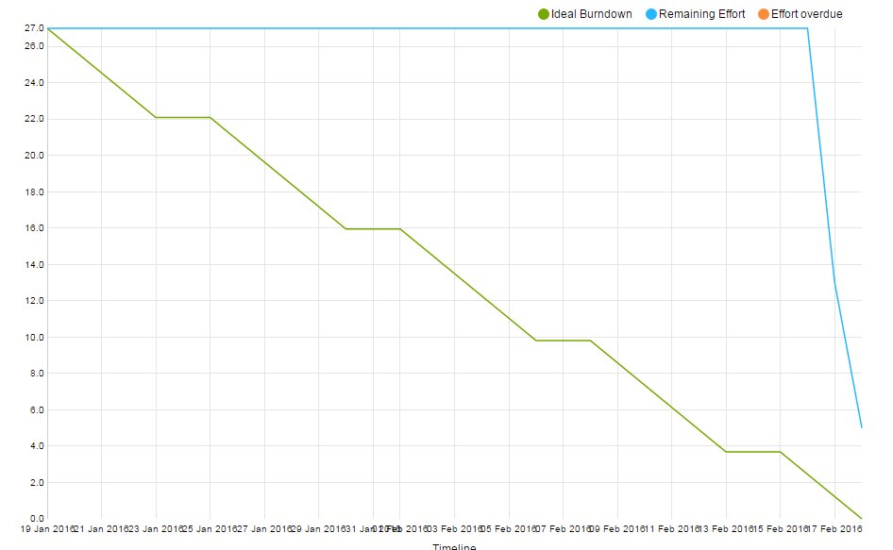
Sprint Burndown Chart

Slide 18
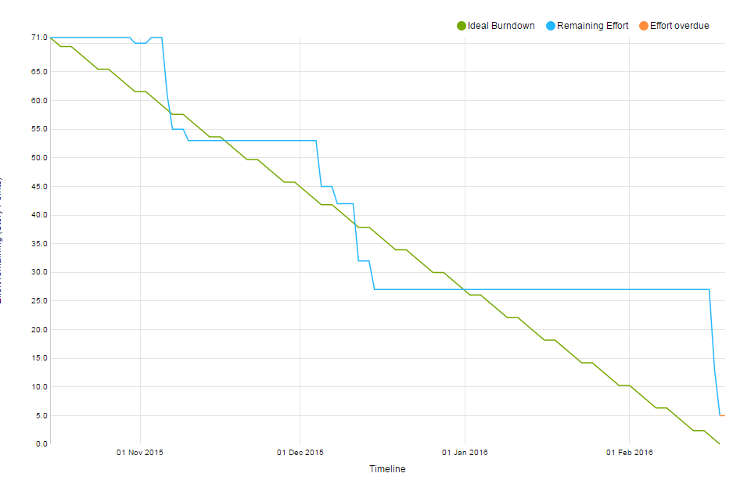
Project Burndown Chart

Slide 19
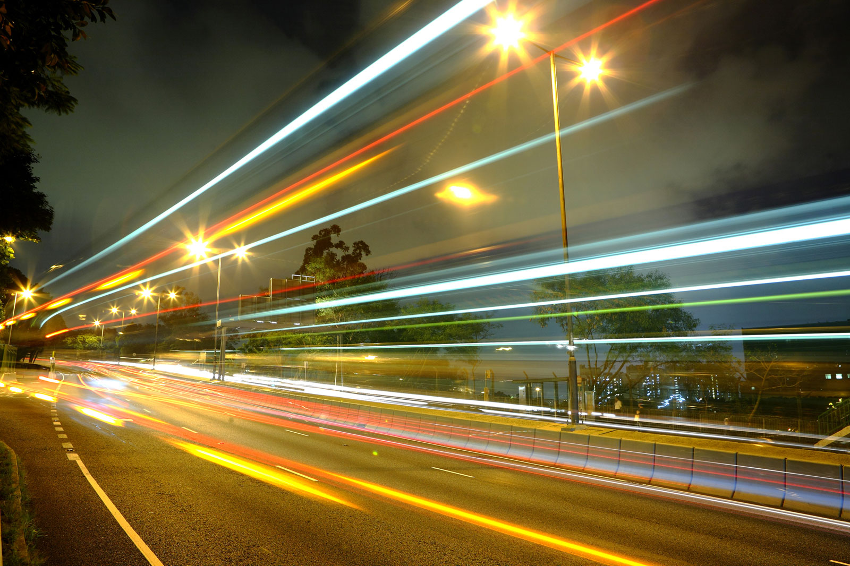
Velocity Measurement
Sprint Velocity: 25/27
Finished out of points
Project Velocity: 66/71 Finished Story Points

Slide 20
DEMO

Slide 21
Sprint 3
Actions
Reflections
Work together with other members to help solve problems
More SCRUM meetings
Merge code segments as they are completed
Problems are solved faster
Implementing new skills/ new things learned
Can see where we need to be for the next sprint as we continue our work this sprint

Slide 22
Sprint 4 Actions
Manage time better individually
Hold more meetings with our client
Improve on communication with the team involving tasks completed/ assignments outside of sprint

Slide 23
Feedback
The website information looks well put together.
The website itself could look more uniform and clean.
Complete the login and logout functions for next sprint( it’s a security error to not have them)

