Slide 1
Latham Fire
Sprint 2
Alphabit Soup

Slide 2
Overview
Web Application for Latham Fire Department
Chiefs can quickly organize their fire trucks

Slide 3
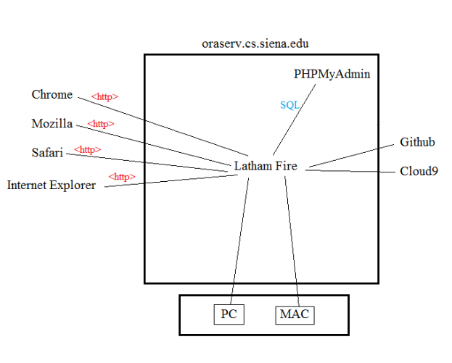
Deployment Diagram

Slide 4
User Stories

Slide 5
User Story 1
Acceptance Criteria
As an Admin,
I want to have a CMS,
So that I can edit the database when logged in.
I can add a firefighter.
I can edit/ update a firefighter.
I can delete a firefighter.
The changes I make to the database will be permanent.

Slide 6
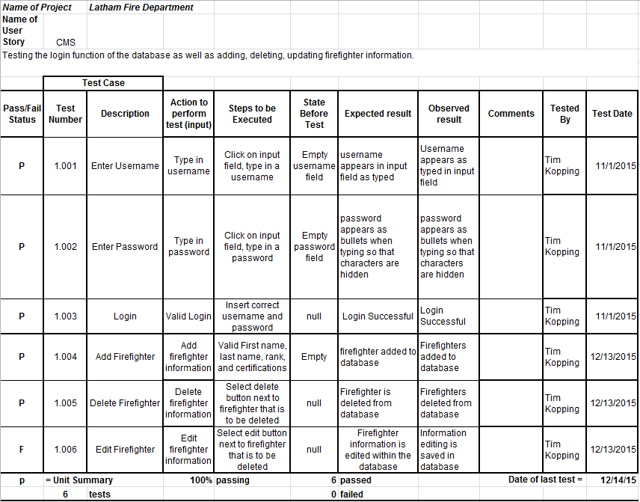
CMS Unit Test Cases

Slide 7
User Story 2
Acceptance Criteria
As an Admin,
I want to be able to drag firefighters with information on their credentials,
So that I can efficiently add firefighters to the appropriate truck .
I can see the information about each firefighter before dragging them.
I can drag a firefighter into or out of any truck.
I can rearrange the order of the list of firefighters within a truck.

Slide 8
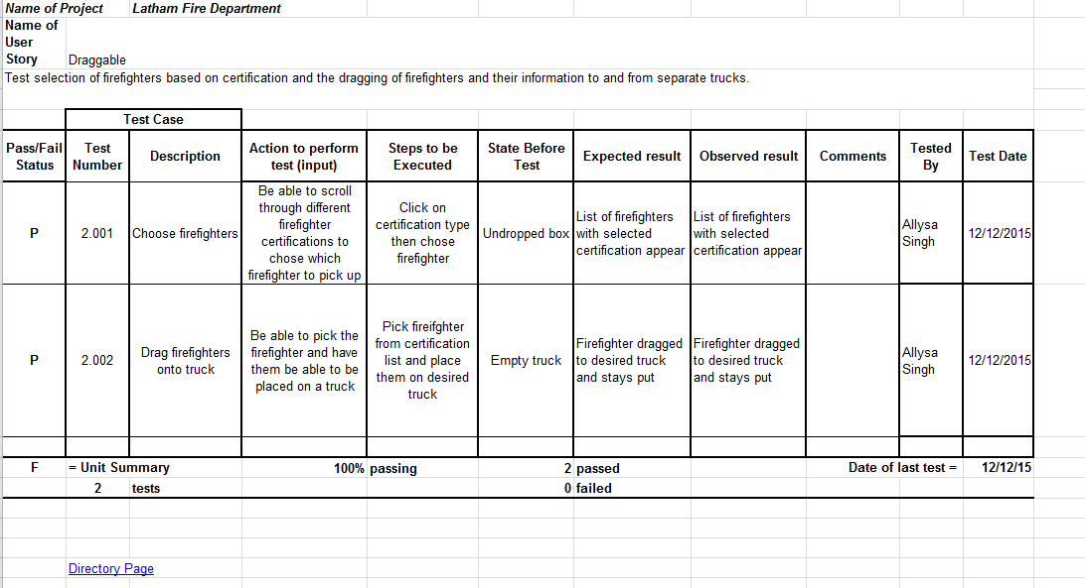
Draggable Unit Test Cases

Slide 9
User Story 3
Acceptance Criteria
As a firefighter,
I want to be able to see the Emergency Information from the call,
So that I can keep track of time and place of calls, dispatches, and arrivals.
I can see static information about the call on screen.

Slide 10
Emergency Call Unit Test Cases

Slide 11
Database Design

Slide 12
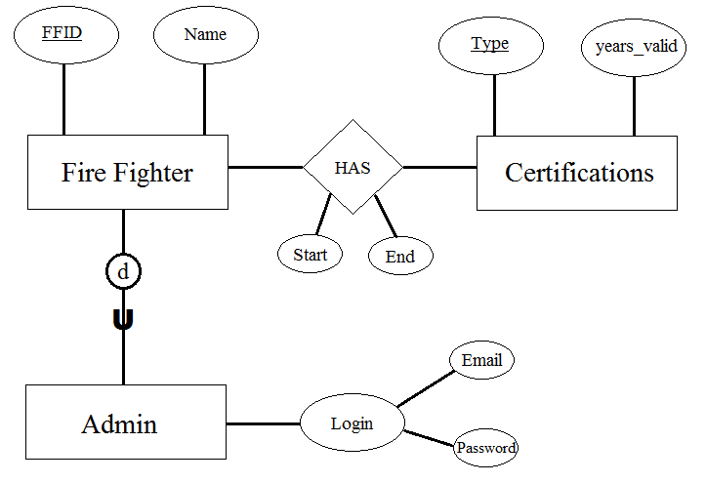
ER Diagram

Slide 13
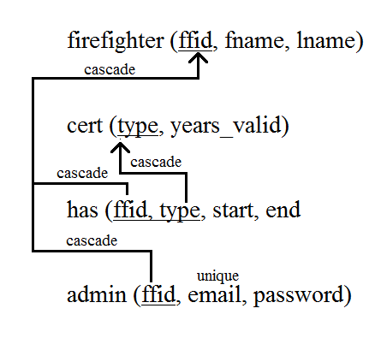
Relational Schema

Slide 14
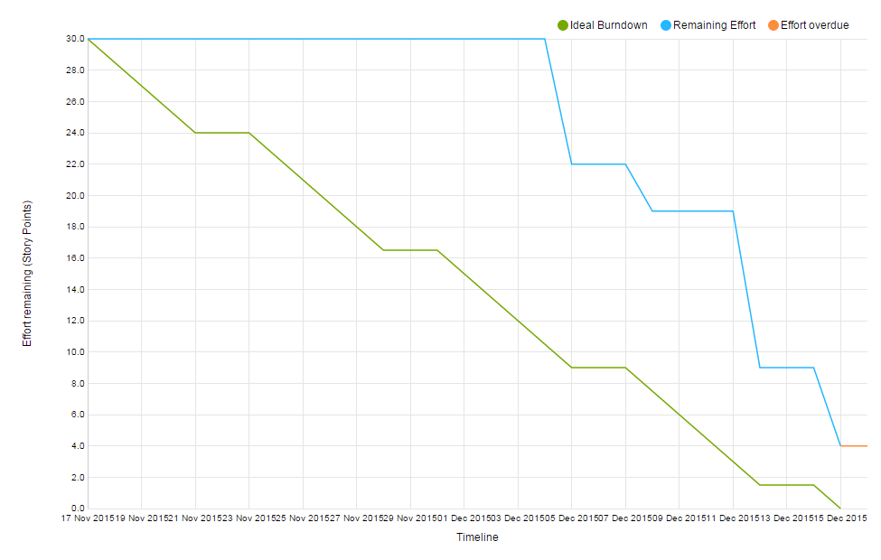
Sprint Burndown Chart

Slide 15
Velocity Measurement
Finished 26 out of 29 points
Estimated 32 points next sprint

Slide 16
DEMO
Notes:
REMEMBER: fireInformation.php!!!!!!

Slide 17
Sprint 2
Actions
Reflections
Upfront organization of sprint
More team meetings outside of SCRUM meetings
Assign tasks to members before the sprint starts
Able to make better use of youtrack
More work completed when meeting outside of class
If a new task comes up, members can take initiative to assign to themselves

Slide 18
Sprint 3 Actions
Implement tasks into whole product upon individual completion
Improve division of work/ tasks
Improve on willingness to learn new things outside of what we are comfortable with/ already know
Include final touch-ups in deliverable

Slide 19
Feedback
Product owner was impressed with improvements made from Sprint 1
Functionality of the product is there, but general aspects need to be cleaned up
Functionality of our database is most important
Overall, a successful sprint

Slide 20
Active Firefighters
As a admin
I want to be able to sort firefighters by availability
So that I can load trucks with only firefighters that are available

Slide 21
Dynamic Call Information
As an administrator,
I want to be able to view a live update of call information on screen,
so that I can respond to the call with the necessary trucks and firefighters.
http://oraserv.cs.siena.edu/~perm_alphabit_soup/LathamFD/fireInformation.php

